Slide 2

“Increase More & More: Getting Better”
~ 1 Thessalonians 4:10

Slide 3
Simply Getting Better:
We have all been held back by things that we dwell upon (E.g. past failures, fear of failing, negative mindset, etc.)!
How do YOU PLAN to get better?
  Just hope & pray it happens?
  Set REAL ambitious goals?
  Set (more) moderate goals for consistency’s sake?

Slide 4


Simply Getting Better:
Much of God’s creation grows steadily through daily increments (Jn. 15:1-8)

Slide 5

Whatever Your Station in Life:
We ALL need to find ways to grow in our service to God & our fellow man:
  Christians are encouraged to “abound more and more” (1 Thess. 3:6-13; 4:1, 9-10)
  The Apostle Paul didn’t just tell others what to do (2 Cor. 11:22-33)
  He was not as mature as he wanted to be, but Paul looked toward getting STRONGER (Phil. 3:12-14)

Slide 6
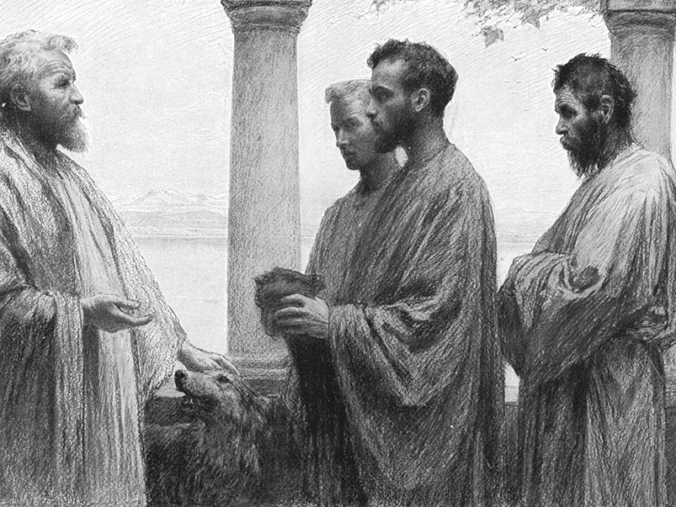

Slide 7
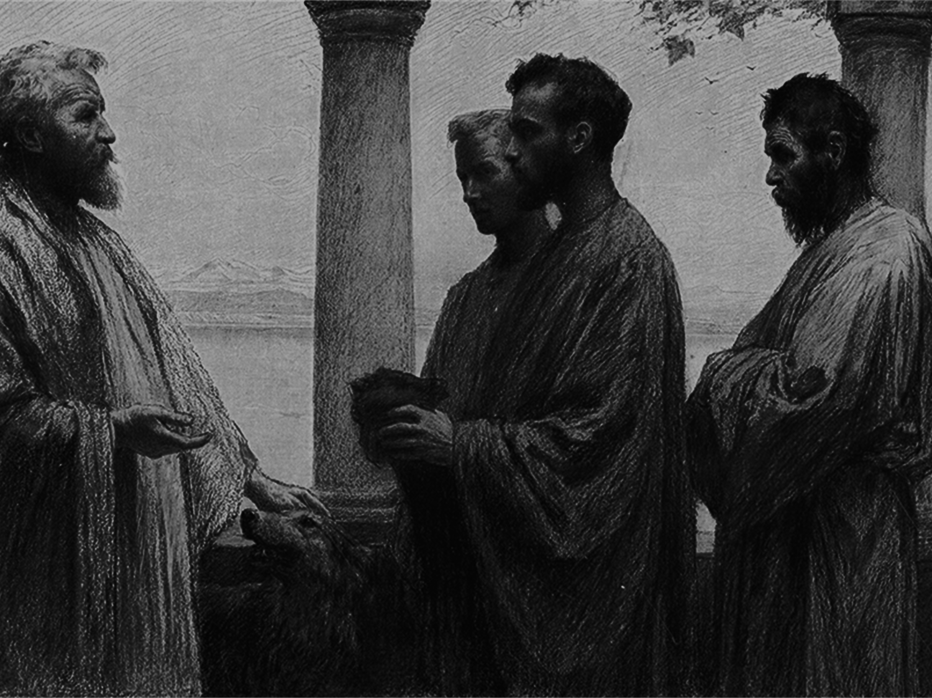
The Parable of the Talents
~ Matthew 25:14-30
The five-talent man gave the five he was given, and then five more (equaling ten).
The two-talent man gained two more talents and gave them to the Lord in addition to what he had been granted (equaling four total for him).
  They BOTH grew 100%!!
We can resolve that we are going to start getting better, even if all we have is one talent!

Slide 8
Simply Getting Better:
What are some things that you are already abounding in?
  Seek ways to abound more
What are some things that you are doing already, but know you need to improve?
  The Lord has blessed you with these talents, utilize them more
What are some things that you know God wants you to do, but you are not currently doing?
  Be honest with yourself, quit making excuses, and simply start DOING

Slide 9
“Increase More & More: Getting Better”
~ 1 Thessalonians 4:10

