Slide 1
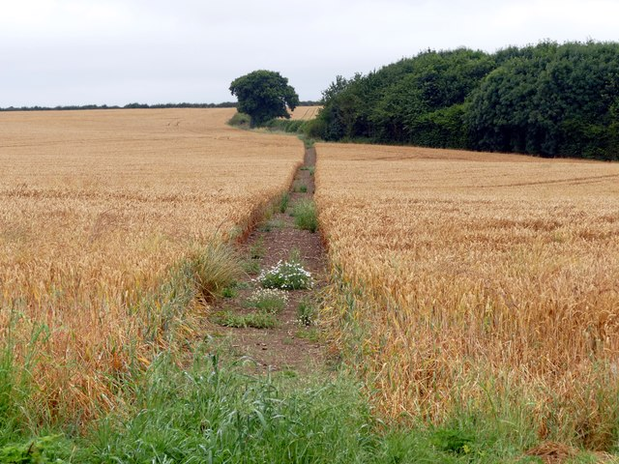
The Parable of the Sower
Matthew 13:1-9, 18-23

Slide 2
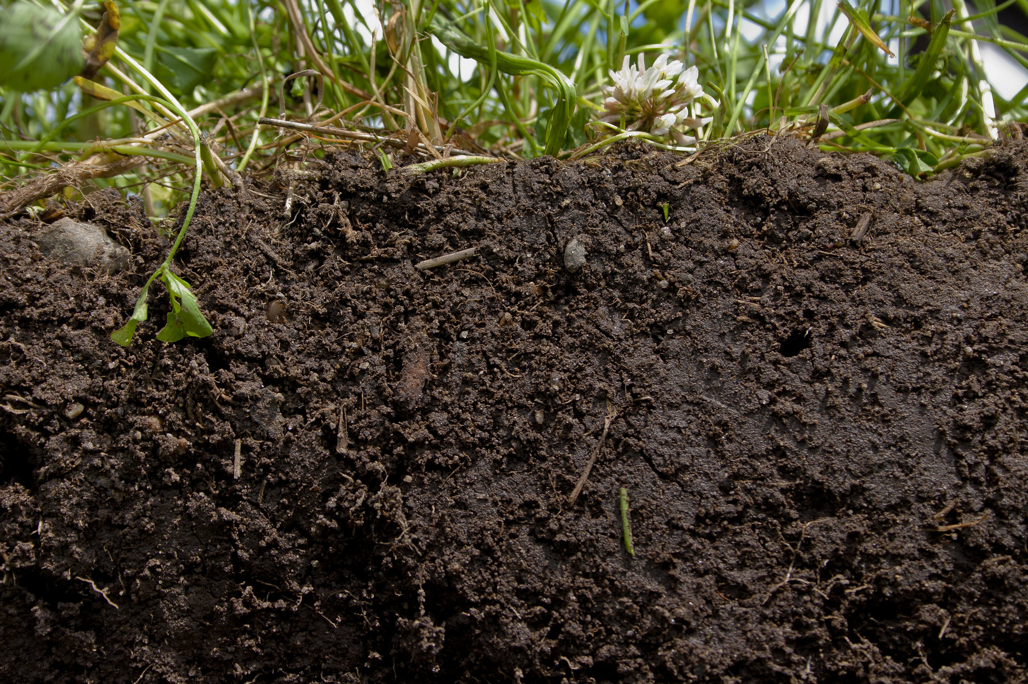
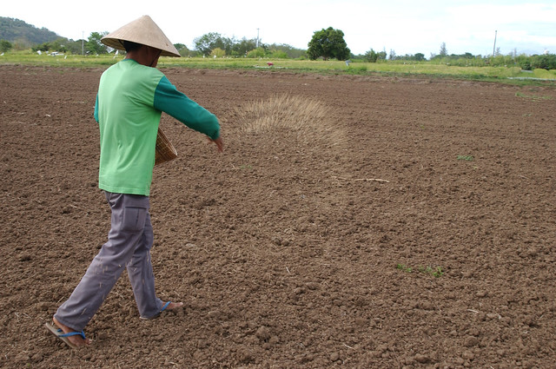
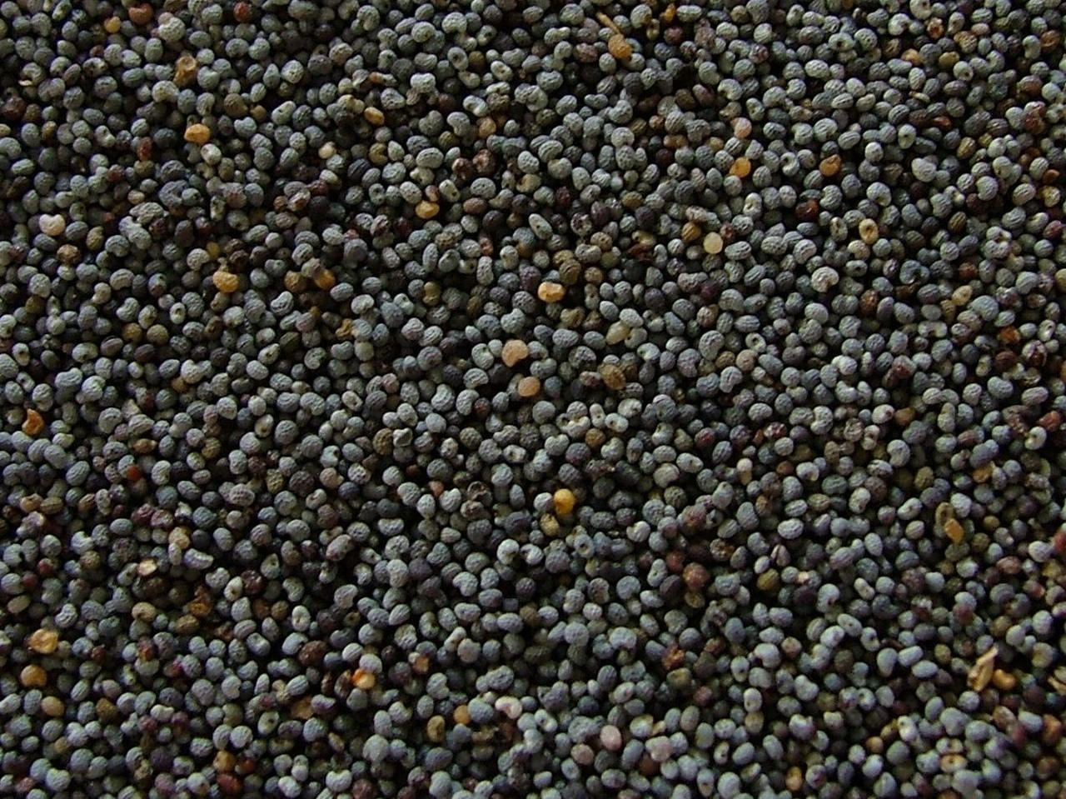
The Soils The Sower The Seed

Slide 3
The Soils
Wayside Soil
Rocky Soil
Thorny Soil
Good Soil

Slide 4
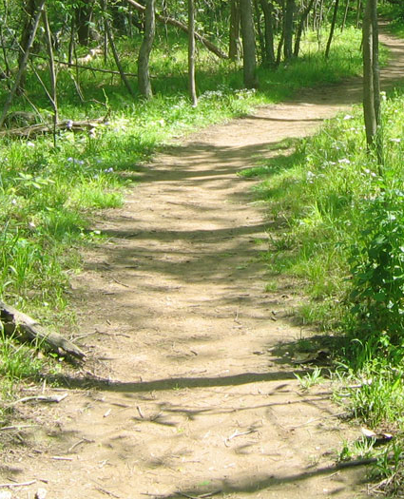
The Wayside
Matt. 13: 4, 19
Characteristics
AG- Hard packed soil, the seed does not penetrate the ground before the birds come and take away the seed.
Jesus explains-¹⁹ When anyone hears the word of the kingdom, and does not understand it, then the wicked one comes and snatches away what was sown in his heart. This is he who received seed by the wayside.
Biblical Example- King Agrippa:
Paul tells of his conversion and sows the seed.
^{Acts 26: 1-3, 26-29}
²⁷ King Agrippa, do you believe the prophets? I know that you do believe.”
²⁸ Then Agrippa said to Paul, “You almost persuade me to become a Christian.”
Almost is not enough

Slide 5
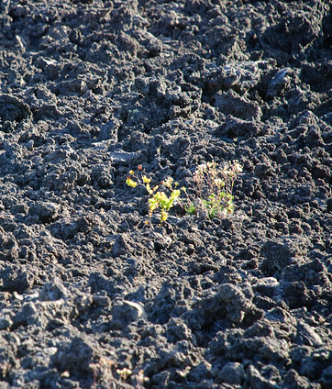
The Rocky Soil
Matt. 13: 5-6, 20-21
Characteristics
AG- Thin layer of soil on top of a rocky ground. The seed grows, but is soon scorched by the sun because it is not rooted in the ground
Jesus explains-²⁰ But he who received the seed on stony places, this is he who hears the word and immediately receives it with joy; ²¹ yet he has no root in himself, but endures only for a while. For when tribulation or persecution arises because of the word, immediately he stumbles.
Biblical Example- Judas: Judas was selected by Jesus to spread the Gospel and did so for about 3 years before betraying Jesus for 30 Pieces of silver.
^{Matthew 26:14-16}
¹⁴ Then one of the Twelve—the one called Judas Iscariot—went to the chief priests ¹⁵ and asked, “What are you willing to give me if I deliver him over to you?” So they counted out for him thirty pieces of silver. ¹⁶ From then on Judas watched for an opportunity to hand him over.
^{Judas gave in to his greed}

Slide 6
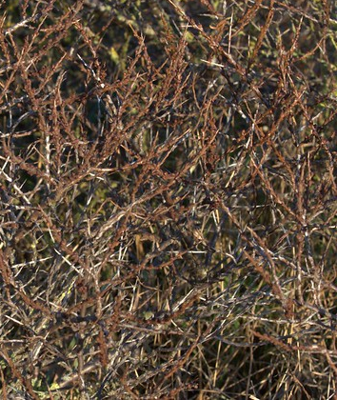
The Thorny Soil
Matt. 13: 7, 22
Characteristics
AG- Thorns choke out the growing seed
Jesus explains- ²² Now he who received seed among the thorns is he who hears the word, and the cares of this world and the deceitfulness of riches choke the word, and he becomes unfruitful.
Biblical Example- Ananias & Sapphira:
A married couple that was part of the early church in Jerusalem
^{Acts 5:1-3}
5 But a certain man named Ananias, with Sapphira his wife, sold a possession. ² And he kept back part of the proceeds, his wife also being aware of it, and brought a certain part and laid it at the apostles’ feet. ³ But Peter said, “Ananias, why has Satan filled your heart to lie to the Holy Spirit and keep back part of the price of the land for yourself? ⁴ While it remained, was it not your own? And after it was sold, was it not in your own control? Why have you conceived this thing in your heart? You have not lied to men but to God.”
^{They tried to deceive God}

Slide 7
The Good soil
Matt. 13:8, 23
Characteristics
AG- Fertile ground that yields a crop
Jesus explains- ²³ But he who received seed on the good ground is he who hears the word and understands it, who indeed bears fruit and produces: some a hundredfold, some sixty, some thirty.”
^{Biblical Example- Paul :}
Paul, after his conversion, lead a faithful life in service to God
^{2 Tim. 4:6-8}
⁶ For I am already being poured out as a drink offering, and the time of my departure is at hand. ⁷ I have fought the good fight, I have finished the race, I have kept the faith. ⁸ Finally, there is laid up for me the crown of righteousness, which the Lord, the righteous Judge, will give to me on that Day, and not to me only but also to all who have loved His appearing.
Paul was faithful to the end after the seed was sown in his heart

Slide 8
It is not our place to judge the Soil
Which would you have thought was the good soil?
An expert in the customs of the Jews that believed in the prophets
      King Aggripa
Someone hand selected by Jesus to spread the Gospel
      Judas
Married couple part of the early Church in Jerusalem
      Ananias & Sapphira
Someone who wanted to kill all Christians
      Paul
-It is not our place to judge the soil
-We cannot see the hearts of Man
-We can only sow the Seed

Slide 9
The Sower
Matt. 13:3 “Behold, a sower went out to sow.”
The sower purposely went out to sow
We are the Sower
  ^{Mark 16:15 ’}He said to them, “Go into all the world and preach the gospel to all creation.”’
How can we sow? Our example
  ^{Matthew 5:14} “You are the light of the world. A town built on a hill cannot be hidden. ¹⁵ Neither do people light a lamp and put it under a bowl. Instead they put it on its stand, and it gives light to everyone in the house. ¹⁶ In the same way, let your light shine before others, that they may see your good deeds and glorify your Father in heaven.”
God has no hand but our hands
If we don’t sow, there will be no harvest
He sowed good seed

Slide 10
The Seed
^{The seed is the word of God}
^{Luke 8:11} “This is the meaning of the parable: The seed is the word of God.
^{1 Peter 1:23} having been born again, not of corruptible seed but incorruptible, through the word of God which lives and abides forever, ²⁴ because
“All flesh is as grass,
And all the glory of man
as the flower of the grass.
The grass withers,
And its flower falls away,
²⁵ But the word of the Lord endures forever.”
Now this is the word which by the gospel was preached to you.
To spread the seed is to preach Christ crucified (1 Cor 1:18-25)
  His life
  His death
  His resurrection

Slide 11
The Seed
Be careful what you sow Gal. 1:6-10
  ⁶ I am astonished that you are so quickly deserting the one who called you to live in the grace of Christ and are turning to a different gospel— ⁷ which is really no gospel at all. Evidently some people are throwing you into confusion and are trying to pervert the gospel of Christ. ⁸ But even if we or an angel from heaven should preach a gospel other than the one we preached to you, let them be under God’s curse! ⁹ As we have already said, so now I say again: If anybody is preaching to you a gospel other than what you accepted, let them be under God’s curse!
Make sure that what we teach is from God’s Word and not our own opinions or feelings

Slide 12
The Parable of the Sower
Matthew 13:1-9, 18-23
Do not judge someone’s soil (heart)
Always be sowing the seed (Word of God)
Be careful not to sow bad seed (false teachings)

Slide 13
Hear (Romans 10:17)
Believe (Mark 16:16)
Repent (Acts 2:38)
Confess (Romans 10:10)
Baptized (Acts 2:38)
Faithful service to God (James 1:12)

