Slide 1
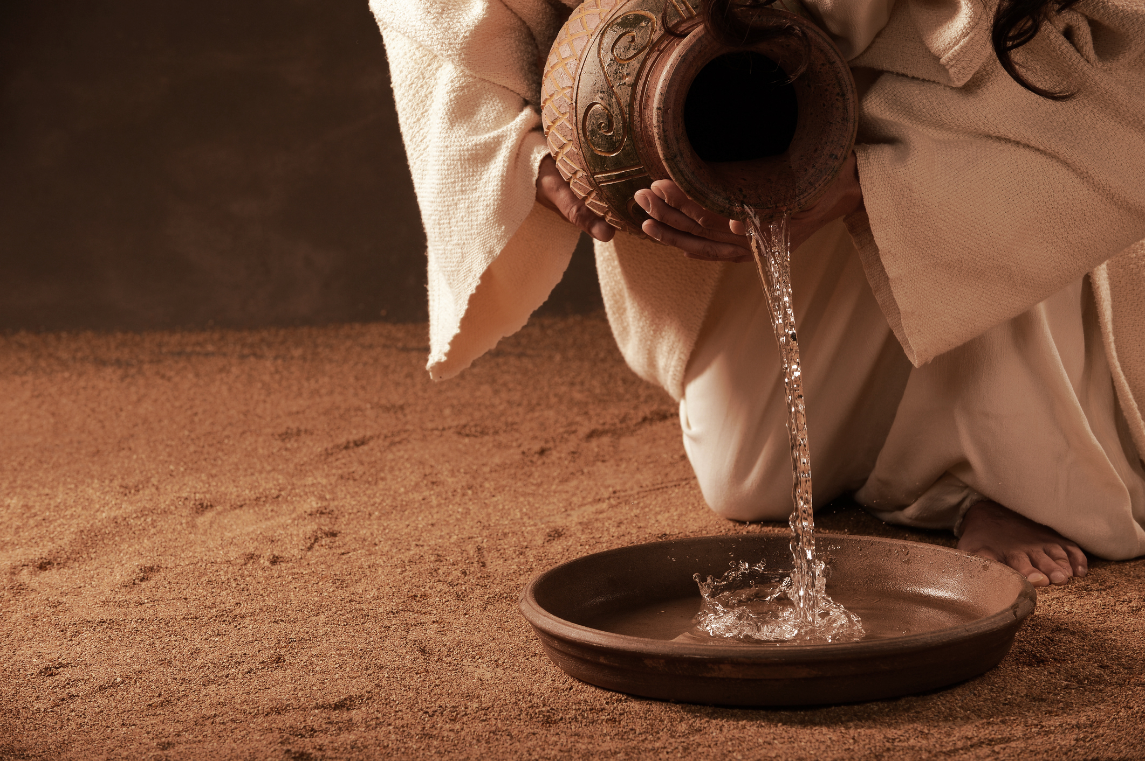
Jesus Washes the Apostles’ Feet
Jn. 13:1-38

Slide 2

Setting the scene:
When looking to the accounts of the last supper, it is impossible to be sure which event/discussion came first.
  At some point, strife arose between the apostles about which would be the greatest.
  No servant had been available to wash their feet, and not one of them would volunteer to wash the others’ feet (Cf. Lk. 22:24-30).

Slide 3
Lessons From the Text:

Slide 4
Lessons From the Text:
Jesus was willing to wash, even Judas’ feet...
  Jn. 13:18-30

Slide 5
Lessons From the Text:
Jesus was willing to wash, even Judas’ feet...
Jesus gave a new command...
  Jn. 13:31-35; Cf. Jn. 3:16; 1 Jn. 3:16-18

Slide 6
Lessons From the Text:
Jesus was willing to wash, even Judas’ feet...
Jesus gave a new command...
Jesus washed Peter’s feet, even though...
  Jn. 13:36-38

Slide 7
Lessons From the Text:
Jesus was willing to wash, even Judas’ feet…
Jesus gave a new command…
Jesus washed Peter’s feet, even though...
Jesus washed all the disciples’ feet…
  Lk. 22:24-30

Slide 8
Lessons From the Text:
Jesus was willing to wash, even Judas’ feet…
Jesus gave a new command…
Jesus washed Peter’s feet, even though...
Jesus washed all the disciples’ feet…
Jesus loved them to the end…
  Cf. Jn. 2:4; Jn. 7:30; Jn. 8:20; Jn. 12:23, 27; Jn. 13:1

Slide 9
Applications:
Do I demand respect?
  Let love be without hypocrisy. Abhor what is evil. Cling to what is good. ¹⁰ Be kindly affectionate to one another with brotherly love, in honor giving preference to one another; Rom 12:9-10 (NKJV)
  Cf. Lk. 22:24-30; Matt. 20:20-28

Slide 10
Applications:
Do we serve only those we deem “worthy”?
  For you, brethren, have been called to liberty; only do not use liberty as an opportunity for the flesh, but through love serve one another. Gal 5:13 (NKJV)
  I, therefore, the prisoner of the Lord, beseech you to walk worthy of the calling with which you were called, ² with all lowliness and gentleness, with longsuffering, bearing with one another in love, ³ endeavoring to keep the unity of the Spirit in the bond of peace. Eph 4:1-3 (NKJV)

Slide 11
Applications:
Loving like Jesus involves seeing as God sees.
  Finally, all of you be of one mind, having compassion for one another; love as brothers, be tenderhearted, be courteous; ⁹ not returning evil for evil or reviling for reviling, but on the contrary blessing, knowing that you were called to this, that you may inherit a blessing. 1 Pet 3:8-9 (NKJV)
  But the end of all things is at hand; therefore be serious and watchful in your prayers. ⁸ And above all things have fervent love for one another, for "love will cover a multitude of sins." ⁹ Be hospitable to one another without grumbling. ¹⁰ As each one has received a gift, minister it to one another, as good stewards of the manifold grace of God. ¹¹ If anyone speaks, let him speak as the oracles of God. If anyone ministers, let him do it as with the ability which God supplies, that in all things God may be glorified through Jesus Christ, to whom belong the glory and the dominion forever and ever. Amen. 1 Pet 4:7-11 (NKJV)

Slide 12
Conclusion
Jesus humbled Himself and served Judas.
Jesus humbled Himself and served Peter.
Jesus humbled Himself and served all the disciples.
Will you follow His example?

