Slide 1
Lessons from Saul’s Decline
1 Samuel 12-13

Slide 2
King Saul
Had good qualities in the early portion of his record.
  Took seriously the job of shepherding (1 Sam. 9:3-5)
  Respected his father (1 Sam. 9:4-5)
  Was very humble (1 Sam. 9:21)
  Decisive in battle against the Ammonites (1 Sam. 11:1-13)
But a great portion of his rule was tainted due to his lack of godly character (Cf. 1 Cor. 10:12).
What led to his decline?
  Perhaps it can be good to look at his example that’s set forth in 1 Sam. 13, in contrast with Samuel’s example set forth in 1 Sam. 12.

Slide 3
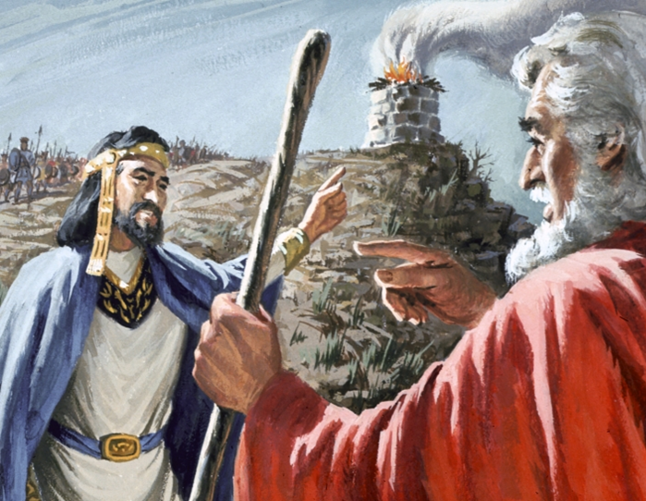
Saul: King of Israel
Allowed fear of the enemy to rob him of faith in God (1 Sam. 13:5-7)
Set poor example; people influenced (1 Sam. 13:7)
Offered an unlawful sacrifice (1 Sam. 13:9, 13)
Tried to justify his actions (1 Sam. 13:11-12)
Did not accept the LORD’s chastening in the right spirit (1 Sam. 13:13-14; Cf. 1 Sam. 15:1-15)

Slide 4
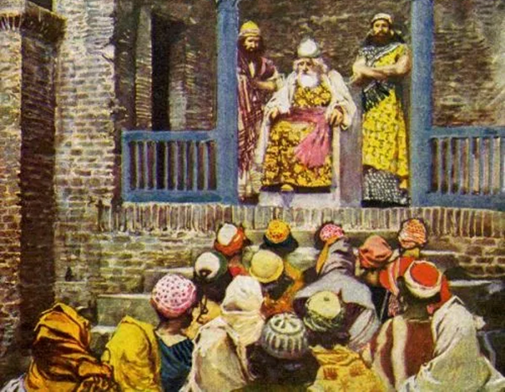
Samuel: Judge of Israel
Record was above reproach (1 Sam. 12:3-5)
Taught of spiritual heritage (1 Sam. 12:6-12)
Applied teaching to needs of all (1 Sam. 12:13-18)
Israel respected Samuel as a man of God (1 Sam. 12:19)
Though rejected, no animosity; concern was for spiritual welfare of God’s people (1 Sam. 12:20-25)

Slide 5
King Saul
Had good qualities in the early portion of his record.
  Took seriously the job of shepherding (1 Sam. 9:3-5)
  Respected his father (1 Sam. 9:4-5)
  Was very humble (1 Sam. 9:21)
  Decisive in battle against the Ammonites (1 Sam. 11:1-13)
But a great portion of his rule was tainted due to his lack of godly character (Cf. 1 Cor. 10:12).
What led to his decline?
  Perhaps it can be good to look at his example that’s set forth in 1 Sam. 13, in contrast with Samuel’s example set forth in 1 Sam. 12.

Slide 6
Lessons from Saul’s Decline
1 Samuel 12-13

Slide 7

Lk. 24:46-47; Cf. Acts 2:38
⁴⁶ Then He said to them, "Thus it is written, and thus it was necessary for the Christ to suffer and to rise from the dead the third day, ⁴⁷ and that repentance and remission of sins should be preached in His name to all nations, beginning at Jerusalem. Luke 24:46-47 (NKJV)
³⁸ Then Peter said to them, "Repent, and let every one of you be baptized in the name of Jesus Christ for the remission of sins; and you shall receive the gift of the Holy Spirit. Acts 2:38 (NKJV)

