Slide 1
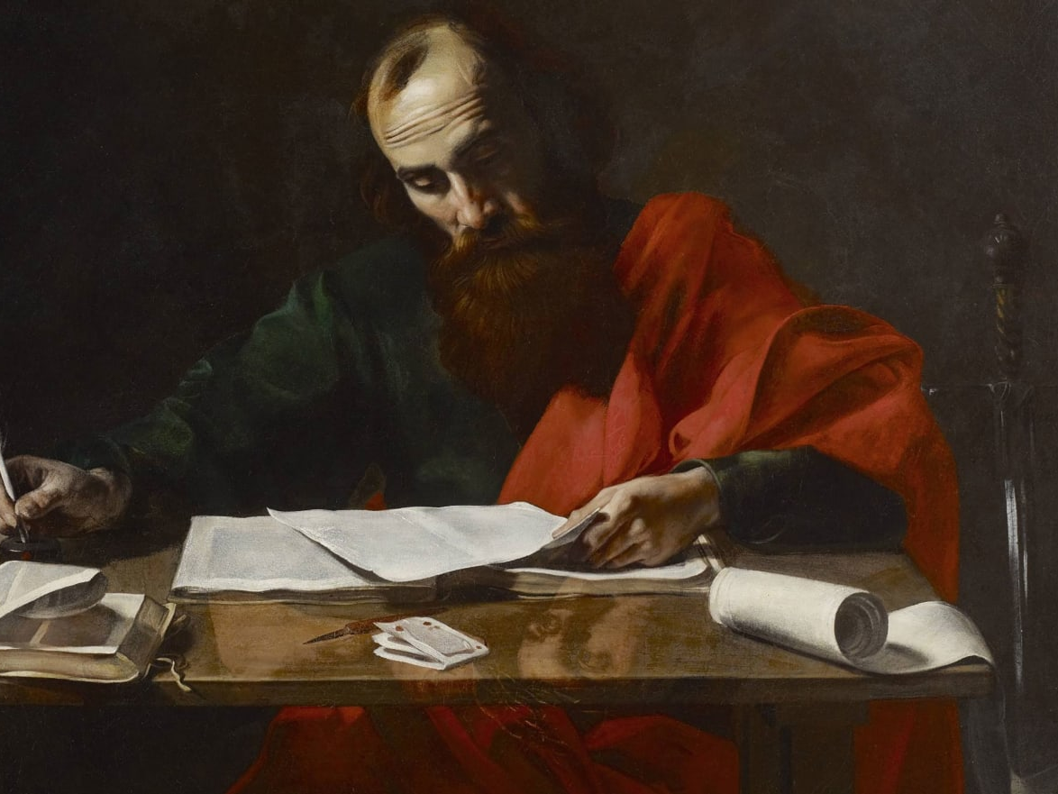
Lessons in Prayer from Paul
~ Ephesians 3:14-18

Slide 2
Lessons in Prayer from Paul
Objective: To better communicate with God through prayer by studying some things that Paul said about the subject.
Two phases of prayer related to Paul will be observed:
  His prayers for fellow Christians in various places
  His requests for prayer from those to whom he writes

Slide 3
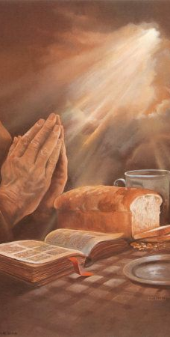
Paul’s Prayers for Others
⁹ For God is my witness, whom I serve with my spirit in the gospel of His Son, that without ceasing I make mention of you always in my prayers, ¹⁰ making request if, by some means, now at last I may find a way in the will of God to come to you. Romans 1:9-10 (NKJV)

Slide 4
Paul’s Prayers for Others
¹⁴ For this reason I bow my knees to the Father of our Lord Jesus Christ, ¹⁵ from whom the whole family in heaven and earth is named, ¹⁶ that He would grant you, according to the riches of His glory, to be strengthened with might through His Spirit in the inner man, ¹⁷ that Christ may dwell in your hearts through faith; that you, being rooted and grounded in love, ¹⁸ may be able to comprehend with all the saints what is the width and length and depth and height-- ¹⁹ to know the love of Christ which passes knowledge; that you may be filled with all the fullness of God. ²⁰ Now to Him who is able to do exceedingly abundantly above all that we ask or think, according to the power that works in us, Eph 3:14-20 (NKJV)

Slide 5
Paul’s Prayers for Others
⁹ And this I pray, that your love may abound still more and more in knowledge and all discernment, ¹⁰ that you may approve the things that are excellent, that you may be sincere and without offense till the day of Christ, ¹¹ being filled with the fruits of righteousness which are by Jesus Christ, to the glory and praise of God. Phil 1:9-11 (NKJV)

Slide 6
Paul’s Prayers for Others
⁹ And this I pray, that your love may abound still more and more in knowledge and all discernment, ¹⁰ that you may approve the things that are excellent, that you may be sincere and without offense till the day of Christ, ¹¹ being filled with the fruits of righteousness which are by Jesus Christ, to the glory and praise of God. Phil 1:9-11 (NKJV)

Slide 7
Paul’s Prayers for Others
⁹ And this I pray, that your love may abound still more and more in knowledge and all discernment, ¹⁰ that you may approve the things that are excellent, that you may be sincere and without offense till the day of Christ, ¹¹ being filled with the fruits of righteousness which are by Jesus Christ, to the glory and praise of God. Phil 1:9-11 (NKJV)

Slide 8
Paul’s Prayers for Others
⁹ And this I pray, that your love may abound still more and more in knowledge and all discernment, ¹⁰ that you may approve the things that are excellent, that you may be sincere and without offense till the day of Christ, ¹¹ being filled with the fruits of righteousness which are by Jesus Christ, to the glory and praise of God. Phil 1:9-11 (NKJV)

Slide 9
Paul’s Prayers for Others
⁹ For this reason we also, since the day we heard it, do not cease to pray for you, and to ask that you may be filled with the knowledge of His will in all wisdom and spiritual understanding; ¹⁰ that you may walk worthy of the Lord, fully pleasing Him, being fruitful in every good work and increasing in the knowledge of God; ¹¹ strengthened with all might, according to His glorious power, for all patience and longsuffering with joy; Col 1:9-11 (NKJV)

Slide 10
Paul’s Prayers for Others
⁹ For this reason we also, since the day we heard it, do not cease to pray for you, and to ask that you may be filled with the knowledge of His will in all wisdom and spiritual understanding; ¹⁰ that you may walk worthy of the Lord, fully pleasing Him, being fruitful in every good work and increasing in the knowledge of God; ¹¹ strengthened with all might, according to His glorious power, for all patience and longsuffering with joy; Col 1:9-11 (NKJV)

Slide 11
Paul’s Prayers for Others
⁹ For this reason we also, since the day we heard it, do not cease to pray for you, and to ask that you may be filled with the knowledge of His will in all wisdom and spiritual understanding; ¹⁰ that you may walk worthy of the Lord, fully pleasing Him, being fruitful in every good work and increasing in the knowledge of God; ¹¹ strengthened with all might, according to His glorious power, for all patience and longsuffering with joy; Col 1:9-11 (NKJV)

Slide 12
Paul’s Prayers for Others
⁹ For this reason we also, since the day we heard it, do not cease to pray for you, and to ask that you may be filled with the knowledge of His will in all wisdom and spiritual understanding; ¹⁰ that you may walk worthy of the Lord, fully pleasing Him, being fruitful in every good work and increasing in the knowledge of God; ¹¹ strengthened with all might, according to His glorious power, for all patience and longsuffering with joy; Col 1:9-11 (NKJV)

Slide 13
Paul’s Prayers for Others
⁹ For this reason we also, since the day we heard it, do not cease to pray for you, and to ask that you may be filled with the knowledge of His will in all wisdom and spiritual understanding; ¹⁰ that you may walk worthy of the Lord, fully pleasing Him, being fruitful in every good work and increasing in the knowledge of God; ¹¹ strengthened with all might, according to His glorious power, for all patience and longsuffering with joy; Col 1:9-11 (NKJV)

Slide 14
Paul’s Prayers for Others
⁹ For this reason we also, since the day we heard it, do not cease to pray for you, and to ask that you may be filled with the knowledge of His will in all wisdom and spiritual understanding; ¹⁰ that you may walk worthy of the Lord, fully pleasing Him, being fruitful in every good work and increasing in the knowledge of God; ¹¹ strengthened with all might, according to His glorious power, for all patience and longsuffering with joy; Col 1:9-11 (NKJV)

Slide 15
Paul’s Prayers for Others
¹¹ Therefore we also pray always for you that our God would count you worthy of this calling, and fulfill all the good pleasure of His goodness and the work of faith with power, ¹² that the name of our Lord Jesus Christ may be glorified in you, and you in Him, according to the grace of our God and the Lord Jesus Christ. 2 Thess 1:11-12 (NKJV)

Slide 16
Paul’s Prayers for Others
³ I thank God, whom I serve with a pure conscience, as my forefathers did, as without ceasing I remember you in my prayers night and day, ⁴ greatly desiring to see you, being mindful of your tears, that I may be filled with joy, 2 Tim 1:3-4 (NKJV)

Slide 17
Paul’s Prayers for Others
⁴ I thank my God, making mention of you always in my prayers, ⁵ hearing of your love and faith which you have toward the Lord Jesus and toward all the saints, ⁶ that the sharing of your faith may become effective by the acknowledgment of every good thing which is in you in Christ Jesus. Philem 1:4-6 (NKJV)

Slide 18
Paul’s Request for the Prayers for Others
³⁰ Now I beg you, brethren, through the Lord Jesus Christ, and through the love of the Spirit, that you strive together with me in prayers to God for me, ³¹ that I may be delivered from those in Judea who do not believe, and that my service for Jerusalem may be acceptable to the saints, ³² that I may come to you with joy by the will of God, and may be refreshed together with you. Romans 15:30-32 (NKJV)

Slide 19
Paul’s Request for the Prayers for Others
⁸ For we do not want you to be ignorant, brethren, of our trouble which came to us in Asia: that we were burdened beyond measure, above strength, so that we despaired even of life. ⁹ Yes, we had the sentence of death in ourselves, that we should not trust in ourselves but in God who raises the dead, ¹⁰ who delivered us from so great a death, and does deliver us; in whom we trust that He will still deliver us, ¹¹ you also helping together in prayer for us, that thanks may be given by many persons on our behalf for the gift granted to us through many. 2 Cor 1:8-11 (NKJV)

Slide 20
Paul’s Request for the Prayers for Others
² Continue earnestly in prayer, being vigilant in it with thanksgiving; ³ meanwhile praying also for us, that God would open to us a door for the word, to speak the mystery of Christ, for which I am also in chains, ⁴ that I may make it manifest, as I ought to speak. ⁵ Walk in wisdom toward those who are outside, redeeming the time. Col 4:2-5 (NKJV)

Slide 21
Paul’s Request for the Prayers for Others
¹ Finally, brethren, pray for us, that the word of the Lord may run swiftly and be glorified, just as it is with you, ² and that we may be delivered from unreasonable and wicked men; for not all have faith. 2 Thess 3:1-2 (NKJV)

Slide 22
Lessons in Prayer from Paul
Objective: To better communicate with God through prayer by studying some things that Paul said about the subject.
Two phases of prayer related to Paul have been observed:
  His prayers for fellow Christians in various places
  His requests for prayer from those to whom he writes

Slide 23
Lessons in Prayer from Paul
~ Ephesians 3:14-18

