Slide 1
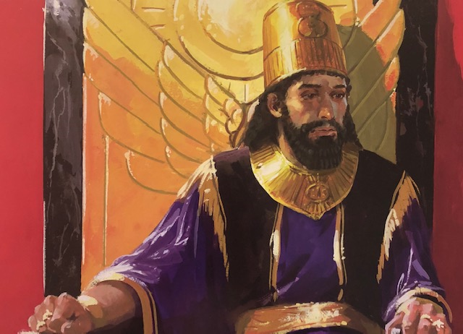

Slide 2
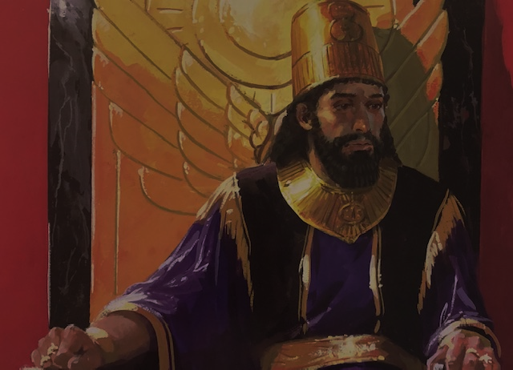
Nebuchadnezzar’s 2nd Dream, Humiliation, and Praise for God
~ Dan 4:1-37

Slide 3
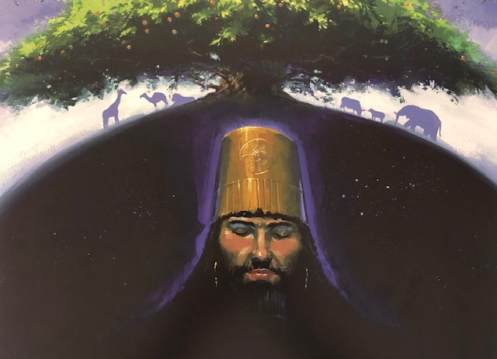

Slide 4

Nebuchadnezzar’s Second Dream (Dan. 4:1-18)
This message is for YOU (4:1)
God’s dominion is from generation to generation (4:3)
The Most High rules in the kingdom on men, gives it to whomever He will, and sets over it the lowest of men (4:17)
Daniel DID understand the dream, and it was NOT good news for Nebuchadnezzar

Slide 5
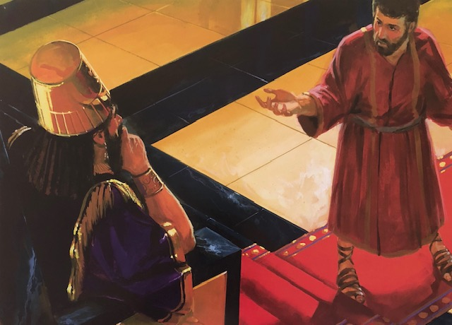

Slide 6
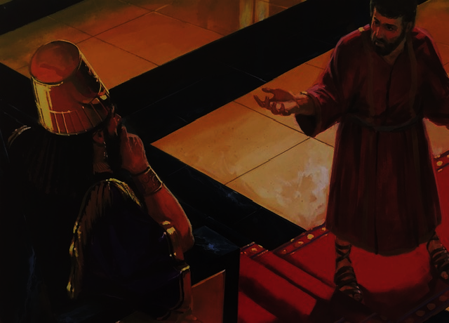
Daniel Explains the Second Dream
(Dan. 4:19-27)
Decree of the Most High troubled Daniel (4:24, 19)
The upcoming events in Nebuchadnezzar’s life would have a purpose (4:25)
Warning was given to Nebuchadnezzar to repent (4:27)
We are not told what Nebuchadnezzar’s reaction was to the dream and its interpretation, but he may have done some reforming because the predicted tragedy was delayed for a time

Slide 7
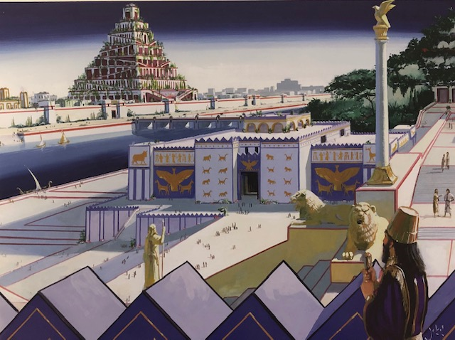

Slide 8
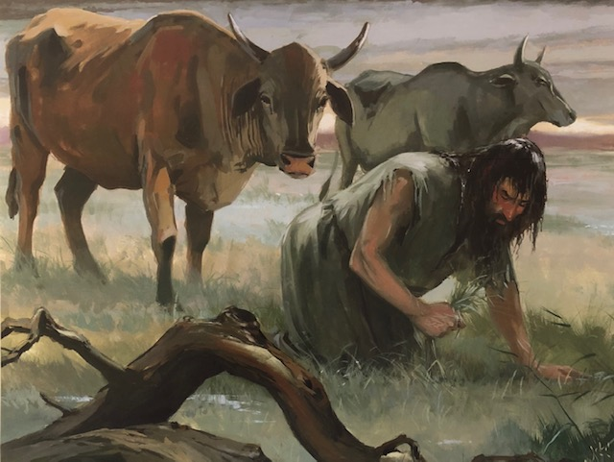

Slide 9
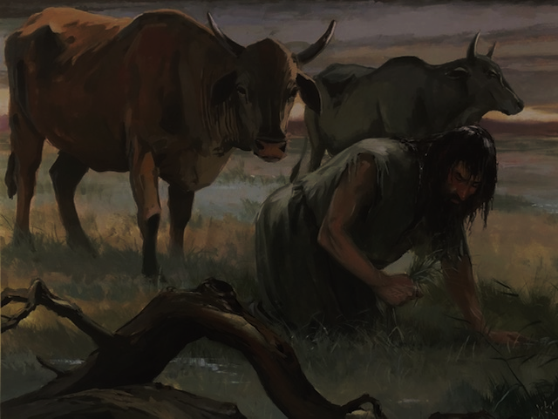
Nebuchadnezzar’s Humiliation
(Dan. 4:28-33)
These things occurred so that Nebuchadnezzar would learn that the Most High rules in the kingdom of men, and gives it to whomever He chooses (4:32)
Remember that any good we attain is only because of the mercy and goodness of God (4:30)
God will exact judgement, coming as a thief in the night… take the warning to be ready seriously

Slide 10
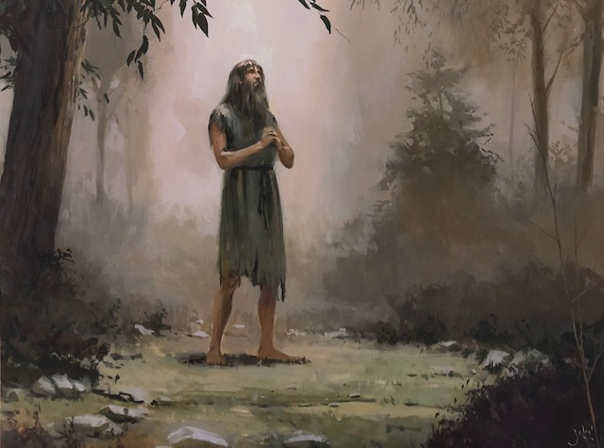

Slide 11

Nebuchadnezzar Praises God
(Dan. 4:34-37)
Nebuchadnezzar had a change of heart and was restored (4:36)!
After being restored, he praised God!
What a powerful lesson for a king to learn!!

Slide 12
Nebuchadnezzar’s 2nd Dream, Humiliation, and Praise for God
~ Dan 4:1-37

