Slide 1

Ephesians 5:15-21
Understand (v 17).
Open your heart to being influenced by the Holy Spirit (through the word), engage yourself in the constant thanksgiving to God, while building up others (vv 18-21).

Slide 2
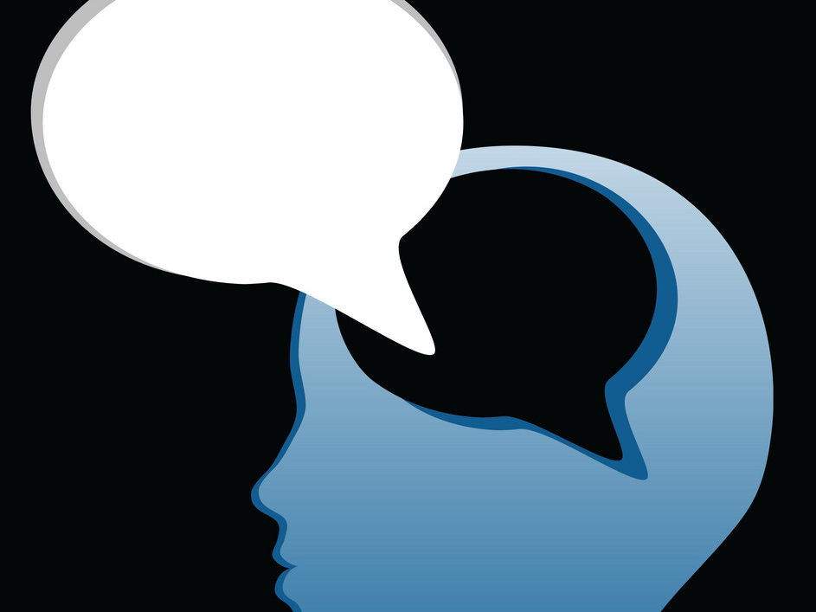
Take Thought Before You Speak
~ James 1:19

Slide 3
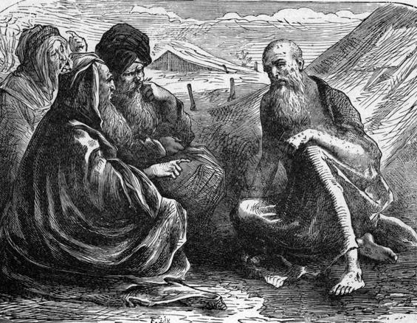
Listening to Others First
Job 2:11-13; Cf. 3:1-26-5:27
Listen & ask questions.
People do not care how much you know until they know how much you care.
Listen with intent of understanding.
The wise man is careful about what he says, and he knows when to keep quiet.

Slide 4
The Example of Jesus
We are always impressed with how Jesus communicated with others.
Often, before Jesus said a word, He would simply listen (Mk. 6:30; Cf. 2:8).
He made people feel they were the most important thing to Him in the moment, because they truly were (Jn. 4:29; Cf. Matt. 9:36)!
When we listen & think (with intent to understand), then we can respond more appropriately.

Slide 5
James Practiced What He Preached
The Jerusalem Conference (Acts 15:6-22).
You know this, but be quick to listen, slow to speak, and slow to wrath. Because man’s wisdom does not bring about the righteousness that God wants (Jas 1:18-22).

Slide 6
The wise man strives to be skillful in getting along with people…
He who is devoid of wisdom despises his neighbor, But a man of understanding holds his peace. Prov 11:12 (NKJV)
He who is slow to wrath has great understanding, But he who is impulsive exalts folly. Prov 14:29 (NKJV)
A friend loves at all times, And a brother is born for adversity. Prov 17:17 (NKJV)
In the mouth of a fool is a rod of pride, But the lips of the wise will preserve them. Prov 14:3 (NKJV)

Slide 7
The wise man strives to be skillful in getting along with people…
A soft answer turns away wrath, But a harsh word stirs up anger. ² The tongue of the wise uses knowledge rightly, But the mouth of fools pours forth foolishness. Prov 15:1-2 (NKJV)
The heart of the wise teaches his mouth, And adds learning to his lips. ²⁴ Pleasant words are like a honeycomb, Sweetness to the soul and health to the bones. Prov 16:23-24 (NKJV)
He who has knowledge spares his words, And a man of understanding is of a calm spirit. ²⁸ Even a fool is counted wise when he holds his peace; When he shuts his lips, he is considered perceptive. Prov 17:27-28 (NKJV)

Slide 8
Take Thought Before You Speak
~ James 1:19

