Slide 1
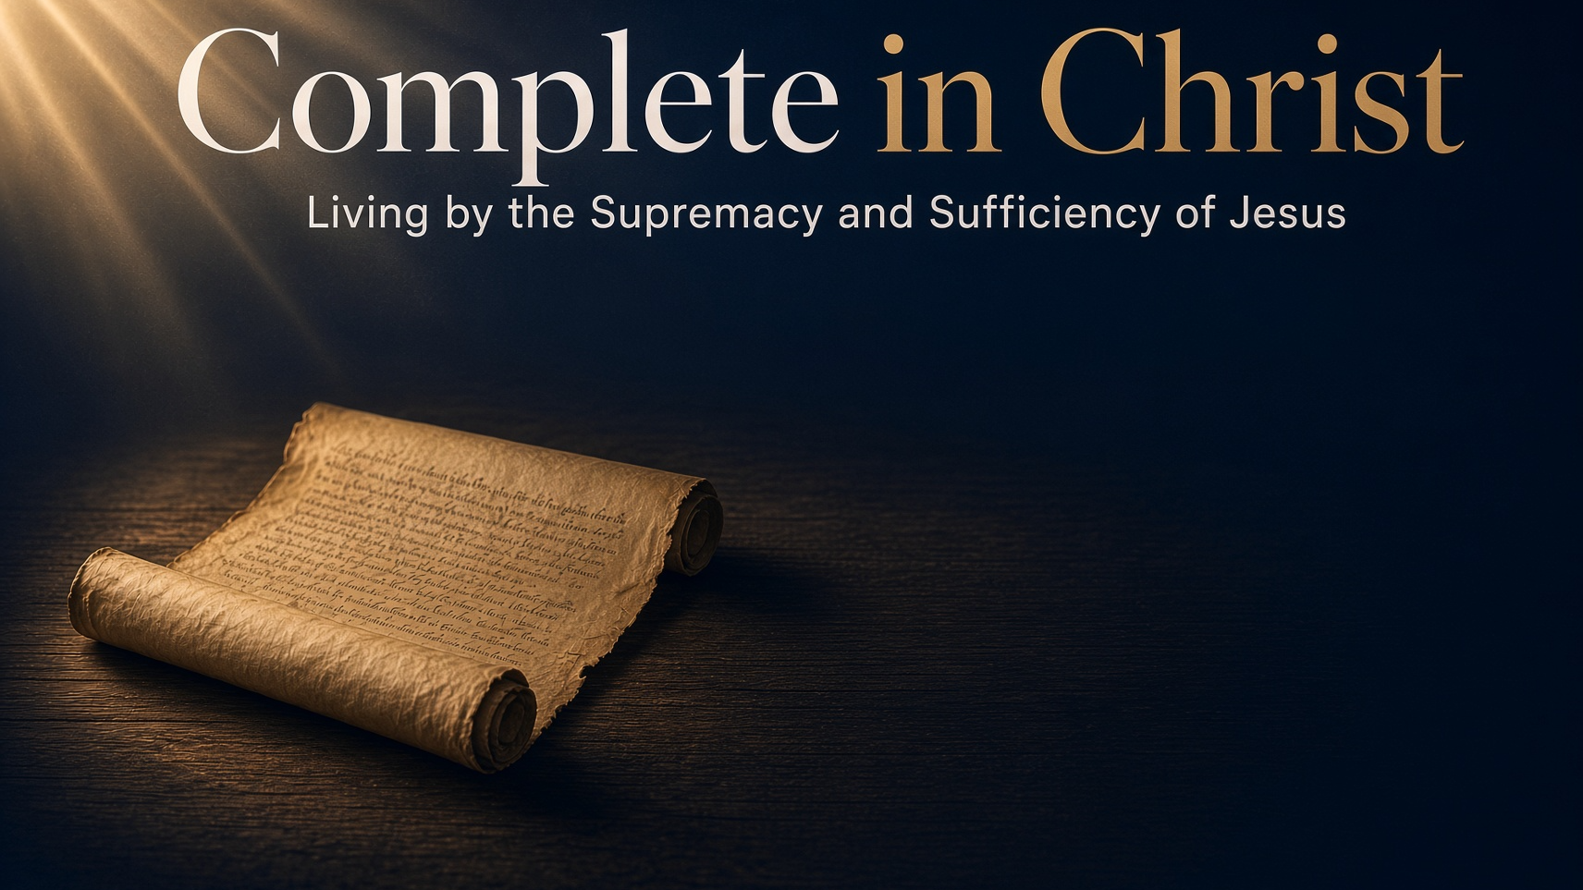
“FAITH, LOVE, & HOPE”
Marks of A Faithful CHURCH
(Colossians 1:1-8)

Slide 2

COMPLETE IN CHRIST — Living by the Supremacy and Sufficiency of Jesus
“FAITH, LOVE, & HOPE” (Colossians 1:1-8)
— Marks of A Faithful CHURCH —
The City Of Colosse
It was a pagan city, with a strong intermingling of Jews
In 62 B.C., there were 11,000 Jewish "freedmen" in the tri-city area
This helps us to understand the nature of some of the problems that arose within the church (problems of both pagan and Jewish origin)

Slide 3
COMPLETE IN CHRIST — Living by the Supremacy and Sufficiency of Jesus
“FAITH, LOVE, & HOPE” (Colossians 1:1-8)
— Marks of A Faithful CHURCH —
LOCATION
1. 100 miles East of Ephesus in Asia Minor.
2. Within a tri-city area with Hierapolis and Laodicea - cf. Co 4:13,16

Slide 4
COMPLETE IN CHRIST — Living by the Supremacy and Sufficiency of Jesus
“FAITH, LOVE, & HOPE” (Colossians 1:1-8)
— Marks of A Faithful CHURCH —
DISTINCTION
1. Hierapolis was known for health, pleasure, relaxation
2. Laodicea was known for commercial trade and politics
3. Colosse, however, was simply a small town

Slide 5
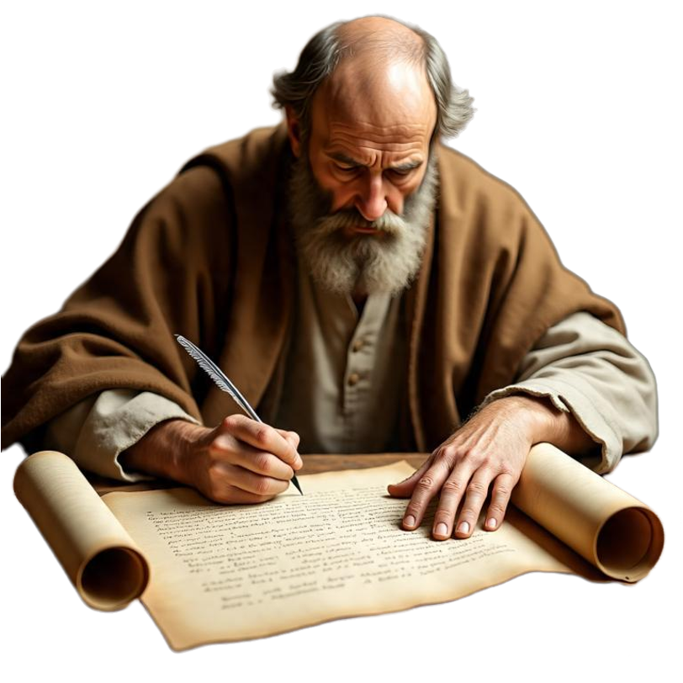
COMPLETE IN CHRIST — Living by the Supremacy and Sufficiency of Jesus
“FAITH, LOVE, & HOPE” (Colossians 1:1-8)
— Marks of A Faithful CHURCH —
The Purpose:
The letter addresses emerging false teaching that undermined Christ’s sufficiency (more fully developed in ch. 2).
To direct their attention to Jesus Christ: The pre-eminent and all-sufficient Savior.

Slide 6
COMPLETE IN CHRIST — Living by the Supremacy and Sufficiency of Jesus
“FAITH, LOVE, & HOPE” (Colossians 1:1-8)
— Marks of A Faithful CHURCH —
Why Study This Book?
We live in an age of subjectivism - Colossians 1:5
We live in an age of science - Colossians 1:15–17
We live in an age of ecumenicalism - Colossians 1:13, 23-25
We live in an age of philosophy and false teaching - Colossians 2:8,18
People are looking for peace, satisfaction, success - Colossians 1:19–20
People are wanting answers for their broken relationships - Colossians 3:18–4:1

Slide 7
COMPLETE IN CHRIST — Living by the Supremacy and Sufficiency of Jesus
“FAITH, LOVE, & HOPE” (Colossians 1:1-8)
— Marks of A Faithful CHURCH —
The Greeting: Identity in Christ (1:1–2)
The Author (verse 1):
Paul identifies himself as “an apostle of Christ Jesus”(apostolos Christou Iēsou) “by the will of God” (dia thelēmatos theou).
Paul begins by asserting his credentials, not out of personal arrogance, but because the message he bears carries cosmic authority.
Colossians 1:1 (NKJV)
¹ Paul, an apostle of Jesus Christ by the will of God, and Timothy our brother,

Slide 8
COMPLETE IN CHRIST — Living by the Supremacy and Sufficiency of Jesus
“FAITH, LOVE, & HOPE” (Colossians 1:1-8)
— Marks of A Faithful CHURCH —
The Greeting: Identity in Christ (1:1–2)
The Author (verse 1):
Timothy is simply “the brother”—a co-sender and partner in the work, as he is in Philippians 1:1, 1 Thessalonians 1:1, and Philemon 1:1
Paul writes from imprisonment (traditionally Rome, c. AD 60–62; alternative proposals include Ephesus or Caesarea).
Colossians 1:1 (NKJV)
¹ Paul, an apostle of Jesus Christ by the will of God, and Timothy our brother,

Slide 9
COMPLETE IN CHRIST — Living by the Supremacy and Sufficiency of Jesus
“FAITH, LOVE, & HOPE” (Colossians 1:1-8)
— Marks of A Faithful CHURCH —
The Greeting: Identity in Christ (1:1–2)
“saints and faithful brethren in Christ”
“Saints” (hagioi) is Paul’s regular term for believers set apart to God (cf. Rom 1:7; 1 Cor 1:2; Eph 1:1; Phil 1:1).
“Faithful” (pistoi) can mean both believing and trustworthy.
Their primary identity is not geographic (“at Colossae”) but relational—“in Christ.”
Colossians 1:2 (NKJV)
² To the saints and faithful brethren in Christ who are in Colosse: Grace to you and peace from God our Father and the Lord Jesus Christ.

Slide 10
COMPLETE IN CHRIST — Living by the Supremacy and Sufficiency of Jesus
“FAITH, LOVE, & HOPE” (Colossians 1:1-8)
— Marks of A Faithful CHURCH —
The Greeting: Identity in Christ (1:1–2)
“saints and faithful brethren in Christ”
The greeting of “grace and peace” combines the Greek greeting of grace with the Hebrew greeting of peace.
Grace (charis (χάρις) is the source; peace (eirene (εἰρήνη) is the result.
From “God our Father.” The standard Pauline opening (Rom 1:7; 1 Cor 1:3; 2 Cor 1:2; Eph 1:2; Phil 1:2; etc.).
Colossians 1:2 (NKJV)
² To the saints and faithful brethren in Christ who are in Colosse: Grace to you and peace from God our Father and the Lord Jesus Christ.

Slide 11
COMPLETE IN CHRIST — Living by the Supremacy and Sufficiency of Jesus
“FAITH, LOVE, & HOPE” (Colossians 1:1-8)
— Marks of A Faithful CHURCH —
The Greeting: Identity in Christ (1:1–2)
“saints and faithful brethren in Christ”
Grace to You (2b) — God’s favor (Eph 2:8; Titus 2:11,12)
And Peace (2b) — Tranquility, wholeness, well being (3:15; Phili 4:7)
From God our Father (2b) — Christians receive and participate in God’s blessings as His children, and are to imitate Him (Eph. 5:1).
Colossians 1:2 (NKJV)
² To the saints and faithful brethren in Christ who are in Colosse: Grace to you and peace from God our Father and the Lord Jesus Christ.

Slide 12
COMPLETE IN CHRIST — Living by the Supremacy and Sufficiency of Jesus
“FAITH, LOVE, & HOPE” (Colossians 1:1-8)
— Marks of A Faithful CHURCH —
Thanksgiving for theIR FAITHFULNESS (1:3–5)
“… thanks to the God and Father”
Paul’s prayer and thanksgiving was constant (“always”).
He does the same for the churches in Rome (Rom 1:8), Corinth (1 Cor 1:4), Ephesus (Eph 1:16), Philippi (Phil 1:3–4), and Thessalonica (1 Thess 1:2; 2 Thess 1:3).
Colossians 1:3 (NKJV)
³ We give thanks to the God and Father of our Lord Jesus Christ, praying always for you,

Slide 13
COMPLETE IN CHRIST — Living by the Supremacy and Sufficiency of Jesus
“FAITH, LOVE, & HOPE” (Colossians 1:1-8)
— Marks of A Faithful CHURCH —
Thanksgiving for theIR FAITHFULNESS (1:3–5)
“since we heard of …”
Paul rejoices because he heard of their "faith in Christ Jesus."
Faith must be “in Christ Jesus”—trust located in the person, sacrifice, and authority of Christ, not merely agreement with facts (cf. Gal 2:16; Eph 1:15; Phil 1:29).
Colossians 1:4–5 (NKJV)
⁴ since we heard of your faith in Christ Jesus and of your love for all the saints; ⁵ because of the hope which is laid up for you in heaven, of which you heard before in the word of the truth of the gospel,

Slide 14
COMPLETE IN CHRIST — Living by the Supremacy and Sufficiency of Jesus
“FAITH, LOVE, & HOPE” (Colossians 1:1-8)
— Marks of A Faithful CHURCH —
Thanksgiving for theIR FAITHFULNESS (1:3–5)
“since we heard of …”
Your “love for all the Saints”
Love is directed to “all the saints.” It is not selective or preferential; it reaches the whole household of faith (cf. Gal 6:10; 1 Thess 4:9–10).
This love is later described as “in the Spirit” (1:8), consistent with the fruit of the Spirit in Galatians 5:22.
Colossians 1:4–5 (NKJV)
⁴ since we heard of your faith in Christ Jesus and of your love for all the saints; ⁵ because of the hope which is laid up for you in heaven, of which you heard before in the word of the truth of the gospel,

Slide 15
COMPLETE IN CHRIST — Living by the Supremacy and Sufficiency of Jesus
“FAITH, LOVE, & HOPE” (Colossians 1:1-8)
— Marks of A Faithful CHURCH —
Thanksgiving for theIR FAITHFULNESS (1:3–5)
“because of the hope which is laid up for you in heaven,”
Hope is not mere optimism; it is the secure, objective inheritance already stored up (apokeimenēn) in the heavens (1 Peter 1:4)
This language echoes the idea of treasure laid up in heaven (cf. Matt 6:20; Luke 12:33).
Colossians 1:4–5 (NKJV)
⁴ since we heard of your faith in Christ Jesus and of your love for all the saints; ⁵ because of the hope which is laid up for you in heaven, of which you heard before in the word of the truth of the gospel,

Slide 16
COMPLETE IN CHRIST — Living by the Supremacy and Sufficiency of Jesus
“FAITH, LOVE, & HOPE” (Colossians 1:1-8)
— Marks of A Faithful CHURCH —
Thanksgiving for theIR FAITHFULNESS (1:3–5)
Pauline triad of faith, love, and hope
1 Thes. 1:3 — “work of faith and labor of love and steadfastness of hope”
1 Cor. 13:13 — “faith, hope, and love abide, these three; but the greatest of these is love”
Romans 5:1–5 — justification by faith, hope that does not put to shame, love poured into our hearts
Colossians 1:4–5 (NKJV)
⁴ since we heard of your faith in Christ Jesus and of your love for all the saints; ⁵ because of the hope which is laid up for you in heaven, of which you heard before in the word of the truth of the gospel,

Slide 17
COMPLETE IN CHRIST — Living by the Supremacy and Sufficiency of Jesus
“FAITH, LOVE, & HOPE” (Colossians 1:1-8)
— Marks of A Faithful CHURCH —
Thanksgiving for theIR FAITHFULNESS (1:3–5)
Pauline triad of faith, love, and hope
Gal. 5:5–6 “…eagerly wait for the hope of righteousness by faith. ⁶ For in Christ Jesus neither circumcision nor uncircumcision avails anything, but faith working through love.”
1 Thessalonians 5:8 “the breastplate of faith and love, and for a helmet the hope of salvation”
Colossians 1:4–5 (NKJV)
⁴ since we heard of your faith in Christ Jesus and of your love for all the saints; ⁵ because of the hope which is laid up for you in heaven, of which you heard before in the word of the truth of the gospel,

Slide 18
COMPLETE IN CHRIST — Living by the Supremacy and Sufficiency of Jesus
“FAITH, LOVE, & HOPE” (Colossians 1:1-8)
— Marks of A Faithful CHURCH —
Source and Power of THEIR FAITH, LOVE, AND HOPE (1:5b–6)
“… the truth of the gospel”
Their hope, faith and love, came through “the word of the truth, the gospel” (Rom. 1:16,17)
Not through self-help programs or philosophical speculation — It was birthed by the “word of the truth of the gospel.” (Rom 10:14-17; 1 Cor 1:18,21; Eph 1:13)
Colossians 1:4–5 (NKJV)
⁴ since we heard of your faith in Christ Jesus and of your love for all the saints; ⁵ because of the hope which is laid up for you in heaven, of which you heard before in the word of the truth of the gospel,

Slide 19
COMPLETE IN CHRIST — Living by the Supremacy and Sufficiency of Jesus
“FAITH, LOVE, & HOPE” (Colossians 1:1-8)
— Marks of A Faithful CHURCH —
Source and Power of THEIR FAITH, LOVE, AND HOPE (1:5b–6)
“… the truth of the gospel”
Paul regularly calls the gospel “the word of truth” or “the word of God” (cf. 2 Cor 6:7; Eph 1:13; 2 Tim 2:15).
In a world saturated with pluralistic philosophies, mystical claims, and shifting cultural norms, the Gospel stands as an objective, historical, and immutable truth.
Colossians 1:5b–6 (NKJV)
⁵ … since which you heard before in the word of the truth of the gospel, ⁶ which has come to you, as it has also in all the world, and is bringing forth fruit,

Slide 20
COMPLETE IN CHRIST — Living by the Supremacy and Sufficiency of Jesus
“FAITH, LOVE, & HOPE” (Colossians 1:1-8)
— Marks of A Faithful CHURCH —
Source and Power of THEIR FAITH, LOVE, AND HOPE (1:5b–6)
“… and is bringing forth fruit”
The gospel is productive - “bearing fruit and increasing” is an allusion to the creation mandate in Genesis 1:28 (cf. Gen 9:1, 7; 17:6, 20; 28:3; 35:11; Exod 1:7) Paul uses the same language again in verse 10.
The gospel is God’s means of filling the earth with people who bear His image in Christ.
Colossians 1:5b–6 (NKJV)
⁵ … since which you heard before in the word of the truth of the gospel, ⁶ which has come to you, as it has also in all the world, and is bringing forth fruit,

Slide 21
COMPLETE IN CHRIST — Living by the Supremacy and Sufficiency of Jesus
“FAITH, LOVE, & HOPE” (Colossians 1:1-8)
— Marks of A Faithful CHURCH —
Faithful Transmission (1:7–8)
“… you also learned from Epaphras”
They learned the gospel from Epaphras, a “beloved fellow servant” (syndoulos) and “faithful minister” (diakonos) of Christ.
Paul uses similar language for other co-workers (cf. Epaphroditus - Phil 2:25; Archippus - Philem 1).
Colossians 1:6–8 (NKJV)
⁶ … as it is also among you since the day you heard and knew the grace of God in truth; ⁷ as you also learned from Epaphras, our dear fellow servant, who is a faithful minister of Christ on your behalf, ⁸ who also declared to us your love in the Spirit.

Slide 22
COMPLETE IN CHRIST — Living by the Supremacy and Sufficiency of Jesus
“FAITH, LOVE, & HOPE” (Colossians 1:1-8)
— Marks of A Faithful CHURCH —
Faithful Transmission (1:7–8)
“… you also learned from Epaphras”
Epaphras is the model of a faithful servant who both plants the church and reports back to the apostle.
Their love is “in the Spirit”—produced by the Holy Spirit (cf. Rom 5:5; Gal 5:22; Eph 5:9).
Colossians 1:6–8 (NKJV)
⁶ … as it is also among you since the day you heard and knew the grace of God in truth; ⁷ as you also learned from Epaphras, our dear fellow servant, who is a faithful minister of Christ on your behalf, ⁸ who also declared to us your love in the Spirit.

Slide 23
COMPLETE IN CHRIST — Living by the Supremacy and Sufficiency of Jesus
“FAITH, LOVE, & HOPE” (Colossians 1:1-8)
— Marks of A Faithful CHURCH —
The church at Colosse had admirable qualities, which we do well to emulate...
Do you have faith in Jesus?
Do you love ALL the brethren?
Do you have the hope of eternal life?

Slide 24
COMPLETE IN CHRIST — Living by the Supremacy and Sufficiency of Jesus
“FAITH, LOVE, & HOPE” (Colossians 1:1-8)
— Marks of A Faithful CHURCH —
The church at Colosse had admirable qualities, which we do well to emulate...
Have you accepted the word of the truth of the gospel?
That you may bring forth fruit unto God?

Slide 25
“FAITH, LOVE, & HOPE”
Let Us Always Bear These Marks of A Faithful CHURCH
(Colossians 1:1-8)

Slide 27
“FAITH, LOVE, & HOPE”
Marks of A Faithful CHURCH
(Colossians 1:1-8)
Charts by Don McClain
Preached 2008 West 65th Street church of Christ
Preached November 8, 2026, Alexander church of Christ
501-568-1062 / Email – donmcclain@sbcglobal.net
Prepared using Keynote 2014 – More PPT & Audio Sermons:
alexanderchurchofchrist.com

Slide 28

1 Thessalonians 1:2–10 (NKJV)
² We give thanks to God always for you all, making mention of you in our prayers, ³ remembering without ceasing your work of faith, labor of love, and patience of hope in our Lord Jesus Christ in the sight of our God and Father, ⁴ knowing, beloved brethren, your election by God. ⁵ For our gospel did not come to you in word only, but also in power, and in the Holy Spirit and in much assurance, as you know what kind of men we were among you for your sake. ⁶ And you became followers of us and of the Lord, having received the word in much affliction, with joy of the Holy Spirit,

Slide 29
1 Thessalonians 1:2–10 (NKJV)
⁷ so that you became examples to all in Macedonia and Achaia who believe. ⁸ For from you the word of the Lord has sounded forth, not only in Macedonia and Achaia, but also in every place. Your faith toward God has gone out, so that we do not need to say anything. ⁹ For they themselves declare concerning us what manner of entry we had to you, and how you turned to God from idols to serve the living and true God, ¹⁰ and to wait for His Son from heaven, whom He raised from the dead, even Jesus who delivers us from the wrath to come.

