Slide 1
PL/SQL Cursors

Slide 2
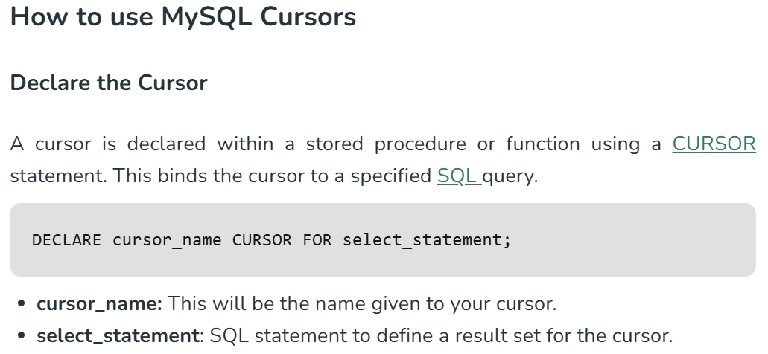
A MySQL cursor is a database object that enables the end-user to retrieve, process, and scroll through rows of the result set one at a time.
Cursors enable the user to fetch and process each row individually, allowing for detailed manipulation and analysis of data.

Slide 3
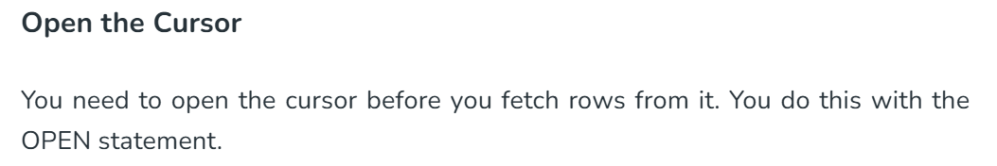
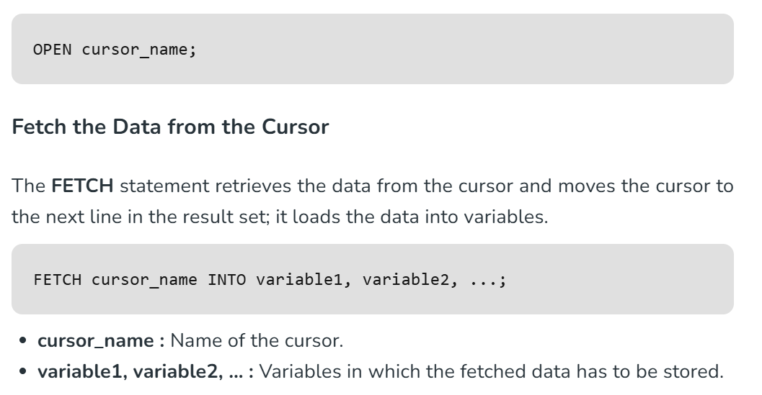

Slide 4
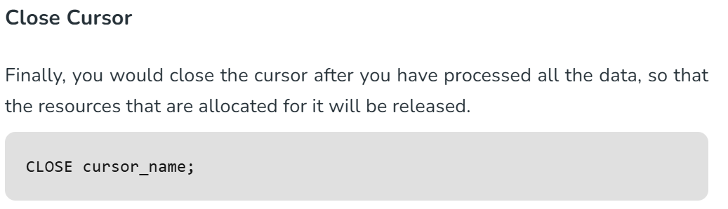

Slide 5
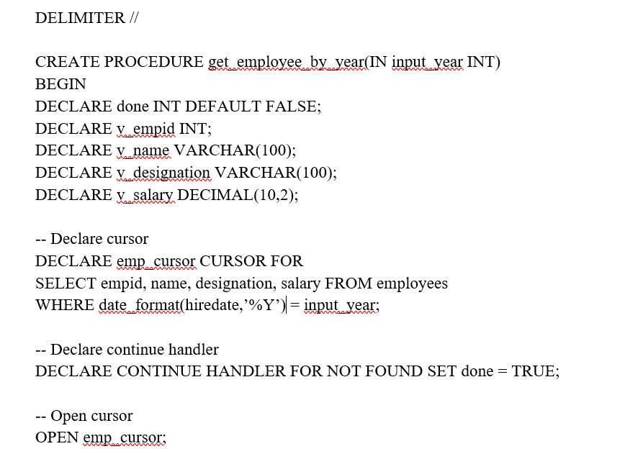
Create a PL/SQL block that declares a cursor. Display the empid ,name, designation and salary of employees who joined in a particular year.

Slide 6
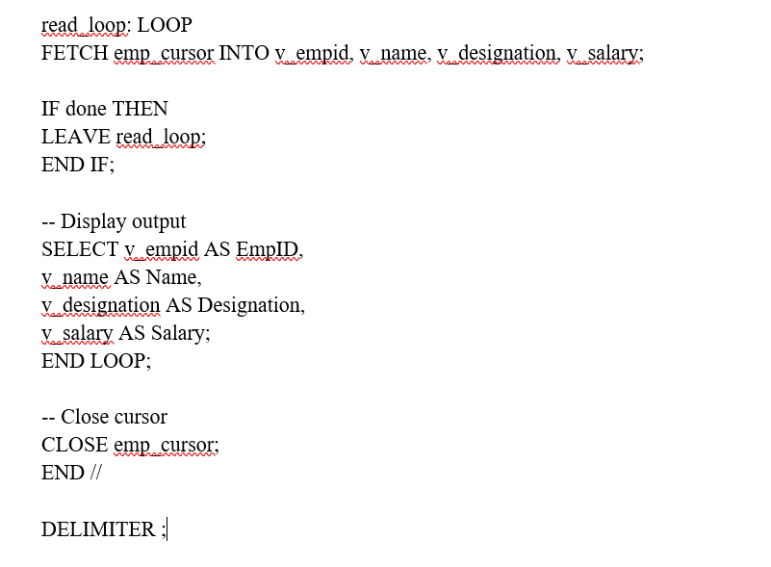

Slide 7
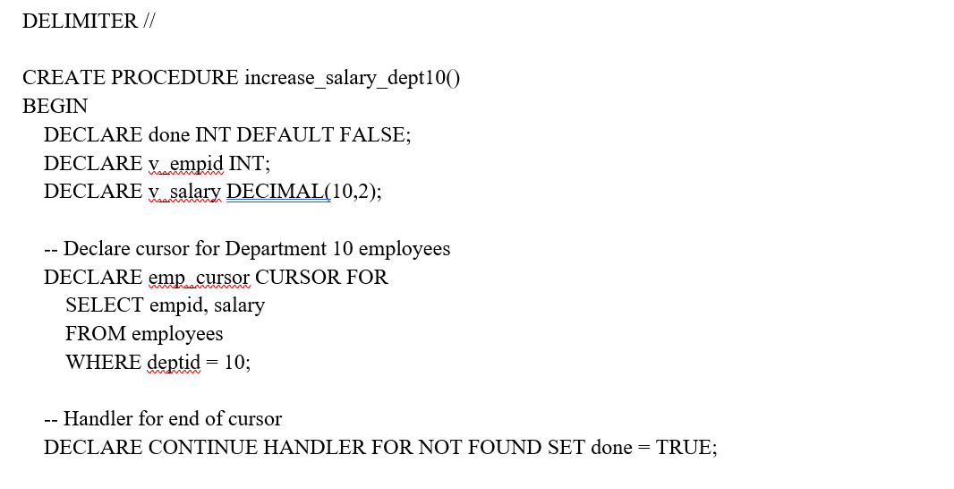
Create a PL/SQL block to increase the salary of the employee in Department 10. The salary increases by 5% for employees whose salary is less than 20000 & 10% for the employees whose salary is greater than 20000.

Slide 8
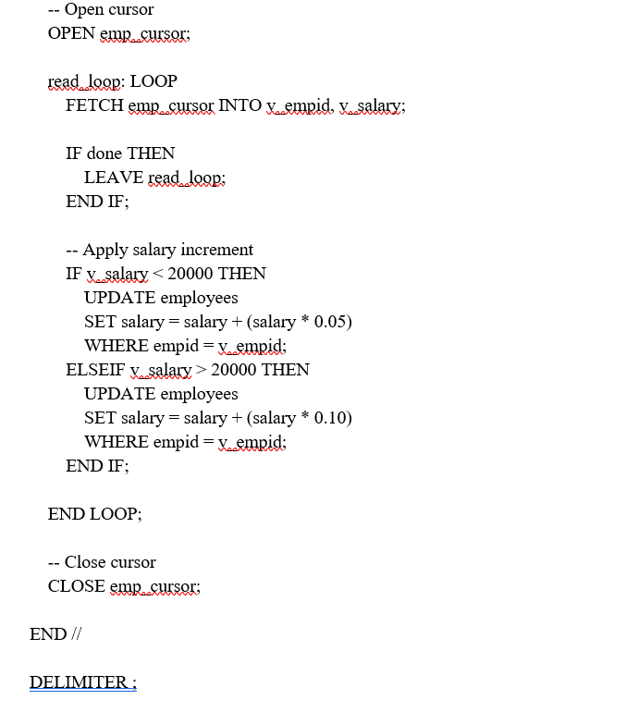

Slide 9
PL/SQL FUNCTIONS

Slide 10
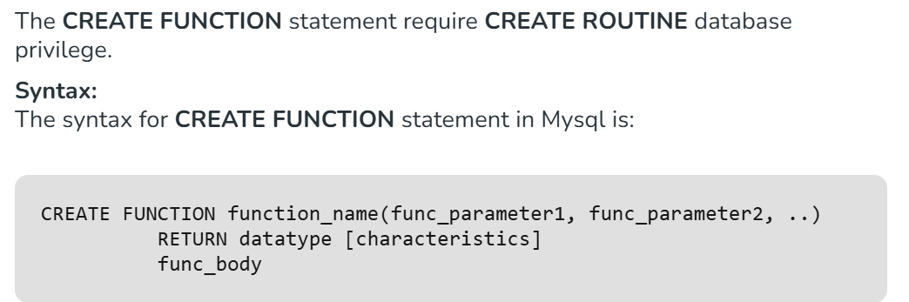
function_name: It is the name by which stored function is called. The name should not be same as native(built_in) function.
func_parameter: It is the argument whose value is used by the function inside its body.
characteristics: The CREATE FUNCTION statement is accepted only if at least one of the characteristics { DETERMINISTIC, NO SQL, or READS SQL DATA } is specified in its declaration.

Slide 11
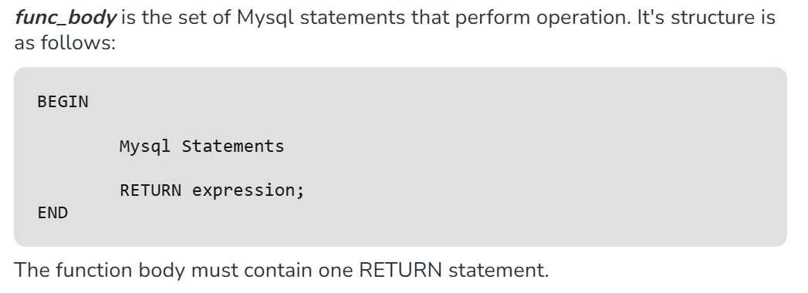

Slide 12
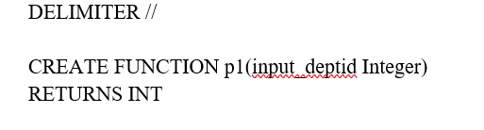
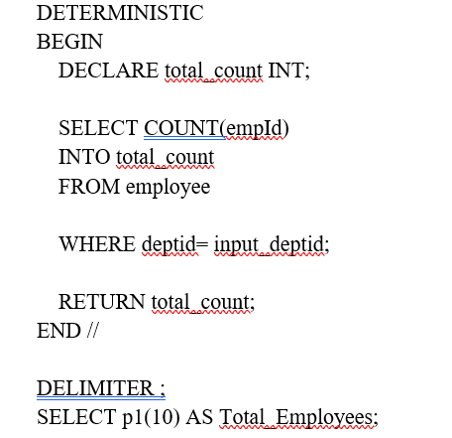
Write PL/SQL function to find the total no of employees in a particular dept (deptid to be given as parameter).

