Slide 1


Bloom Watch
“A smart tool to monitor and analyze plant blooming patterns”
Presented By: Chintala Vijaya Spoorthi
For NASA Space Apps Hackathon 2025

Slide 2
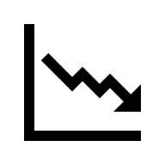



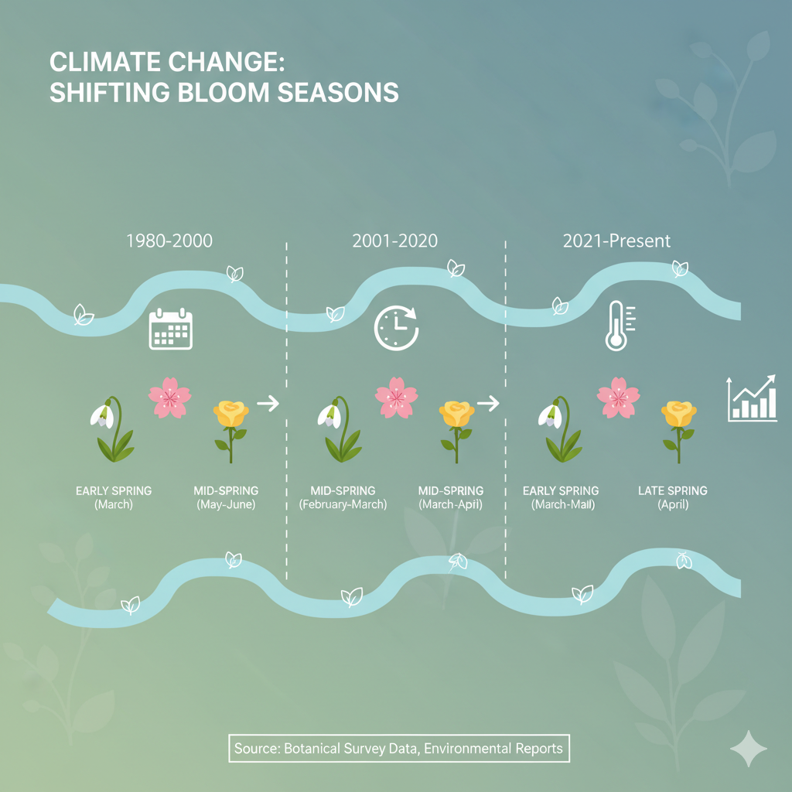
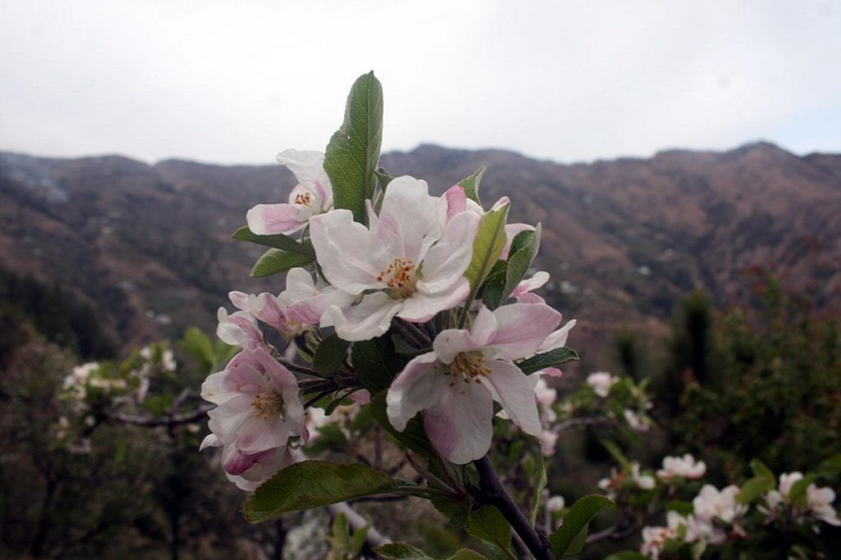
Problem Statement
Unpredictable Blooming: Climate change is making plants bloom earlier or later than usual.
Impact On Nature:
Changes affect pollinators(like bees), crops and ecosystems.
Data Gap: Farmers, researchers and citizens don’t have easy tools to track bloom patterns.
Result: Without bloom data farmers miss the right time for sowing or harvesting, scientists can not understand climate change is affecting plants, communities may not be ready for changes in ecosystem.
Apple orchards that usually blossom in late spring are now budding much earlier in Himachal Pradesh.

Slide 3



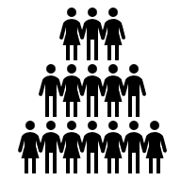

SOLUTION
What we built:
Collect Plan Bloom Data(CSV File)
Analyze using Python: Bar Charts, Pie charts, CSV insights.
Compare results with NASA climate Data(temperature, rainfall, vegetation patterns).
Helps track if plants are blooming earlier/later due to climate change
Open for everyone -> Students, Farmers and researchers can all contribute bloom records.
Bloom data(CSV) -> Python Analysis(Charts) -> Insights -> Compare with NASA climate data.
“We use NASA Earth science data to give climate context”.

Slide 4
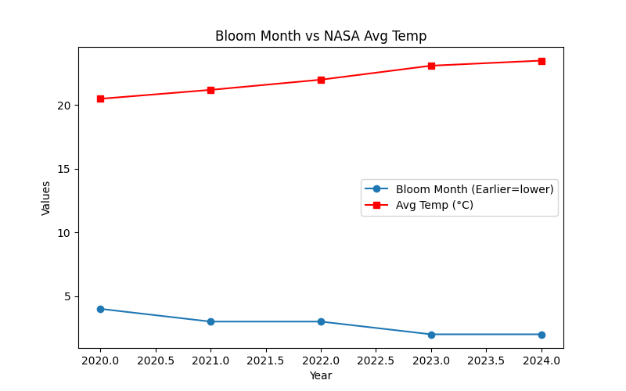
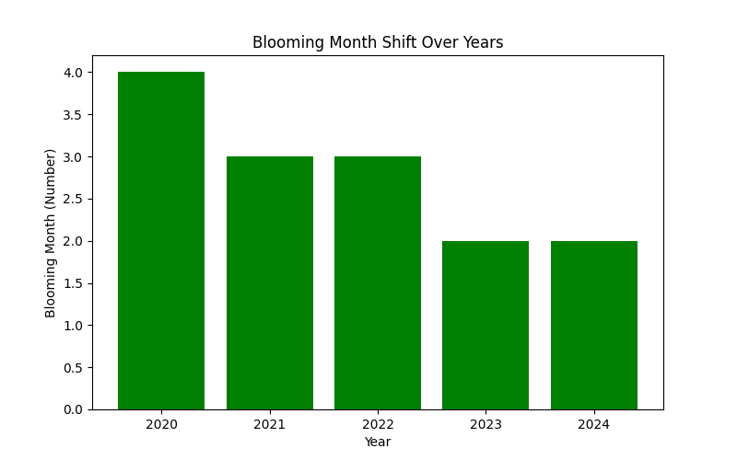
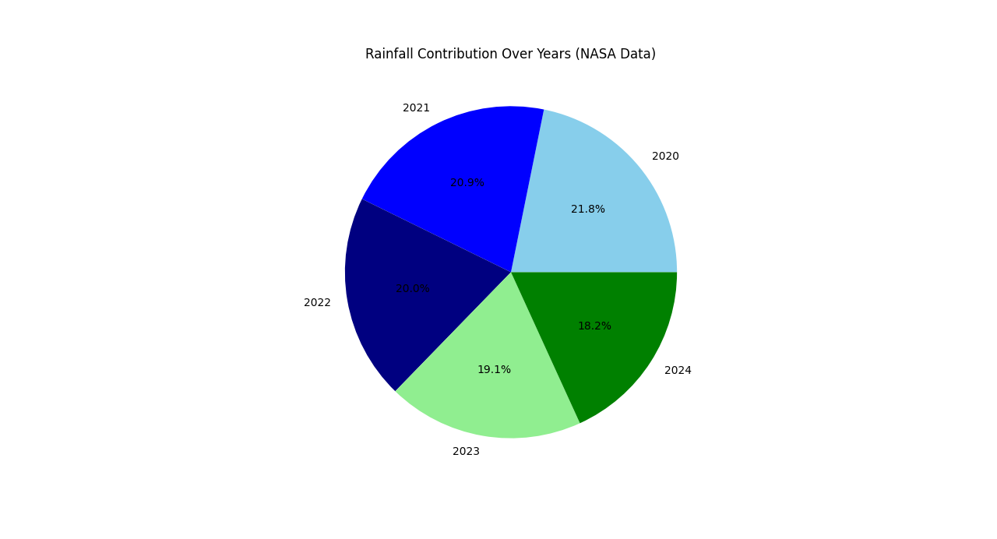
Data And results
Rainfall contribution distribution
Blooming months reduced from 2020-2024
Blooming months shift earlier as temperature rises

Slide 5





Future Scope
Mobile App/ Web Portal: Let framers, students and researches upload bloom data easily.
Nasa Data Integration: Directly connect with satellite datasets(NDVI, Rainfall< temperature).
AI & machine Learning: Predict future bloom dates and detect unusual shifts.
Global Impact: Support agriculture, research and communities across the world.
Alerts & Notifications: Warn users if plants are blooming too early/late due to climate change.
Open Data & Education: Provide bloom trends for awareness, school projects and policy support.
“Together, technology and data can help us protect crops, adapt to climate change, and secure our future harvests”.

Slide 6
Conclusion And Impact
Bloom watch bridges local bloom data with NASA satellite climate data.
Provides simple, clear insights through graphs and CSV analysis.
A first step towards smarter tools that connect people with Earth observation.
Future ready to help farmers, researchers and communities adapt to climate change.
Provides timely alerts to protect crops and irrigation sources.
Warns about harmful algal bloom that kill fish or release toxins, saving their livelihood.
Can grow into a full app with AI predictions and global impact.
“A small seed today, a global impact tomorrow.”

Slide 7
Thank You
Bloom Watch- NASA Space Apps 2025
“Tracking blooms today, protecting ecosystems tomorrow.”

