Slide 1
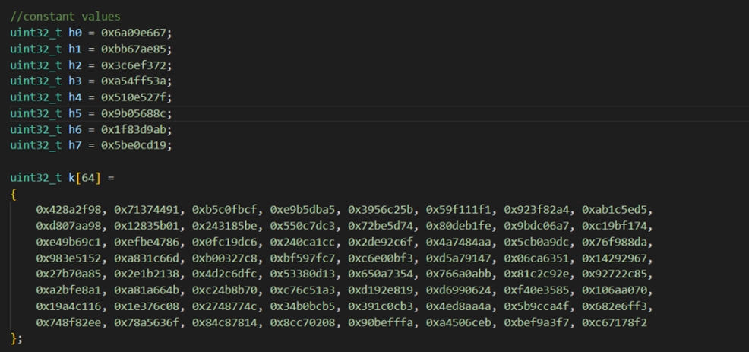
Initialising Constant Values The constants in sha 256 algorithm are stored as given in the pseudocode, the h0 to h7 represent the hash values which are first 32 bits of the fractional parts of the square roots of the first 8 primes 2 to 19 and k array values represent the round constants which are first 32 bits of the fractional parts of the cube roots of the first 64 primes 2 to 311.

Slide 2
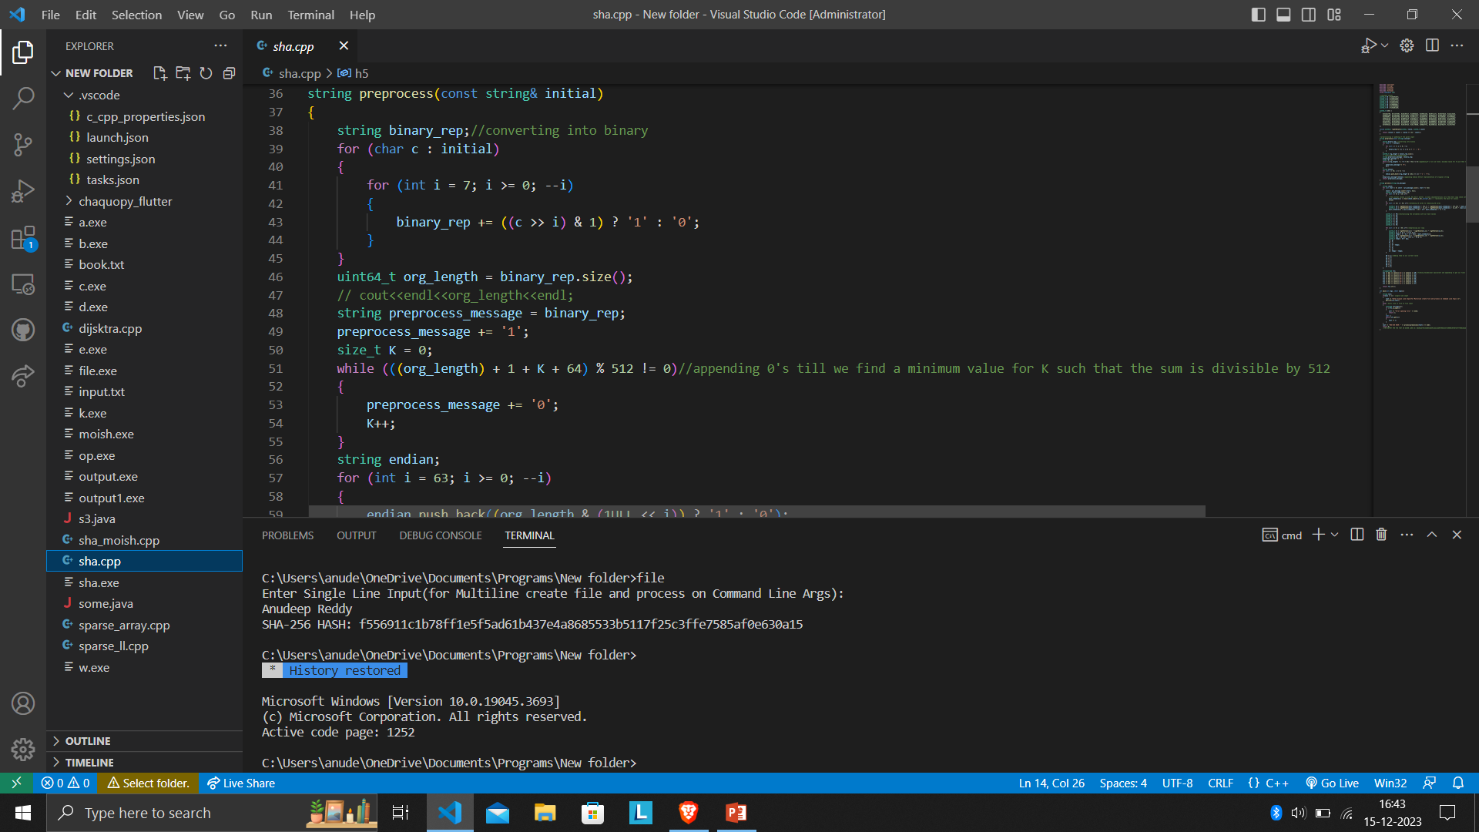
The initial process is preprocessing the given string. Binary Representation We convert the given string of data into the binary format but making sure we get 8 bits of every character in the string. Appending ‘0’ bits The ‘1’ bit gets appended to the binary converted string. K ‘0’ bits are appended till the sum of original length, the added ‘1’ bit, 64 and K is divisible by 512. This is to make sure that the final length of our padded message is a multiple of 512 so that we can process it by dividing them into chunks.

Slide 3
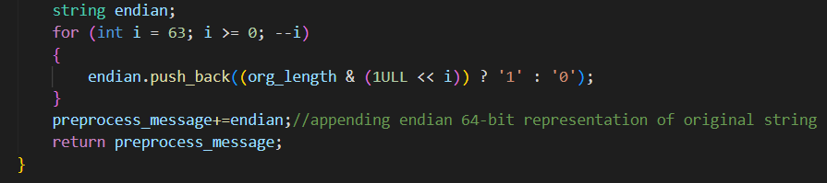
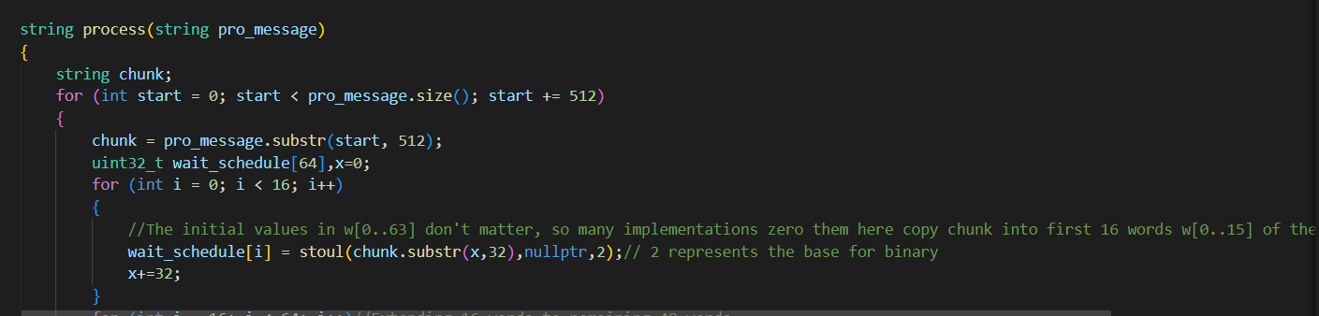
The final part of preprocessing is appending the original message length as a 64 bit endian integer, to do this we process the loop 64 times to append 64 bits and checks if ith bit of the original length and appends 1 or 0 depending on the individual bit values and 1ULL makes sure we get 64-bit unsigned integer. Processing of Message For every 512 bits we divide the padded message into a chunk and process it, so we create an array called message schedule array, the first 15 values do not matter so we copy our chunk values to our message schedule array, we are incrementing by 32 because we want them to be 32-bit words.

Slide 4
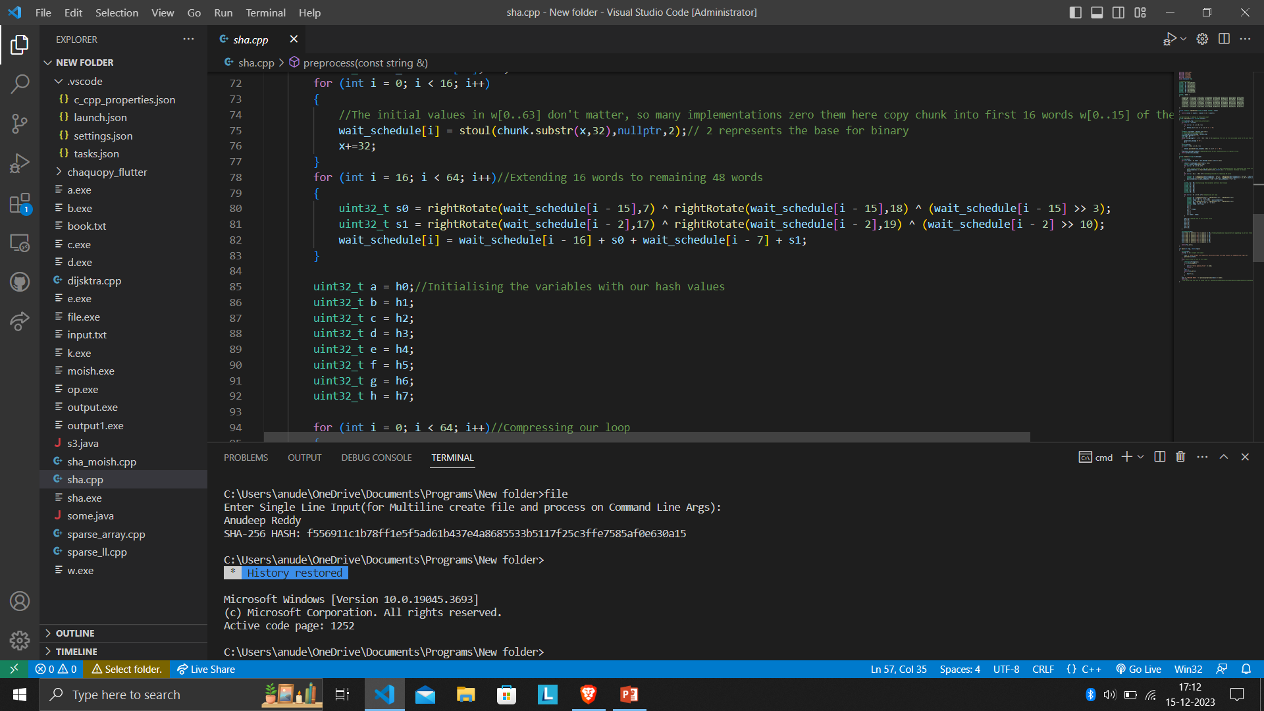
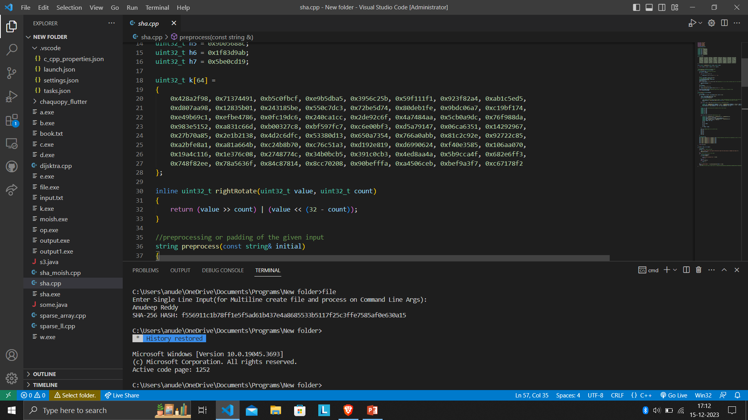
The next 16 to 63 indices are filled with the extension of the first 16 words, this is done by right rotation and right shift of the initial values and adding all the generated values. Right Rotate We give the parameters as the value and the number of times to rotate, it takes the value and right shifts the value by count bits and takes the OR of this and left shift of given value by (32-count bits).

Slide 5
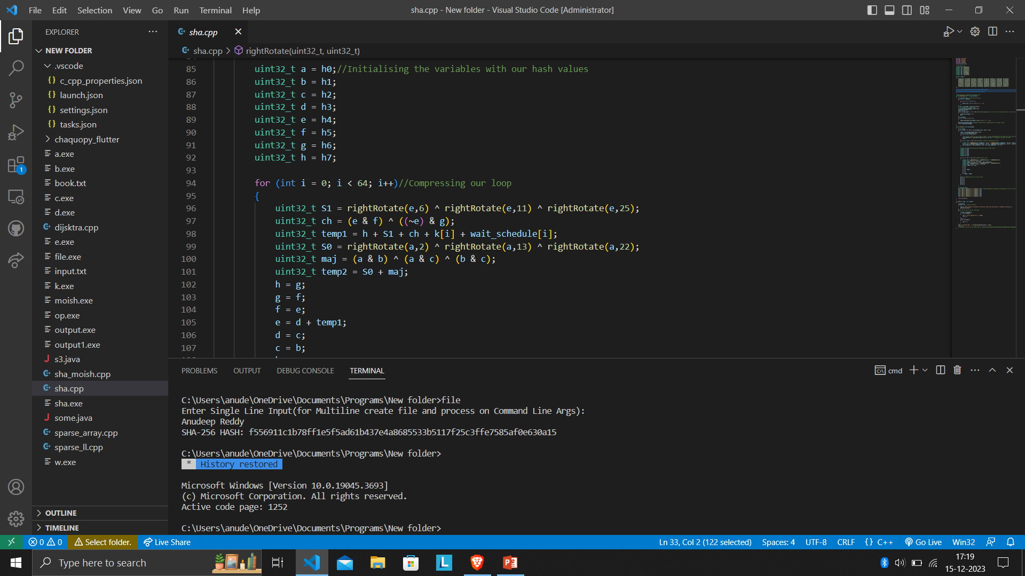
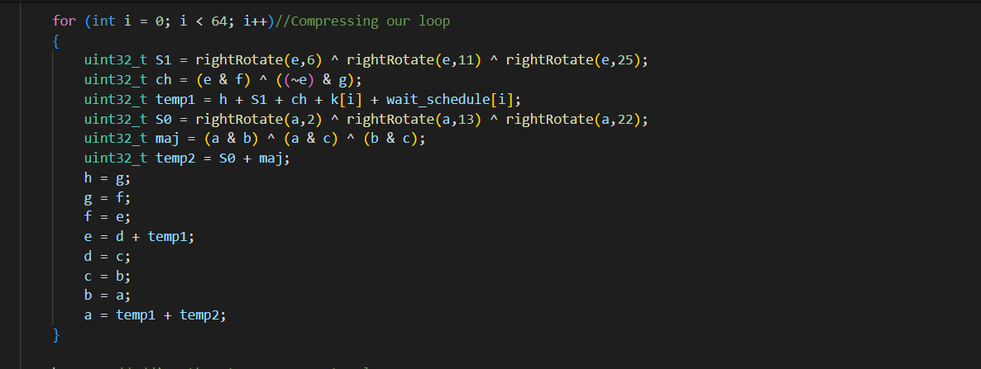
The hash values are stored in our variables, these are useful for our compression of loop. Compression of loop This loop is important for compression of the input data block, the rightrotate is done so that the bits are mixed to ensure strong encryption, xor is used to choose bits depending on the intermediate values, from this temporary values are calculated and the state variables are updated for the present loop.

Slide 6
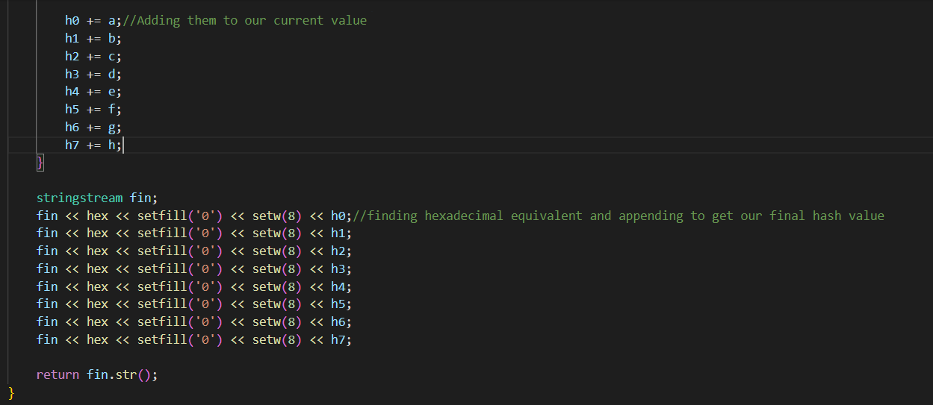
The calculated hash values are added to our instantiated hash values, at the end of all the chunks we are ready with the updated hash values which are result of aggregate appending of intermediate hash values. To get the final hash value we take all the calculated hash values and convert them to hexadecimal and append them to our final string which is our final generated hash value.

Slide 7
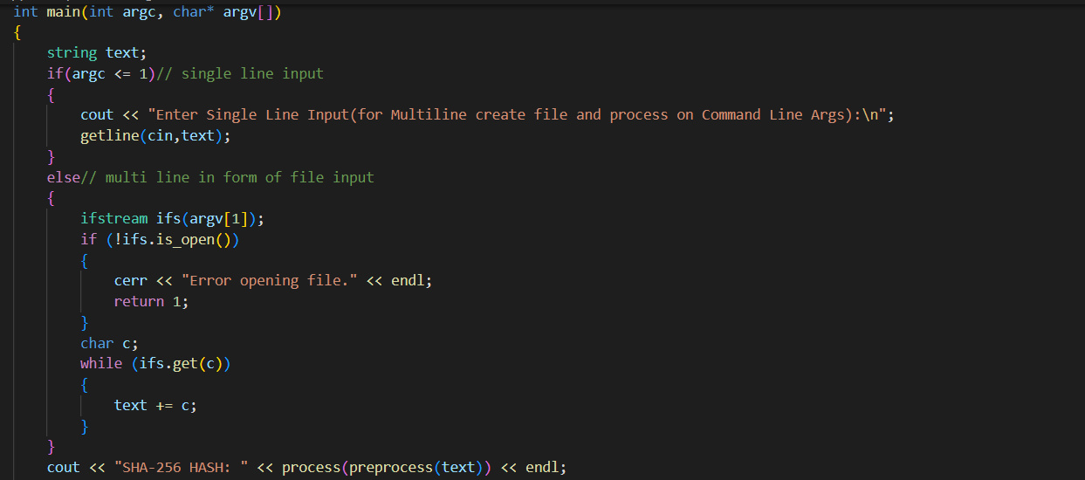
Taking Input We take inputs in two forms which is giving it a manual input of a single line or providing it a file with text in it. For normal command line text, we use getline to consider the input even after spaces which is not possible with cin. For taking file as input we compile the program and use g++ filename.cpp –o outputfilename (For compiling) outputfilename inputfilename The “inputfilename” is a command line argument and we check if it is present in the directory, if it is present we get all the characters from the file and append it to our input string and send it to our functions. The generated hash value for the text given at https://quod.lib.umich.edu/cgi/r/rsv/rsv idx?type=DIV1&byte=4697892 is 8d202adf39c3e88510a591cbe1cbd96708e3237140060c0768f2577f9d81d3ad

