Slide 1

Research Question – Tutorial Presentation for Feedback Date: 18/11/2024
Group Name: A 073 Name of Student Presenting:

Slide 2
This dataset is interesting to us because it explores on how personal factors like age and BMI influence personal health insurance charges, providing insights into the determinants of healthcare costs. Our Independent variable is: the age of the individual This Independent variable datatype is : Interval/measurement data. Our Dependent variable is: personal health insurance charges This Dependent variable datatype is : Interval/measurement data.
Dataset ID: DS253 insurance.csv
Notes:
Before specifying your Research Question you must define the type of data you are analysing. Are the variables you select interval data (measurement data you can divide, multiple, etc), OR are they ordinal (there is a definite order but the intervals between each variable are not necessarily equal, or the terms might be subjective like in a likert scale); OR are they just categorical/nominal (Items such as film names, cities, etc., that you can count numbers of occurrences? You also need to understand whether the variable is either dependent or independent and this will vary according to the context. Independent variables may cause an effect, whereas the dependent variable might be effected by the independent variable. Check the lecture notes on the RQ for more information and examples.
You will get only one opportunity to present your Research Question ahead of the submission date. Have your questions ready, and be ready to take notes on feedback.

Slide 3
“Is there a correlation between personal health insurance charges and age of the individual?” Null hypothesis (H_{o}): there is no correlation between the personal health insurance charges and the age of individual Alternative hypothesis (H₁); there is a correlation between the personal health insurance charges and the age of the individual.
Our Research Question is

Slide 4
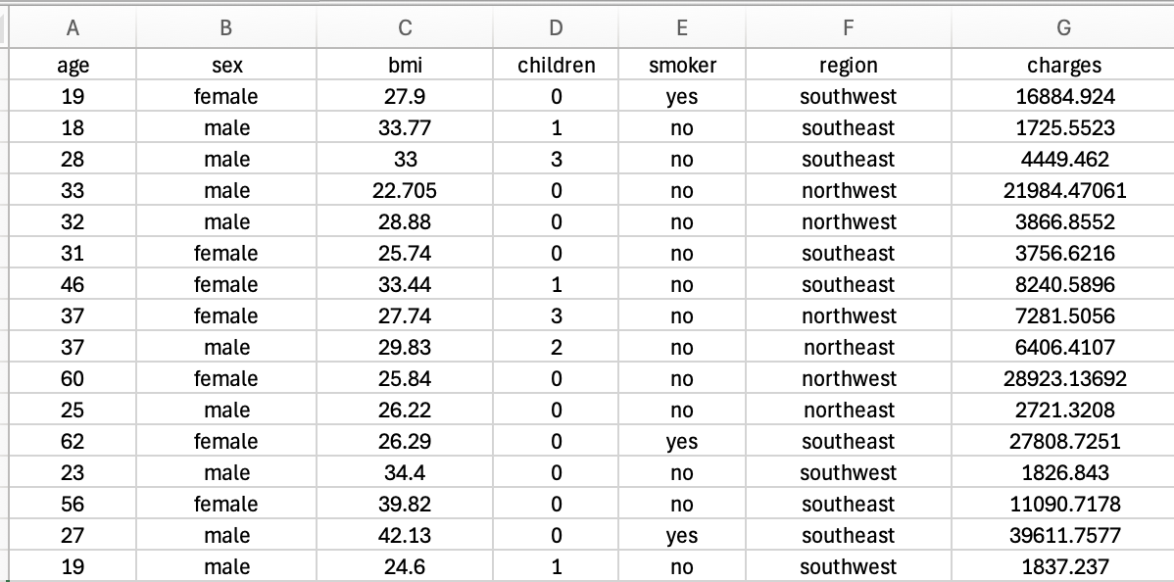
Dataset – DS253

