Slide 1


Nimble: Scalable TCP-Friendly Programmable In-Network Rate-Limiting
Vineeth Sagar Thapeta¹
Komal Shinde¹
Mojtaba Malekpourshahraki¹
Darius Grassi¹
Balajee Vamanan¹
Brent Stephens²
1
2
University of Illinois At Chicago
University of Utah

Slide 2
Core Problem:
It is difficult to provide performance isolation at line-rate in today’s cloud data center networks

Slide 3







Anatomy of a Cloud Application
Latency Sensitive
Bandwidth Hungry

Slide 4

Outline
Cloud Architecture
Problem and Solution
Problems with Current Approaches
Our Solution: Nimble
Controller and Isolation Policies
Evaluation

Slide 5



Problem: Performance Isolation
Dropped
TCP generally converges to per-flow fairness.
Tenant A
To improve network utilization, some applications open many connections compared to others.
It’s possible to game the system by opening lots of connections.
Tenant B

Slide 6
Solution: In-Network Rate-Limiting
Tenant A
In-network rate-limiting can provide performance isolation by monitoring and enforcing the rate per traffic class (TC)
Tenant B
Dropped

Slide 7

Outline
Cloud Architecture
Problem and Solution
Problems with Current Approaches
a. Scalability
b. Edge-Based Rate-Limiting overhead
c. TCP Friendliness
Our Solution: Nimble
Controller and Isolation Policies
Evaluation

Slide 8
Problem 1: Switches cannot scalably provide performance isolation

Slide 9
Problems with In-Network Rate-Limiting
Q1
Q2
Virtual Queues (VQ) require a physical queueing resource. They are a Scarce Resource!
Q2
Q2
Modern datacenter switches have 8 ̶ 32 VQ per port
Q2
Q1
Q2
Q1
Q2
Per-TC occupancy is used to perform ECN marking for DCTCP
Other systems use hardware timers or recirculation for packet generation to provide token bucket abstractions. Timers are a scarce resource!
Packet Scheduler
Wire

Slide 10
Solution: Nimble uses plentiful stateful memory (Registers) on commodity programmable switches to scalably (100K rate-limiters per switch) implement performance isolation (rate-limiting)

Slide 11
Problem 2: Edge-based Rate-Limiting leads to a lot of churn.

Slide 12
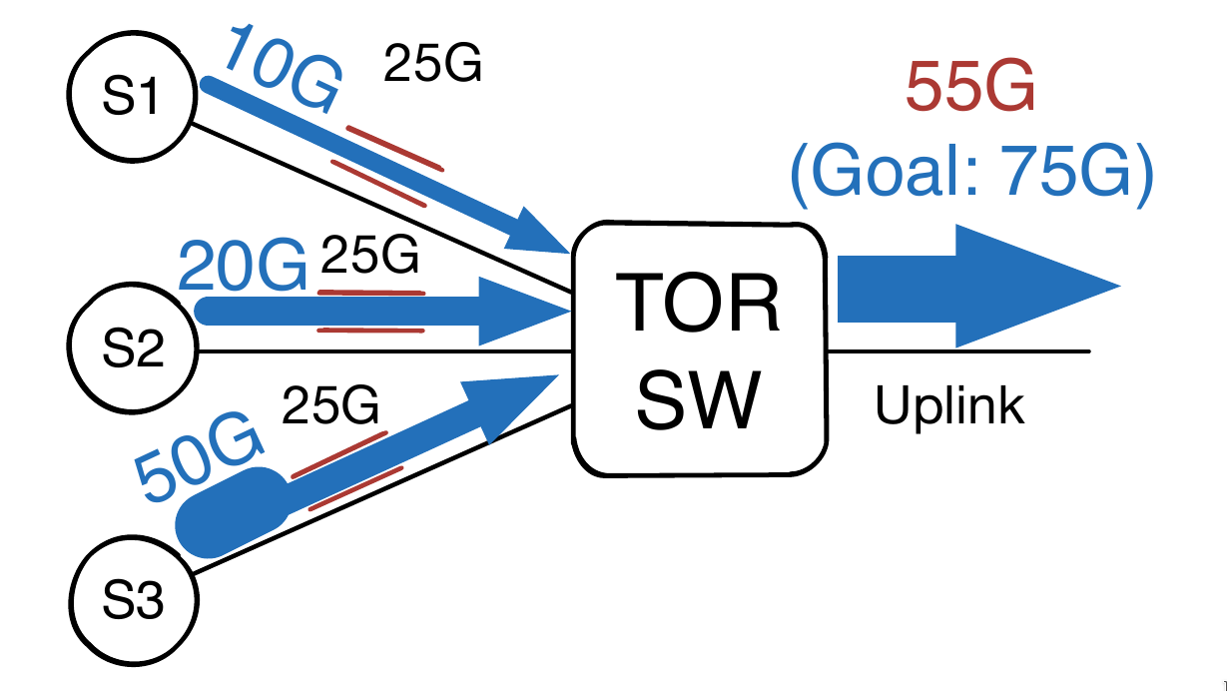
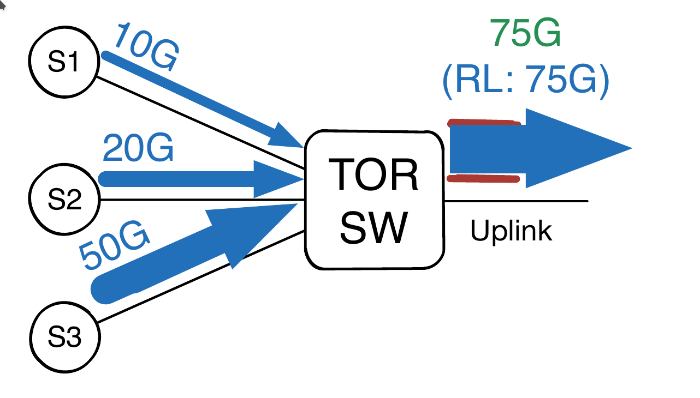
Problems with Edge-Based Rate-Limiting
The under utilization (top figure) of the bandwidth can be solved by measuring the network demand. Given the number of edge rate-limiter updates, it leads to a lot of churn
The edge is untrusted in IXPs, Transit and Private WANs
Notes:
*change what is written in bubble 1

Slide 13
Solution: Nimble introduces a new controller design to reduce the number of rate-limiter updates by a factor of 10x ̶ 20x and improves the network utilization by 24%

Slide 14
Problem 3: Existing rate-limiting approaches are not TCP-friendly
Notes:
"Existing rate-limiting approaches are not TCP-friendly"

Slide 15
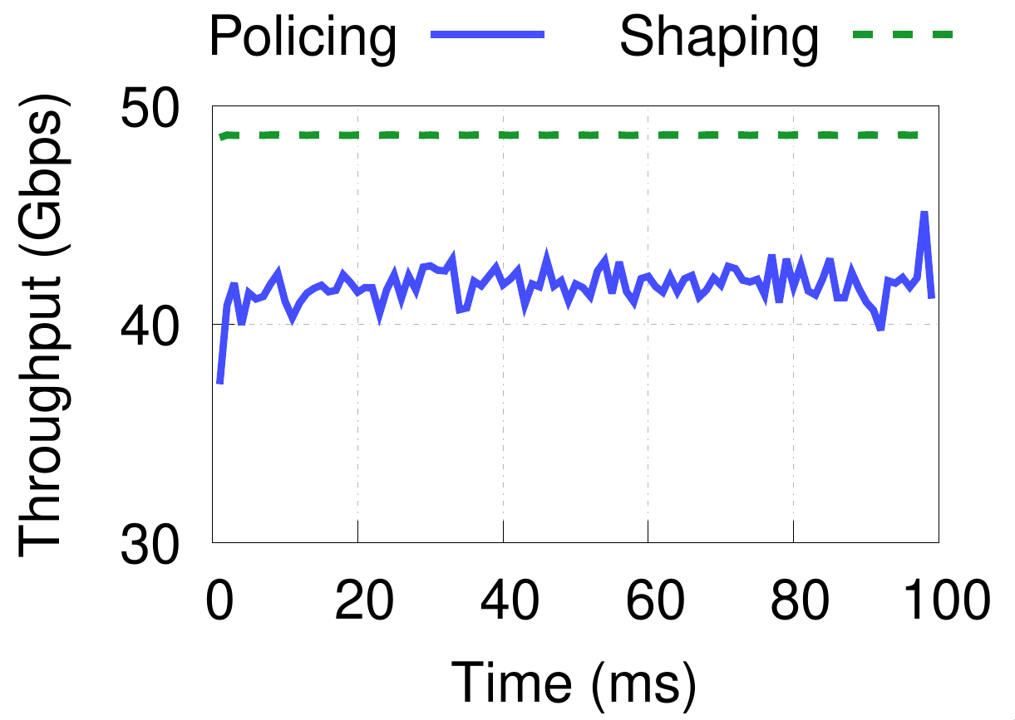
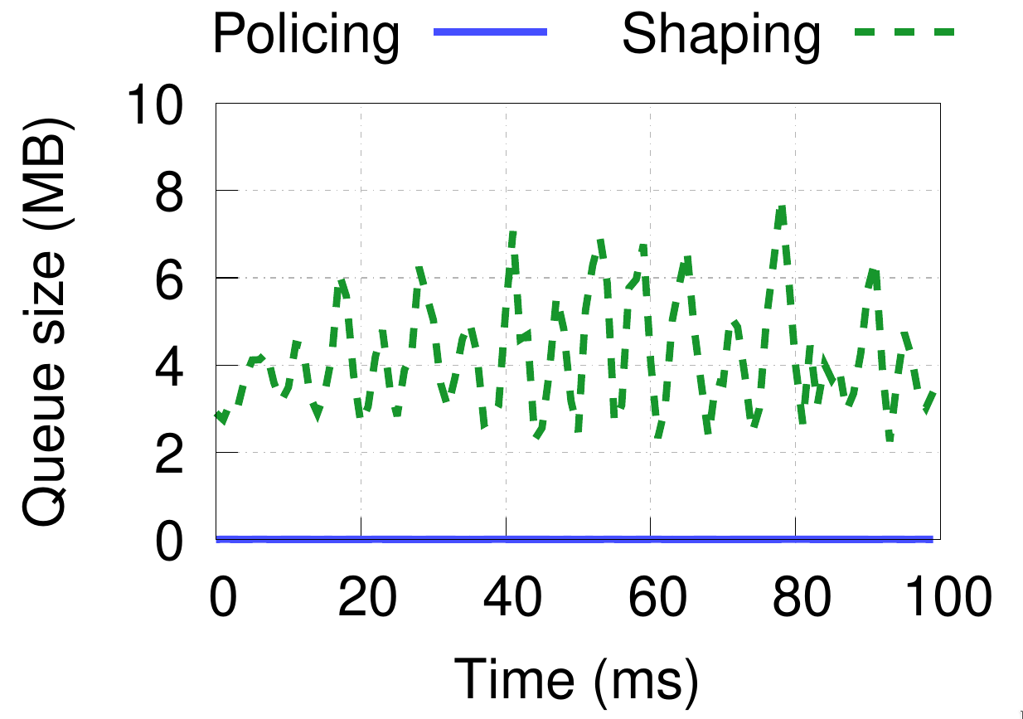
Problem: TCP Friendliness
Policing is inaccurate
Shaping causes queue buildup

Slide 16
Solution: ECN marking causes end-hosts to converge to policy compliant rates, and bounds the queue occupancy. Nimble decides which packets to mark and which packets to drop. As a consequence Nimble is both TCP Friendly and accurate in enforcing the assigned rate
Notes:
"Existing rate-limiting approaches are not TCP-friendly"

Slide 17
Outline
Cloud Architecture
Problem and Solution
Problems with Current Approaches
Our Solution: Nimble
Controller and Isolation Policies
Evaluation

Slide 18
Nimble API
Virtual Queues
Switch Programs
Native Meters
Logical Meters
Global Controller to enforce Isolation policies
Global Policy
Local Policy

Slide 19

Nimble Switch Primitives
VQs enable scheduling and shaping
VQs as seen previously require physical queueing resources.
Packet Scheduler
Leaky Bucket
Rate Limiting
Each rate-limiter is specified by a 2 tuple of (R, B) or a Rate and a tuple of (B,B):
R = Ratelimit
B = Burst tolerance

Slide 20
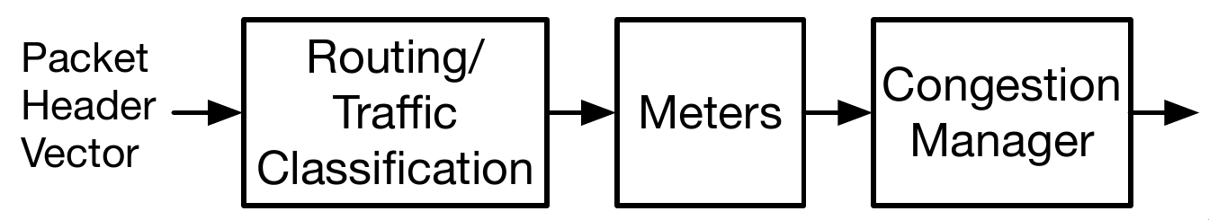
Native Meters Architecture
7 tuple lookup to perform routing and TC lookup.
The switches are programmable, the operators can create new stage after the routing table. Endless possibilities!

Slide 21
Native Meters Architecture
Packet

Slide 22
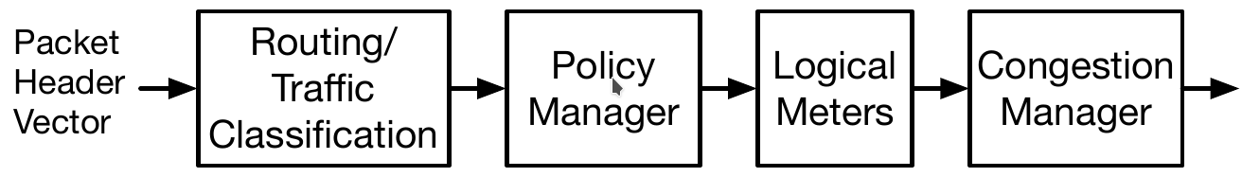
Logical Meters Architecture
Policy Manager maps the traffic class from the previous stage to a rate and a burst size.

Slide 23
Logical Meters Architecture

Slide 24

Logical Meters Continued
TC 1
TC 2
The timestamp of the most recent packet is stored in a register
TC2
The appropriate rate for the current policy must be computed earlier in the pipeline
TC1
TC2
Qcounter
TC2
C2
TC2
On packet arrival:
deltaTS = currTS – prevTS
drainBytes = policyRate * deltaTS
LqSize = LqSize + pktSize – drainBytes
TC1
TC2
Note: pktSize is not added to the queue if it causes the queue overflow
TC2
TC2TC2
Bytes are added to and subtracted from the logical queue counter for every packet
Wire

Slide 25
Meters: Congestion Manager

Slide 26
Meters: Congestion Manager
Color | ECN Enabled | ECN Disabled
Yellow | All Packets are marked | Probabilistic Dropping
Red | All packets are dropped | All Packets are dropped

Slide 27
Outline
Cloud Architecture
Problem and Solution
Problems with Current Approaches
Our Solution:Nimble
Controller and Isolation Policies
Evaluation

Slide 28
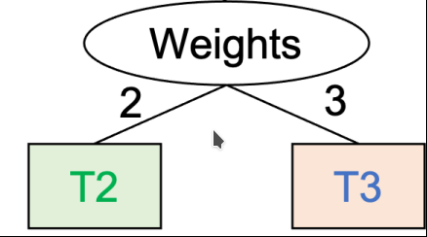
Controller: Supported Enforcement Techniques
Priority based enforcement
Weighted fair sharing
Priority with a rate R

Slide 29
Controller: Intuition for installing a global policy
Input: Network Policy, Set of Routing Paths for a TC, network topology
Find the bottleneck link on every path and assign the rate-limiter at that port.
If you cannot enforce a rate-limit at the bottleneck link, The packet is bound to get dropped at the bottleneck link even if it’s forwarded from the previous links.

Slide 30
Outline
Cloud Architechture
Problem and Solution
Problems with Current Approaches
Our Solution:Nimble
Controller and Isolation Policies
Evaluation

Slide 31



Implementation and Platforms
Full deployment with a Intel Tofino programmable switch (33x100Gbps)
nimble.p4
Proof-of-concept through simulation

Slide 32
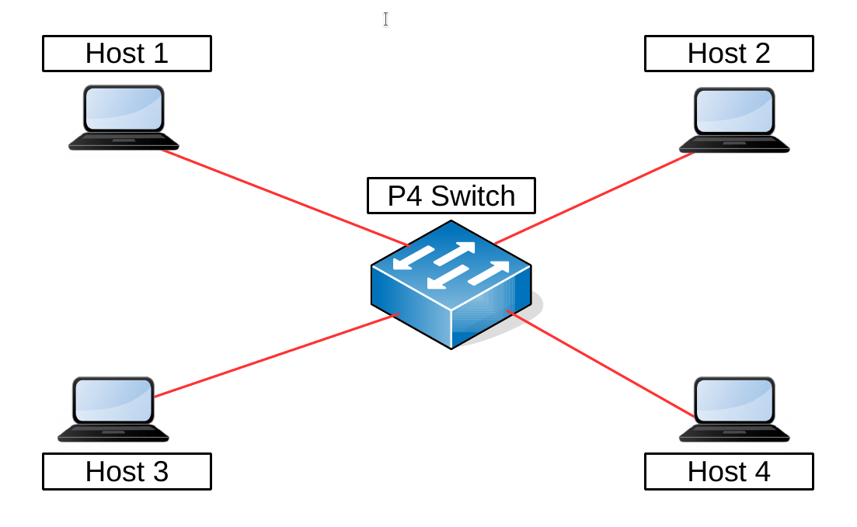
Testbed Network

Slide 33
Evaluation: Multiple Congestion Control Algorithms
Question: Can Nimble can provide performance isolation in the presence of multiple congestion control algorithms?

Slide 34
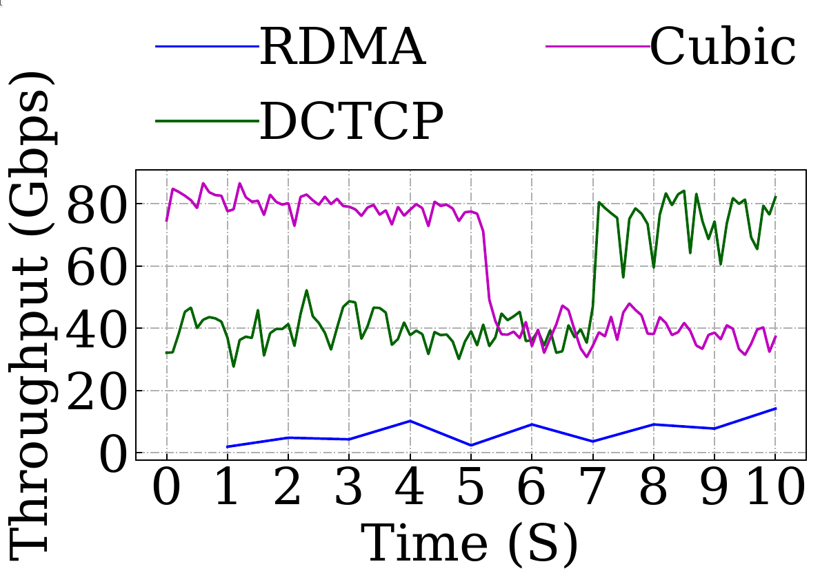
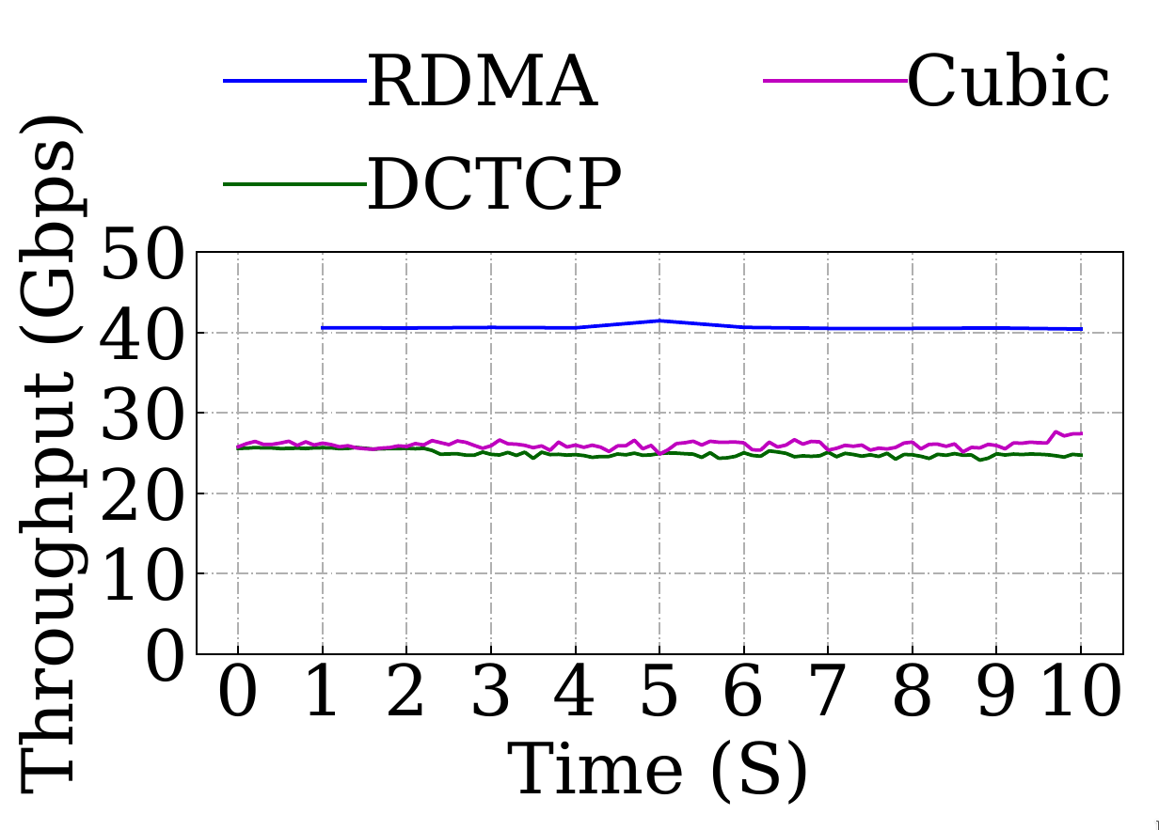
Evaluation: Multiple Congestion Control Algorithms

Slide 35
Evaluation: Scalability Experiment
Question: Can Nimble scale to a network of large size?

Slide 36
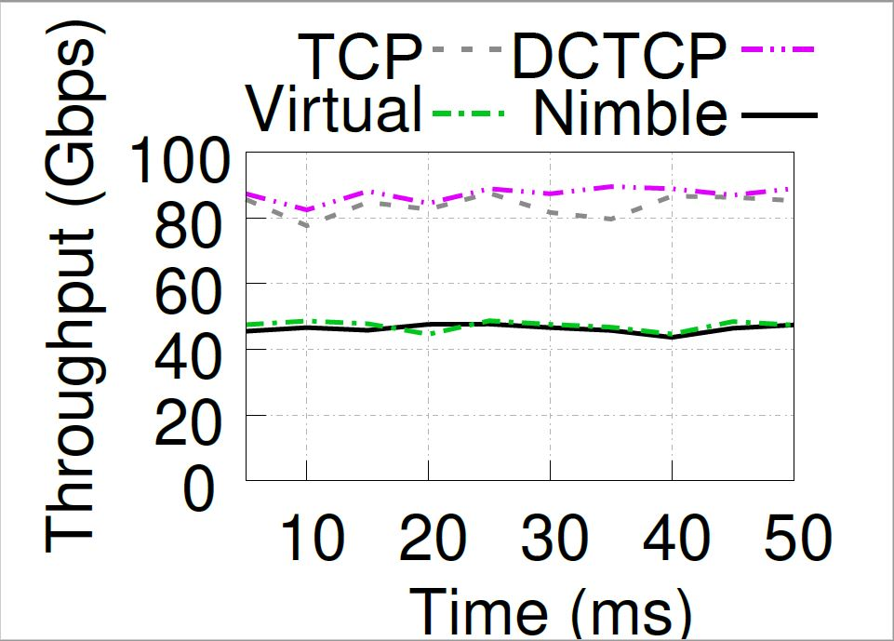
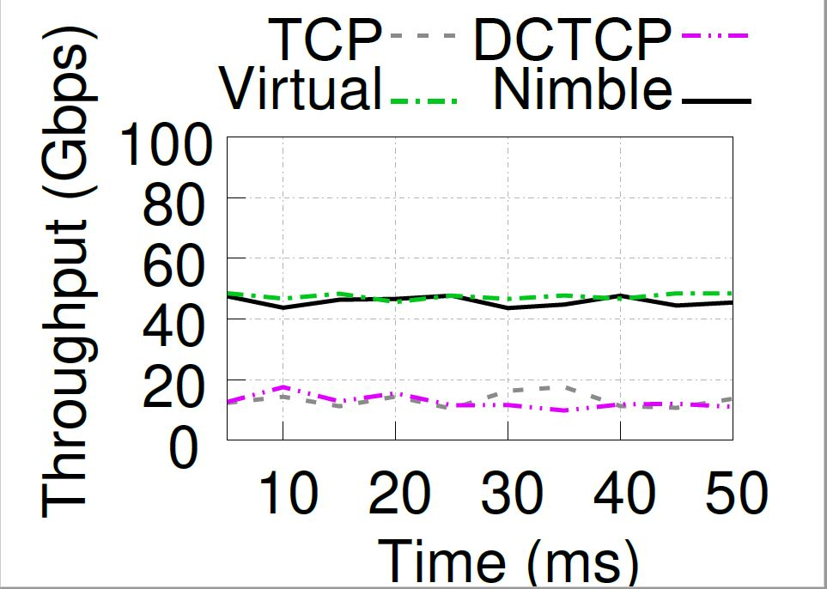
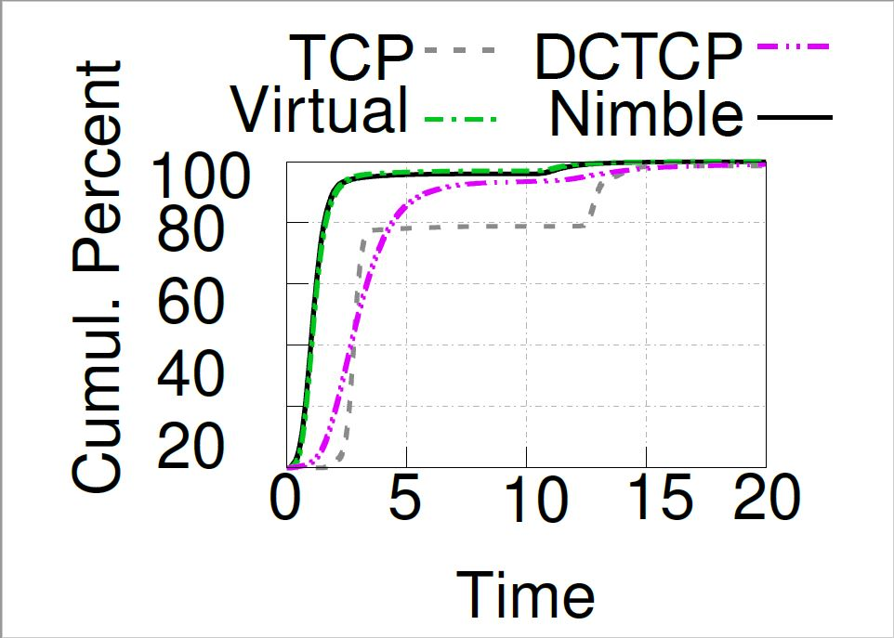
Evaluation: Scalability Experiment

Slide 37
Evaluation: Controller Scalability Experiment
Question: How does the controller scale in a network of large size?

Slide 38
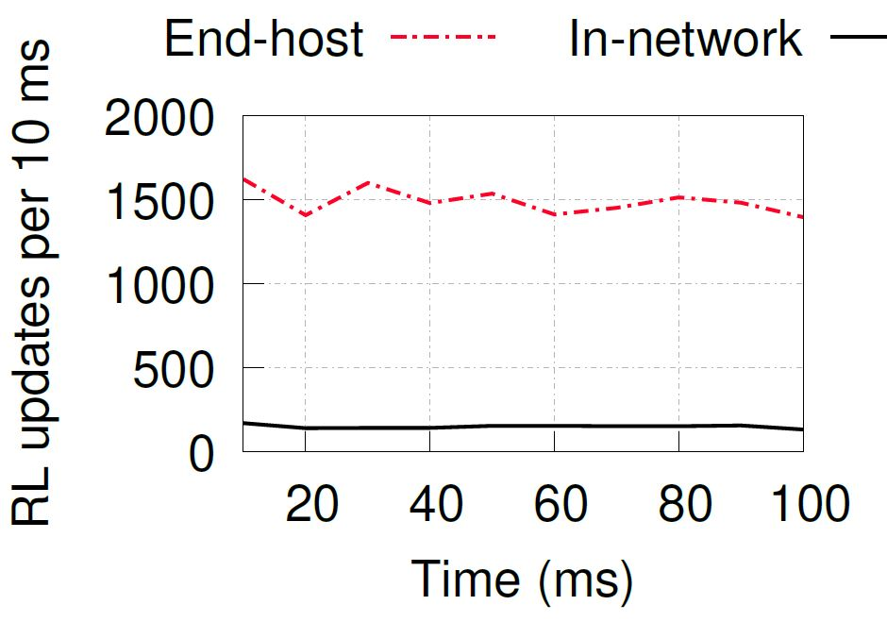
Evaluation: Controller Scalability Experiment

Slide 39
Conclusion
Code: https://github.com/vsag96/Nimble
We introduce a new primitives to scalably implement rate-limiting
We use ECN Shaping, a TCP friendly approach to enforcing the rate-limit
We introduce a new controller to install in-network rate-limiters to enforce isolation

