Slide 1
Fairness Definitions Explained
Sahil Verma, IIT Kanpur, India
Julia Rubin, University of British Columbia, Canada
May 29th, 2018

Slide 2
Our Goals
Collect definitions of fairness for the algorithmic classification problem
Explain the rationale behind each definitions
Demonstrate each definition on a single unifying case-study: German Credit Dataset

Slide 3
German Credit Dataset
Contains 1000 records from 1994
Each record has ~20 attributes, such as, credit amount, duration, employment, age, marital status and gender
Popular in fairness literature
Ground truth: good or bad credit score
Question: Will a classifier trained on this data discriminate by gender?

Slide 4
Methodology
Trained Logistic Regression classifier (Python) on 90% of the data; tested on 10% of the data (repeated for 10 folds)
The data set does not contain single women
considered whether married/divorced men are treated similarly to married/divorced women

Slide 5
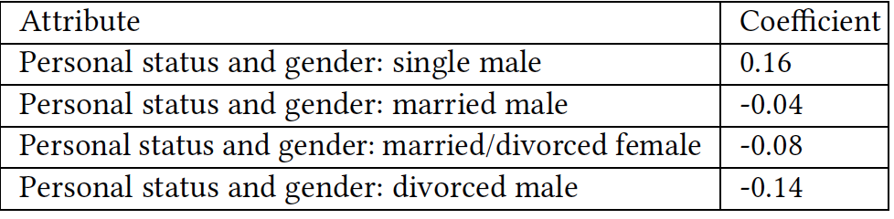
Coefficient Analysis

Slide 6
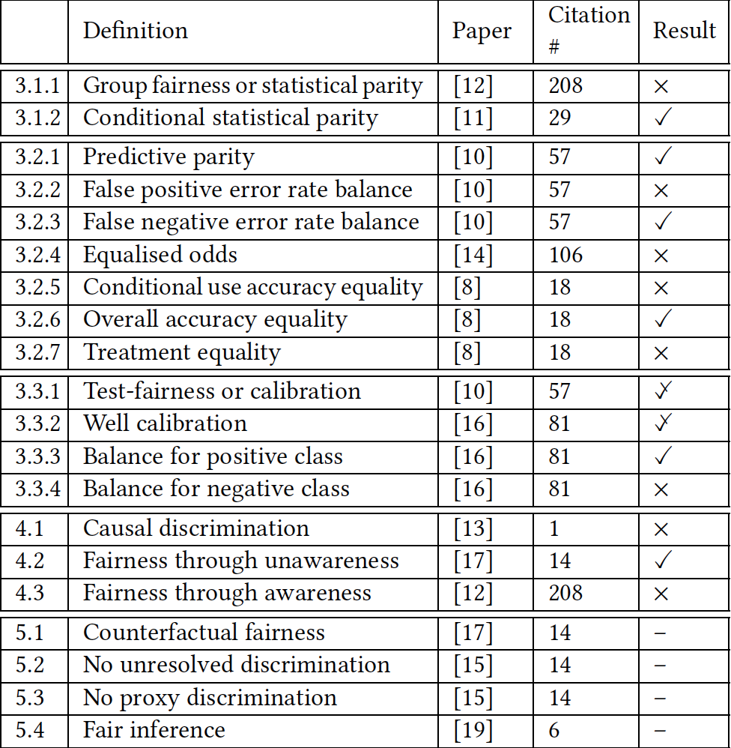
Considered Definitions
Statistical
Similarity-Based
From NIPS, Big Data, AAAI, FATML, ICML, KDD, online reports
Causal Reasoning

Slide 7
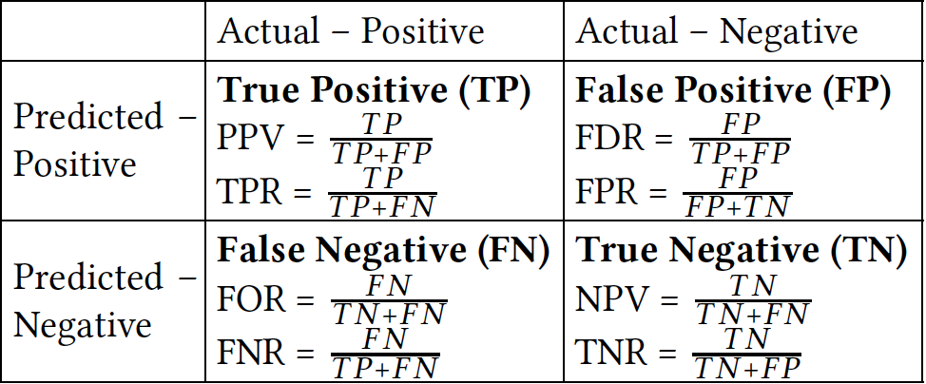
Statistical Measures
Vertically:
The ratio of “good” applicants who were assigned a good predicted credit score
The ratio of “good” applicants who were assigned a bad predicted credit score
The ratio of “bad” applicants who were assigned a good predicted credit score
…
Horizontally:
The ratio of applicants with good predicted score who actually have a good score
…

Slide 8
What is really fair?
The ratio of “good” applicants who get the loan is the same for both males and females [equal opportunity]
The ratio of “bad” applicants who do not get the loan is the same for both males and females [predictive equality]
The same ratio of male and female applicants receives the loan [group fairness]
The ratio of “good” applicants within the loan recipients is the same for both males and females [predictive parity]
Anything else?
Mathematically, a classifier cannot satisfy all definitions at the same time when the base rates for a good credit score are different (72% and 65% for males and females in our case)
Notes:
To ensure that the same proportion of “good” males and females indeed receives the loan, numerically, more males will get the loan, as there are more “good” males in the general population.
Now, to keep the ratio of “good” males and females in loan recipients the same, the ratio of “bad” males and females in loan recipients should be the same as well. As there are numerically more males receiving the loan, more bad males will receive the loan.
This, together with the lower rate of “bad” males in general population implies that the ratio of “bad” males that incorrectly receive the credit will be higher, as we saw in our example.
---
the rate of “bad” males and females out of all loan recipients should be the same as well. But as there is less “bad” males in general population , which means that, numerically, more bad males will receive the loan.
we also need to keep the ratio of “bad” male and females that receive the loan is the same.
And as there are less “bad” males in the general population, this means that more bad males than females will receive the load.
as the ratio of “good” males is higher in the general population,
we either deny “good” males loans or more “bad“ male applicants will be assigned with the good credit score
--
Now, that implies that

Slide 9


Experiments
The ratio of “good” applicants who get the loan is the same for males and females (86% for both)
The ratio of truly “good” males and females within those who got the loan is same (73% for males and 74% for females)
The ratio of male and female applicants who get the loan is not the same (81% for males and 75% for females)
“Bad” male applicants are more likely to be assigned with a good predicted credit score (70% for males and 55% for females)

Slide 10
Question …
Suppose we believe in group fairness: the same ratio of male and female applicants receives the loan.
Are we happy?

Slide 11
Similarity-based Measures
Fairness through unawareness:
Individuals that only differ in the sensitive attributes should get a similar classification.
No sensitive attributes are explicitly used in the decision-making process.
Fairness through awareness
The similarity of individuals is defined via a distance metric.
The distance between the distributions of outputs for individuals should be at most the distance between the individuals.

Slide 12
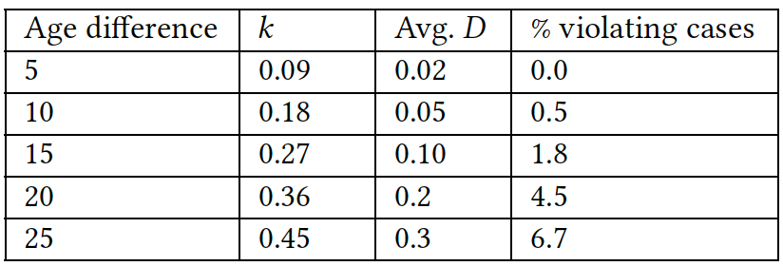
Experiments
For 8.8% “generated” identical applicants, the output classification is not the same
Becomes “fair” when the gender attribute is excluded
Distance metric affects the outcomes

Slide 13
Conclusions
Tens of definitions, some are satisfied and some are not
Statistical definitions are easy to compute
But some rely on the availability of the actual outcome
Similarity-based definitions are sensitive to the distance metric
Understanding which definition is appropriate to a particular situation is challenging

Slide 14
Backup

Slide 15
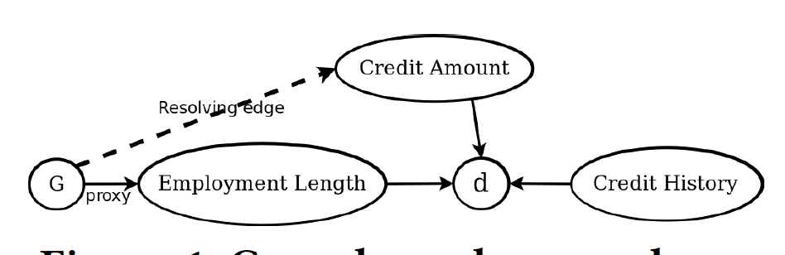
Causal Reasoning
Captures the relations between attributes and their influence on the outcome
Estimate effects of sensitive attributes
Used to build algorithms that ensure a tolerable level of discrimination due to these attributes

Slide 16
How did that happen?
Since in our dataset the base rate for an actual good credit score is 0.72 and 0.65 for males and females respectively, accordingly a higher proportion of males are deemed to have a good credit score, resulting in a higher proportion of bad credit males getting good credit scores compared to bad credit females.
You cannot be fair both ways simultaneously.

Slide 17
Notations
d – predicted score
Y – actual score
G – protected attribute (marital status + gender)
Example: P(Y = 1|d = 1,G = m)
probability of a male applicant with a good predicted credit score to actually have a good credit score

Slide 18
Example
Both protected and unprotected groups have equal probability of a subject in a positive class to have a negative predictive value.
I.e., probability of a “good” applicant to be incorrectly assigned a bad predicted credit score should be the same for genders: P(d = 0|Y = 1,G = m) = P(d = 0|Y = 1,G = f)
If we look at people with good actual scores, the percentage of those assigned a bad predicted score (false negative) should be the same for both males and females
Results: 0.14 for both male and female applicants

Slide 19
Example
Both protected and unprotected groups have equal probability of a subject in the negative class to have a positive predictive value.
I.e., the probability of a “bad” applicant to be incorrectly assigned a good predicted credit score should be the same for both genders: P(d = 1|Y = 0,G = m) = P(d = 1|Y = 0,G = f )
If we look at people with bad actual scores, the percentage of those assigned a good predicted score (false positives) should be the same for both males and females
Results: 0.7 for male and 0.55 for female applicants

Slide 20
Example
Both protected and unprotected groups have equal probability of a subject with positive predicted value to truly belong to the positive class.
E.g., the probability of an applicant with a good predicted credit score to actually have a good credit score should be the same for both genders: P(Y = 1|d = 1,G = m) = P(Y = 1|d = 1,G = f )
If we look at people with good predicted credit score, the percentage of truly “good” males and females should be the same
Results: 0.73 for male and 0.74 for female applicants

Slide 21
Example
Subjects in both protected and unprotected groups have equal probability of being assigned to the positive predicted class.
E.g., male and female applicants have equal probability to have good predicted credit score: P(d =1|G = m) = P(d = 1|G = f ).

Slide 22
Explanations
To ensure that the same proportion of “good” males and females indeed receives the loan, numerically, more males will receive the loan, as there are more “good” males in the general population.
To keep the ratio of “good” males and females in loan recipients the same, the ratio of “bad” males and females in loan recipients should be the same as well. As there are numerically more males receiving the loan, more bad males will receive the loan.
This, together with the lower rate of “bad” males in the general population, implies that the ratio of “bad” males that incorrectly receive the credit will be higher.

