Slide 2
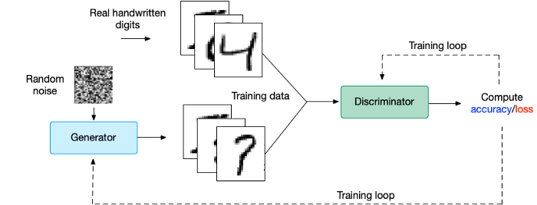

Slide 3
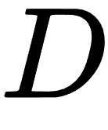
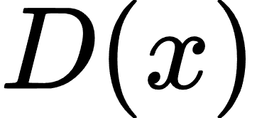
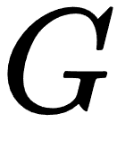
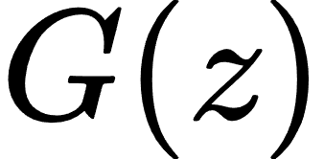
Real data
Training Data (Actual)
Training loop
Random noise
Discriminator
Compute
accuracy/loss
Generator
Training Data
(Generated, Fake data)
Training loop
Generative Adversarial Network (GAN)

