Slide 1
Dream Box

Slide 2
B.Rakesh 1602-17-737-301
B.Saikiran 1602-17-737-302
Internal Guide : Mrs.Aruna Mam

Slide 3
PURPOSE
DreamBox is a blog for those who wants to prepare and collaborate for placements.
It is an interactive and informational web-based platform that provides to write their own placement story or journey.
It an interface for career guidence sharing community

Slide 4
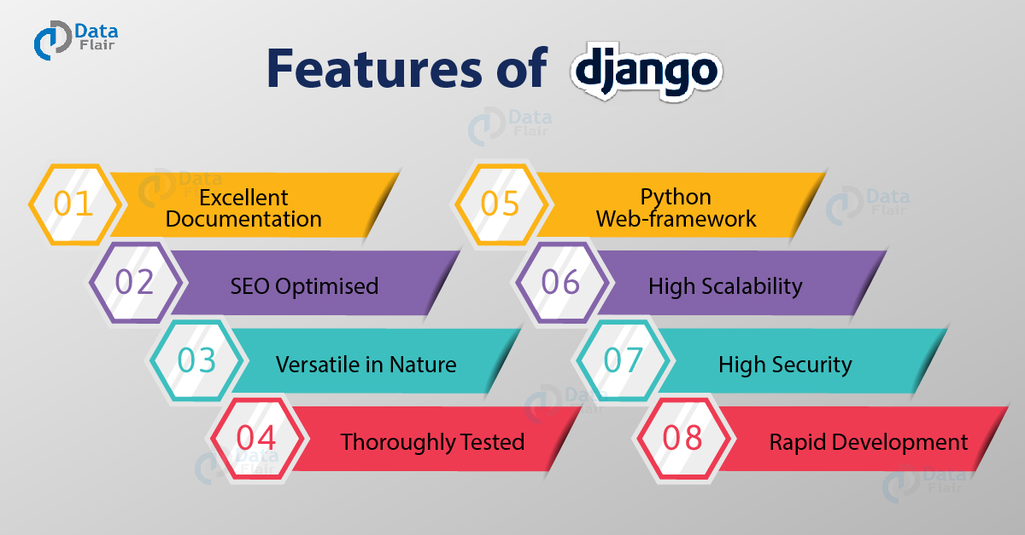
FRAMEWORK

Slide 5

DATABASE
open source
Reliability
Robustness
performance

Slide 6
CLOUD DEPLOYMENT
HEROKU
Heroku is a container-based cloud Platform as a Service (PaaS).
Used to deploy, manage, and scale modern apps.
Elegant
Flexible

Slide 7
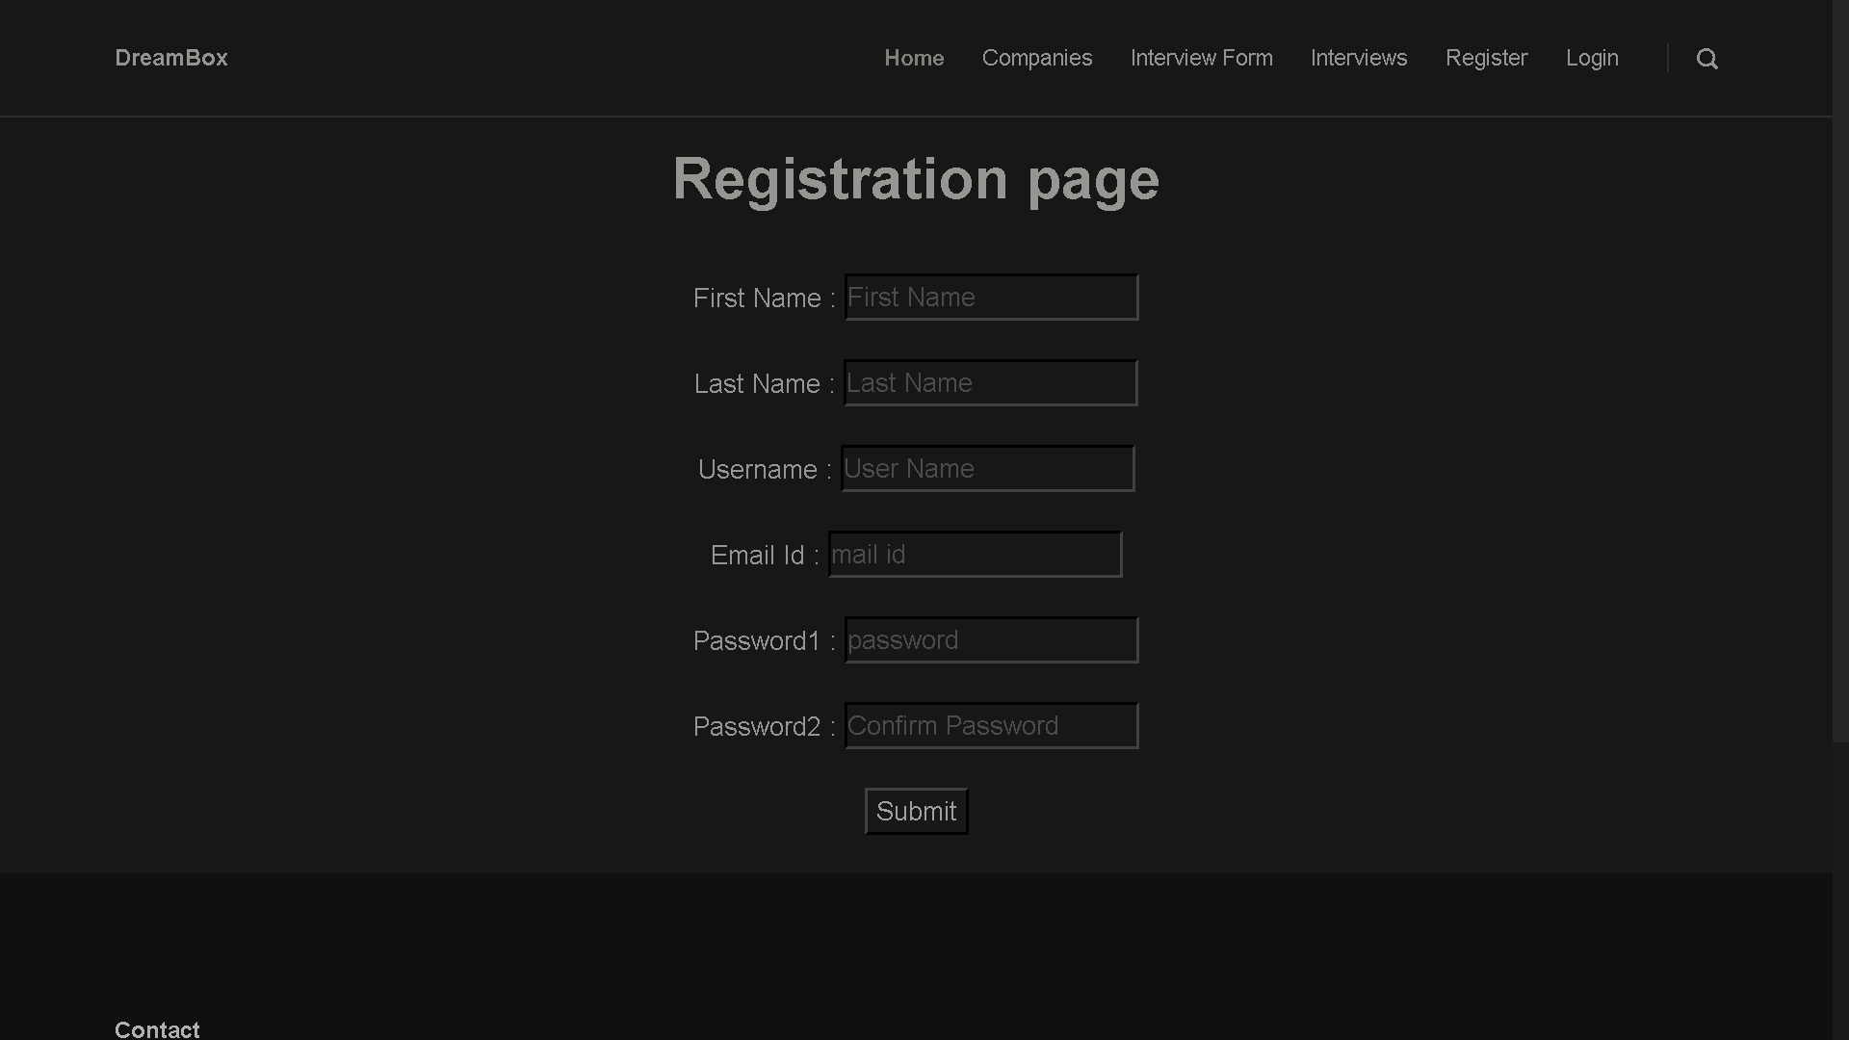
Registration

Slide 8
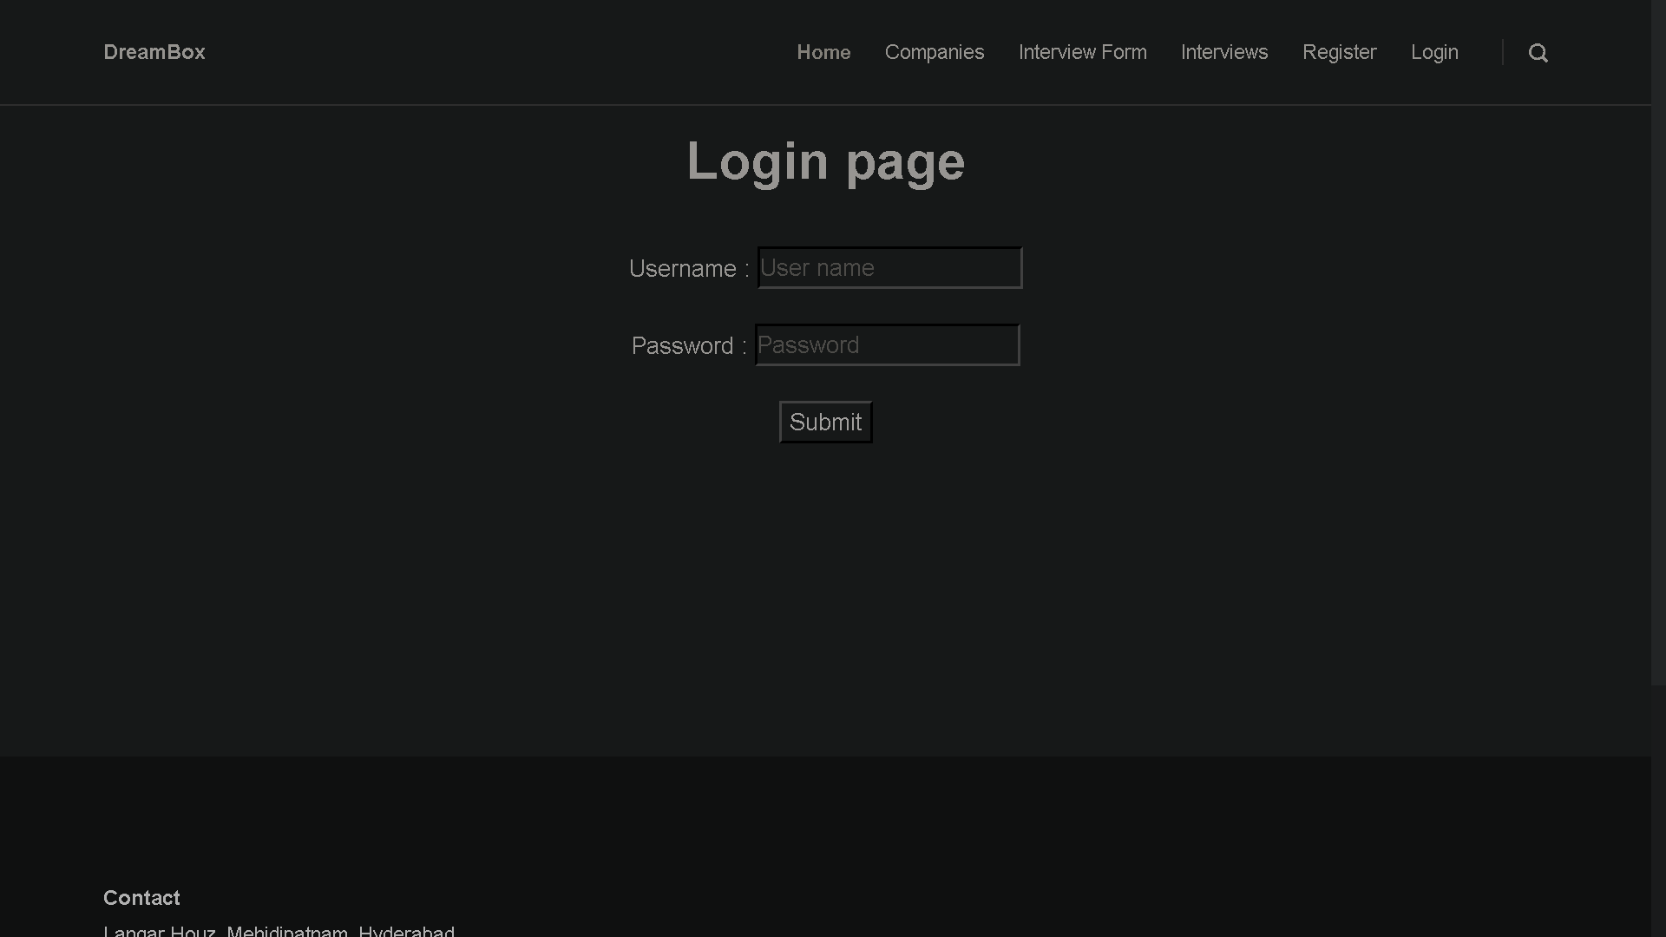
Login / Sign in

Slide 9
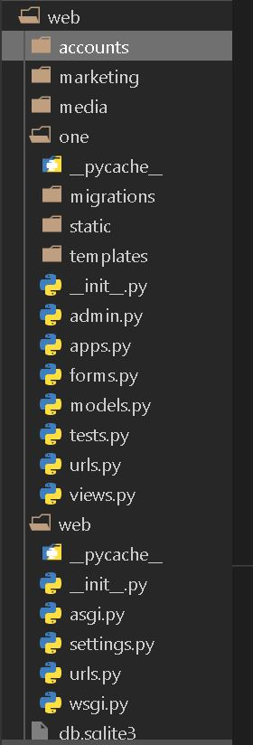
Modules

Slide 10
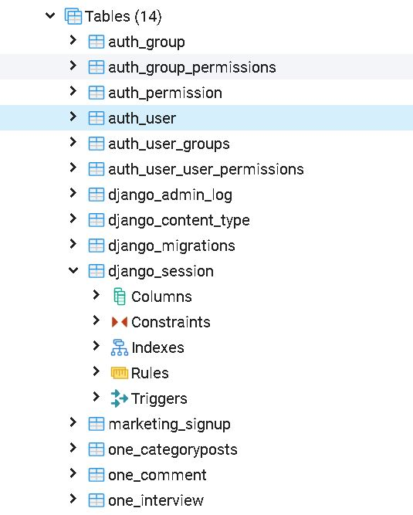
Databases

Slide 11
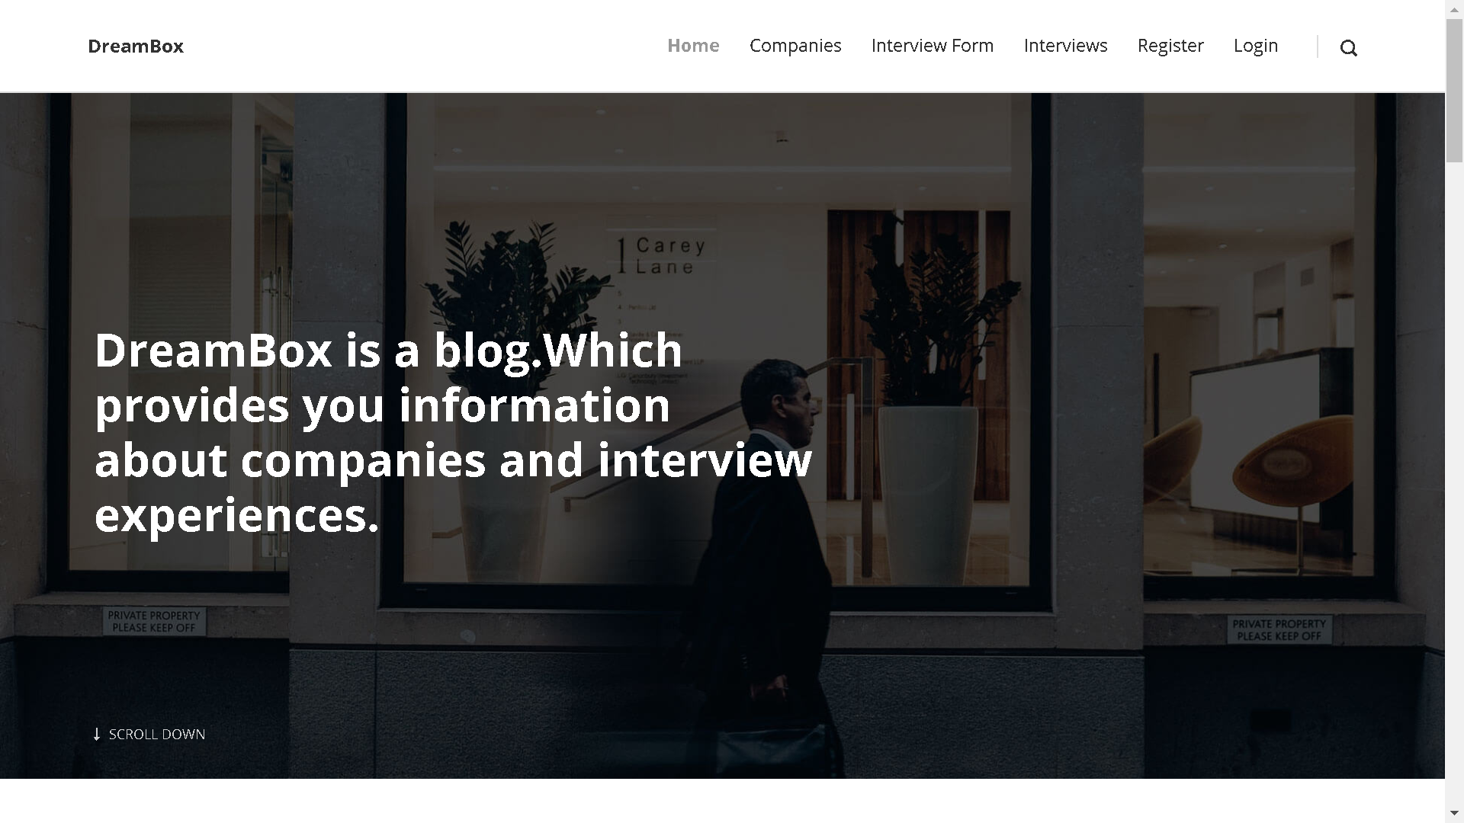
Home Page

Slide 12
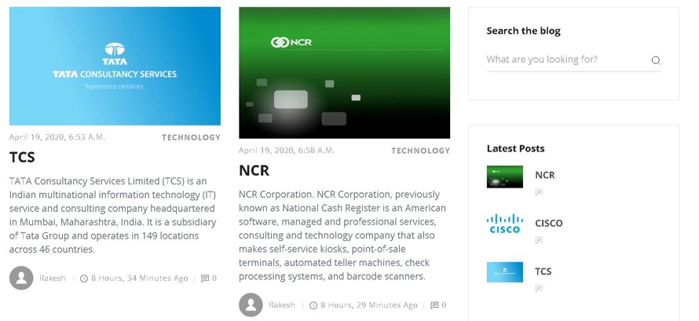
Companies Posts

Slide 13
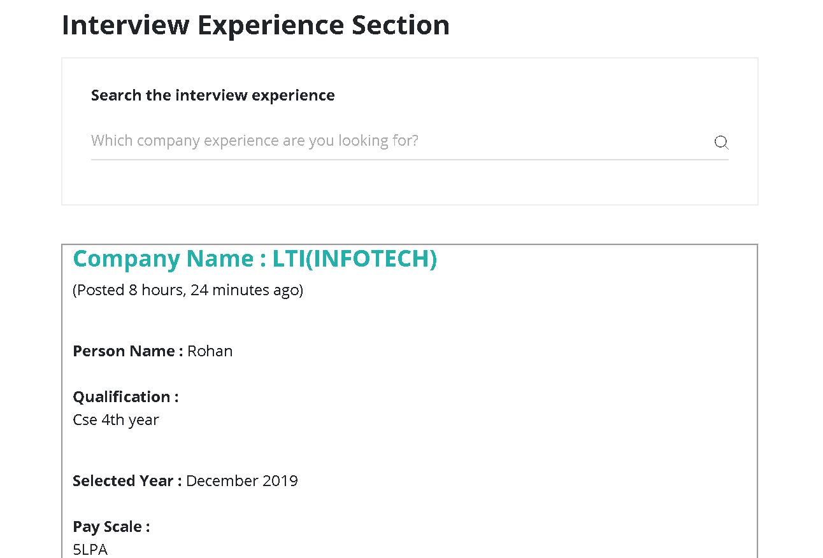
Posting your Experince on the Blog

Slide 14
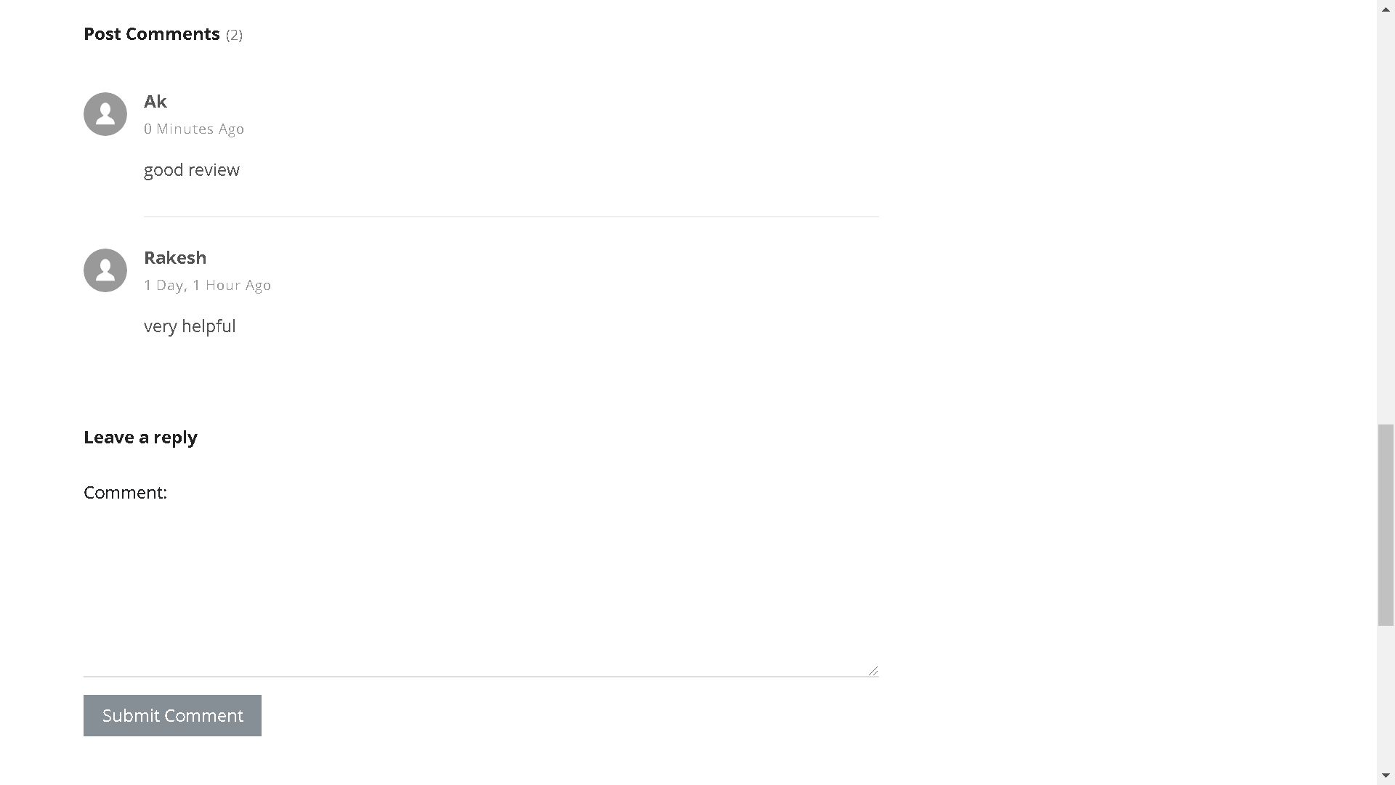
Comments and Feedback

Slide 15
SCOPE
The blog adds more features for developing career building and interactive chatting for all freshers, experienced from the respective company

Slide 16
References
https://docs.djangoproject.com/en/3.0/
https://www.postgresql.org/docs/
https://devcenter.heroku.com/articles/getting-started-with-python

Slide 17
THANK YOU!

