Slide 1
Alzheimer's Disease Detection using Deep Learning
Team : F
Vikas (TD68615)
Chandana(QZ89614)
Sailesh V(CZ93536)

Slide 2
Topic Outline
Introduction Medical Thesis
Deep Learning Usage in Alzheimer's Detection
Contrasting Medical Procedures and Deep Learning Techniques Dataset and Models Identified and used
Exploratory Data Analysis Findings and Results Conclusions
Presentation Outline

Slide 3
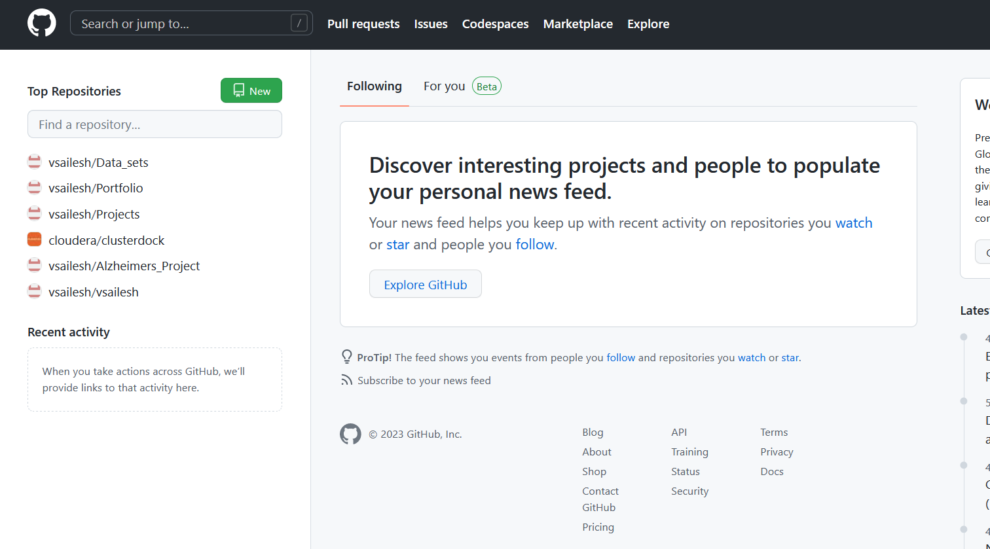
GIT HUB
https://github.com/vsailesh/Alzheimers_Project

Slide 4
Introduction
A L Z H E I M E R ' S D I S E A S E
Alzheimer’s disease is an irreversible, progressive brain disorder that slowly
destroys memory and thinking skills and, eventually, the ability to carry out the
simplest tasks.
S Y M P T O M S
Requires a medical diagnosis
Memory loss and confusion are the main symptoms.
People may experience: Cognitive Behavioural
Mood
Psychological
inability to combine muscle
movements, jumbled speech, or loss of appetite

Slide 5

Medical Thesis
It is the cause of 60–70% of cases of dementia. Experts haven’t determined a single cause of Alzheimer’s disease but they have identified certain risk factors, including:
Age. Most people who develop Alzheimer’s disease are 65 years of age or older.
Family history. If you have an immediate family member who has developed the condition, you’re more likely to get it.
Genetics. Certain genes have been linked to Alzheimer’s disease.

Slide 6
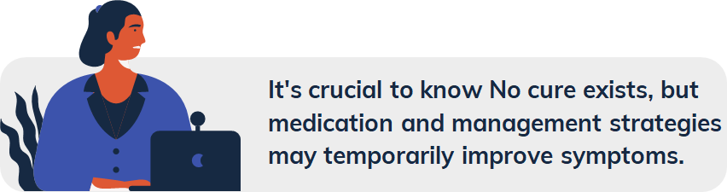
Literature Survey:
Stage 1. There are no symptoms at this stage but there might be an early diagnosis based on family history.
Stage 2. The earliest symptoms appear, such as forgetfulness.
Stage 3. Mild physical and mental impairments appear, such as reduced memory and concentration. These may only be noticeable by someone very close to the
person.
Stage 4. Alzheimer’s is often diagnosed at this stage, but it’s still considered mild. Memory loss and the inability to perform everyday tasks is evident.
Stage 5. Moderate to severe symptoms require help from loved ones or caregivers. Stage 6. At this stage, a person with Alzheimer’s may need help with basic tasks,
such as eating and putting on clothes.
Stage 7. This is the most severe and final stage of Alzheimer’s. There may be a loss of speech and facial expressions.

Slide 7
Literature Survey:
[1] A Survey on Alzheimer's disease Detection and Prediction Using Deep Learning Vision, Kumar Reddy Ellendula, Computer science and engineering K L University Hyderabad.
The article discusses the potential of using machine learning algorithms, particularly deep learning approaches, for the detection and classification of Alzheimer's disease. Alzheimer's disease is a serious neurological condition that damages brain cells, leading to memory loss and difficulties in everyday tasks. While the disease is currently incurable, early identification can help reduce symptoms. The article highlights the need for more research into using deep learning algorithms for Alzheimer's disease detection and classification. The article also provides a detailed overview of five studies that have shown significant improvements in accuracy compared to traditional methods, using deep learning techniques such as attention networks, VGG, and transfer learning. Overall, the article suggests that deep learning approaches hold promise for improving Alzheimer's disease diagnosis.

Slide 8
Literature Survey:
EXISTING MODELS:
Aunsia Khan et al. [2021] have proposed the study based on the comparison and evaluation of recent work done in the prognosis and prediction of Alzheimer’s disease using machine learning methods with a generated accuracy of about 84%.
Doaa Ebrahim et al. [2020] They used the VGG16 pre-trained learning transfer network as a feature extractor in their work.To assess the model's performance, they also calculated a performance metric. The algorithm produced the best accuracy when data were divided into 20% for testing and 80% for training, with a training accuracy of 97.49% and testing accuracy of 95.31%..
The article describes a systematic review of publications on the use of deep learning approaches for the early detection and automated classification of Alzheimer's disease (AD) using neuroimaging data. The review covers studies published between January 2013 and July 2018, identified through a PubMed and Google Scholar search. Of the 16 studies meeting inclusion criteria, 4 used a combination of deep learning and traditional machine learning, while 12 used only deep learning approaches. The best results were obtained through the combination of multimodal neuroimaging and fluid biomarkers. The review suggests that deep learning approaches hold promise for improving the diagnostic classification of AD, and that the field is still evolving with continued improvement in performance and incorporation of additional hybrid data types. Future research may benefit from incorporating explainable approaches to add knowledge of specific disease-related features and mechanisms.

Slide 9
H O W D E E P L E A R N I N G H E L P S ?
The end to- end process of neural networks has been employed for pattern classification allows us to make more clear and proper classification of the disease.
M A C H I N E L E A R N I N G V S D E E P
L E A R N I N G
Deep Learning techniques have shown more accurate and precised results than Machine learning models by incorporating the ANN(Artificial Neural Network) and CNN(Convolutional Neural Networks) models than
traditional models.
D E E P L E A R N I N G U S A G E I N
A L Z H E I M E R ' S D E T E C T I O N
B A S I C U S E O F I M A G E S A S D A T A
When we focus on early diagnosis of AD based on convolutional neural networks (ConvNets) by using magnetic resonance imaging (MRI). Image slices of gray matter and white matter from MRI have been used as the inputs for classification.

Slide 10
Diagnosis
Densenet121
Densenet169
Insceptionv3
Vgg19
ResNet50 Pre-trained Model
Techniques
Deep Learning Techniques
Medical Procedures
Densenet121
Densenet169
Insceptionv3
VGG19
Densenet201
Densenet201 + VGG19
•MRI(Magnetic Resonance Imaging)
•CT-SCAN
•PET ,EEG

Slide 11
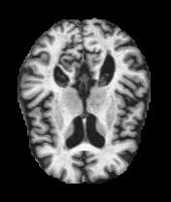
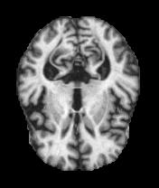
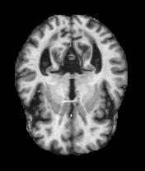
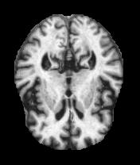
Dataset:
No Demented
Mild Demented
Very Mild Demented
Moderate Demented

Slide 12
Dataset :
Alzheimer's Dataset ( 4 class of Images) Images of MRI Segmentation
C L A S S E S :
N O N D E M E N T E D
V E R Y M I L D D E M E N T E D
M I L D D E M E N T E D
M O D E R A T E D E M E N E T E D
Test Split : 23% Test & 77% Train
Image Type: JPG

Slide 13
Data Pre-Processing :
Images : 5121 Images Train – Test Split: 4098 - 1023
Run Time : 4 – 5 hrs
CPU + GPU : 19833.7s - GPU T4 x2 in kaggle
Image Type: Raw Image
MRI Sequence: T1-Weighted
Image Size: 256x 256
Resize: Used ImageData generator to make sure the image fits into the neural network with out loosing color dimensions.

Slide 14
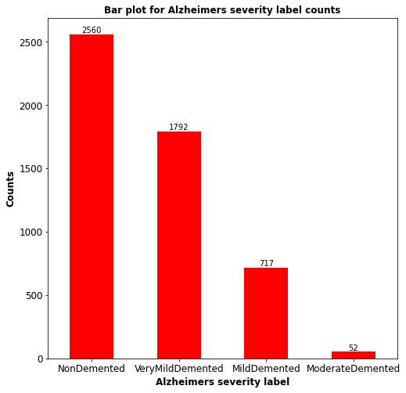
EDA

Slide 15
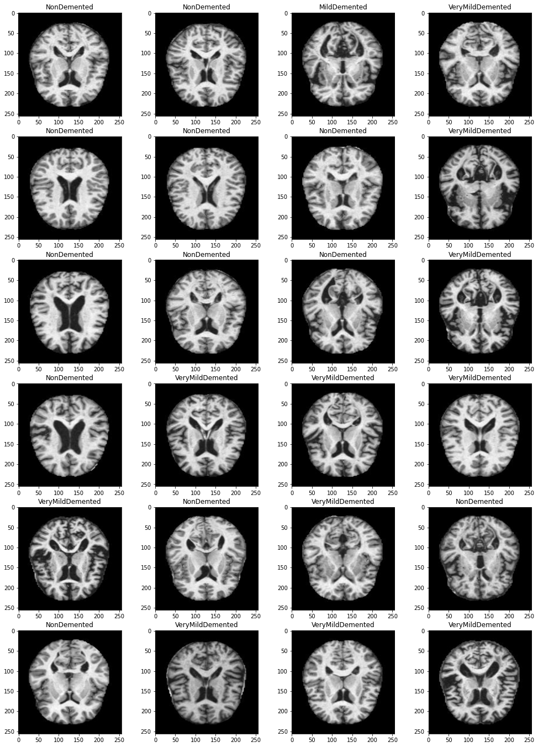
Test Set

Slide 16
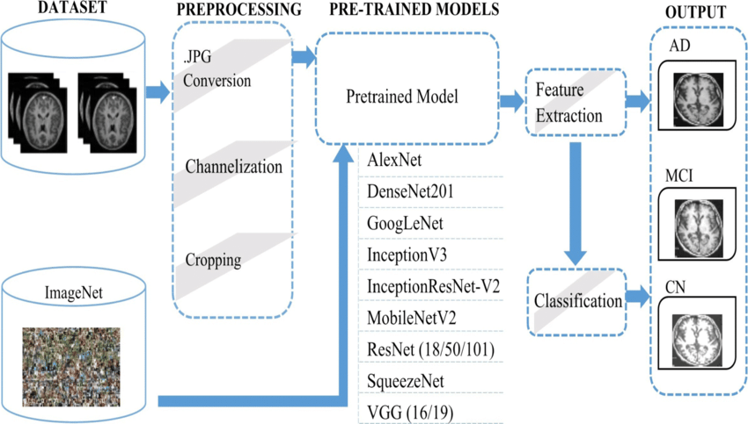
Process Flow
Source : https://www.researchgate.net/figure/Flow-diagram-of-proposed-study-for-automatic-Alzheimer-detection_fig1_348727600

Slide 17
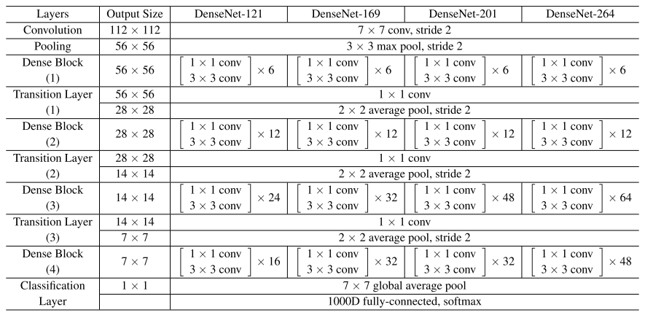
Densenet 121 & 169
DenseNet169 is another variant of the DenseNet architecture that extends DenseNet121. It has a deeper network structure with more layers, resulting in increased model capacity and potential for learning more complex patterns and representations.
Similar to DenseNet121, DenseNet169 utilizes skip connections to facilitate feature propagation, enabling better gradient flow and information sharing across layers.
DenseNet169 has demonstrated superior performance in various computer vision tasks, particularly when handling larger and more challenging datasets. It offers an improved trade-off between model size, computational efficiency, and accuracy compared to deeper architectures like DenseNet201 or ResNet models.

Slide 18
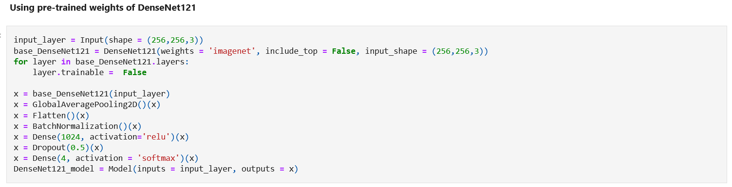
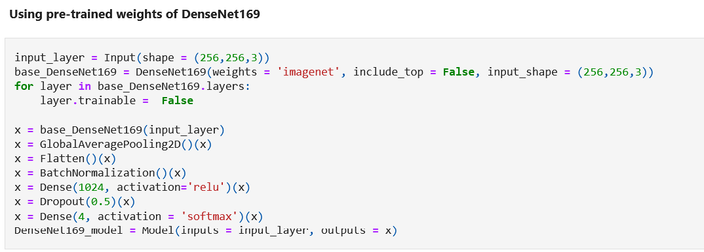
Densenet 121 & 169

Slide 19
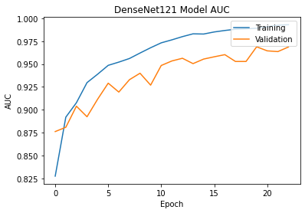
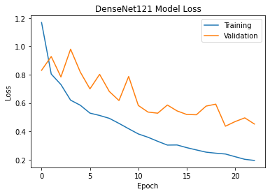
Densenet 121

Slide 20
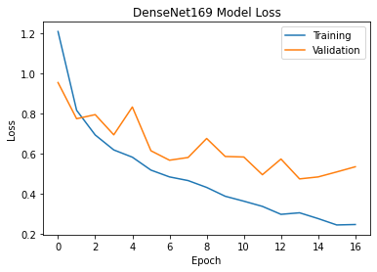
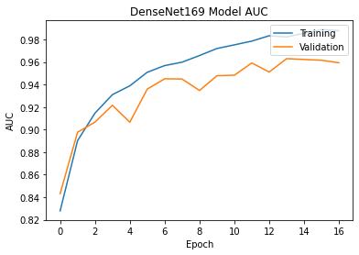
Densenet 169

Slide 21
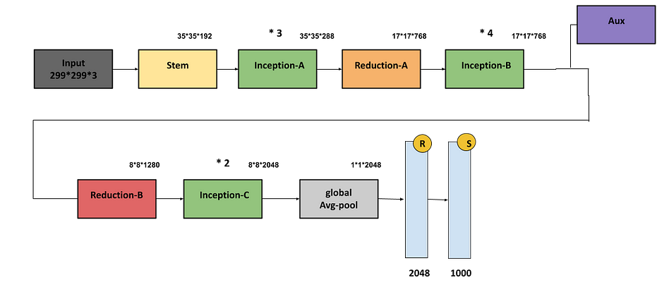
Inception V3
Inception V3 is a deep convolutional neural network architecture that was introduced as part of the Inception series by Google Research. It is designed to address the trade-off between depth and computational efficiency in convolutional neural networks.
Inception V3 incorporates the use of inception modules, which are convolutional modules with different filter sizes (1x1, 3x3, 5x5) stacked together. This allows the network to capture features at multiple scales and enhances its ability to learn complex patterns.
Inception V3 has achieved high performance in various computer vision tasks, including image classification, object detection, and image segmentation. It has been widely adopted and used as a pre-trained model for transfer learning due to its strong performance and generalization capabilities.

Slide 22
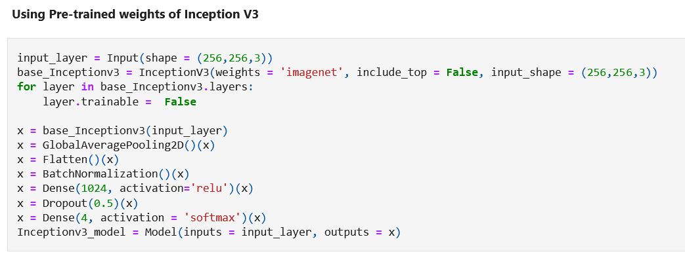
Inceptionv3

Slide 23
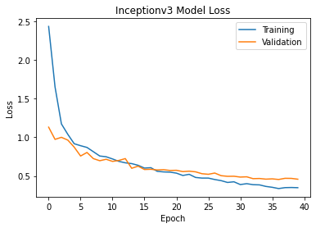
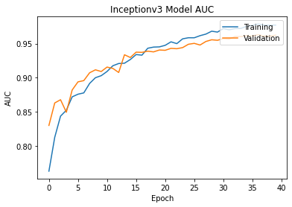
InceptionV3

Slide 24
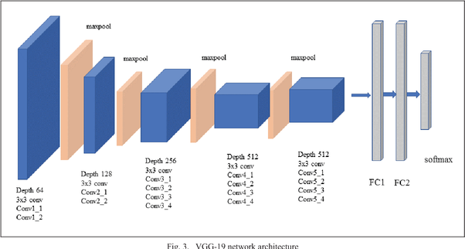
Vgg19
VGG19 is a convolutional neural network architecture that consists of 19 layers, including convolutional layers, max pooling layers, and fully connected layers. It is known for its simplicity and uniformity in design, with small 3x3 convolutional filters used throughout the network.
VGG19 is characterized by its deep architecture, allowing it to capture intricate patterns and features in images. The increased depth of the network enables it to learn complex representations and achieve high accuracy in tasks such as image classification.
VGG19 has been widely used as a pre-trained model in transfer learning, where the knowledge learned from large-scale datasets can be leveraged for various computer vision tasks. Its pre-trained weights are available, making it accessible and beneficial for researchers and practitioners working on image-related applications.

Slide 25
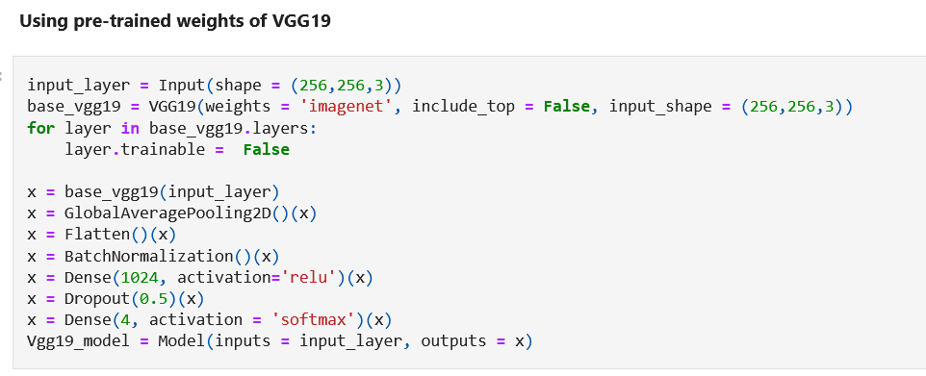
VGG 19

Slide 26
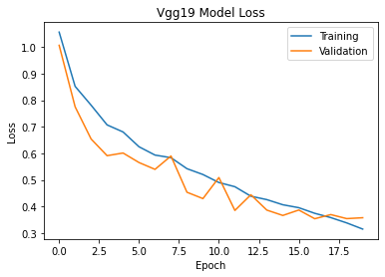
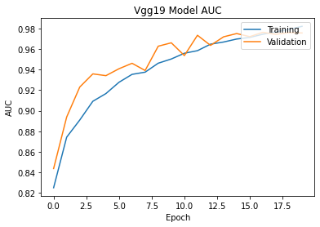
Vgg19

Slide 27
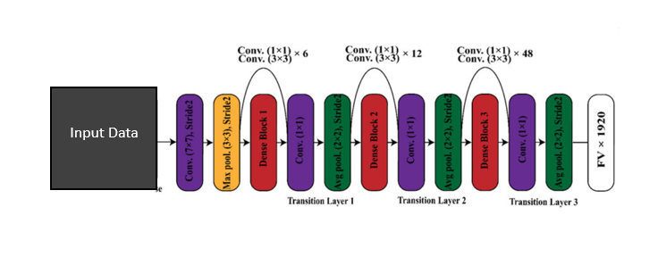
DenseNet201
DenseNet201 is a convolutional neural network architecture known for its dense connections, where each layer is connected to every other layer in a feed-forward fashion. This dense connectivity enables feature reuse and gradient flow, leading to improved information flow and reduced vanishing gradient problems.
DenseNet201 introduces the concept of "bottleneck layers" to reduce the number of parameters and computational cost. These bottleneck layers use 1x1 convolutions to compress the feature maps before applying the standard 3x3 convolutions, making the network more efficient.
DenseNet201 has achieved state-of-the-art performance on various image classification tasks, surpassing other popular architectures like VGG and ResNet. Its ability to capture intricate details and learn rich feature representations makes it highly effective for complex visual recognition tasks.

Slide 28
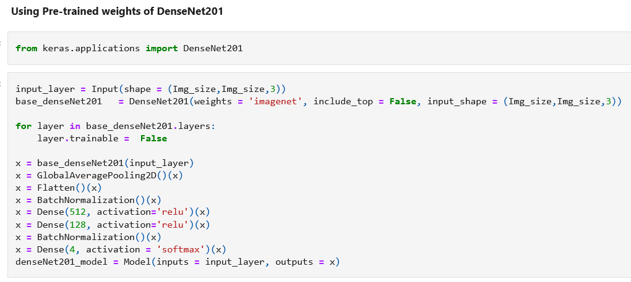
DenseNet201

Slide 29
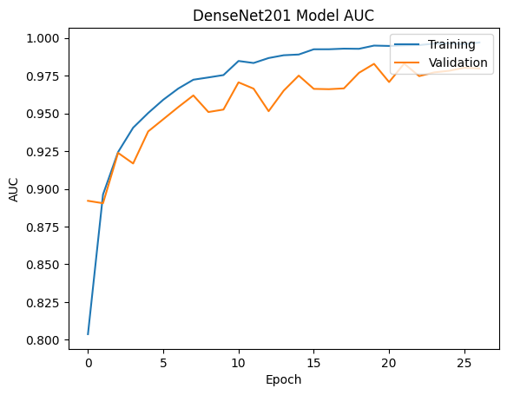
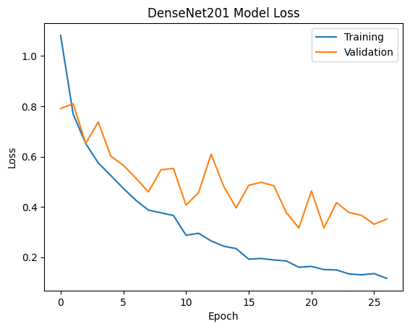
DenseNet201

Slide 30
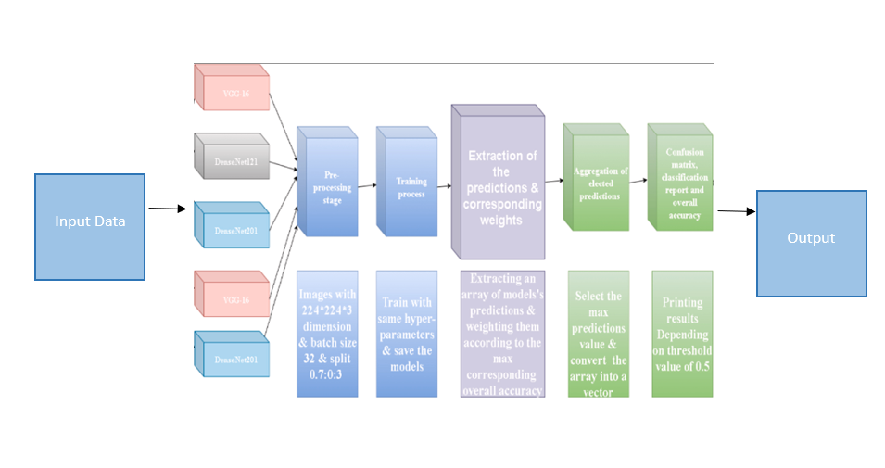
DenseNet201 + Vgg19
DenseNet201 and VGG19 are powerful deep learning architectures used for image classification tasks.
Combining DenseNet201 and VGG19 can leverage the strengths of dense connections and deep layer representation, potentially improving overall performance.
Ensemble techniques or transfer learning with fine-tuning can be employed to effectively combine DenseNet201 and VGG19 for enhanced accuracy and robustness in image classification.

Slide 31
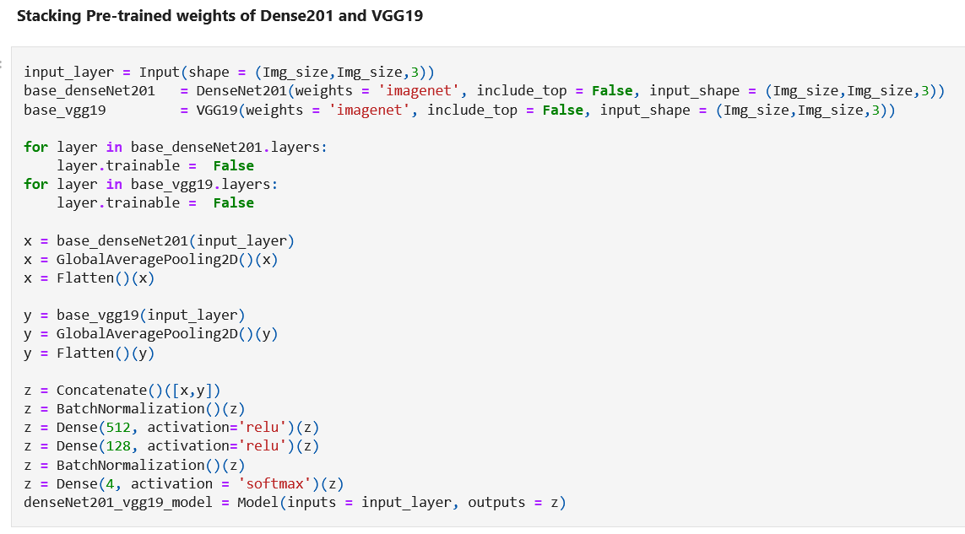
DenseNet201 + Vgg19

Slide 32
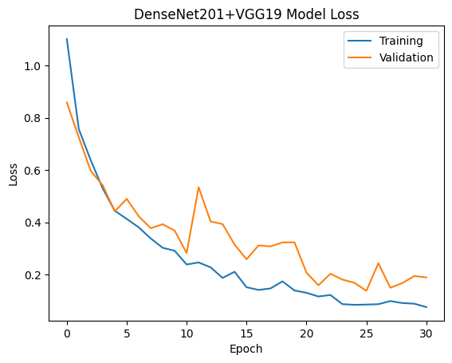
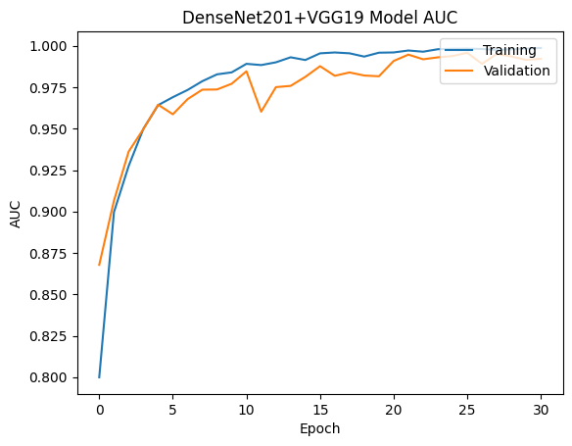
DenseNet201 + Vgg19

Slide 33
Classification Report for test data:
 | precision | recall | f1-score | support
Non Demented | 0.69 | 0.89 | 0.78 | 640
Very Mild Demented | 0.74 | 0.62 | 0.68 | 448
Mild Demented | 0.93 | 0.31 | 0.47 | 179
Moderate Demented | 0.83 | 0.83 | 0.83 | 12
Accuracy |  |  | 0.72 | 1279
Macro Avg | 0.80 | 0.67 | 0.69 | 1279
Weighted Avg | 0.74 | 0.72 | 0.70 | 1279

Slide 34
Classification Report for Kaggle test data:
 | precision | recall | f1-score | support
Non Demented | 0.94 | 1.00 | 0.97 | 640
Very Mild Demented | 0.99 | 0.92 | 0.95 | 448
Mild Demented | 1.00 | 0.97 | 0.98 | 179
Moderate Demented | 1.00 | 1.00 | 1.00 | 12
Accuracy |  |  | 0.96 | 1279
Macro Avg | 0.98 | 0.97 | 0.97 | 1279
Weighted Avg | 0.96 | 0.96 | 0.96 | 1279

Slide 35
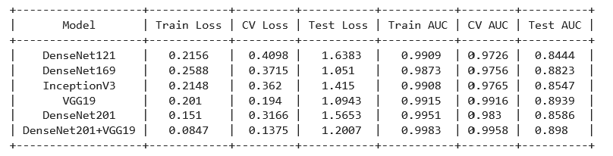
Results

Slide 36
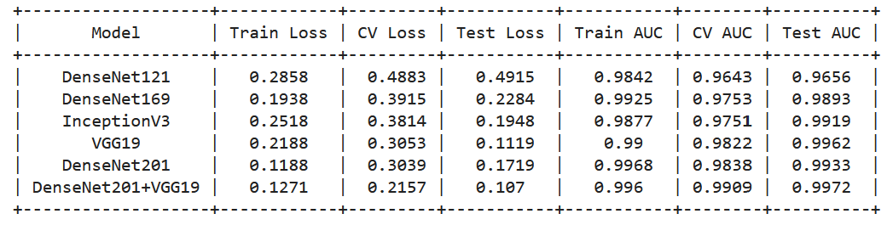
Kaggle Results

Slide 37
References: 1. Dubey, S. (2019, December 26). Alzheimer's dataset ( 4 class of images). Kaggle. Retrieved February 28, 2023, from https://www.kaggle.com/datasets/tourist55/alzheimers-dataset-4-class-of-images?resource=download 2. Centers for Disease Control and Prevention. (2020, October 26). What is alzheimer's disease? Centers for Disease Control and Prevention. Retrieved February 28, 2023, from https://www.cdc.gov/aging/aginginfo/alzheimers.html 3. Jo, T., Nho, K., & Saykin, A. J. (2019). Deep learning in Alzheimer's disease: diagnostic classification and prognostic prediction using neuroimaging data. Frontiers in aging neuroscience, 11, 220. 4. Kavitha, C., Mani, V., Srividhya, S. R., Khalaf, O. I., & Tavera Romero, C. A. (2022). Early-stage Alzheimer's disease prediction using machine learning models. Frontiers in public health, 10, 240. 5. Salehi, A. W., Baglat, P., & Gupta, G. (2020). Alzheimer’s disease diagnosis using deep learning techniques. Int. J. Eng. Adv. Technol, 9(3), 874-880. 6. A Survey on Alzheimer's disease Detection and Prediction Using Deep Learning Vision, Kumar Reddy Ellendula, Computer science and engineering K L University Hyderabad. 7. Jo, T., Nho, K., & Saykin, A. J. (2019). Deep learning in Alzheimer's disease: diagnostic classification and prognostic prediction using neuroimaging data. Frontiers in aging neuroscience, 11, 220.

Slide 38
References: 8. Zhao, Z., Chuah, J. H., Lai, K. W., Chow, C.-O., Gochoo, M., Dhanalakshmi, S., Wang, N., Bao, W., &amp; Wu, X. (2023, February 6). Conventional machine learning and deep learning in alzheimer’s disease diagnosis using neuroimaging: A Review. Frontiers in computational neuroscience. https://www.ncbi.nlm.nih.gov/pmc/articles/PMC9939698/ 9. Bhatele, K. R., Jha, A., Tiwari, D., Bhatele, M., Sharma, S., Mithora, M. R., &amp; Singhal, S. (2022, December 29). Covid-19 detection: A systematic review of machine and Deep Learning-based approaches utilizing chest x-rays and CT scans. Cognitive computation. https://www.ncbi.nlm.nih.gov/pmc/articles/PMC9797382/ 10. Helaly, H. A., Badawy, M., &amp; Haikal, A. Y. (2022). Deep Learning Approach for early detection of alzheimer’s disease. Cognitive computation. https://www.ncbi.nlm.nih.gov/pmc/articles/PMC8563360/ 11. Odusami, M., Maskeliūnas, R., &amp; Damaševičius, R. (2022, January 19). An intelligent system for early recognition of alzheimer’s disease using neuroimaging. Sensors (Basel, Switzerland). https://www.ncbi.nlm.nih.gov/pmc/articles/PMC8839926/ 12. Vrahatis, A. G., Skolariki, K., Krokidis, M. G., Lazaros, K., Exarchos, T. P., &amp; Vlamos, P. (2023, April 22). Revolutionizing the early detection of alzheimer’s disease through non-invasive biomarkers: The role of Artificial Intelligence and deep learning. Sensors (Basel, Switzerland). https://www.ncbi.nlm.nih.gov/pmc/articles/PMC10180573/

Slide 39
References: 13. Kim, J. S., Han, J. W., Bae, J. B., Moon, D. G., Shin, J., Kong, J. E., Lee, H., Yang, H. W., Lim, E., Kim, J. Y., Sunwoo, L., Cho, S. J., Lee, D., Kim, I., Ha, S. W., Kang, M. J., Suh, C. H., Shim, W. H., Kim, S. J., &amp; Kim, K. W. (2022, October 26). Deep learning-based diagnosis of alzheimer’s disease using brain magnetic resonance images: An empirical study. Scientific reports. https://www.ncbi.nlm.nih.gov/pmc/articles/PMC9606115/ . 14. Jo, T., Nho, K., & Saykin, A. J. (2019). Deep learning in Alzheimer's disease: diagnostic classification and prognostic prediction using neuroimaging data. Frontiers in aging neuroscience, 11, 220.

Slide 40
THANK YOU

