Slide 1
AWS Architecture: Use case
Migrate an Enterprise WebApp from on-prem to AWS cloud

Slide 2
Requirements: Propose an architecture to migrate this app to AWS with minimum development changes and good features of cloud
There is a web app running on on-prem. It uses SQL EE Server as DB as SSRS is being used for few reports.
Users from on-prem AD get listed in one of the modules of this app.
User authentication(login) happens against Azure AD
This app sends reports files to customers via emails (when requested). These may be complex reports and a 3rd party library may be used to generate reports.
Also has dependency on few on-prem systems to ingest some data from these systems at regular intervals (e.g. twice daily)
This application is for intranet and not exposed to internet

Slide 3
Component breakdown into plan:
There is a web app running on on-prem. It uses SQL EE Server as DB as SSRS is being used for few reports.
Host webapp on EC2 server with autoscaling, run SQL server Standard Edition on RDS and re-develop the report module.
Store session info in database instead into EC2
Users from on-prem AD get listed in one of the modules of this app.
Lambda Function to connect on-prem AD and retrieve the required data and insert into RDS. Lambda can be scheduled using CloudWatch Events.
VPN/DirectConnect is required and include VPC id into Lambda.
User authentication(login) happens against Azure AD.
Use NAT gateway to reach 3rd party authentication API.

Slide 4
Remaining components:
This app sends reports files to customers via emails (when requested). These may be complex reports and a 3rd party library may be used to generate reports.
Lambda function to generate the report, possible to use 3rd party libraries. Store the file in S3, make an entry into DB and then send the email. VPC id should be spacified while creating the lambda.
Also has dependency on few on-prem systems to ingest some data from these systems at regular intervals (e.g. twice daily)
Lambda functions and VPC id
This application is for intranet and not exposed to internet
All resources in private subnet
Only NAT in public subnet
VPN/DirectConnect with on-prem firewall ports open for VPC CIDR.

Slide 5
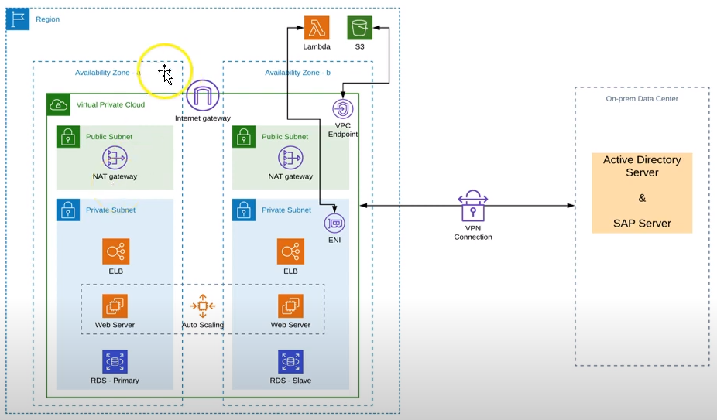
Proposed tentative diagram:

