Slide 1
Cloud Modernization Use cases
For CMM application modernizing guild

Slide 2
Use case 1: Migrate an app from on-prem:
Environment:
Java coding environment using maven builds
Hosting a lightweight tomcat web services app
Requirements:
Reduce infrastructure cost
Reduce operational involvement
Automated deployment with deployment confirmation
Maintain code versioning and relative deployment versioning
Developer should be able to test changes quickly
Developer should be able to spend more time on development.

Slide 3
Tools and artifacts to use:
GitHub for code versioning
Maven for java builds
Build docker using Dockerfile with git version tags
Repository use DockerHub to store relevant docker versions
Prepare docker environment on host server using Ansible playbook
Push docker and run new webservice on predefined port
Use webhooks to automate quick builds and reduce operations
Integrate all in Jenkins CI/CD pipeline in Jenkinsfile

Slide 4
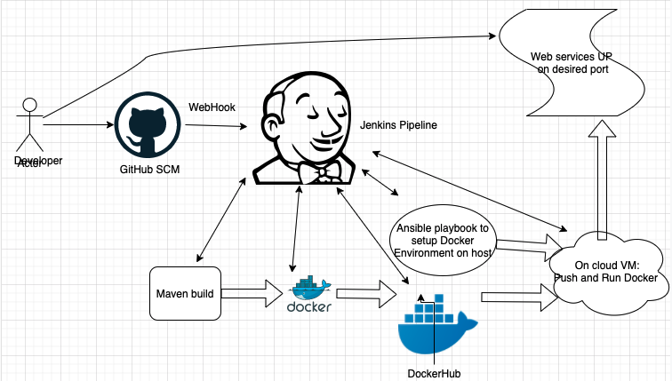
Workflow diagram:

Slide 5
Use case 2: Provisioning cloud VM and host an app
Environment:
Migrate on-prem app to a cloud VM
Use the smaller VM size to reduce cost
Host an app based on user-data scripts
Requirements:
Use Infrastructure as Code tool
Use cloud agnostic tool for compatibility on multi-cloud
Reduce operations time and effort
Can be orchestrated with other CI/CD tools
Developer don’t have to memorize each cloud’s CLI syntax etc.
Host an application based on user-data scripts
Provide a DNS based URL for application

Slide 6
Tools and artifacts to use:
Microsoft Azure
HashiCorp Terraform for IaC
User-data scripts
DNS URL for website
Can integrate with Jenkins if required
Bring up webservices and site
Use terraform graph to get environment picture

Slide 7
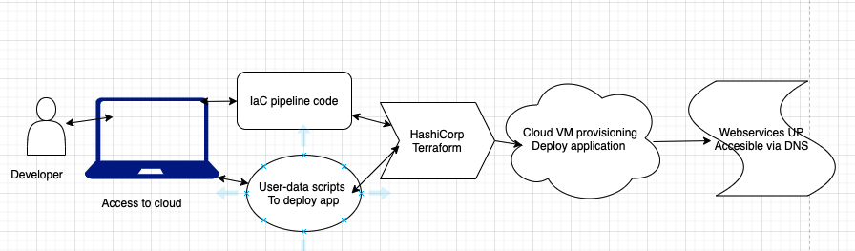
Workflow diagram: Terraform deploy app

