Slide 1
Jenkins CI/CD automation
The leading open source automation software, Jenkins provides hundreds of plugins to support building, deploying and automating any project.

Slide 2
Jenkins features:
Continuous Integration and Continuous Delivery:
As an extensible automation server, Jenkins can be used as a simple CI server or turned into the continuous delivery hub for any project.
Easy installation:
Jenkins is a self-contained Java-based program, ready to run out-of-the-box, with packages for Windows, Linux, macOS and other Unix-like operating systems.
Easy configuration:
Jenkins can be easily set up and configured via its web interface, which includes on-the-fly error checks and built-in help.
Plugins:
With hundreds of plugins in the Update Center, Jenkins integrates with practically every tool in the continuous integration and continuous delivery toolchain.
Extensible:
Jenkins can be extended via its plugin architecture, providing nearly infinite possibilities for what Jenkins can do.
Distributed:
Jenkins can easily distribute work across multiple machines, helping drive builds, tests and deployments across multiple platforms faster.

Slide 3
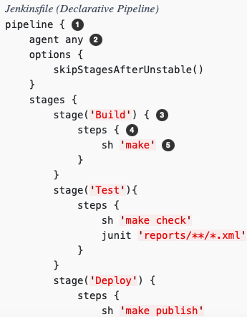
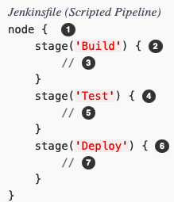
CI/CD pipeline:
CI/CD automation pipelines are written as Jenkinsfile for a job in Groovy language and there are two type of pipelines
Declarative Pipeline: →
Scripted Pipelines:

Slide 4
Plugins
Supported plugins examples are following :
Those plugins can be installed automatically as part of installation too:
ant:latest
antisamy-markup-formatter:latest
build-timeout:latest
cloudbees-folder:latest
configuration-as-code:latest
credentials-binding:latest
email-ext:latest
git:latest
github-branch-source:latest
gradle:latest
ldap:latest
mailer:latest
matrix-auth:latest
pam-auth:latest
pipeline-github-lib:latest
pipeline-stage-view:latest
ssh-slaves:latest
timestamper:latest
workflow-aggregator:latest
ws-cleanup:latest

Slide 5
Other Features:
Other configuration items can be automated
Using JCaaC Jennis Configuration as a Code(e.g. casc.yaml)
Credentials and Secrets can be masked, stored and referenced
Webhooks to integrate with GitHub repositories
jenkins:
securityRealm:
local:
allowsSignup: false
users:
- id: ${JENKINS_ADMIN_ID}
password: ${JENKINS_ADMIN_PASSWORD}
unclassified:
location:
url: http://server_ip:8080/

Slide 6
Hashicorp Terraform IaC:
Terraform is an open-source infrastructure as code software tool that provides a consistent CLI workflow to manage hundreds of cloud services. Terraform codifies cloud APIs into declarative configuration files.
Cloud agnostic and supports multicloud environments like

Slide 7
CLI, plugins and modules:
Terraform cli is very verbose and easy to read code and output
Plugins are provided for various environments APIs like
AWS
Azure
GCP
K8s
Docker etc.
Code configuration can be arranged in multiple modules and tf/tfvars files.

Slide 8
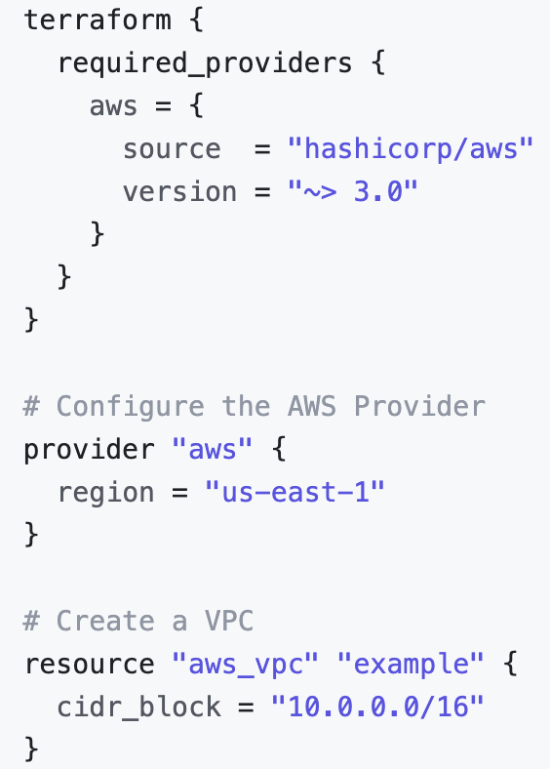
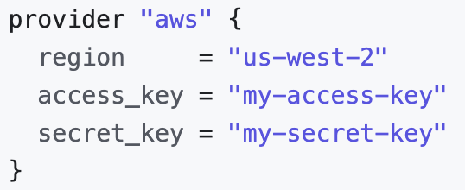
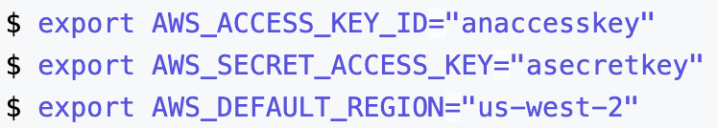
Declare provider.tf API and access to cloud:

Slide 9
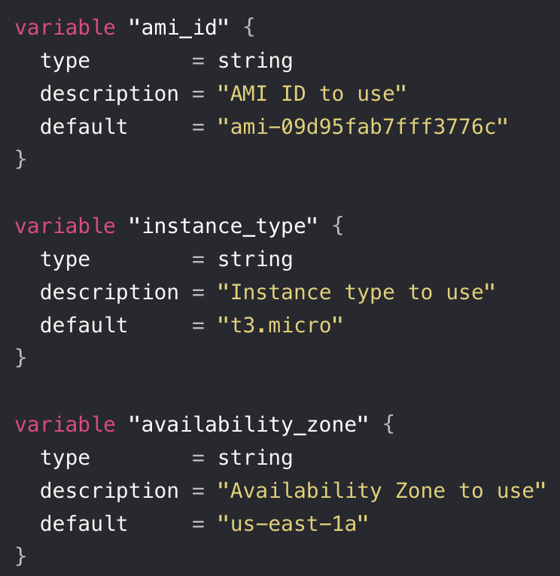
Define variables in variable.tf file:

Slide 10
Declare resources with variables and tags:
resource "aws_instance" "iac_in_action" {
ami = var.ami_id
instance_type = var.instance_type
availability_zone = var.availability_zone
tags = { Name = "Terraform-managed EC2 Instance for IaC in Action" }
}

Slide 11
CLI usage:
It’s a single file, easy to download and start using it:
# terraform init (To initialize environment and download API file)
# terraform plan (To plan the decelerated resources in env.)
# terraform apply (Execute changes to maintain declarative state)
# terraform destroy (To remove declared resources)
IaC easy to build/deploy, maintain and delete infrastructure.

