Slide 1
Basic UI Structure
Root App
Footer
Header
Simple Signature & Year
Menu
Body
Based on selection in Menu, The components in Body Change

Slide 2
Apps in ‘Menu’
To-Do
Notes
Calendar

Slide 3
To-Do
Body
To-Do
To-Do Content
To-Do Nav
Fetch ToDo Lists
Fetch the ToDo list based
On ToDoList ID
ToDoService
Backend
REST API
ToDo-List
ToDoDAOService

Slide 4
Backend

Slide 5
Backend Microservices
Eureka Naming Service
API Gateway
Docker
Front-end App
REST API
{JSON}
Data service
SQL DB
Cloud Config
Git

Slide 6
JSON to SQL DB mapping
v1
Table: todomasterlist
Integer id,
String title
{
"todomasterlist": [
{
"id": 1,
"title": "Grociers",
"todolist": [
{
"id": 1,
"completed": true,
"content": "sugar"
},
…
],
…
}
Primary Key (id)
Relationship: id -> list_id
Table: todolist
Integer id,
Integer list_id,
Boolean completed,
String content
Composite Primary Key (id, list_id)
Note:- list_id is ignored when forming as Json Response.

Slide 7
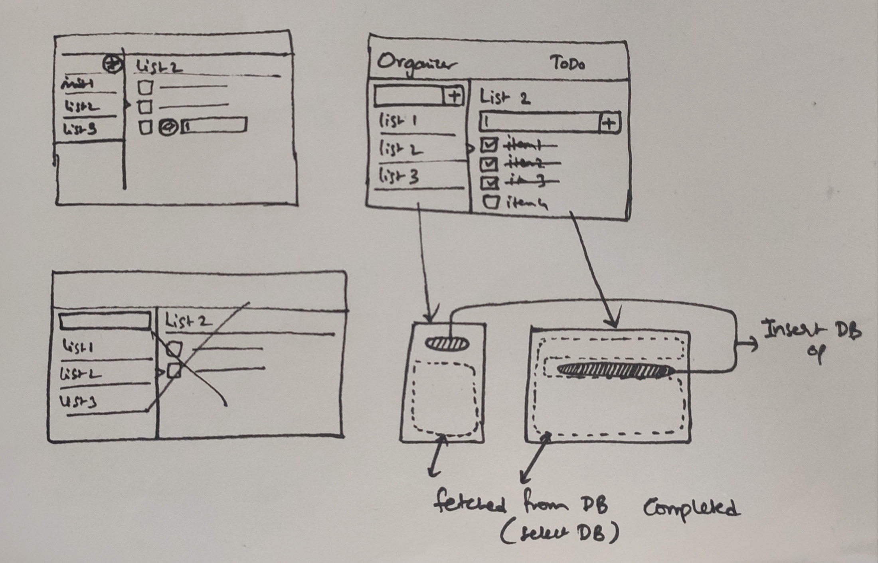
Need to add Textbox in both ToDo-Nav & ToDo-Content

