Slide 1
Development and Integration of Configurable Cache RTL Model
Vahid Saljooghi
December 2012
Supervisor: Prof. Macii & Prof. Edefors

Slide 2

Outline
Introduction & Motivations
Instruction cache datapath
Instruction cache controller
Data cache controller: write through with no allocation
Data cache controller: write through with allocation
Data cache controller: write back with allocation
Arbiter
Simulation, Synthesis and Verification
System context
Implementation issues
Cache Future improvements
Demo
References
Acknowledgments and Questions
Notes:
Insert a map of your country.

Slide 3
Introduction & Motivations
Task: Implementing generic instruction and data cache
Motivation: To have model which can be tuned for specific set of applications e.g. in embedded system design.
Integration: With MIPS r2000 processor
Parameters: # of Sets, # of Ways: Direct-mapped, Set associative,
Replacement policy : LRU, Pseudo random
Write policy, Block size, Main memory width, PC length and Data bus length
Harvard architecture VS von Neumann architecture
Harvard Arch.: Instruction and data cache use a single memory unit ( With help of arbiter)
Notes:
Insert a picture of one of the geographic features of your country.

Slide 4
Continued
Compilation of HDL files and benchmarks using make file scripts
Simulation: With Modelsim and SimVision
Synthesis: With Xilinx XST for Virtex4 FPGA family
Verification: Using eembc benchmark suite including:
Printing 18, hello world!, CRC, eembc-rgbcmy01, eembc-empty, eembc-autcor00, eembc-conven00, eembc-fft00, eembc-viterb00
Outcome:
Publication on IEEEXplore and presentation in Norchip conference.
Open core IP downloadable through GitHub repository

Slide 5
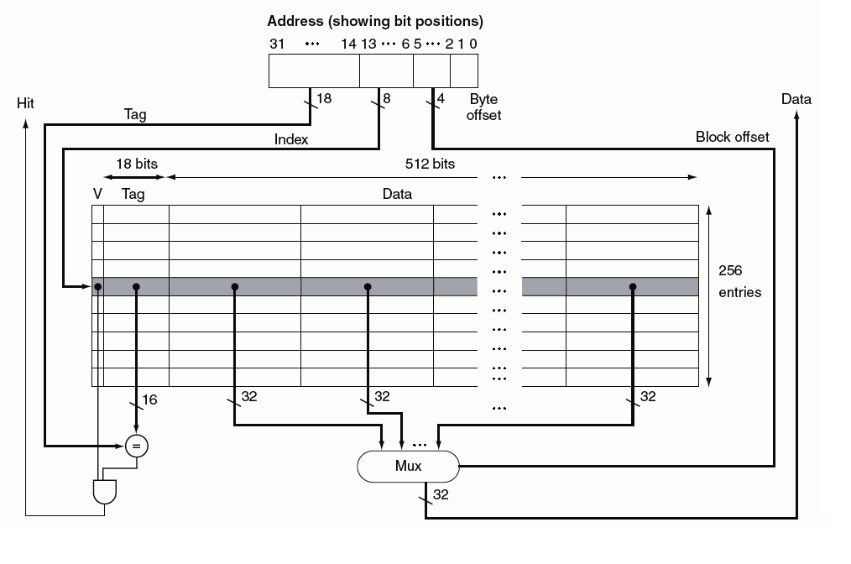
Basic Cache Structure

Slide 6
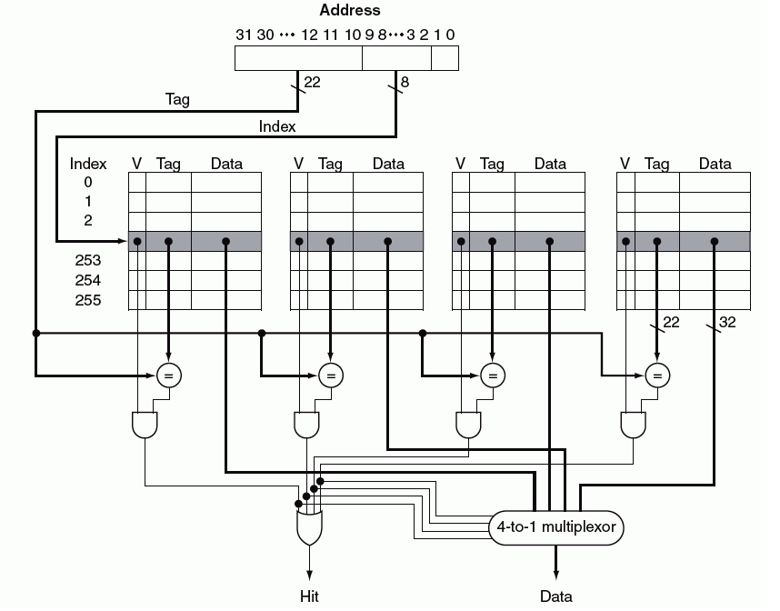
Basic Cache: 4 Way Associative

Slide 7
Instruction Cache Datapath
Tag Size: 21 bits, Index Size: 10 bits, offset: 1 bit
Notes:
Insert a picture illustrating a season in your country.

Slide 8
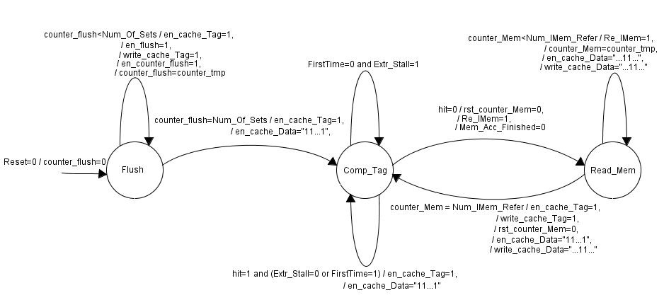
Inst. Cache Controller

Slide 9
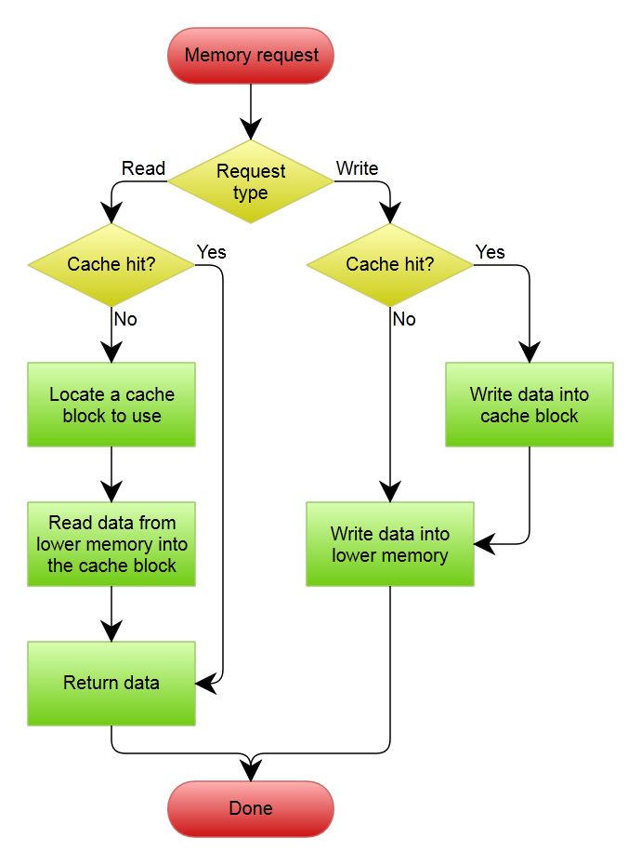
Data Cache (WrThrNoAlloc)
Write through with no write allocate
Notes:
Insert a picture illustrating a custom or tradition here.

Slide 10
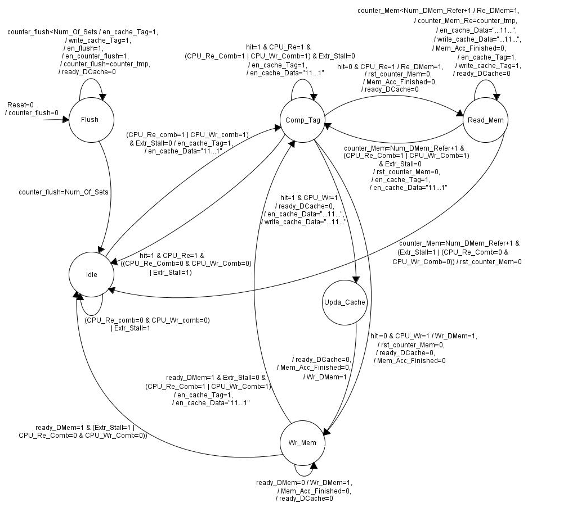
DC_Controller_WrThrNoAlloc

Slide 11
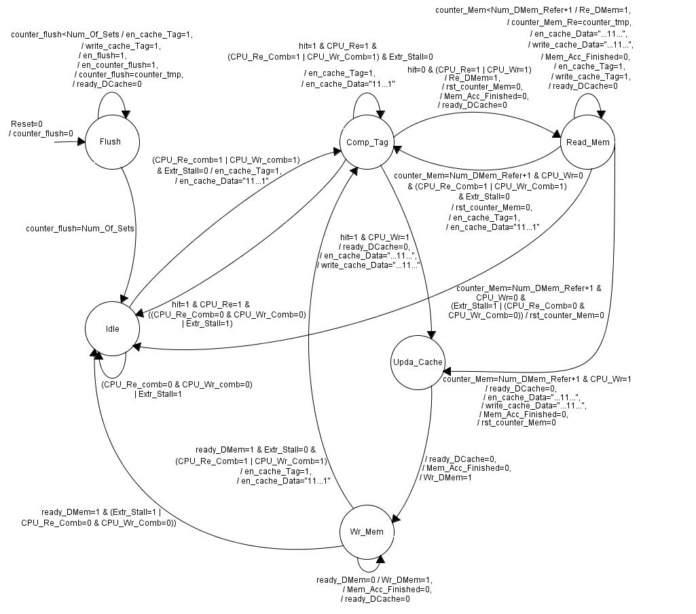
Data Cache WrThrAlloc
Write through with write allocate

Slide 12
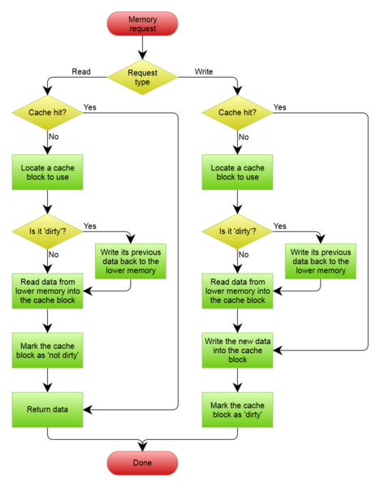
Data Cache WrBackAlloc
Write back with write allocate

Slide 13
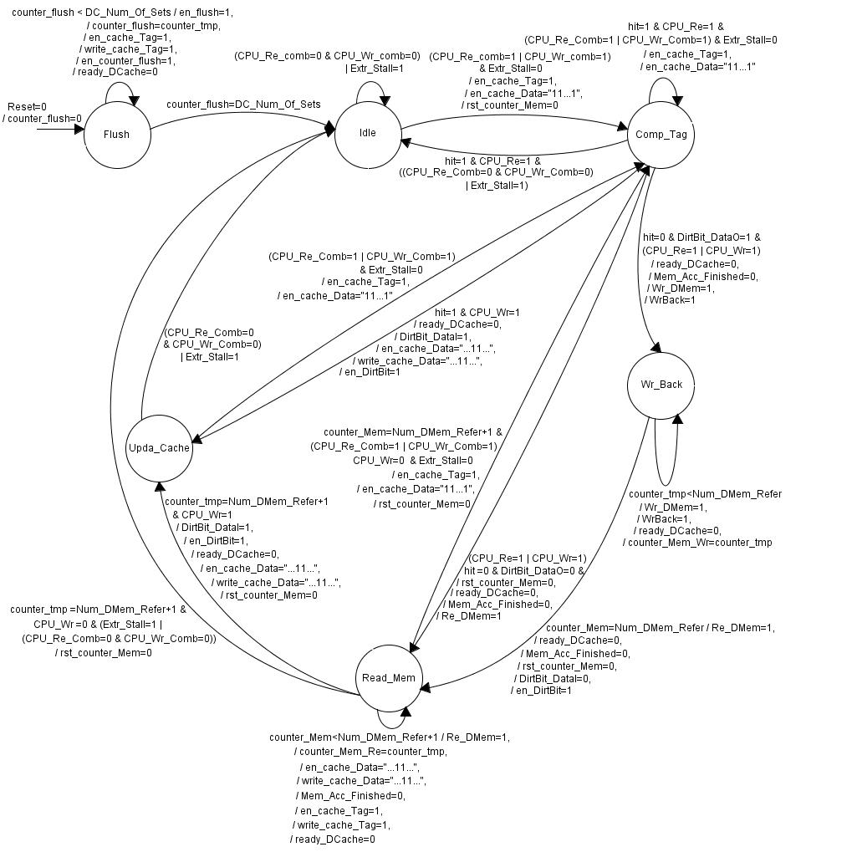
DC_Controller_WrBackAlloc

Slide 14
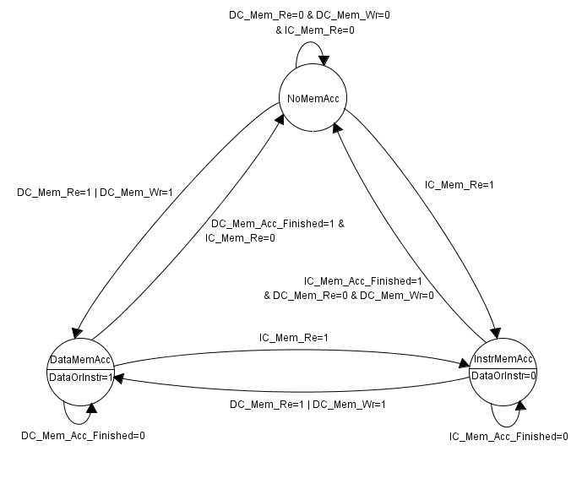
Arbiter

Slide 15
Simulation and Verification
Step by step procedure
Iterative task
To find the inconsistency: Comparing state of processor and memory before adding cache with the state after cache integration

Slide 16
Inst. Cache Test

Slide 17
Data Cache Test (WrThr)

Slide 18
Data Cache (Write Back)

Slide 19
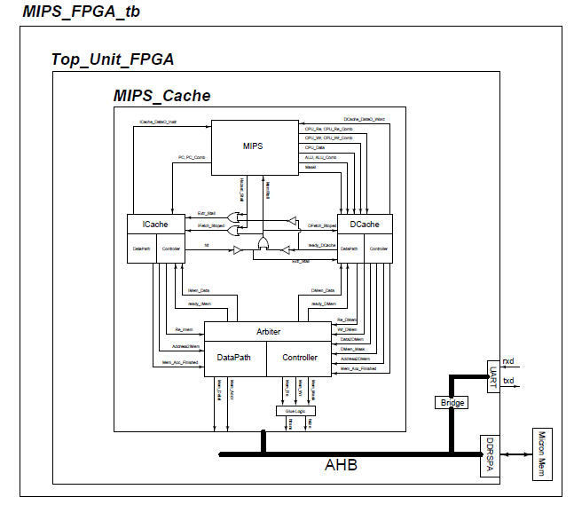
Cache in SoC environment

Slide 20
Implementation issues
Processor was written with little consideration of caches. Learning how it works and modifying it to accept caches.
Scripts were mainly written for Flexsoc, so occasionally they needed modification.
Cache is an intermediary module and it should work with both processor and memory, in addition it contains memory blocks itself. This shows importance of signal synchronization in the design.
Debugging should be done step by step, adding ICache with no associativity then with associativity and later with DCache together and so on.

Slide 21
Cache Improvements
Early restart: to resume execution as soon as the requested word of the block is returned , rather than wait for the entire block
Even more sophisticated scheme: requesting word that is needed first and later ask for rest of block. (critical word first)
Buffer data that is going to be written to memory and continue execution, so whenever memory is free we can put data from buffer to it in background as CPU continue its processing.
LFU, Pseudo LRU
Marking some memory ranges as non-cacheable can improve performance, by avoiding caching of memory regions that are rarely re-accessed. This avoids the overhead of loading something into the cache, without having any reuse.
Coherency: Communication protocols between the cache managers which keep the data consistent

Slide 22
References
[1] A. Gonzalez, F. Latorre, and G. Magklis, Processor Microarchitecture, An implementation perspective. Morgan & Claypool Publishers, 2010
[2] D. A. Patterson and J. L. Hennessy, Computer Organization and Design: The Hardware/Software Interface. Morgan Kaufmann Publishers, 1998.
[3] Z. Navabi, VHDL: Analysis and Modeling of Digital Systems, McGraw-Hill Professional, 1998
[4] GRLIB IP Library User’s Manual, Aeroflex Gaisler, Jan. 2012, version 1.1.0 - B4113, [Online]. http://www.gaisler.com/products/grlib/grlib.pdf.
[5] GRLIB IP Core User’s Manual, Jan. 2012, version 1.1.0-B4112, [Online]. http://gaisler.com/products/grlib/grip.pdf.
[6] AMBA TM Specification, ARM Ltd, May 1999, rev 2.0.
[7] Embedded Microprocessor Benchmark Consortium. [Online]. Available: http://www.eembc.org
[8] A. Milenkovic, M. Milenkovic, and N. Barnes, “A performance evaluation of memory hierarchy in embedded systems,” in Proc. 35th Southeastern Symp. System Theory, 2003, pp. 427–431.
[9] R. Bahar, G. Albera, and S. Manne, “Power and performance tradeoffs using various caching strategies,” in Proc. Int. Symp. Low Power Electronics and Design (ISLPED), 1998, pp. 64–69.
[10] A. Putnam, S. Eggers, D. Bennett, E. Dellinger, J. Mason, H. Styles, P. Sundararajan, and R. Wittig, “Performance and power of cache-based reconfigurable computing,” in Proc. Int. Symp. on Computer Architecture (ISCA), 2009, pp. 395–405.
[11] N. Ickes, Y. Sinangil, F. Pappalardo, E. Guidetti, and A. P. Chandrakasan, ”A 10 pJ/cycle ultra-low-voltage 32-bit microprocessor system-on-chip,” in Proc. European Solid-State Circuits Conference (ESSCIRC), 2011, pp. 159-162
[12] N. Ickes, D. Finchelstein, and A. P. Chandrakasan, “A 10-pJ/instruction, 4-MIPS Micropower DSP for Sensor Applications,” Asian Solid-State Circuits Conference (A-SSCC), 2008, pp. 289-292
[13] T. Sudarshan, R. A. Mir, and S.Vijayalakshmi, “Highly Efficient LRU Implementations for High Associativity Cache Memorys,” in Proc. of 12th IEEE International Conference on Advanced Computing and Communications, 2004, pp. 24–35.
[14] F. Vahid, W. Najjar, and C. Zhang, “A highly configurable cache architecture for embedded systems,” in Proc. 30th Annual International Symp. on Computer Architecture, 2003, PP. 136-146.
[15] R. R. Bani, S. P. Mohanty, E. Kougianos, and G. Thakral, “Design of a Reconfigurable Embedded Data Cache,” International Symp. on Electronic System Design (ISED), 2010, pp. 163-168.

Slide 23

Q&A
Thanks for attending this session.
Contact:
vahid_saljooghi@yahoo.com

