Slide 1

Project: CLUSTERING

Slide 2
OBJECTIVE
To analyze customer demographic and behavioral data.
To identify distinct customer segments using clustering techniques.
To understand purchasing patterns across different customer groups.
To determine which customer segments are most responsive to marketing campaigns.
To support targeted marketing and personalized product strategies.

Slide 3
DATASET DETAILS
Dataset Details – Customer Personality Analysis
People (Customer Information)
ID: Unique customer identifier
Year_Birth: Customer’s birth year
Education: Education level
Marital_Status: Marital status
Income: Yearly household income
Kidhome: Number of children in the household
Teenhome: Number of teenagers in the household
Dt_Customer: Date of enrollment with the company
Recency: Days since last purchase
Complain: Customer complaint status (1 = Yes, 0 =No)

Slide 4
Products (Spending Behavior – Last 2 Years)
MntWines: Amount spent on wines
MntFruits: Amount spent on fruits
MntMeatProducts: Amount spent on meat products
MntFishProducts: Amount spent on fish products
MntSweetProducts: Amount spent on sweets
MntGoldProds: Amount spent on gold products
Promotion (Marketing Campaign Response)
NumDealsPurchases: Purchases made using discounts
AcceptedCmp1–AcceptedCmp5: Acceptance of previous campaigns (1 = Yes, 0 = No)
Response: Acceptance of the most recent campaign
Place (Purchase Channels)
NumWebPurchases: Website purchases
NumCatalogPurchases: Catalogue purchases
NumStorePurchases: In-store purchases
NumWebVisitsMonth: Website visits per month
Target
Perform customer clustering to identify and summarize distinct customer segments.

Slide 5
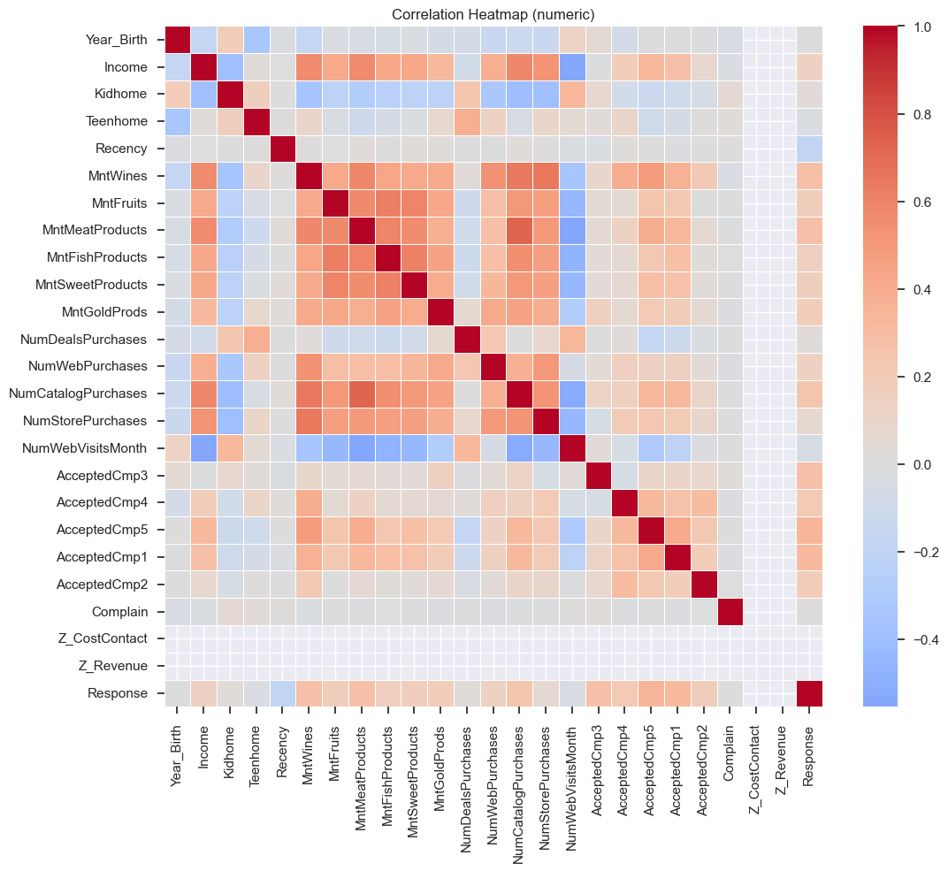
Digramatic Representation of Correlation

Slide 6
CORRELATION
Customers with higher income usually spend more on products.
If a customer buys more of one product, they often buy more of other products too.
Customers with children or teenagers tend to spend less.
Customers who bought recently are more active buyers.
Customers who shop through multiple channels (online, store, catalog) are more valuable.
Visiting the website many times does not always mean more purchases.
Customers who spend more are more likely to accept marketing offers.
Complaints do not strongly affect customer buying behavior.
Overall:
Correlation analysis helps the company understand customer behavior and choose the right customers for targeted marketing and clustering

Slide 7
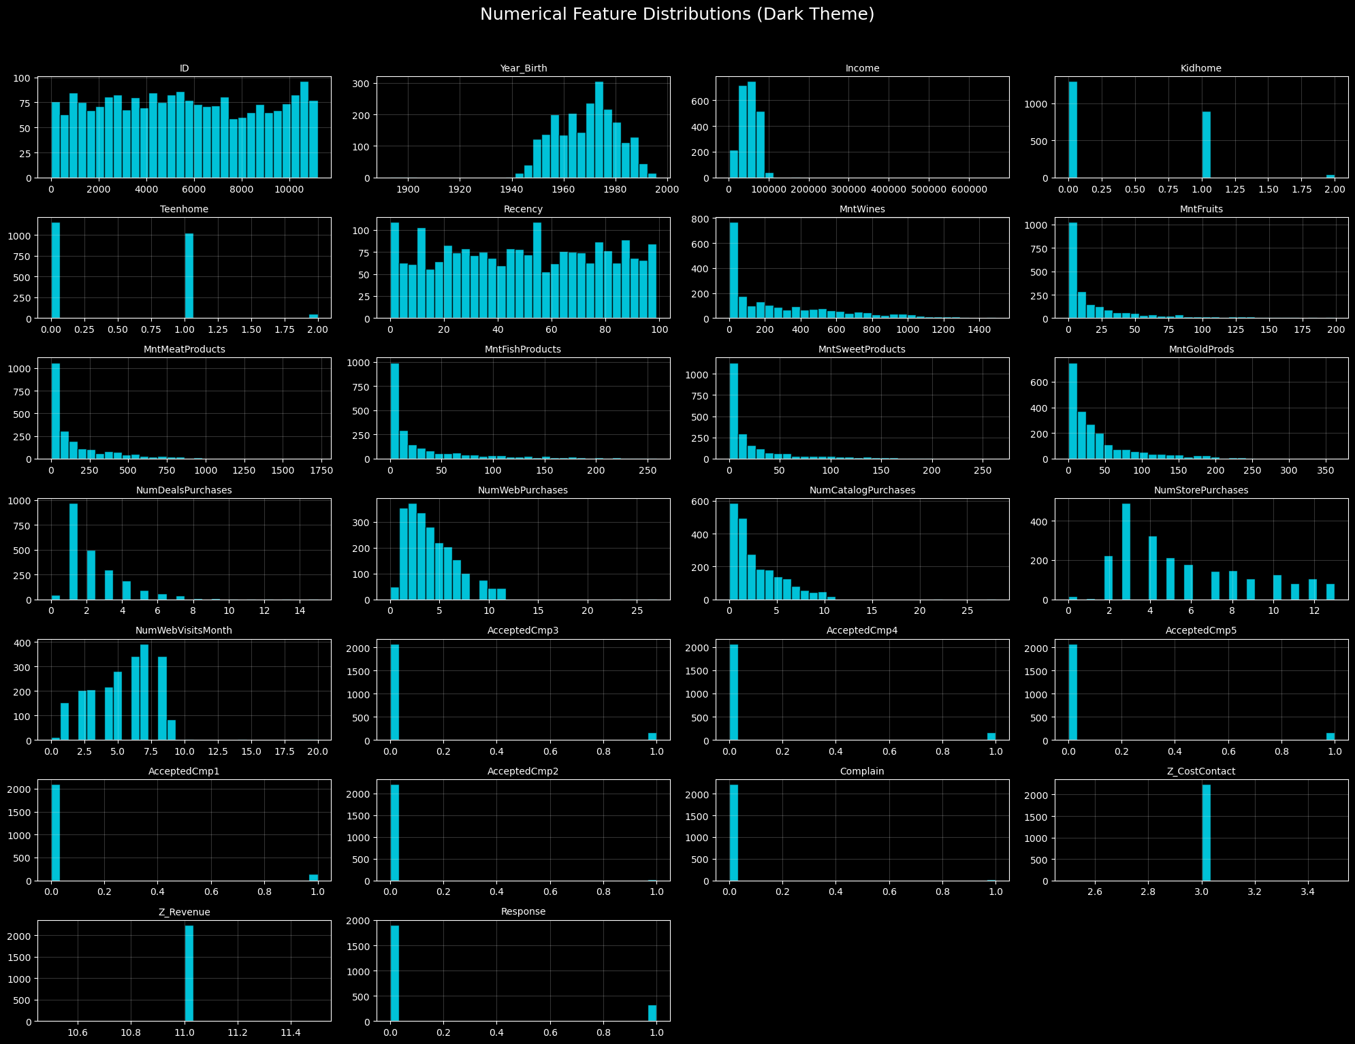
Data Visualization

Slide 8
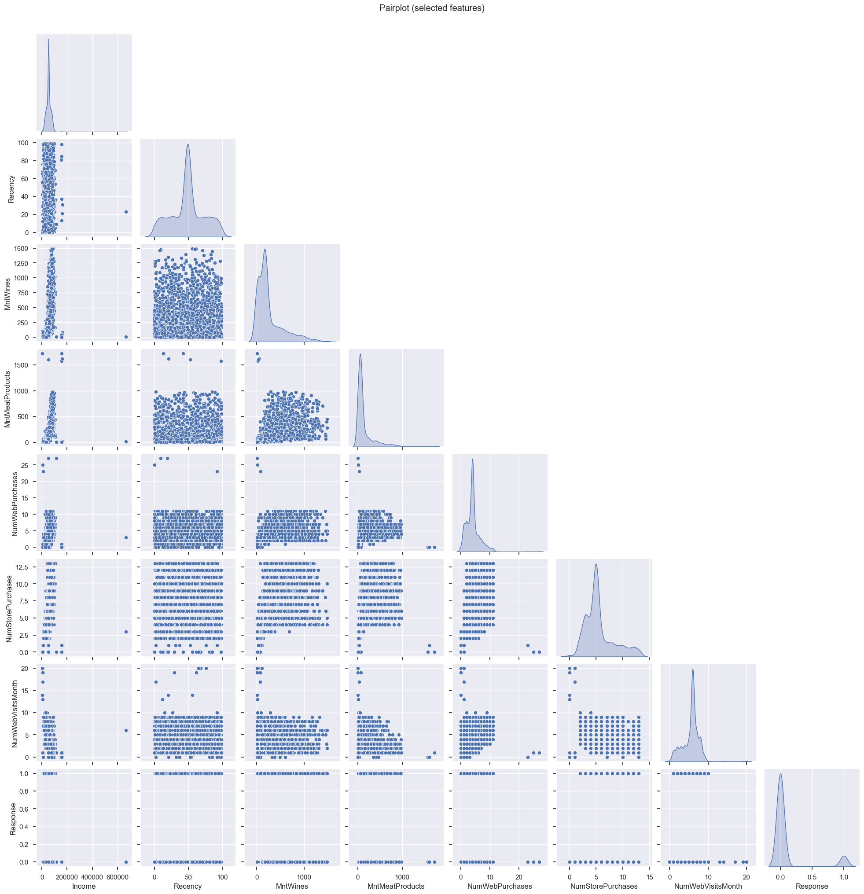
Pairwise Plot
Higher Income customers tend to have higher spending in categories like MntWines and MntMeatProducts, although there is still a lot
of spread (not all rich customers spend a lot).​
Customers with higher Total web or store purchases usually have higher product spend, indicating that more active shoppers contribute
more revenue across channels.​
Response (campaign acceptance) tends to be 0 for most points, so accepted customers appear as a smaller subset in the scatterplots, often with slightly higher spend or engagement.​

Slide 9
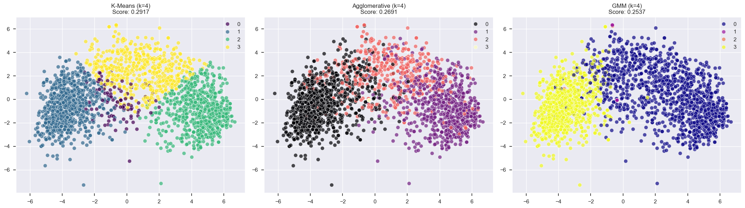
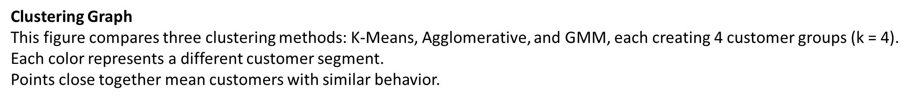
Model Building in Clustering

Slide 10
K-Means
Creates clear and well-separated clusters.
Has the highest score, so it performs the best among the three.
Agglomerative Clustering
Clusters are slightly overlapping.
Works well but separation is not as clear as K-Means.
GMM (Gaussian Mixture Model)
Forms more flexible clusters, but boundaries are less clear.
Has the lowest score among the three methods.
Overall Conclusion
K-Means gives the best customer segmentation for this dataset.
The clusters can be used to identify different customer types and apply targeted marketing strategies

Slide 11
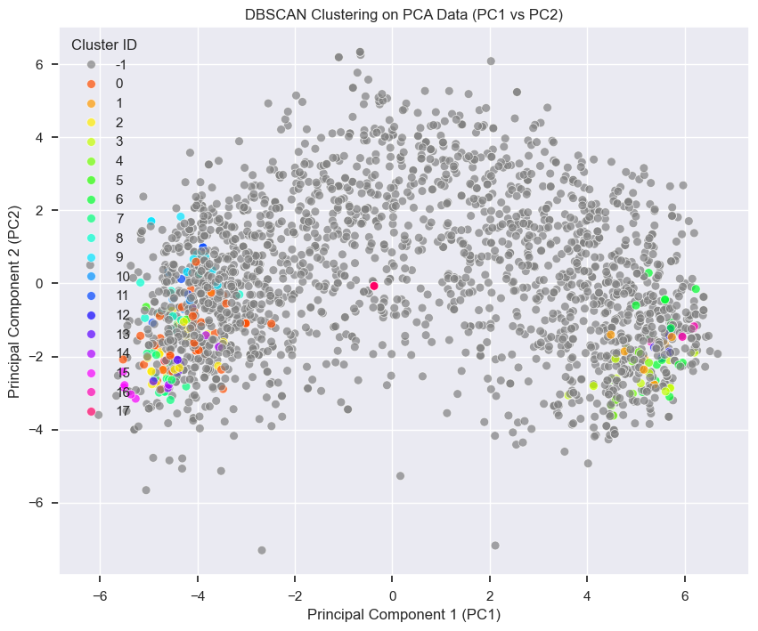
Best Model DBSCAN is the clearly superior model here, achieving a remarkably high Silhouette Score of 0.9071 with 18 clusters.
Why it's the best: A Silhouette Score close to $+1$ indicates that the clusters are well-separated and that each point is assigned to a highly appropriate cluster. DBSCAN's density-based approach likely found natural, non-spherical groupings that the partition-based methods (K-Means) and model-based methods (GMM) missed.

Slide 12
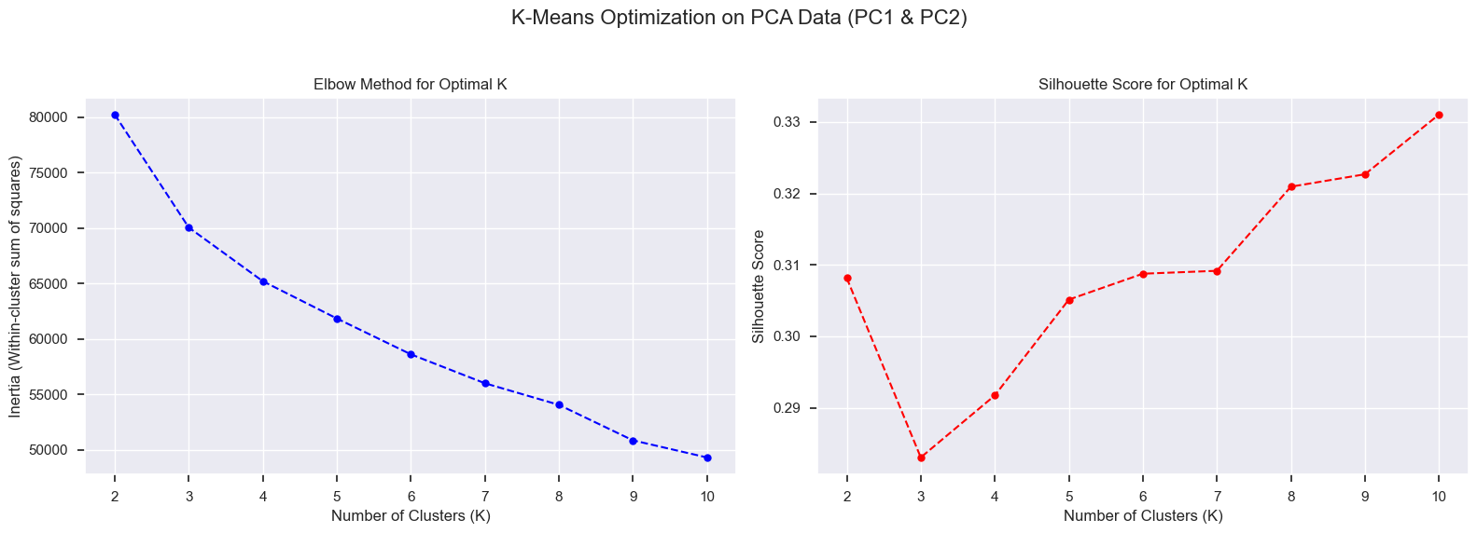
Decide Number of Clusters (k)

Slide 13
This figure helps us decide the best number of clusters (K) for K-Means using two methods.
Elbow Method (Left Graph)
The line shows how inertia (error) decreases as K increases.
A sharp drop is seen up to K = 4, after which the improvement slows.
This point is called the “elbow”.
Choosing more than 4 clusters does not improve results much.
Silhouette Score (Right Graph)
The silhouette score measures how well-separated the clusters are.
Higher score = better clustering.
The score improves steadily after K = 4 and remains reasonable.
K = 4 gives a good balance between cluster separation and simplicity.

Slide 14
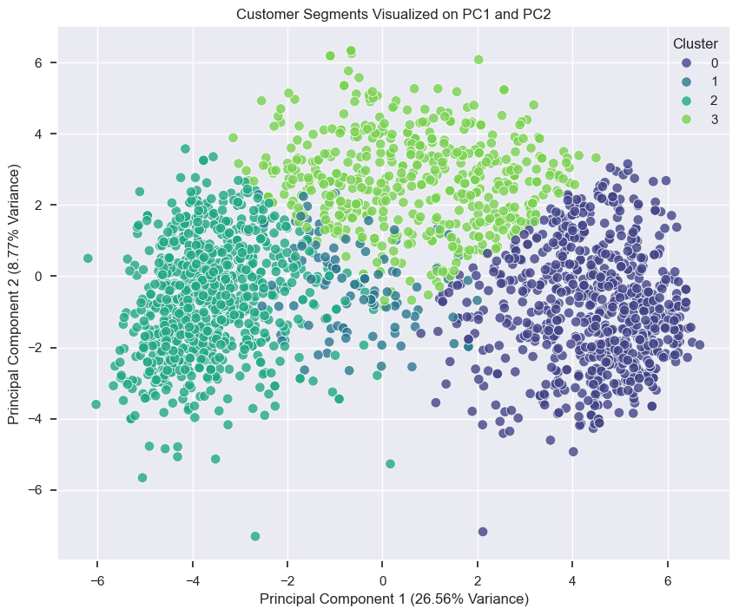
Train Models
This graph shows the final customer segments after applying K-Means clustering (K = 4).
The data is reduced to two dimensions (PC1 and PC2) using PCA to make it easy to visualize.
Each dot represents a customer, and each color represents a different customer segment.
PC1 (26.56%): This is the "Wealth Axis." About 26% of your customer behavior is explained simply by how much money they have.
PC2 (8.77%): This is the "Engagement Axis." This 9% explains the difference between someone who visits the site to browse (Cluster 2) versus someone who visits to buy (Cluster 3).

Slide 15
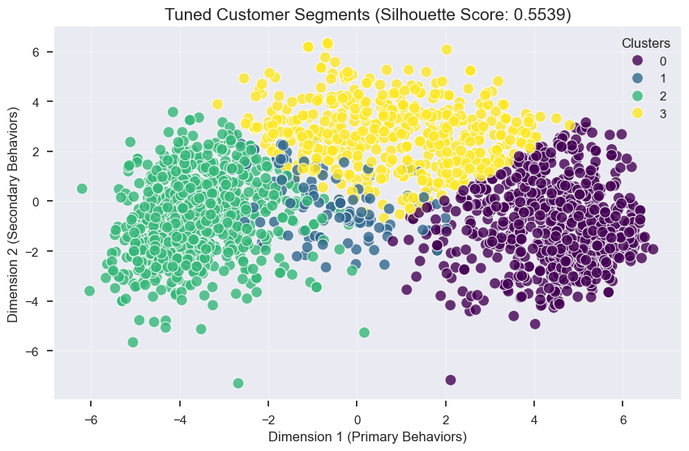
Model Evaluation
Key Insight
The clusters are clearly separated, showing meaningful customer groups
Silhouette Score (0.55) indicates good-quality clustering
Each cluster represents a distinct customer type,
enabling more targeted marketing and personalization
Minimal overlap between clusters suggests lower confusion
and more reliable customer segmentation

Slide 16
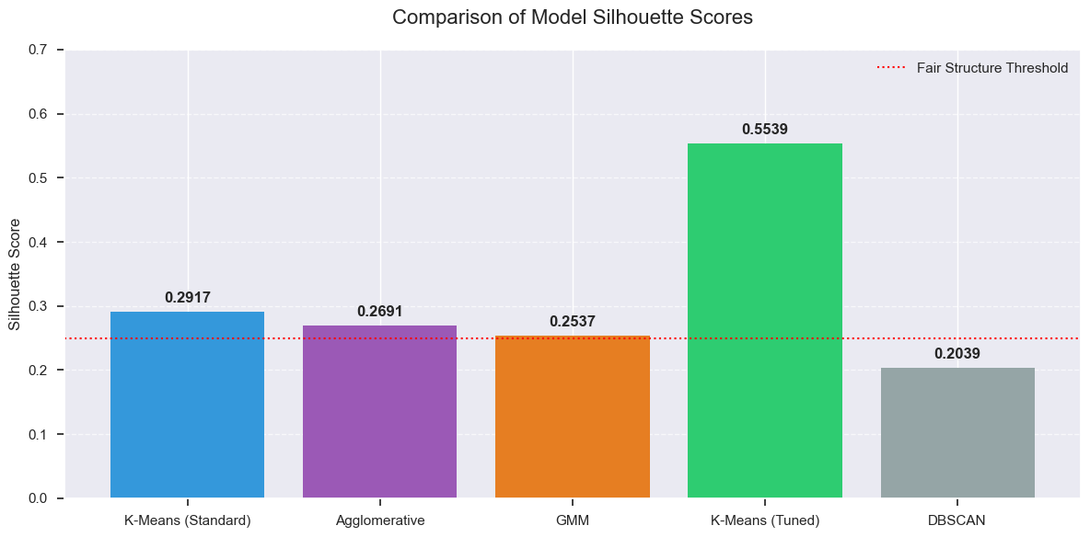
Model Comparison
Tuned K-Means performs the best, achieving the highest Silhouette Score (0.55), indicating the most well-defined and reliable clusters
Standard K-Means, Agglomerative, and GMM show only moderate clustering quality, slightly above the fair-structure threshold
DBSCAN performs the weakest, suggesting it struggles to identify clear customer groups in this dataset
Model tuning significantly improves clustering performance, highlighting the importance of parameter optimization
Based on cluster separation and quality, Tuned K-Means is the most suitable model for customer segmentation

Slide 17
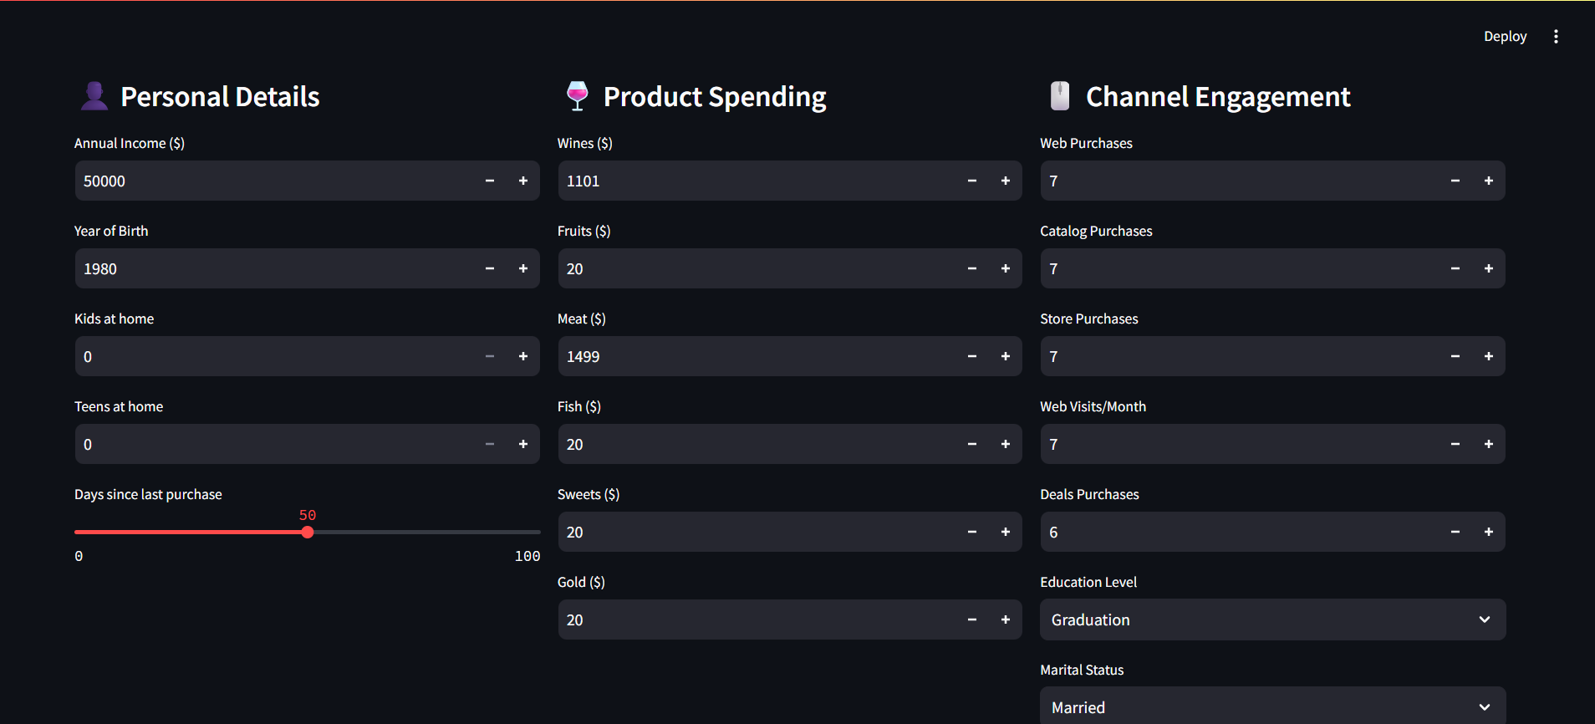
Deployment
How the System Works
Input Data
  Personal details: income, age, kids at home, teens at home, Day since last purchase
  Product spending: wine, meat, fruits, fish, sweets, gold, etc.
  Channel engagement: web, catalog purchases, store purchases, web month, deals purchases, education level, marital status
  The model processes these inputs and assigns each customer to one of four clusters
  Each cluster represents a distinct spending and engagement pattern

Slide 18
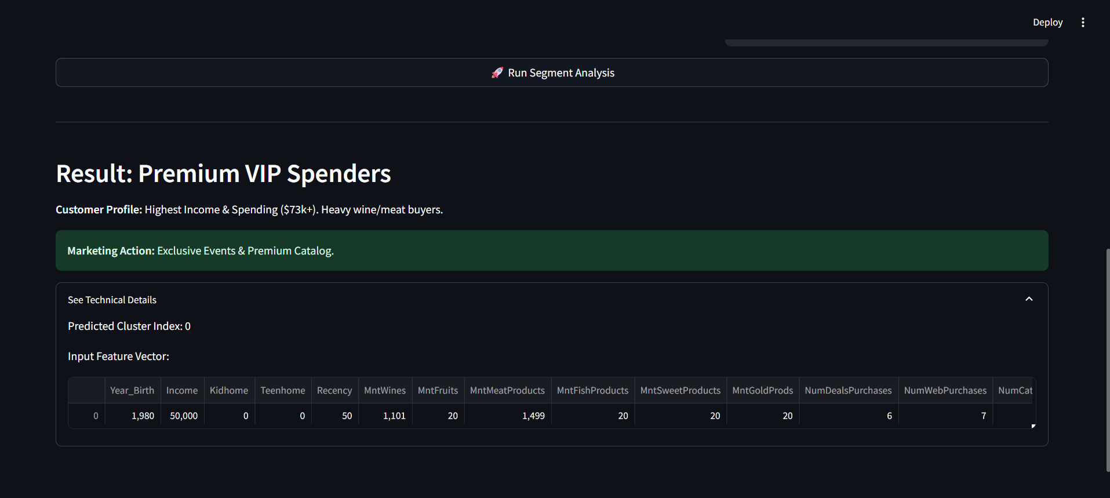
We use 4 clusters
Premium vip spenders
Steady Moderate spenders
Value shoppers
Digital online enthusiasts
The model assigns the customer to Cluster 1: Premium VIP Spenders
This is based on high income and high spending, especially on premium products like wine and meat
The customer shows recent activity and multi-channel engagement
Recommended action: Offer exclusive deals, VIP programs, and premium catalogs

Slide 19
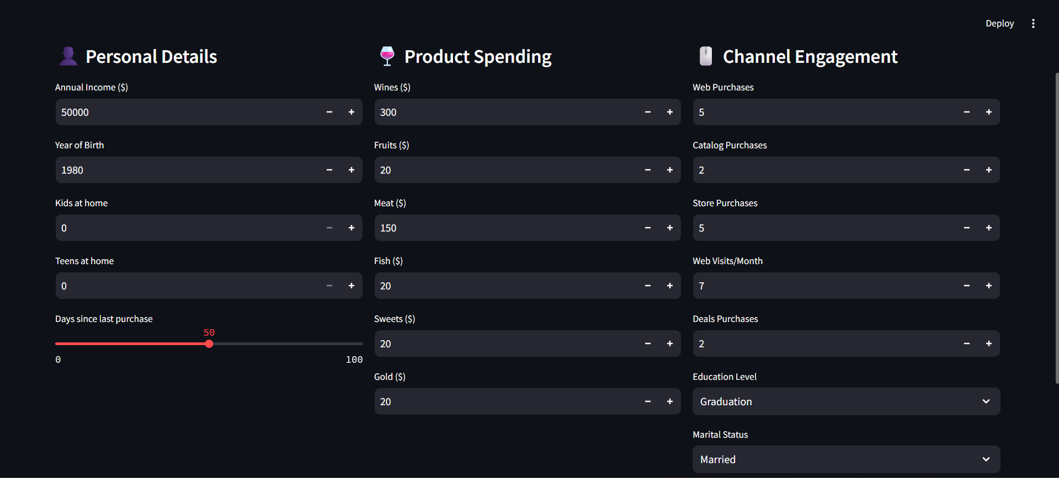
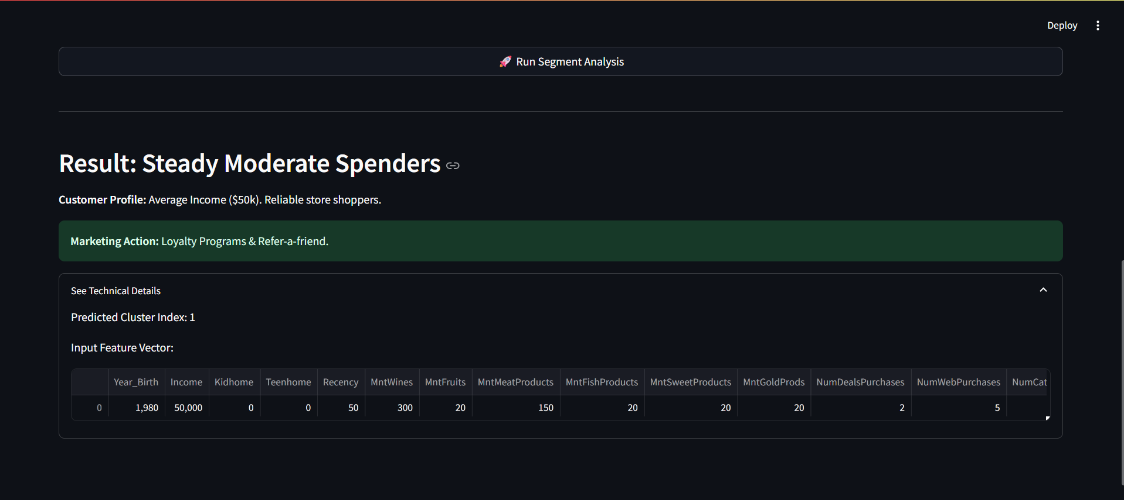
Change The Input Data
The model assigns the customer to Cluster 2: Steady Moderate Spenders
The customer has average income with consistent, moderate spending
Mostly reliable store shoppers with balanced purchase behavior
Recommended action: Loyalty programs, repeat-purchase offers, and refer-a-friend campaigns

Slide 20
Challenges Faced During the Project
electing the right features to create meaningful customer segments
Ensuring clean, scaled, and consistent data across training and deployment
Choosing the optimal number of clusters with both technical and business relevance
Translating technical cluster results into clear business actions

Slide 21
Business Use of This System
Enables personalized marketing campaigns
Improves customer retention and loyalty
Helps focus on high-value customers
Optimizes marketing cost and ROI
Supports better business decision-making
Why This System Is Needed
Customers behave differently in terms of spending and engagement
A one-size-fits-all strategy does not work
The business needs a data-driven way to understand customer behavior

Slide 22
THANK
YOU

