Slide 1
Ecommerce Capstone Project
Group Name:
Sanil Vannantavita
Rakesh Tripathi

Slide 2
Business Objective
ElecKart is an e-commerce firm Based out Canada specialized in electronics Product. Here the business objective is to make a market mix model for 3 product sub-categories - Camera accessory, Gaming accessory and Home Audio to see the actual impact of different marketing levers over sale of last one year and recommend the optimal budget allocation for different marketing levers for the next year. Data is available from July 2015 to June 2016

Slide 3
Data understanding
Below data sets are available for analysis.
Consumer Electronics data: Order level sales data is available for the period of July 2015 to June 2016. 1648824 records are available
Media Investment data : Monthly spend on various advertising channels
Special Sales Calendar data : Days when there was any special sale information
Monthly NPS Score : Net Promoter Score which shows how satisfied the consumer
Stock Index data: Stock Index of the company monthly level
Climate data: Climate data of Canada provided to check the effect on revenue for climate

Slide 4
Data Preparation
2) Below are the data issues identified.
deliverycdays and deliverycdays columns having 80% null values
gmv,cust_id and pincode columns are having null values. There are 4904 values are missing for these columns .
product_analytic_vertical is having 5828 missing values.
There are 5290 records with product_mrp as zero values.
There 70321 records with product_procurement_sla as -1 value
cust_id column is having 817926 negative values (almost 50%)
pincode column is having 805932 negative values (almost 50%)
There are records with gmv value higher than product_mrp.

Slide 5
Data Preparation
1 ) Below are the data clean up actions done
Dropped deliverycdays and deliverycdays columns since it’s having 80% null values
Rows with missing values for gmv,cust_id and pincode columns are removed.
Rows with missing values for product_analytic_vertical is removed.
Rows with product_mrp value as zero are removed , since it’s not possible to have product with mrp value as zero •
Negative values in product_procurement_sla is invalid scenario. Hence replacing with zero values
Dropped cust_id and picode coulmns from data set since it is having 50% negative values
There are many null values in climate dataset which has been treated accordingly.

Slide 6
Data Preparation
3) Below are the steps covered as part of final data preparation
Derived weekly_number column which starts for W29 (July-2015) to W28 (July-2016) in sales data set •
Daily order level data has been aggregated at weekly level for duration between June 2015 to July 2016 for 3 product sub categories – Camera Accessory, Home audio and Gaming Accessory. •
Monthly level media investment spend has been converted into weekly media investment spend.
Monthly level NPS score has been considered for each week of the month.
Monthly stock data has been considered at weekly level
Climate data converted into weekly level with few derived columns which would help to find the effect of climate on revenue. •
All these different data set are merged together at weekly level to perform the modelling part
Using filtering 3 datasets can be created for Camera Accessory, Home audio and Gaming Accessory

Slide 7
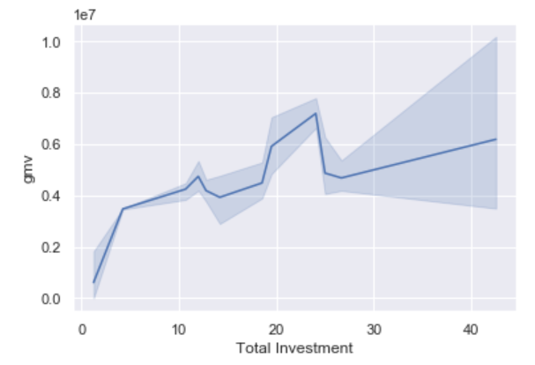
EDA analysis: Camera Accessory
Gmv vs Total Investment
Above graph shows the relation between gmv and the total investment for the media investment data

Slide 8
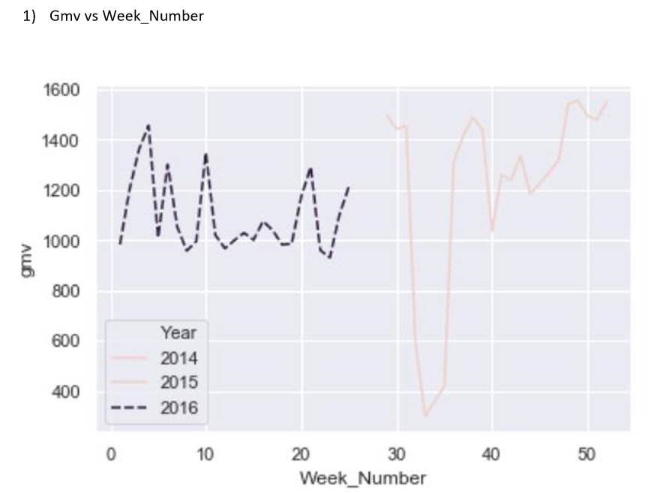
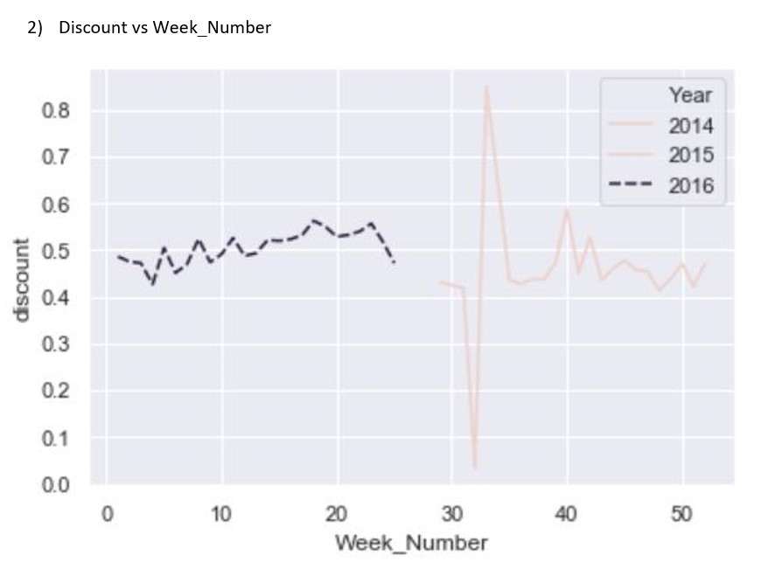
EDA analysis: Camera Accessory
From the above two graph, we could see that more discount is not effective for CameraAccessory categories in terms of gmv. Gmv is getting reduced if we give more than 50% discount.

Slide 9
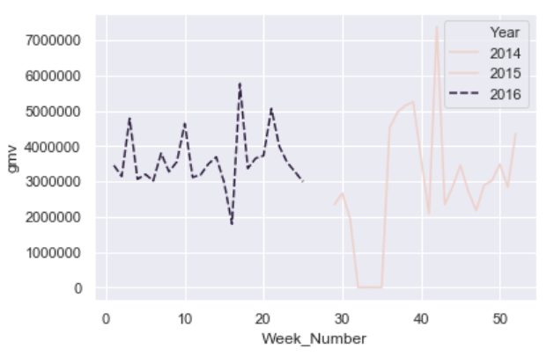
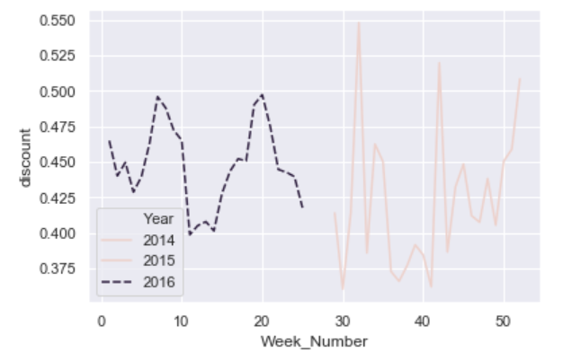
EDA analysis: Home Audio
From the above two graph, we could see that more discount is having positive impact onHome Audio categories gmv

Slide 10
Derived List of kpi
Week number :- It will give the week number
Pay flag : It will set flag as one if it is salary day
Holiday flag :- It will set flag as one if it is holiday
List price:- gmv/units
Discount :- (product_mrp- list_price)/ product_mrp
Rain condition : - It will set flag as one if it rain
Snow condition : - It will set flag as one if it snowing
Ad stock value : it will show the ad stock value

Slide 11
Model Building : Camera Accessories
Below are the outcome of 4 models
f
Model | Significant Variable | R Square on train data | R Square on test data
Simple linear Model | SEM+Sponsorship+product_analytic_vertical_Lens+product_analytic_vertical_CameraBattery+product_analytic_vertical_CameraTripod+pay_flag+Radio | .919 | .971
Multiplicative Model | product_analytic_vertical_CameraTripod+product_analytic_vertical_CameraBag+product_analytic_vertical_Lens+product_analytic_vertical_Strap+TV+Discount | .99 | .895
Koyck Model | product_analytic_vertical_Filter+product_analytic_vertical_CameraBattery+product_analytic_vertical_Flash+product_analytic_vertical_CameraTripod+SEM+pay_flag | .95 | .914
Distributed Lag Model | product_analytic_vertical_Filter+product_analytic_vertical_CameraBattery+product_analytic_vertical_Flash+product_analytic_vertical_CameraTripod+pay_flag | .95 | .90
Simple Linear Model chosen as the best model since it is having high R square value on test data

Slide 12
Model Building : Home Audio
Below are the outcome of 4 models
Model | Significant Variable | R Square on train data | R Square on test data
Simple linear Model | Discount+product_analytic_vertical_FMRadio+product_analytic_vertical_HomeAudioSpeaker+Sponsorship+Online marketing +SEM | .99 | .98
Multiplicative Model | product_analytic_vertical_FMRadio+product_analytic_vertical_HomeAudioSpeaker+Sponsorship+SEM+cold_day | .99 | .992
Koyck Model | product_analytic_vertical_FMRadio+product_analytic_vertical_HomeAudioSpeaker+Digital+Sponsorship+Affiliates+Discount | .99 | .983
Distributed Lag Model | product_analytic_vertical_FMRadio+product_analytic_vertical_HomeAudioSpeaker+Digital+Sponsorship | .99 | .98
Koyck model chosen as the best model since it is having high R square value on test data

Slide 13
Model Building : Game Accessories
Below are the outcome of 4 models
Model | Significant Variable | R Square on train data | R Square on test data
Simple linear Model | product_analytic_vertical_GamingGun+product_analytic_vertical_GamingMouse+Sponsorship+TV+Content Marketing +Radio | .91 | .57
Multiplicative Model | product_analytic_vertical_GamingHeadset+product_analytic_vertical_GamingMouse+product_analytic_vertical_TVOutCableAccessory+TV+Digital+Other | .98 | .93
Koyck Model | product_analytic_vertical_GamePad+product_analytic_vertical_GamingAccessoryKit+TV+Digital+Sponsorship+Radio | .87 | .61
Distributed Lag Model | Digital+Sponsorship+Online marketing | .45 | .57
Multiplicative Model chosen as the best model since it is having high R square value on test data

Slide 14
Recommendation : Camera Accessories
pay_flag
Sponsorship spend has positive impact on sales. One unit of this ad spend will increase the sale by 0.04 units.
Radio spend has positive impact on sales. One unit of this ad spend will increase the sale by 0.09 units
Camera Battery, Camera Tripod, and Lens has positive impact on the company revenue. Hence company should promote all these products comparatively more, then they can achieve more revenue.
On the salary days (1st and 15th days of the month) sales are comparatively less. Hence company can give more discounts on these days to attract more sales and to increase the revenue

Slide 15
Recommendation : Home Audio
pay_flag
Sponsorship spend has positive impact on sales. One unit of this ad spend will increase the sale by 0.07 units. Company should focus more on this sponsorship
Discount has positive impact on sales. One unit of this discount will increase the sale by 0.08 units. Company should plan more discount deals on Home Audio products
FM Radio and Home audio speaker have positive impact on the company revenue. Hence company should promote all these products comparatively more, then they can achieve more revenue.

Slide 16
Recommendation : Game Accessories
pay_flag
Other spend has positive impact on sales. One unit of this ad spend will increase the sale by 0.02 units. Company should focus more on this sponsorship
Sponsorship has positive impact on sales. Company should plan more Sponshorship deals on Home Audio products
Gaming headset, Gaming mouse and TV out cable Accessory have positive impact on the company revenue. Hence company should promote all these products comparatively more, then they can achieve more revenue.

