Slide 1
Predix Tunnel
From GE to Predix…the easy way

Slide 2
Overview
A simple, lightweight, and easy to use Windows application that can easily move data from a PostgreSQL Database on the GE Network to a PostgreSQL Database Service in Predix Cloud.
Requires a small NodeJS application running in cloud.
Works with GE Proxies.
Authentication with a Predix UAA Token.
1 Time data loading.
Build in data loading scheduler.
No SQL to write.

Slide 3
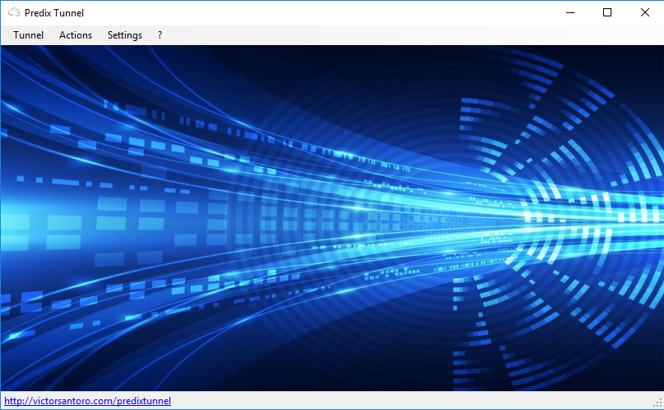
Simplicity

Slide 4
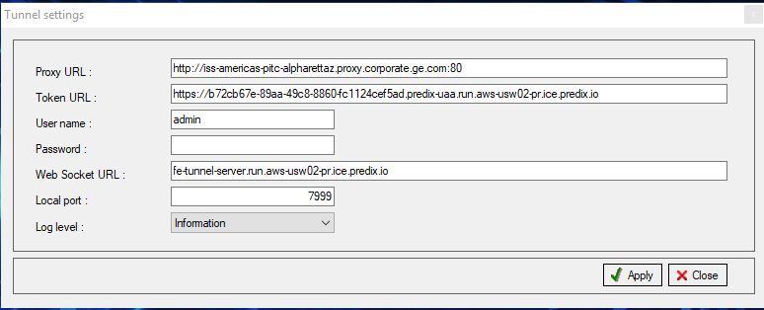
tunnel Setup

Slide 5
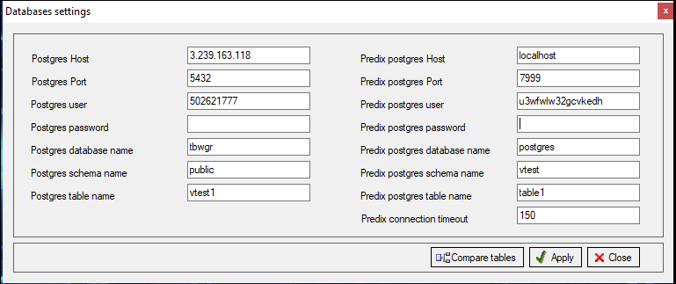
DB Setup
You can compare source and destination tables

Slide 6
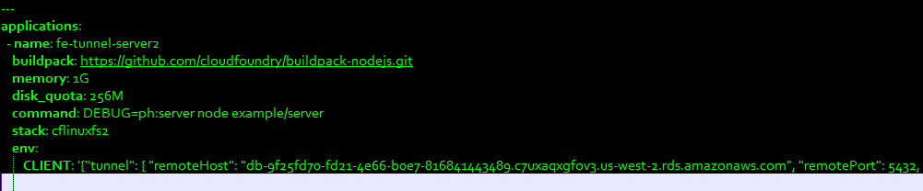
1 Minute Cloud Setup
Edit Manifest File & Config.JSON File
Push to Cloud (without windows Distributed Version Folder)

Slide 7
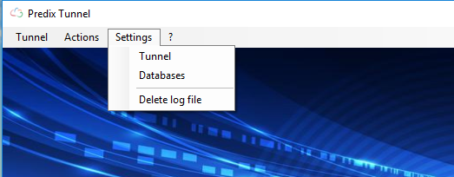
Tunnel Configuration
PostgreSQL DB Configuration
Empty the log file

Slide 8
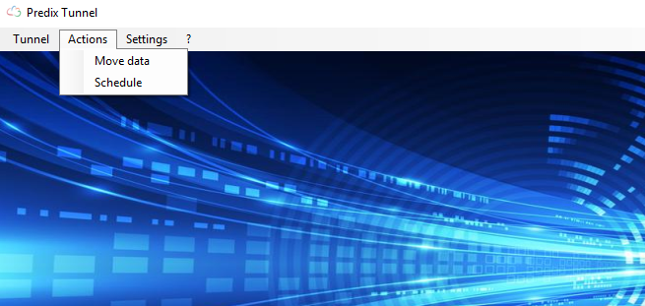
Click for 1 time data load
Schedule data loading

Slide 9
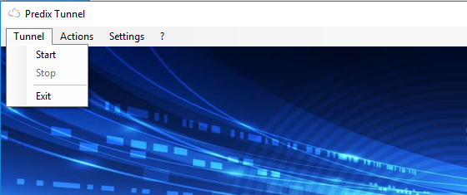
Start the Tunnel
Stop the Tunnel
Exit the program (if you click the x in the corner it will still be running in task bar to allow multiple instances

Slide 10
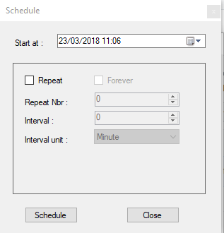
Scheduler
Choose Start data and time
Choose to Repeat
Choose Forever to move indefinitely
Choose number of repeat moves
Choose your interval and interval unit –
Minute
Hour
Day
Week

Slide 11
Data
The source and target tables must have the same column names and in the same order.
The application will select the entire source table and insert into the target cloud table.
Any data manipulations must be done in source table / view.
Use the comparison button to compare db tables.

Slide 12
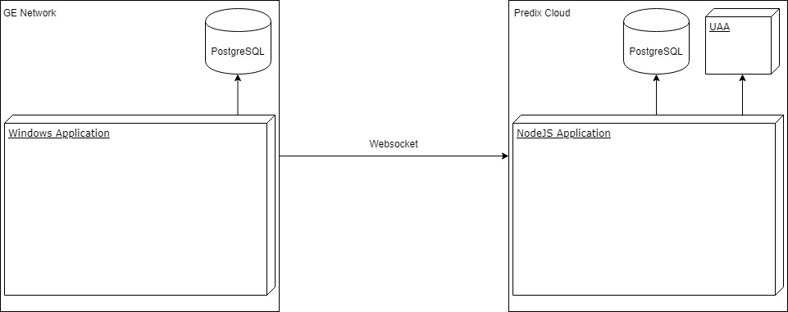
Architecture

Slide 13
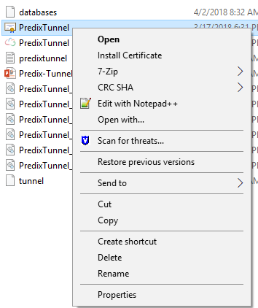
First use instructions
In the Distributed Version Folder, run the PredixTunnel security certificate right click and choose Install Certificate
Open the PredixTunnel App – copy the “Your ID” and send to email address to obtain key file. Once you receive the key file click the “Import license” and choose that key file.
Configure the Manifest.yml and Config.JSON files with your UAA/clientID/ clientSecret/nodejs url
Push nodejs app to Predix without the Distributed Version Folder.
Setup your Databases and Tunnel connections.
Leave Local Port to 7999, Leave Predix postgres Host to “localhost”, Leave Predix postgres Port to 7999.
For Large data moves you can adjust the Predix timeout seconds.
Leave Log level to “Information” for all events or change for specific warnings or Errors.
Move or schedule your data transfers (tables must be the same).

Slide 14
Contact for support & licensing
tunnelsupport@gidhr.com

