Slide 1
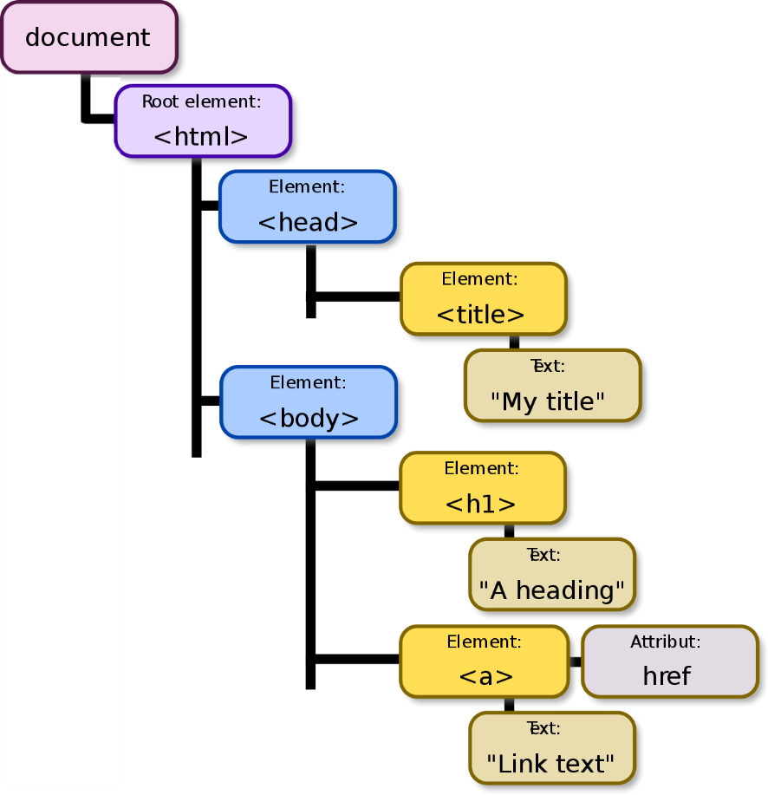
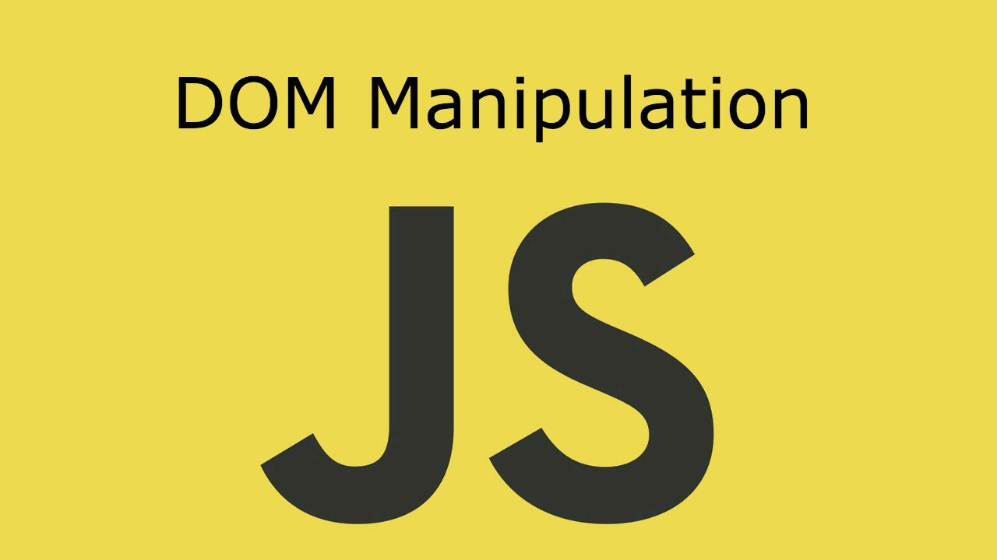
DOM Manipulation
Create / Delete DOM Elements, Handle Browser Events
SoftUni Team
Technical Trainers
Software University
http://softuni.bg

Slide 2
Table of Contents
Manipulating the DOM
Create Elements
Delete Elements
Element Attributes
Event Handling
Attach / Detach Events

Slide 3
Have a Question?
sli.do #JSCORE

Slide 4
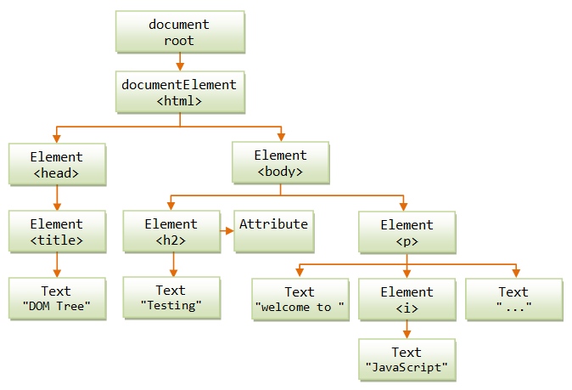
DOM Manipulation
Modify the DOM Tree

Slide 5
Creating New DOM Elements
HTML elements are created with document.createElement
This is called a Factory Pattern
Variables holding HTML elements are live:
If you modify the contents of the variable, the DOM is updated
If you insert it somewhere in the DOM, the original is moved
Text added to textContent will be escaped
Text added to innerHTML will be parsed and turned into actual HTML elements → beware of XSS attacks!

Slide 6
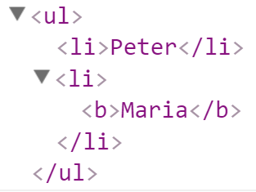
Creating New DOM Elements: Examples
let list = document.createElement("ul");
let liPeter = document.createElement("li");
liPeter.textContent = "Peter";
list.appendChild(liPeter);
let liMaria = document.createElement("li");
liMaria.innerHTML = "<b>Maria</b>";
list.appendChild(liMaria);
document.body.appendChild(list);

Slide 7
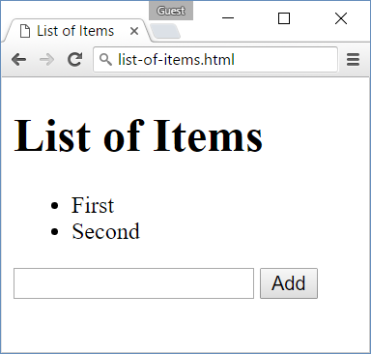
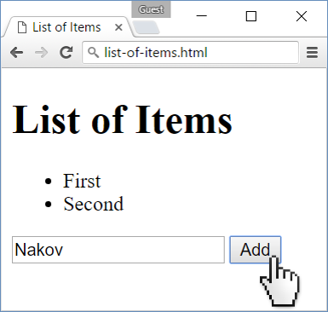
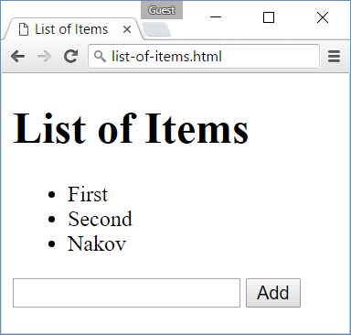
Problem: List of Items
Create a HTML page holding a list of items + text box + button for adding more items to the list
Write a JS function to append the specified text to the list

Slide 8
Problem: List of Items – HTML
<h1>List of Items</h1>
<ul id="items"><li>First</li><li>Second</li></ul>
<input type="text" id="newItemText" />
<input type="button" value="Add" onclick="addItem()">
<script>
function addItem() {
// TODO: add new item to the list
}
</script>

Slide 9
Solution: List of Items
function addItem() {
let text =
document.getElementById('newItemText').value;
let li = document.createElement("li");
li.appendChild(document.createTextNode(text));
document.getElementById("items").appendChild(li);
document.getElementById('newItemText').value = '';
}
Check your solution here: https://judge.softuni.bg/Contests/328

Slide 10
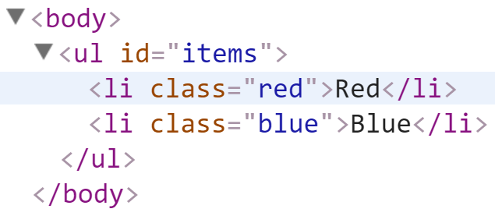
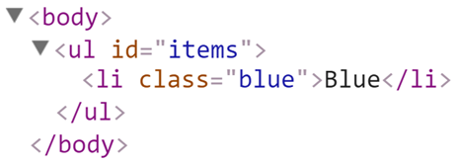
Deleting DOM Elements
<ul id="items">
<li class="red">Red</li>
<li class="blue">Blue</li>
</ul>
let redElements =
document.querySelectorAll("#items li.red");
redElements.forEach(li => {
li.parentNode.removeChild(li);
});

Slide 11
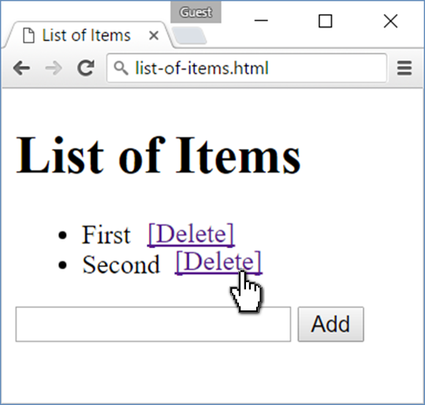
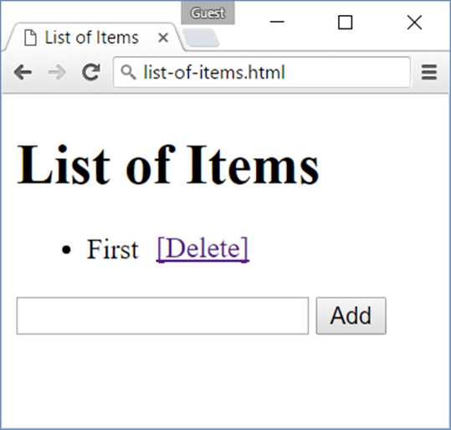
Problem: Add / Delete Items
Extend the previous problem
Implement [Delete] action as link after each list item

Slide 12
Problem: Add / Delete Items – HTML
<h1>List of Items</h1>
<ul id="items"></ul>
<input type="text" id="newText" />
<input type="button" value="Add" onclick="addItem()">
<script>
function addItem() { ...
function deleteItem() { ... }
}
</script>

Slide 13
Solution: Add / Delete Items
function addItem() {
let text = document.getElementById('newText').value;
let li = document.createElement("li");
li.appendChild(document.createTextNode(text + " "));
let span = document.createElement('span');
span.innerHTML = "<a href='#'>[Delete]</a>";
span.firstChild.addEventListener('click', deleteItem);
li.appendChild(span);
document.getElementById("items").appendChild(li);
document.getElementById('newText').value = '';

Slide 14
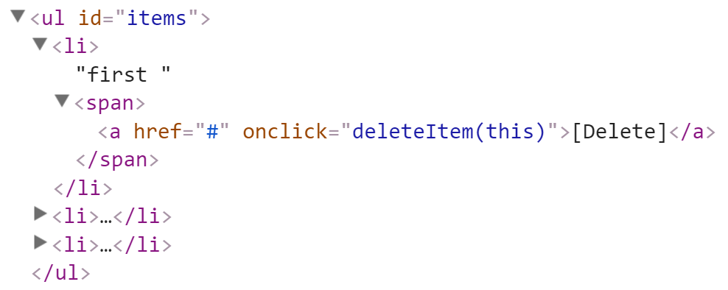
Solution: Add / Delete Items (2)
function deleteItem() {
let li = this.parentNode.parentNode;
let ul = li.parentNode;
ul.removeChild(li);
}
}
this.parentNode.parentNode == li
this.parentNode == span
this holds the clicked hyperlink
Check your solution here: https://judge.softuni.bg/Contests/328

Slide 15
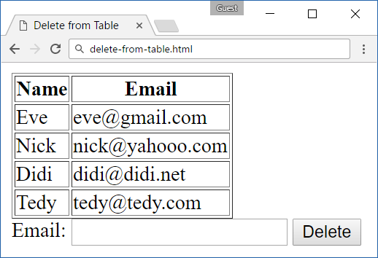
Problem: Delete from Table
<table border="1" id="customers">
<tr><th>Name</th><th>Email</th></tr>
<tr><td>Eve</td><td>eve@gmail.com</td></tr>
<tr><td>Nick</td><td>nick@yahooo.com</td></tr>
<tr><td>Didi</td><td>didi@didi.net</td></tr>
<tr><td>Tedy</td><td>tedy@tedy.com</td></tr>
</table>
Email: <input type="text" name="email" />
<button onclick="deleteByEmail()">Delete</button>
<div id="result" />

Slide 16
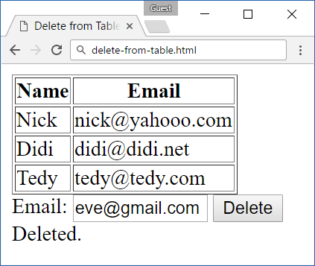
Solution: Delete from Table
function deleteByEmail() {
let email = document.getElementsByName("email")[0].value;
let secondColumn = document.querySelectorAll(
"#customers tr td:nth-child(2)");
for (let td of secondColumn)
if (td.textContent == email) {
let row = td.parentNode;
row.parentNode.removeChild(row);
document.getElementById('result').
textContent = "Deleted.";
return;
}
document.getElementById('result').textContent = "Not found.";
}
Check your solution here: https://judge.softuni.bg/Contests/328

Slide 17


Practice: DOM and Events
Live Exercises in Class (Lab)

Slide 18
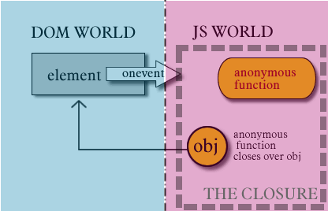
Handling Events
Browser Events and DOM Events

Slide 19
Handling Events in JS
Browsers send events to notify the JS code of interesting things that have taken place
<div id='text'>Some text</div>
let div = document.getElementById('text');
div.onmouseover = function(event) {
event.target.style.border = "3px solid green";
}
div.onmouseout = function() {
this.style.border = ""; // this === event.target
}

Slide 20
Event Types in DOM API
Mouse events
Touch events
DOM / UI events
click
mouseover mouseout mousedown
mouseup
touchstart
touchend
touchmove
touchcancel
load (finished loading)
unload (exit from page)
resize (window resized)
dragstart / drop
Keyboard events
Focus events
Form events
keydown
keypress (emit char)
keyup
focus (got focus)
blur (lost focus)
input (value changed)
change (change + leave) submit (form sent)
reset (form reset)
Learn more at https://developer.mozilla.org/docs/Web/Events

Slide 21
Add / Remove Event Handler
let textbox = document.createElement('input');
textbox.type = 'text';
textbox.value = "I am a text box";
document.body.appendChild(textbox);
textbox.addEventListener('focus', focusHandler);
function focusHandler(event) {
textbox.value = "Event handler removed";
textbox.removeEventListener('focus', focusHandler);
}
Subscribe to events like this, don't use onclick / onfocus

Slide 22
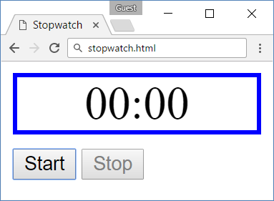
Problem: Stopwatch
A HTML page holds time-box + [Start] + [Stop] buttons
Implement the missing JS function stopwatch()
Increase the time at each second
Disable / enable buttons
<div id="time" style="border:3px solid blue; text-align:center; font-size:2em; margin-bottom:10px">00:00</div>
<button id="startBtn">Start</button>
<button id="stopBtn" disabled="true">Stop</button>
<script>window.onload = function() { stopwatch(); }</script>

Slide 23
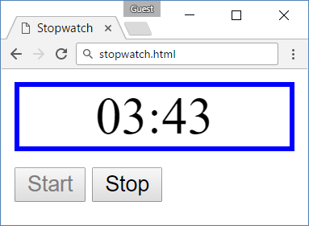
Solution: Stopwatch
function stopwatch() {
let time, intervalID;
let startBtn = document.getElementById('startBtn');
let stopBtn = document.getElementById('stopBtn');
startBtn.addEventListener('click', function() {
time = -1;
incrementTime();
intervalID = setInterval(
incrementTime, 1000);
startBtn.disabled = true;
stopBtn.disabled = false;
});

Slide 24
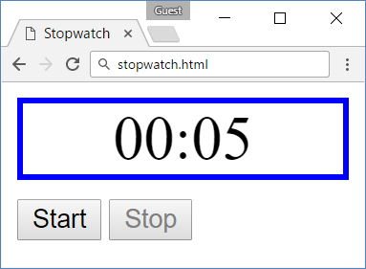
Solution: Stopwatch (2)
stopBtn.addEventListener('click', function() {
clearInterval(intervalID);
startBtn.disabled = false;
stopBtn.disabled = true;
});
function incrementTime() {
time++;
document.getElementById('time').textContent =
("0" + Math.trunc(time / 60)).slice(-2) +
':' + ("0" + (time % 60)).slice(-2);
}
}
Check your solution here: https://judge.softuni.bg/Contests/328

Slide 25
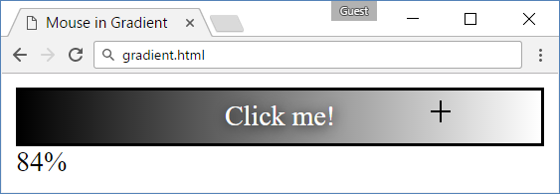
Problem: Mouse in Gradient
A HTML page holds linear gradient box
Moving the mouse should show percentage [0% … 100%], depending on the location of mouse
Left side → 0%; middle → 50%; right side → 100%

Slide 26
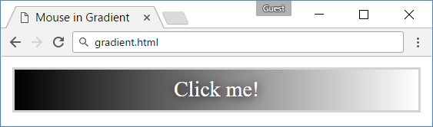
Problem: Mouse in Gradient – HTML
<html>
<head>
<title>Mouse in Gradient</title>
<link rel="stylesheet" href="gradient.css" />
<script src="gradient.js"></script>
</head>
<body onload="attachGradientEvents()">
<div id="gradient-box">
<div id="gradient">Click me!</div>
</div>
<div id="result"></div>
</body>
</html>

Slide 27
Problem: Mouse in Gradient – CSS
#gradient-box {
width: 300px;
border: 2px solid lightgrey;
}
#gradient-box:hover {
border: 2px solid black;
}
#gradient {
height: 30px;
color: white;
text-shadow:
1px 1px 10px black;
text-align: center;
line-height: 30px;
background:
linear-gradient(
to right, black, white);
cursor: crosshair;
}

Slide 28
Solution: Mouse in Gradient
function attachGradientEvents() {
let gradient = document.getElementById('gradient');
gradient.addEventListener('mousemove', gradientMove);
gradient.addEventListener('mouseout', gradientOut);
function gradientMove(event) {
let power = event.offsetX / (event.target.clientWidth - 1);
power = Math.trunc(power * 100);
document.getElementById('result').textContent = power + "%";
}
function gradientOut(event) {
document.getElementById('result').textContent = "";
}
};
Check your solution here: https://judge.softuni.bg/Contests/328

Slide 29
Problem: Highlight Active
A webpage contains multiple input boxes inside divs
Apply styling to the div that holds the focused input box
Set class "focus" for active
Remove class attribute from inactive

Slide 30
Problem: Highlight Active (2)
<!DOCTYPE html><html lang="en">
<head>
<meta charset="UTF-8"><title>Focus</title>
<link rel="stylesheet" href="focus.css" />
<script src="focus.js"></script>
</head>
<body onload="focus()">
<div>
<div><h1>Section 1</h1><input type="text"/></div>
<div><h1>Section 2</h1><input type="text"/></div>
<div><h1>Section 3</h1><input type="text"/></div>
<div><h1>Section 4</h1><input type="text"/></div>
</div>
</body>
</html>

Slide 31
Problem: Highlight Active (3)
Place all project files in the same folder
Listen for focus and blur events
focus.css
div {
width: 470px;
}
div div {
text-align: center;
display: inline-block;
width: 200px;
height: 200px;
margin: 15px;
border: 1px solid #999;
}
.focused {
background: #999999;
}
focus.js
function focus() {
// TODO
}

Slide 32
Solution: Highlight Active
function focus() {
let inputs = document.getElementsByTagName('input');
Array.from(inputs).forEach(i => {
i.addEventListener('focus', (event) => {
event.target.parentNode.className = 'focused';
});
i.addEventListener('blur', (event) => {
event.target.parentNode.removeAttribute('class');
});
});
}

Slide 33


Problem: Dynamic Validation
A webpage contains a single email input field
Display real-time feedback for user's input
Valid input format: <name>@<domain>.<extension>
Only lowercase Latin letters are allowed for all parts
Apply class "error" when input is invalid
.error { border: 2px solid red; }
<label for="email">Enter email:</label>
<input id="email" type="text"/>

Slide 34
Solution: Dynamic Validation
function validate() {
document.querySelector('input')
.addEventListener('change', onChange);
let regex = /^([\w\-.]+)@([a-z]+)(\.[a-z]+)+$/;
function onChange(event) {
if (!regex.test(event.target.value))
event.target.className = 'error';
else
event.target.removeAttribute('class');
}
}

Slide 35
Practice: DOM and Events
Live Exercises in Class (Lab)

Slide 36

Summary
Arrow functions ≈ short function syntax
Modifying DOM elements:
Handling events:
let menu = document.getElementById('menu');
menu.style.display = 'none';
menu.appendChild(
document.createElement('hr'));
let link = menu.children[0];
menu.removeChild(link);
let menu = document.getElementById('menu');
menu.onclick = function(event) { … }

Slide 37
https://softuni.bg/trainings/2081/js-advanced-october-2018

Slide 38













SoftUni Diamond Partners

Slide 39





SoftUni Organizational Partners

Slide 40




Trainings @ Software University (SoftUni)
Software University – High-Quality Education and Employment Opportunities
softuni.bg
Software University Foundation
http://softuni.foundation/
Software University @ Facebook
facebook.com/SoftwareUniversity
Software University Forums
forum.softuni.bg

Slide 41

License
This course (slides, examples, demos, videos, homework, etc.) is licensed under the "Creative Commons Attribution-NonCommercial-ShareAlike 4.0 International" license

