Slide 1
PARKINSON’S DISEASE GAIT ANALYSIS USING RNN
SIMPLE RNN—GRU—LSTM
BINARY CLASSIFICATION

Slide 2
Hyperparameter and model setting
Dropout = 0.5
Learning rate = 0.001 (learning decay used)
Optimizer = Adam
Batch size = 800
Training-Test split = 75-25 % (from the training set, validation set of 20% is taken during training)
Loss function = Binary Cross Entropy

Slide 3
METRICS
S.NO | METRICS | SIMPLE RNN | GRU | LSTM
1 | TRAINING ACCURACY | 0.9622 | 0.9820 | 0.9721
2 | TRAINING LOSS | 0.1036 | 0.0489 | 0.0750
3 | VALIDATION ACCU. | 0.9621 | 0.9817 | 0.9718
4 | VALIDATION LOSS | 0.1029 | 0.0497 | 0.0753
5 | TESTING ACCURACY | 0.9617 | 0.9816 | 0.9711
6 | TESTING LOSS | 0.1031 | 0.0498 | 0.0758
7 | PRECISION | 0.9617 | 0.9816 | 0.9711
8 | RECALL | 0.9617 | 0.9816 | 0.9711
9 | AUROC | 0.9537 | 0.9781 | 0.9651

Slide 4
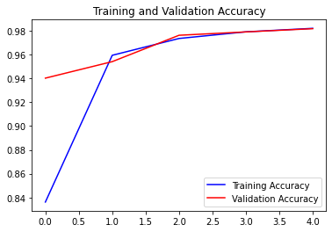
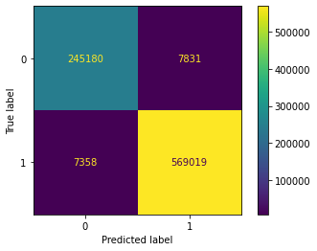
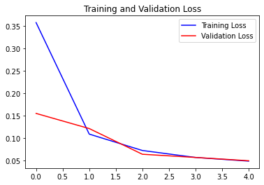
GRU

Slide 5
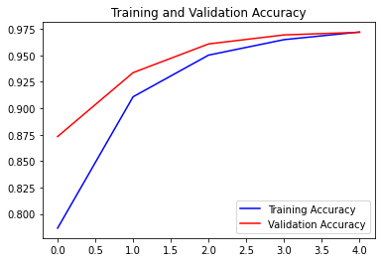
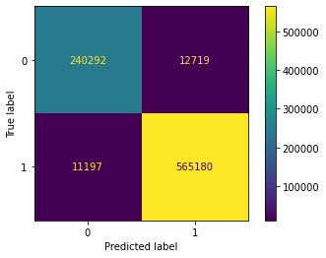
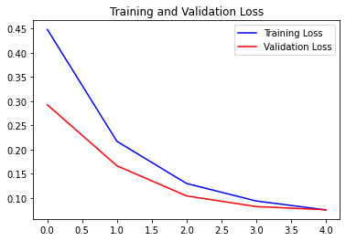
LSTM

Slide 6
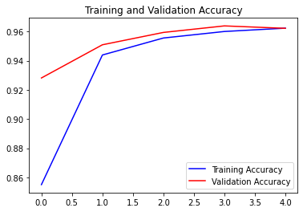

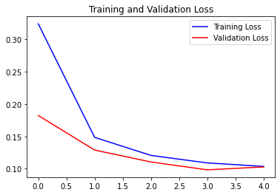
SIMPLE RNN

Slide 7
PARKINSON’S DISEASE GAIT ANALYSIS USING RNN
SIMPLE RNN—GRU—LSTM
HOEHNYAHR SCALE - MULTI CLASS CLASSIFICATION

Slide 8
Hyperparameter and model setting
Dropout = 0.5
Learning rate = 0.001 (learning decay used)
Optimizer = Adam
Batch size = 800
Training-Test split = 75-25 % (from the training set, validation set of 20% is taken during training)
Loss function = CATEGORICAL Cross Entropy

Slide 9
METRICS
S.NO | METRICS | SIMPLE RNN | GRU | LSTM
1 | TRAINING ACCURACY | 0.9354 | 0.9707 | 0.9634
2 | TRAINING LOSS | 0.1851 | 0.0812 | 0.1018
3 | VALIDATION ACCU. | 0.9267 | 0.9710 | 0.9638
4 | VALIDATION LOSS | 0.2050 | 0.0785 | 0.0986
5 | TESTING ACCURACY | 0.9270 | 0.9704 | 0.9639
6 | TESTING LOSS | 0.2045 | 0.07954 | 0.0986
7 | PRECISION | 0.9270 | 0.9704 | 0.9639
8 | RECALL | 0.9270 | 0.9704 | 0.9639
9 | AUROC | 0.9640 | 0.9781 | 0.9788

Slide 10
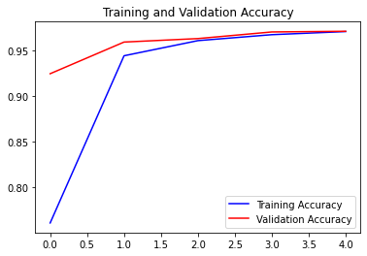
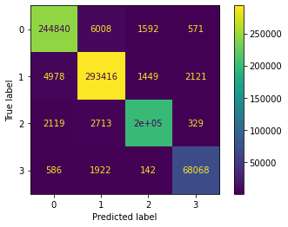
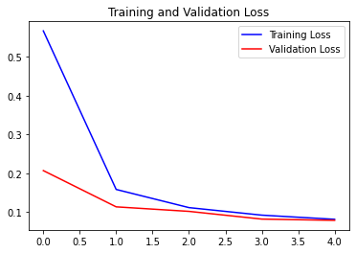
GRU

Slide 11
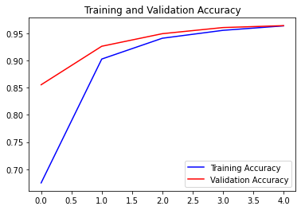

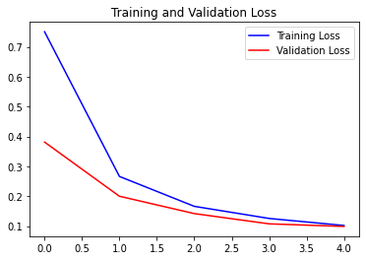
LSTM

Slide 12
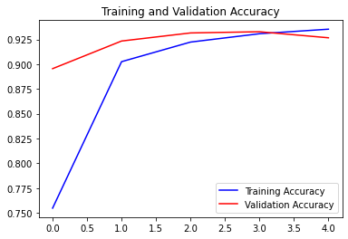

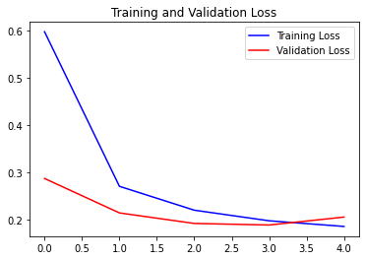
SIMPLE RNN

Slide 13
PARKINSON’S DISEASE GAIT ANALYSIS USING RNN
SIMPLE RNN—GRU—LSTM
UPDRS SCALE - MULTI CLASS CLASSIFICATION

Slide 14
Hyperparameter and model setting
Dropout = 0.5
Learning rate = 0.001 (learning decay used)
Optimizer = Adam
Batch size = 800
Training-Test split = 75-25 % (from the training set, validation set of 20% is taken during training)
Loss function = CATEGORICAL Cross Entropy

Slide 15
METRICS
S.NO | METRICS | SIMPLE RNN | GRU | LSTM
1 | TRAINING ACCURACY | 0.9355 | 0.9714 | 0.9649
2 | TRAINING LOSS | 0.1890 | 0.0805 | 0.0982
3 | VALIDATION ACCU. | 0.9412 | 0.9712 | 0.9654
4 | VALIDATION LOSS | 0.1684 | 0.0787 | 0.0943
5 | TESTING ACCURACY | 0.9414 | 0.9713 | 0.9657
6 | TESTING LOSS | 0.1681 | 0.0786 | 0.0937
7 | PRECISION | 0.9414 | 0.9713 | 0.9657
8 | RECALL | 0.9414 | 0.9713 | 0.9657
9 | AUROC | 0.9742 | 0.9935 | 0.9945

Slide 16
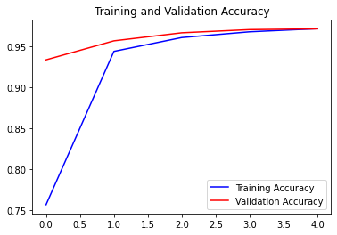
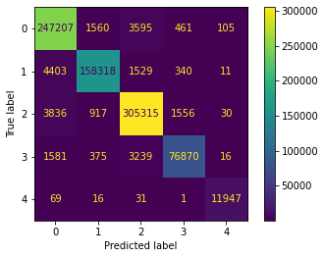
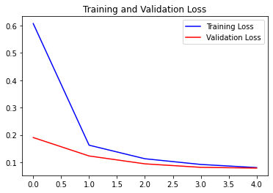
GRU

Slide 17


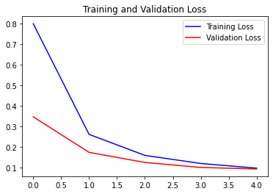
LSTM

Slide 18
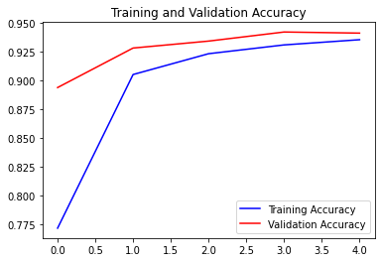
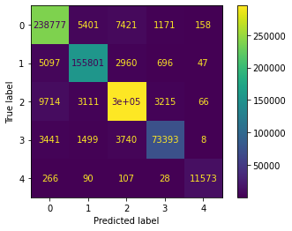
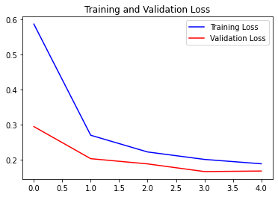
SIMPLE RNN

