Slide 1
How to do Data Science?
- A Colaberry Data Science Module

Slide 2
Agenda
Our Approach to Data Science
2 Steps to Modeling
4 Steps to Optimization
7 Steps to Data Science

Slide 3

Our Approach to Data Science

Slide 4
The Essence of Data Science
Problem Statement
Data Acquisition
Problem Identification
Exploratory Data Analysis
Model Selection
Model Application
Production
Data Science is a meticulous, detailed and well-executed experimentation on data
The objective is to mine the data available and learn patterns
The process contains 7 steps, which are shown in the workflow diagram to the right hand side.
The process would seem overwhelming for new learners. Hence we broke this workflow into 3 stages, introducing (and focusing on) a few key steps in each stage.

Slide 5

Steps in Data Science Workflow
2
4
7
Steps to Modeling
2 key steps that are essential to learn how to choose, design and apply a model.
Steps to Optimization
Additional steps like EDA, Problem Identification get added to Modeling
stages.
Steps to Data Science
This phase adds Problem Statement, Data Acquisition and Production stages.
Click to see
DS Process Flow

Slide 6
2 Steps to Modeling

Slide 7
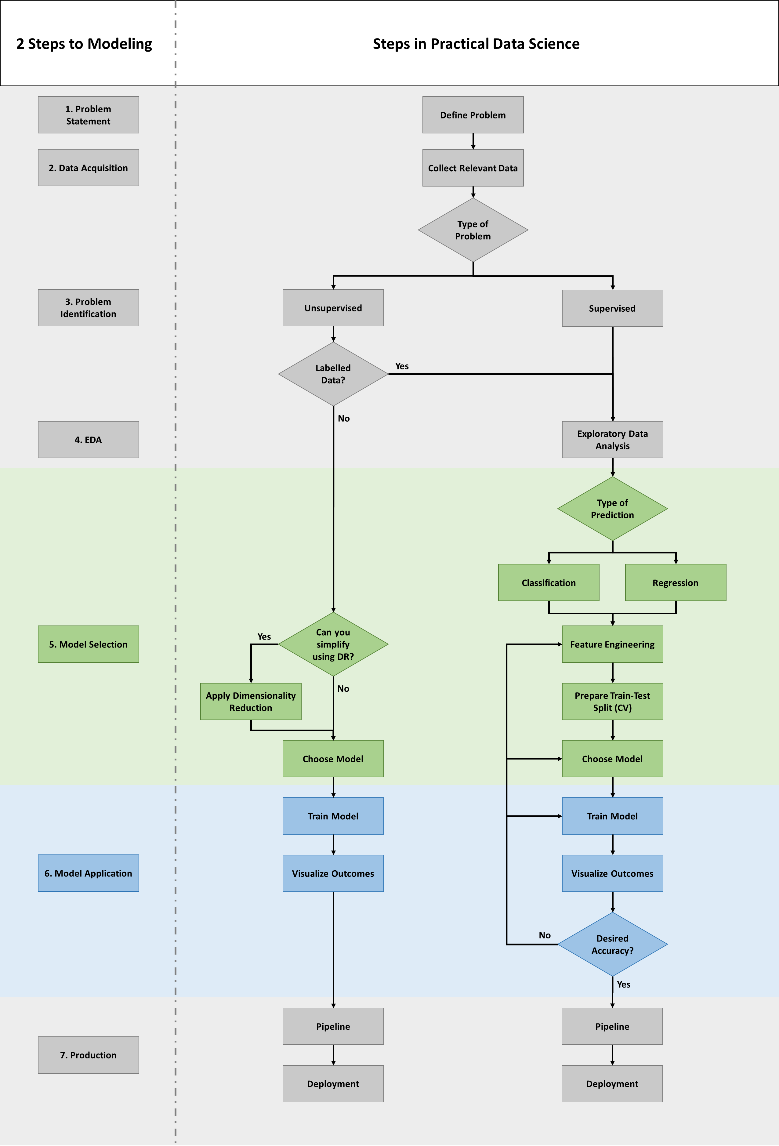
The 2 Steps to Modeling

Slide 8
Step 1 – Model Selection
Model Selection
Model Application
Model Selection is the process of selecting a model or a group of applicable models for a given problem.
Models can be effectively selected based on the below given criteria
Expected outcome (including value, type etc.)
Available data inputs (including nature, scale, etc.)
Choice of machine learning approach

Slide 9
Step 2 – Model Application
Model Selection
Model Application
Model Application is the process of applying a model to processed features from a given dataset.
Model Application generally involves the application of –
fit() – The fit function is generally used to apply the model function to learn the patterns among the features of the dataset.
predict() – The predict function is used to predict a few sample values of the target variable based on sample input values of the predictors.

Slide 10
4 Steps to Optimization

Slide 11
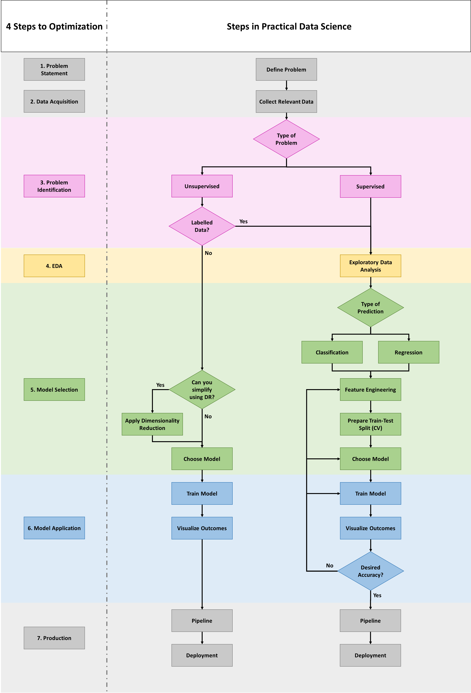
The 4 Steps to Optimization

Slide 12
Step 1 – Problem Identification
Problem Identification
EDA
Model Selection
Model Application
Problem Identification:
In this step, the questions framed in the problem statement, the data collected in the data acquisition stage are analysed to determine the nature of the problem.
Dataset is analysed to identify whether the data has labels or not. Labelled data is where the metadata of every data point is clearly known and we have a clear association among the features of the dataset.

Slide 13
Step 2 – Exploratory Data Analysis
Problem Identification
EDA
Model Selection
Model Application
Exploratory Data Analysis (EDA):
Understanding the data you are going to work with, is critical
Domain knowledge and a good data dictionary explain the meaning of various features of the dataset
Descriptive statistics is used to understand more about the data and the nature of various observations of each feature – central tendency, variations, distribution etc.

Slide 14
Step 3 – Model Selection
Problem Identification
EDA
Model Selection
Model Application
Model Selection is the process of selecting a model or a group of applicable models for a given problem.
Models can be effectively selected based on the below given criteria
Expected outcome (including value, type etc.)
Available data inputs (including nature, scale, etc.)
Choice of machine learning approach

Slide 15
Step 4 – Model Application
Problem Identification
EDA
Model Selection
Model Application
Model Application is the process of applying a model to processed features from a given dataset.
Model Application generally involves the application of –
fit() – The fit function is generally used to apply the model function to learn the patterns among the features of the dataset.
predict() – The predict function is used to predict a few sample values of the target variable based on sample input values of the predictors.

Slide 16
7 Steps to Data Science

Slide 17
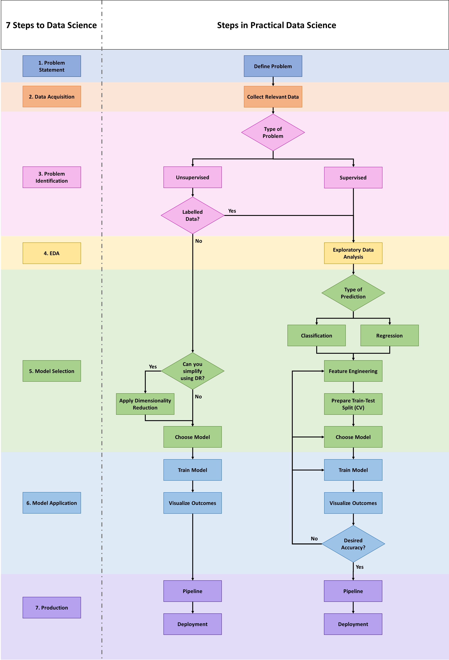
The 7 Steps to Data Science

Slide 18
Step 1 – Problem Statement
Problem Statement
Data Acquisition
Problem Identifica-tion
Model Selection
Model Application
EDA
Production
Problem Statement:
Define the problem you are trying to address/the process you are trying to improve
Have questions to be asked from the data – A data scientist may not always have clear requirements and unexpected insights may be discovered by experimentation
How does it positively impact your business or what negative impact are you trying to avoid?

Slide 19
Step 2 – Data Acquisition
Problem Statement
Data Acquisition
Problem Identifica-tion
Model Selection
Model Application
EDA
Production
Data Acquisition:
Identify various datasets and data points required to approach and possible solve the problem statement
Identify the various sources of data from where you can extract the above required data
Analyse the general quality and adequacy of such data and perform transformation and cleaning operations to enable further data access and analysis

Slide 20
Step 3 – Problem Identification
Problem Statement
Data Acquisition
Problem Identifica-tion
Model Selection
Model Application
EDA
Production
Problem Identification:
In this step, the questions framed in the problem statement, the data collected in the data acquisition stage are analysed to determine the nature of the problem.
Dataset is analysed to identify whether the data has labels or not. Labelled data is where the metadata of every data point is clearly known and we have a clear association among the features of the dataset.

Slide 21
Step 4 – Exploratory Data Analysis
Problem Statement
Data Acquisition
Problem Identifica-tion
Model Selection
Model Application
EDA
Production
Exploratory Data Analysis (EDA):
Understanding the data you are going to work with, is critical
Domain knowledge and a good data dictionary explain the meaning of various features of the dataset
Descriptive statistics is used to understand more about the data and the nature of various observations of each feature – central tendency, variations, distribution etc.

Slide 22
Step 5 – Model Selection
Problem Statement
Data Acquisition
Problem Identifica-tion
Model Selection
Model Application
EDA
Production
Model Selection is the process of selecting a model or a group of applicable models for a given problem.
Models can be effectively selected based on the below given criteria
Expected outcome (including value, type etc.)
Available data inputs (including nature, scale, etc.)
Choice of machine learning approach

Slide 23
Step 6 – Model Application
Problem Statement
Data Acquisition
Problem Identifica-tion
Model Selection
Model Application
EDA
Production
Model Application is the process of applying a model to processed features from a given dataset.
Model Application generally involves the application of –
fit() – The fit function is generally used to apply the model function to learn the patterns among the features of the dataset.
predict() – The predict function is used to predict a few sample values of the target variable based on sample input values of the predictors.

Slide 24
Step 7 - Production
Problem Statement
Data Acquisition
Problem Identifica-tion
Model Selection
Model Application
EDA
Production
Production:
Production involves deploying the model built in a cloud environment
This process involves separating the model and its co-efficients/hyper parameters, testing the model under various conditions, using cookie cutter frameworks (optional) and finally deploying and running it on a server
Models have to be frequently maintained in order to stay relevant to changing business processes, programming language code, changes in data/features etc.

Slide 25
Appendix

Slide 26
DS Process Flow
Problem Statement
Data Acquisition
Problem Identification
Exploratory Data Analysis
Model Selection
Model Application
Production

