Slide 1
How to do Data Science?
- A Colaberry Data Science Module

Slide 2
Agenda
Our Approach to Data Science
4 Steps to Model Building
6 Steps to Data Science

Slide 3

Our Approach to Data Science

Slide 4
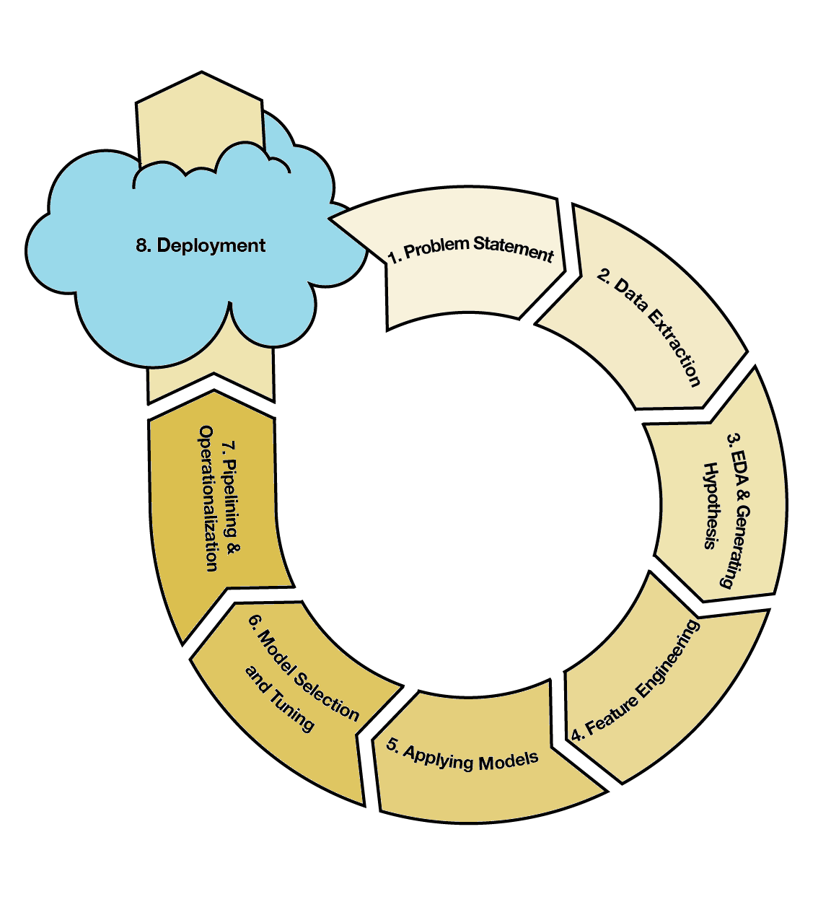
The Essence of Data Science
Data Science is a meticulous, detailed and well-executed experimentation on data
The objective is to mine the data available and learn patterns
The process involves multiple steps out of which 8 of the major, common steps are shown in the workflow diagram to the right hand side.
The process would seem overwhelming for new learners. Hence we broke this workflow into 3 stages, introducing (and focusing on) a few key steps in each stage.

Slide 5

Steps in Data Science Workflow
4
6
3
Steps to Model Building
4 key steps that need to be kept in mind while building a data science model
Steps to Data Science
Additional steps like EDA, Model Selection, Pipelining get added to modeling
Steps to a DS Project
This phase is ‘rinse and repeat’, where a project is taken up and solved from scratch
Click to see
DS Process Flow

Slide 6
4 Steps to Model Building

Slide 7
Step 1 – Problem Statement
Problem Statement
Perform Modeling
Reporting Results
Operation-alization
Problem Statement:
Define the problem you are trying to address/the process you are trying to improve
Have questions to be asked from the data – A data scientist may not always have clear requirements and unexpected insights may be discovered by experimentation
How does it positively impact your business or what negative impact are you trying to avoid?

Slide 8
Step 2 – Perform Modeling
Problem Statement
Perform Modeling
Reporting Results
Operation-alization
Performing Modelling
Perform analysis on the data – feature selection involves identification of independent and dependent various for model building
Fit a model to the features so as to achieve a certain outcome
Are your questions answered?

Slide 9
Step 3 – Reporting Results
Problem Statement
Perform Modeling
Reporting Results
Operation-alization
Reporting Results
Make new predictions using trained models, interpret model results
Make visualisations to present the results graphically
Present the results of analysis to business users

Slide 10
Step 4 - Operationalization
Problem Statement
Perform Modeling
Reporting Results
Operation-alization
Operationalization
Operationalize and deploy the models to a cloud environment for easy distribution and maintenance
Ensure the models are maintainable and updated as the business environment changes
Optimize the models to meet changing business needs

Slide 11
6 Steps to Data Science

Slide 12
Step 1 – EDA
Problem Identifica-tion
Apply Models
Model Selection
EDA
Pipelining
Deployment
Exploratory Data Analysis (EDA):
Understanding the data you are going to work with is the first step
Domain knowledge and a good data dictionary explain the meaning of various features of the dataset
Descriptive statistics is used to understand more about the data and the nature of various observations of each feature – central tendency, variations, distribution etc.

Slide 13
Step 2 – Problem Identification
Problem Identifica-tion
Apply Models
Model Selection
EDA
Pipelining
Deployment
Problem Identification:
EDA helps us understand the type, context and nature of data we will work with. The question that we would like to answer gives us an idea of expected output.
With the combined information of input data and expected output, we can identify what class of models and what steps of data processing are required.
Problem identification helps understand which models are applicable to the data.

Slide 14
Step 3 – Apply Models
Problem Identifica-tion
Apply Models
Model Selection
EDA
Pipelining
Deployment
Apply Models:
This step in the process goes back to the previous phase of model building
Once step 1 (Problem Statement) is defined, steps 2 and 3 (Perform Modeling and Reporting Results) can be repeated for every model that would be applied
Step 4 (Operationalization) is carried out only for the best of the models

Slide 15
Step 4 – Model Selection
Problem Identifica-tion
Apply Models
Model Selection
EDA
Pipelining
Deployment
Model Selection:
Model Selection is performed based on Model Validation techniques
Many statistical measures can be used to validate the models built
For a given problem and data set, a single statistic may be consistently used to measure accuracy of multiple models
The model with optimal accuracy if chosen as the one to be deployed

Slide 16
Step 5 – Pipelining
Problem Identifica-tion
Apply Models
Model Selection
EDA
Pipelining
Deployment
Pipelining:
This is the process of defining information flows into the model built
New data is generated continuously and models may need to be executed periodically in order to generate new insights
This step defines the features which need to extracted as independent, dependent variables and the way they feed into the model

Slide 17
Step 6 - Deployment
Problem Identifica-tion
Apply Models
Model Selection
EDA
Pipelining
Deployment
Deployment:
Deployment involves productionalizing the model built in a cloud environment
Models have to be frequently maintained in order to stay relevant to changing business processes, programming language code, changes in data etc.

Slide 18
Appendix

Slide 19
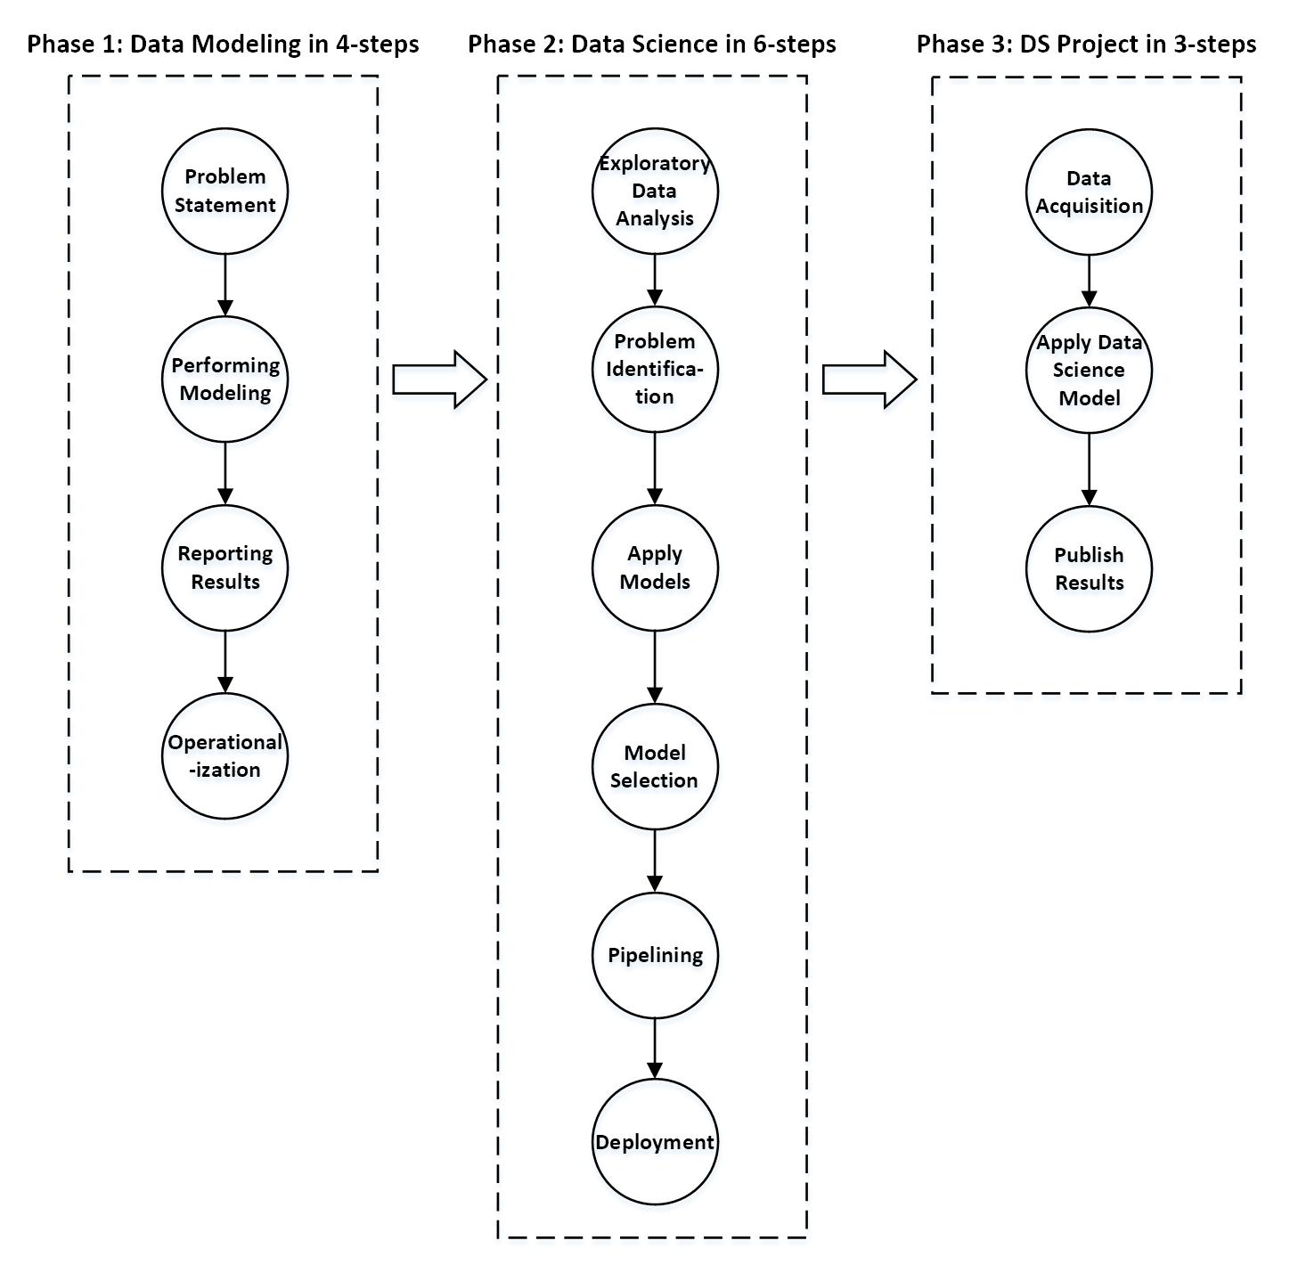
DS Process Flow

