Slide 1
PROJECT 7
Disaster Tweet Classification
Using NLP & Machine Learning
Submitted by: Satish Vonteddu
Program: Data Analytics Internship
Organization: NextHikes IT Solutions
Batch: L-110226-W2PM-B15
Submission: 15 October 2026
Project 7 • Satish Vonteddu • 1

Slide 2
Project at a Glance
7,613
Tweets
5,003
Features
81.55%
Final Accuracy
76.80%
Final F1
87.27%
ROC-AUC
• Goal: classify tweets as real disaster vs non-disaster.
• Approach: NLP preprocessing + TF-IDF + tweet-level features + machine learning.
• Final model: tuned Multinomial Naive Bayes (alpha = 0.5).
• Deployment: Streamlit Community Cloud with a simple prediction interface.
Project 7 • Satish Vonteddu • 2

Slide 3
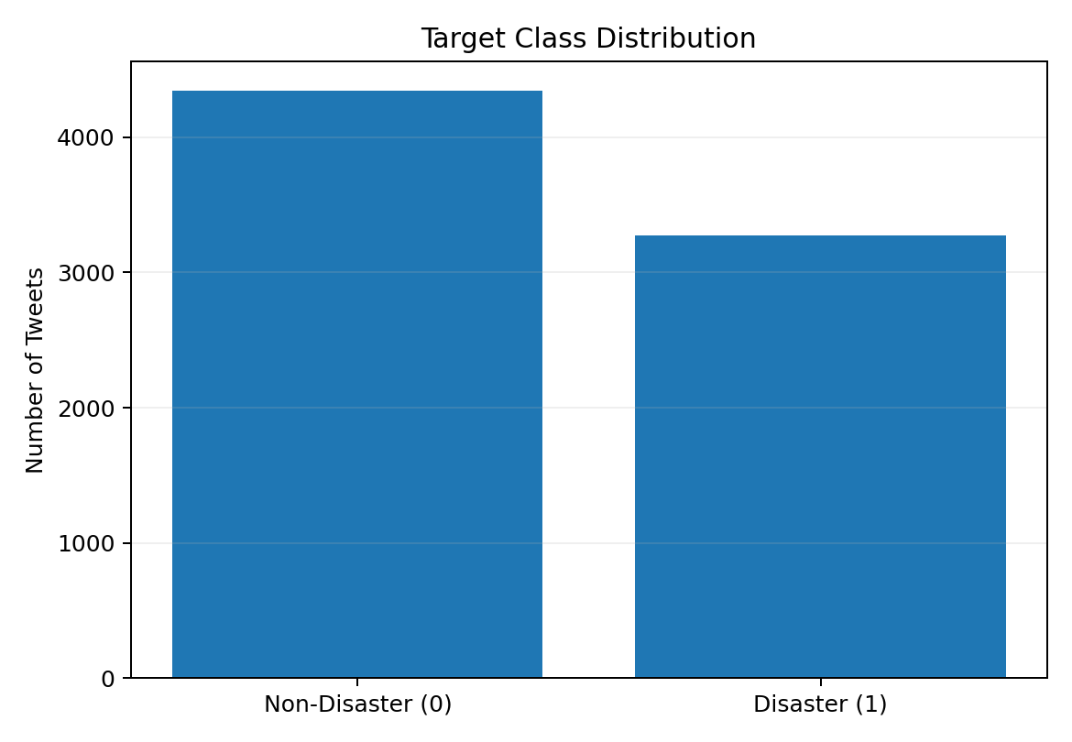
Dataset & EDA
• Dataset: twitter_disaster.csv
• 7,613 rows × 5 columns
• 4,342 non-disaster (57.03%)
• 3,271 disaster (42.97%)
• Missing: keyword 61; location 2,534
• Important: supplied CSV has 7,613 rows although the brief referenced 10,000.
Project 7 • Satish Vonteddu • 3

Slide 4
Text Preprocessing & Feature Engineering
• Lowercase → remove URLs/HTML → remove punctuation/special characters.
• Normalize whitespace → tokenize → remove English stopwords.
• WordNet lemmatization creates the cleaned final_text field.
• TF-IDF: 5,000 maximum features.
• Additional features: tweet length, hashtag indicator, mention indicator.
• Final feature space: 5,003 features.
• 80/20 stratified split: 6,090 train / 1,523 test.
Project 7 • Satish Vonteddu • 4

Slide 5
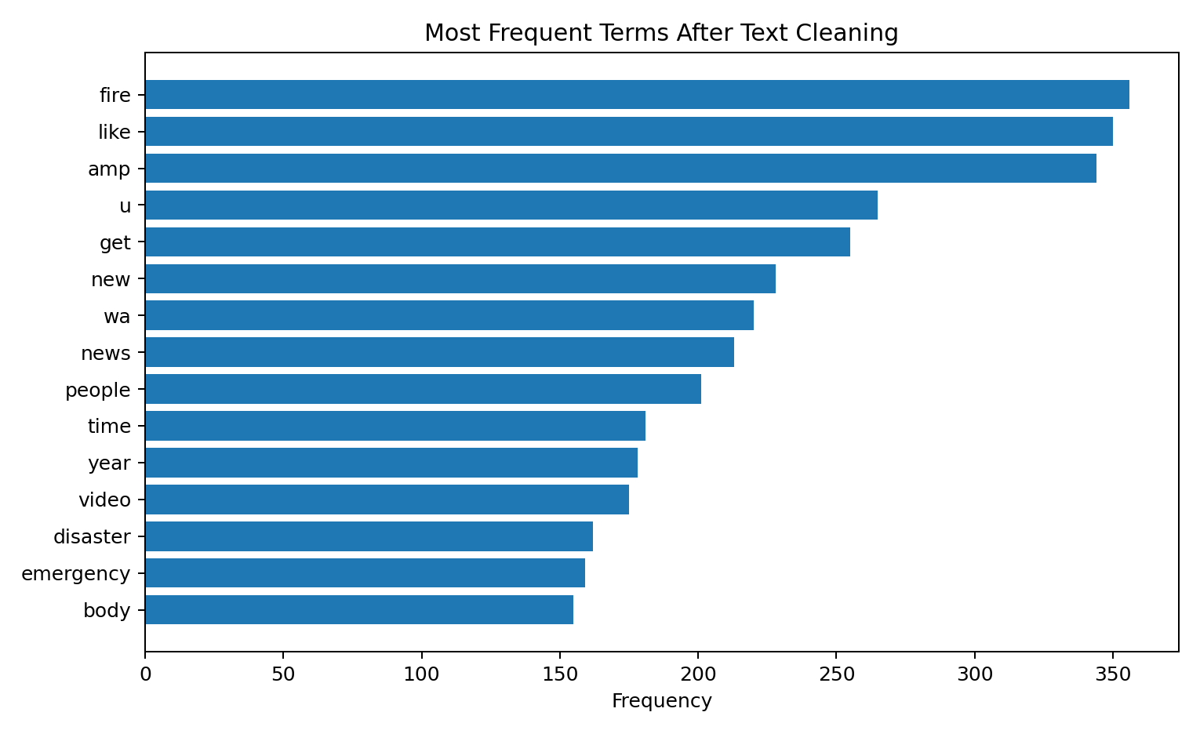
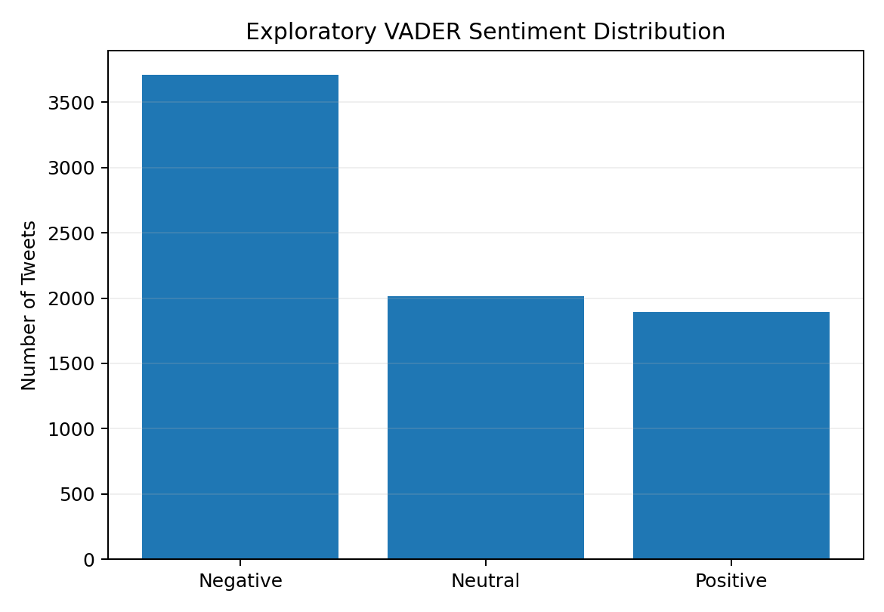
Exploratory Analysis — Frequent Words & Sentiment
VADER: 3,708 negative • 2,012 neutral • 1,893 positive
Project 7 • Satish Vonteddu • 5

Slide 6
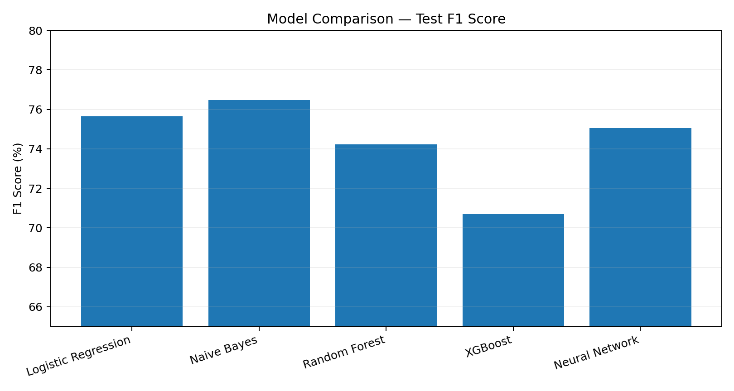
Model Comparison
• Logistic Regression: F1 75.66%
• Naive Bayes: F1 76.47%
• Random Forest: F1 74.22%
• XGBoost: F1 70.70%
• Neural Network: F1 75.06%
Project 7 • Satish Vonteddu • 6

Slide 7
Cross-Validation & Hyperparameter Tuning
• 5-fold CV F1 — Logistic Regression: mean 0.7527, std 0.0082.
• 5-fold CV F1 — Naive Bayes: mean 0.7394, std 0.0144.
• Logistic Regression grid: C = [0.1, 1, 10], solvers liblinear/lbfgs.
• Best Logistic Regression: C = 1, lbfgs; test F1 remained 75.66%.
• Naive Bayes alpha grid: [0.01, 0.1, 0.5, 1, 2].
• Best alpha = 0.5 → selected final model.
Project 7 • Satish Vonteddu • 7

Slide 8
Final Model — Tuned Multinomial Naive Bayes
Alpha = 0.5
81.55%
Accuracy
83.48%
Precision
71.10%
Recall
76.80%
F1 Score
87.27%
AUC
• Average Precision: 87.28%.
• Confusion matrix: TN 777 | FP 92 | FN 189 | TP 465.
• The final model was serialized and reused for application inference.
Project 7 • Satish Vonteddu • 8

Slide 9
Error Analysis & Generalization
777
True Negative
92
False Positive
• Training F1 = 0.8382; test F1 = 0.7680.
• Training-test gap = 7.02 percentage points.
• This indicates a moderate training-test performance gap.
• Practical inference was validated with an unseen earthquake example.
189
False Negative
465
True Positive
Project 7 • Satish Vonteddu • 9

Slide 10
Deployment Architecture
1
User Tweet
2
Preprocess
3
TF-IDF + 3 Features
4
Serialized NB Model
5
Prediction + Confidence
6
Streamlit UI
• Local Flask version: app.py + Templates/index.html.
• Public Streamlit version: disaster_classifier_app.py.
• Deployment platform: Streamlit Community Cloud.
• Python version configured for deployment: 3.13.
Project 7 • Satish Vonteddu • 10

Slide 11
Live Application Validation
93.14%
Disaster test — flood/evacuation
79.69%
Non-disaster metaphor — cooking
• Both classes were tested successfully on the public deployment.
• The UI returns a clear class label and prediction confidence.
https://disaster-tweet-classification-baylfnxfscsp4xt4dmffxa.streamlit.app/
Project 7 • Satish Vonteddu • 11

Slide 12
GitHub Repository — Submission Ready
• README.md — complete project documentation and links.
• disaster_classifier_app.py — Streamlit app.
• app.py + Templates/index.html — Flask app.
• disaster_tweet_model.pkl — trained model.
• tfidf_vectorizer.pkl — vectorizer.
• requirements.txt — dependencies.
• .gitignore, .python-version, LICENSE — repository configuration.
https://github.com/vsatish5621/Disaster-Tweet-Classification
Project 7 • Satish Vonteddu • 12

Slide 13
Important Technical Limitation
• TF-IDF was fitted before the train/test split in this project run.
• That introduces mild data leakage because vocabulary statistics were exposed to the full dataset.
• Therefore, the reported metrics should not be presented as a strictly leakage-free benchmark.
• Recommended next step: use a scikit-learn Pipeline so TF-IDF is fitted only on training data within validation folds.
Project 7 • Satish Vonteddu • 13

Slide 14
Future Improvements
• Leakage-free Pipeline and stronger validation strategy.
• Word2Vec/GloVe or transformer-based embeddings.
• Class weighting and threshold tuning to improve disaster recall.
• Deeper error analysis for ambiguous/metaphorical tweets.
• Richer UI analytics and prediction history.
• External unseen-dataset evaluation.
Project 7 • Satish Vonteddu • 14

Slide 15
Requirement Coverage
• EDA & preparation ✓
• Text cleaning, tokenization & lemmatization ✓
• Word-frequency & sentiment exploration ✓
• TF-IDF + additional tweet features ✓
• Five candidate models + cross-validation ✓
• Hyperparameter tuning ✓
• Accuracy / Precision / Recall / F1 / ROC-AUC / AP ✓
• Confusion matrix & error analysis ✓
• Model serialization ✓
• Flask local application ✓
• Streamlit public deployment ✓
• GitHub repository + live validation ✓
Project 7 • Satish Vonteddu • 15

Slide 16
FINAL CONCLUSION
A complete NLP classification workflow was built, evaluated and deployed.
81.55% Accuracy • 76.80% F1 • 87.27% ROC-AUC
GitHub
https://github.com/vsatish5621/Disaster-Tweet-Classification
Live App: https://disaster-tweet-classification-baylfnxfscsp4xt4dmffxa.streamlit.app/
Project 7 • Satish Vonteddu • 16

Slide 17
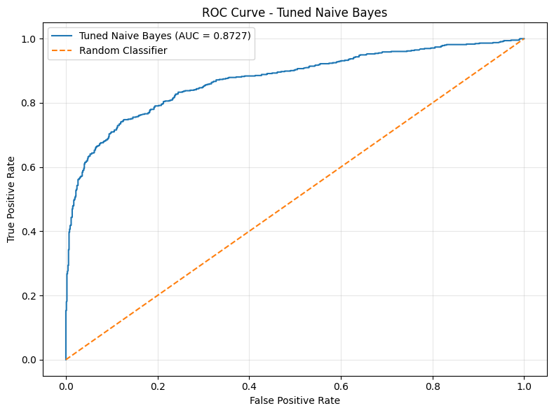
ROC Curve – Tuned Multinomial Naive Bayes
ROC-AUC = 0.8727

Slide 18
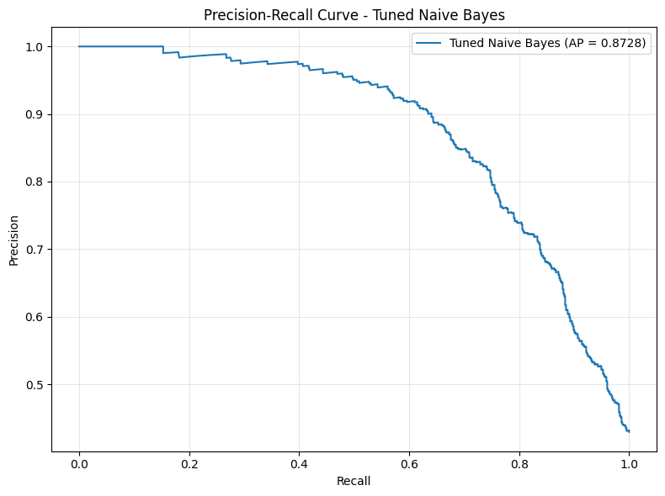
Precision–Recall Curve – Tuned Multinomial Naive Bayes
Average Precision = 0.8728

