Slide 1
Rossmann Sales Forecasting
Project 6 • Final Presentation
ROSSMANN
SALES FORECASTING
Retail Sales • Customer Demand • Deep Learning • MLOps • BI • Deployment
Official submission: 15 September 2026
GitHub: vsatish5621/Rossmann-Sales-Forecasting
Submitted By:
Data Analytics Internship
L-110226-W2PM-B15
Name: Satish Vonteddu
NextHikes IT Solutions
Submission Date: 15 September 2026
01

Slide 2
Executive Summary
End-to-end solution
Training rows
Stores
Final test rows
Sales RF R²
1,017,209
1,115
41,088
0.8859
• Forecast daily store Sales up to six weeks ahead.
• Model both Sales and Customers for business usability.
• Combine Random Forest with an LSTM time-series model.
• Track models with MLflow and data with DVC.
• Deliver Power BI insights and a deployed Streamlit application.
02

Slide 3
Business Need & Official Scope
Source: Project 6 brief
• Business need: replace judgement-only forecasting with a repeatable predictive product.
• Required drivers: promotions, competition, school/state holidays, seasonality and locality.
• Task 1: purchasing-behavior EDA and business insights.
• Task 2: preprocessing, sklearn pipeline, tree model, uncertainty, serialization, LSTM and MLflow.
• Task 3: manager-facing web interface, predictions, plot/CSV output and hosting.
Official brief explicitly permits Streamlit/Flask/etc. and hosting on Heroku or another suitable platform.
03

Slide 4
Dataset & Data Understanding
1,017,209 training records
train.csv
1,017,209 × 9
Historical training
store.csv
Store master
1,115 × 10
test.csv
Future test records
41,088 × 8
sample_submission.csv
Submission format
41,088 × 2
04

Slide 5
Solution Architecture
Data → ML/DL → MLOps → BI → App
Load & Clean
Feature Engineering
LSTM
Power BI
EDA
RF + Customer
MLflow + DVC
Streamlit
One reproducible workflow connects analysis, prediction, governance, reporting and serving.
05

Slide 6
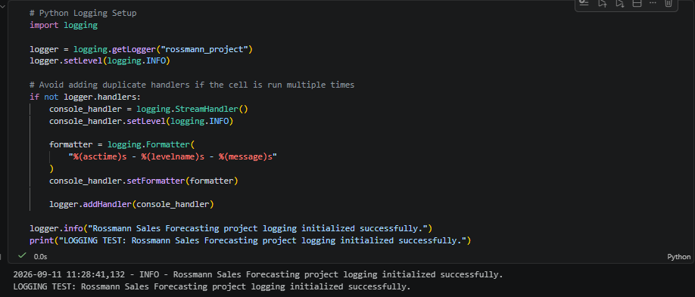
Data Quality & Cleaning
Reliable modeling foundation
• Train had no missing values in original columns.
• Store missing: CompetitionDistance 3; competitor open month/year 354 each; Promo2 timing/interval 544 each.
• Promo2=0 structurally explains the 544 Promo2 missing values.
• No duplicates in train or store.
• Open=0 → Sales=0 for 172,817 closed-store rows; 54 open-store rows had Sales=0 and were retained.
• Missing values are handled inside the sklearn preprocessing pipeline.
06

Slide 7
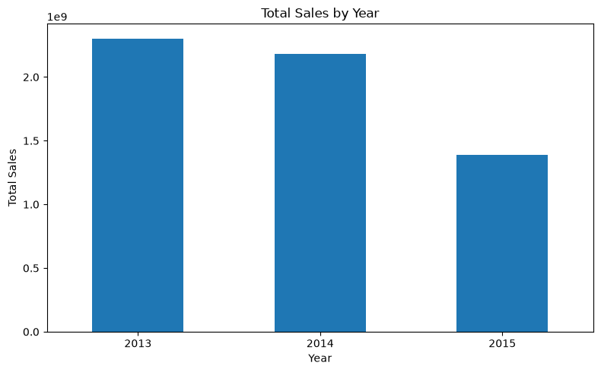
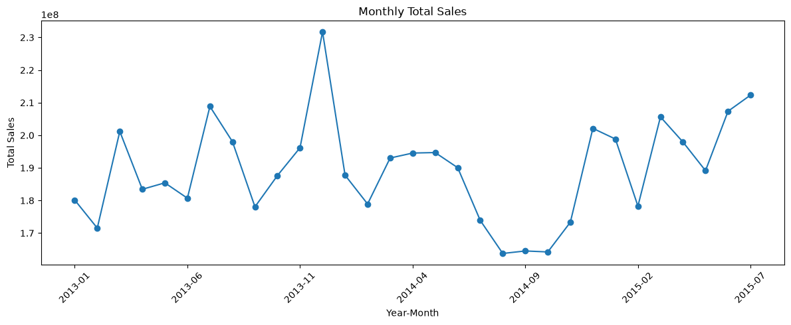
EDA — Sales & Seasonality
Business behavior
Annual and monthly patterns confirm strong seasonality and changing demand levels over time.
07

Slide 8
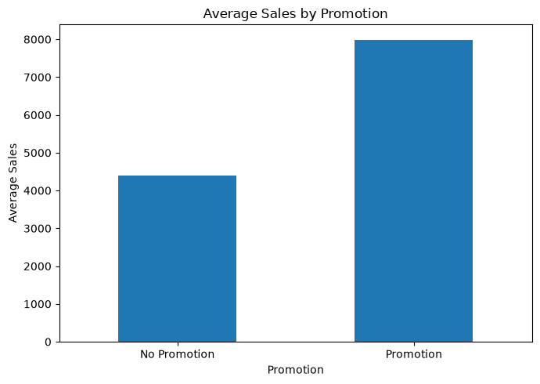
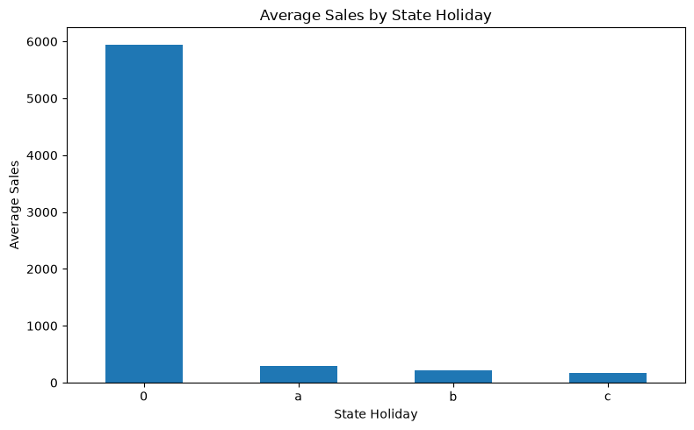
EDA — Promotion & Holidays
Demand drivers
Promo: Avg Sales 4,406 → 7,991; Avg Customers 518 → 820. State-holiday days show sharply lower demand.
08

Slide 9
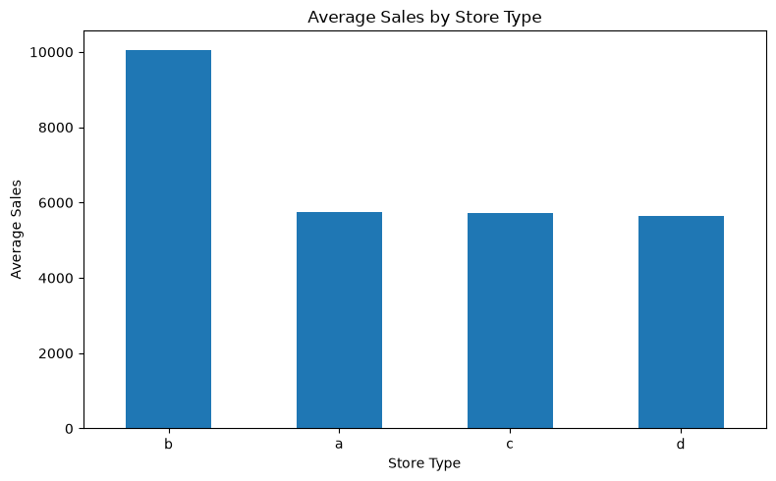
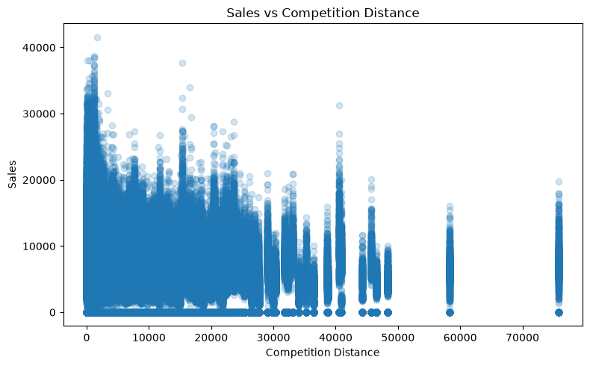
EDA — Stores, Assortment & Competition
Store context
Assortment b leads average Sales; CompetitionDistance has weak overall correlation (-0.0192).
09

Slide 10
EDA — Key Business Insights
What the data says
• Sales–Customers correlation is 0.8947, indicating a strong positive relationship.
• Promotion increases average Sales from 4,406.05 to 7,991.15 and average Customers from 517.82 to 820.10.
• Promotion share is 38.15% in train and 39.58% in test; the difference is about 1.43 percentage points.
• State holidays have much lower average Sales/Customers than non-holiday days; the holiday-period average rises again after the holiday.
• Christmas behavior is highly seasonal: Dec 25 is near-zero relative to normal trading days, while Dec 23 and Dec 30 are much stronger.
• Sunday is a major operational trough: average Sales about 204 versus weekday average about 6,866.81.
• Only 10 stores were open all seven days; weekend performance therefore depends strongly on store operating patterns.
• Assortment b has the highest average Sales, followed by c and a.
• Sales vs CompetitionDistance correlation is -0.0192, so distance alone does not explain Sales well.
• 351 stores have CompetitionDistance available but missing competitor opening month/year; 3 stores have missing CompetitionDistance and missing opening dates.
• SchoolHoliday shows a substantial train/test distribution shift (17.86% vs 44.35%), which is an important deployment caveat.
10

Slide 11
Feature Engineering & Preprocessing
20 Sales-model features
• Calendar: Year, Month, Day, WeekOfYear, IsWeekend, YearMonth.
• Categorical: StateHoliday, StoreType, Assortment, PromoInterval.
• Numeric: Store, DayOfWeek, Open, Promo, SchoolHoliday, competition fields and Promo2 fields.
• Median imputation for numeric values.
• Most-frequent imputation + OneHotEncoder for categorical values.
• Customers excluded from Sales model to avoid future-information leakage.
11

Slide 12
Random Forest — Sales Forecasting
Chronological validation
MAE
RMSE
R²
Chronological split
809.24
1,218.28
0.8859
Train: Jan 2013 – Jun 2015
Validation: Jul 2015
RF: 100 trees • depth 20 • min leaf 2
Training objective: regression loss; evaluation emphasizes MAE, RMSE and R² for business interpretability.
12

Slide 13
Sales Model — Results & Feature Importance
MAE / RMSE / R²
• Open: 0.508711
• CompetitionDistance: 0.092245
• Promo: 0.080344
• Store: 0.070218
• CompetitionOpenSinceYear: 0.041116
• CompetitionOpenSinceMonth: 0.033846
Why Open dominates
Closed stores naturally produce zero Sales, so operating status is highly informative to the model. Feature importance is model reliance, not causality.
Approximate interval: mean ± 1.96 × tree prediction standard deviation; lower bound clipped at zero.
13

Slide 14
Customer Demand Model
Second business output
Customer MAE
Customer RMSE
Customer R²
60.23
91.12
0.9562
• Separate Random Forest predicts customer numbers.
• Uses the same chronological validation design.
• Provides a business companion to Sales forecasting.
• Both outputs are exposed by the Streamlit interface.
14

Slide 15
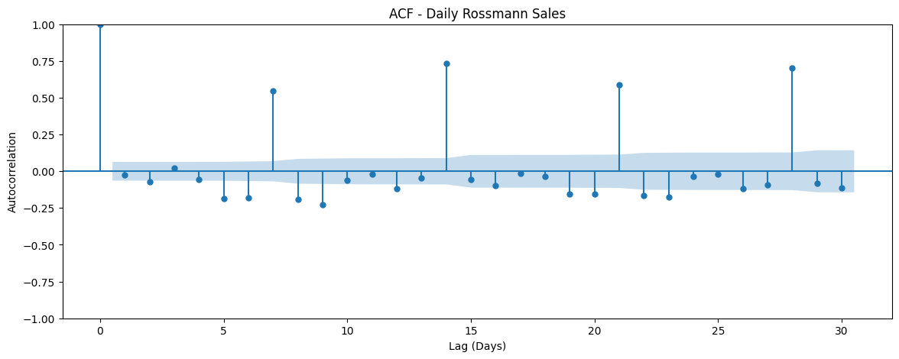
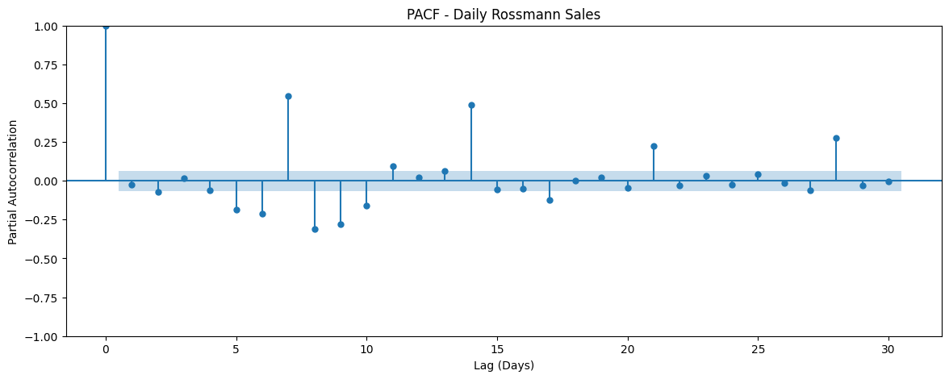
LSTM — Time Series Preparation
ADF, ACF/PACF, 28-day window
ADF p ≈ 6.4×10⁻⁵ → stationary path; differencing not required.
Weekly spikes in ACF/PACF motivated a 28-day sliding window.
Scaling: (-1,1), fitted on training data only.
15

Slide 16
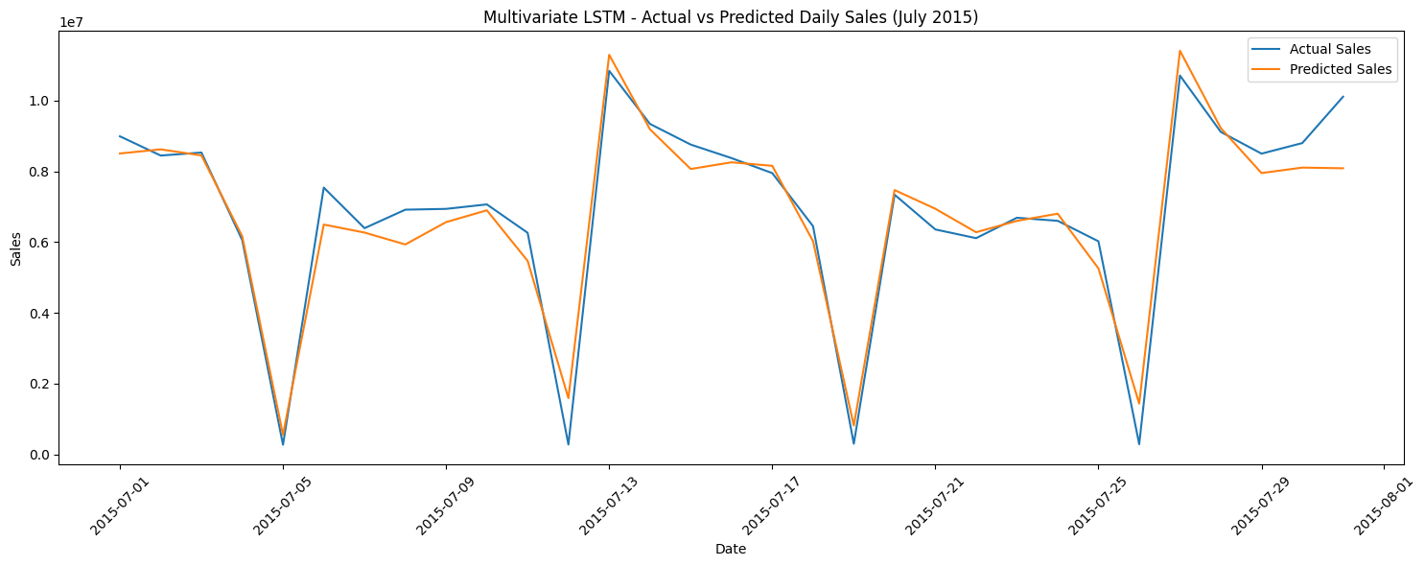
LSTM — Model & Results
Multivariate LSTM
MAE
RMSE
504,875.09
669,092.44
R²
Architecture
0.9451
Input (28,3) → LSTM(64) → Dropout(0.2) → Dense(1)
Features: daily Sales + OpenStores + DayOfWeek. Sunday troughs are captured much better than in the univariate model.
16

Slide 17
MLflow & Model Serialization
Tracking + registry
• Experiment: Rossmann_Sales_Forecasting.
• Tracked parameters, metrics and model artifacts.
• MLflow inference reproduced 41,088 test predictions.
• Registered model: Rossmann_Sales_Forecasting_RF.
• Registry Version 1 + Version 2 retained.
• Timestamped serialized models support reproducible serving.
Registry accuracy rule
Version 2 is a second registry release from the validated artifact — NOT a newly trained model.
Capture/retain the actual MLflow dashboard screenshot for the final evidence folder.
17

Slide 18
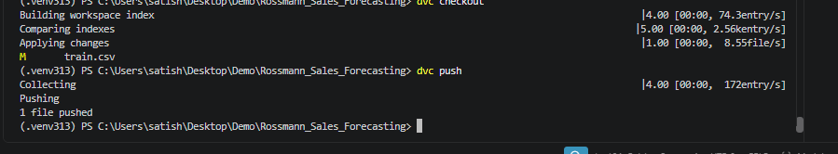
DVC, GitHub & Power BI
Governance + BI
DVC
GitHub
Power BI
V1: 6fe968e
Original Rossmann datasets
V2: 5312ffc
Prepared training dataset
dvc diff confirmed train.csv changed.
https://github.com/vsatish5621/Rossmann-Sales-Forecasting
FactSales
DimStore
DimDate
DAX measures
Year / Month / Store Type slicers
18

Slide 19
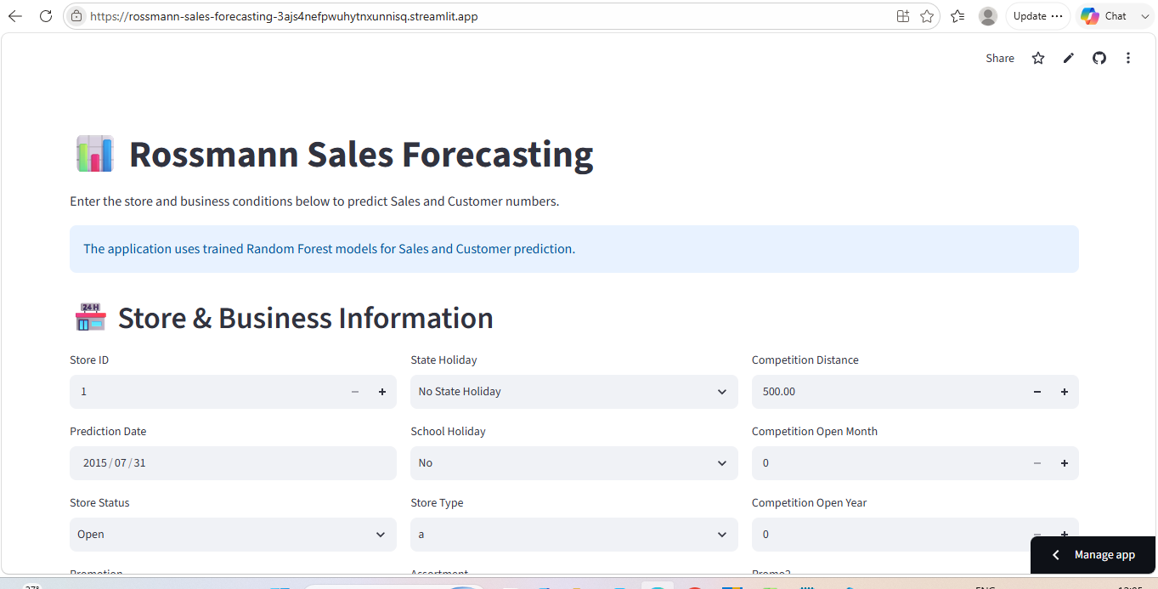
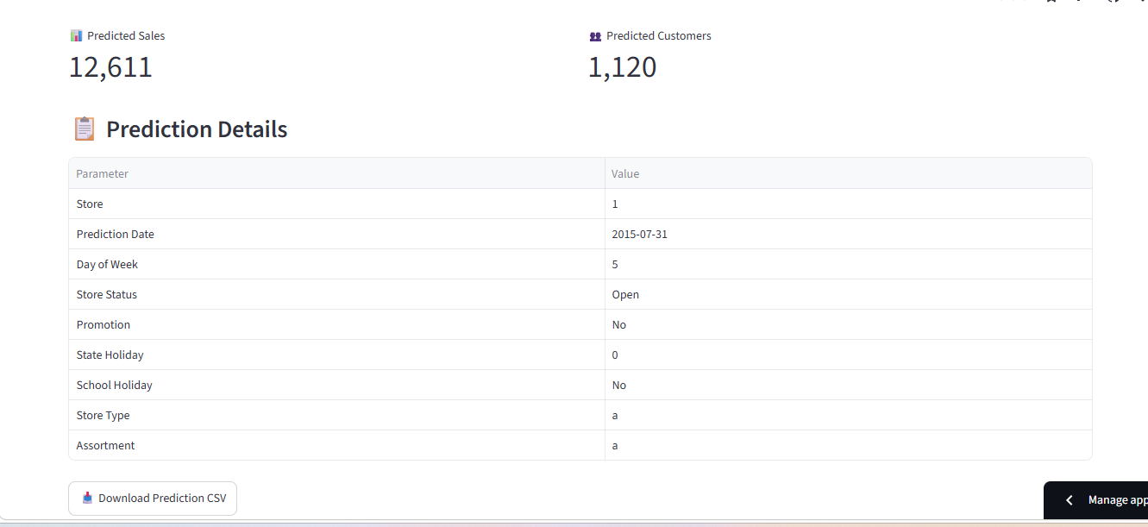
Streamlit Deployment & Live Prediction
Production-facing interface
Live URL
https://rossmann-sales-forecasting-3ajs4nefpwuhytnxunnisq.streamlit.app
19

Slide 20
Final Results, Limitations & Submission Readiness
Ready for final audit
Sales RF R²
Customer RF R²
LSTM R²
Test predictions
0.8859
0.9562
0.9451
41,088
• Core technical work is complete: five notebooks, RF, Customer RF, LSTM, MLflow, DVC, Power BI, GitHub and live Streamlit deployment.
• Final evidence retained: MLflow registry, Power BI dashboard and EDA question-by-question analysis.
• Official frontend examples verified: CSV upload, dedicated Sales/Customers plots and CSV download.
• Export final PDF + PPT, inspect, package and submit by 15-Sep-2026.
READY FOR FINAL SUBMISSION
20

Slide 21
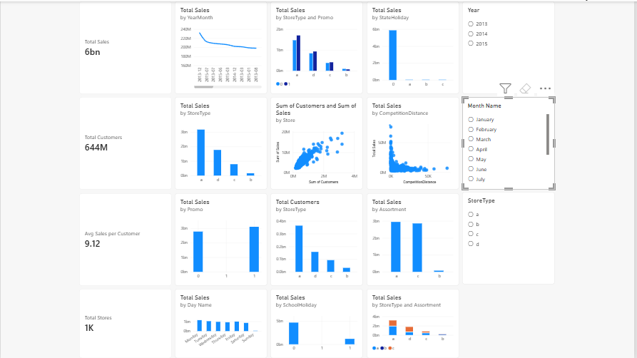
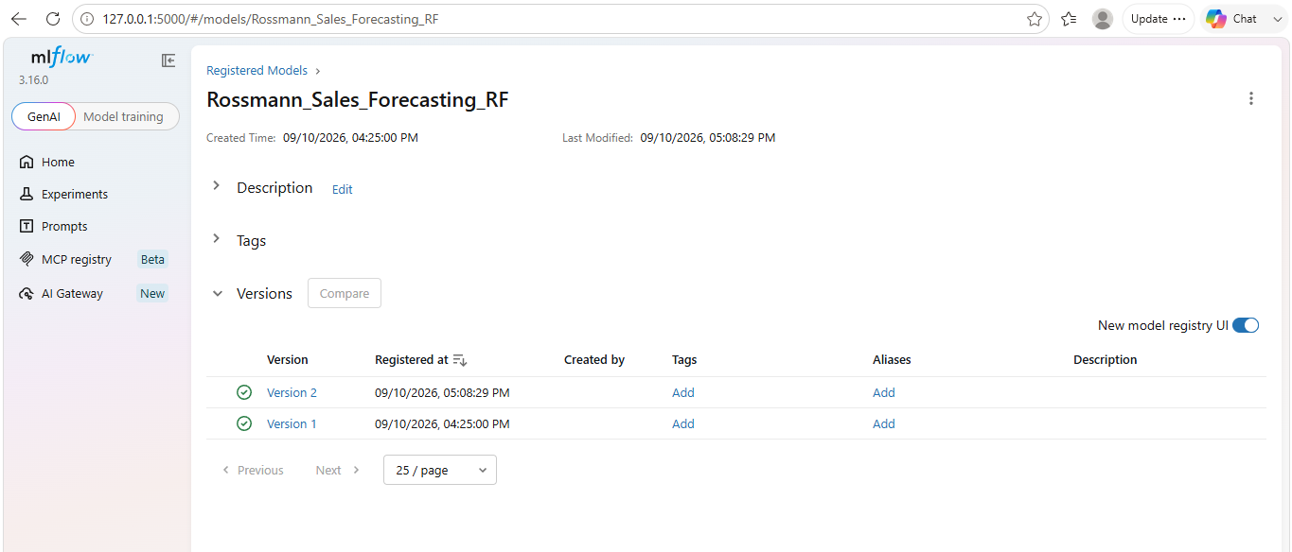
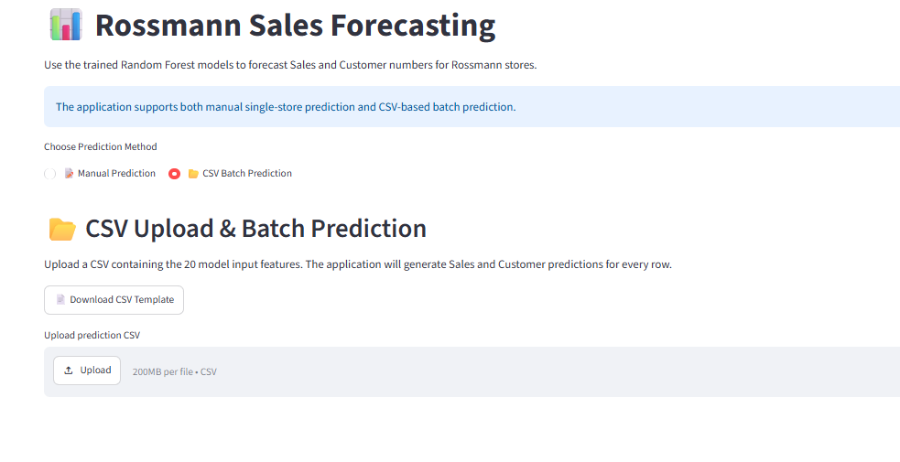
Implementation Evidence
21
Selected evidence from the completed project workflow
Power BI dashboard
MLflow model registry
Streamlit prediction interface
CSV batch prediction input

Slide 22
Streamlit Application — Business Workflow
22
Manager-facing interface for store-level and batch forecasting
Manual prediction
Store, date, operating status, promotion, holiday, assortment and competition inputs.
Batch prediction
CSV template/upload workflow supports multiple prediction rows.
Outputs
Predicted Sales and Customers, result table and downloadable CSV.
Live app:
rossmann-sales-forecasting-3ajs4nefpwuhytnxunnisq.streamlit.app

Slide 23
Power BI — Business Intelligence Layer
23
Historical analysis, dimensional modelling and interactive filtering
Model
FactSales + DimStore + DimDate with active one-to-many relationships.
Measures
Total Sales • Total Customers • Avg Sales per Customer • Total Stores
Filters
Year • Month Name • Store Type
Business use
Trend, promotion, holiday, store and competition analysis.

Slide 24
MLOps — MLflow, Versioning & Reproducibility
24
Model tracking, registry releases and dataset lineage
MLflow Registry
Rossmann_Sales_Forecasting_RF with Version 1 and Version 2.
Important interpretation
Version 2 is a second registry release of the validated artifact, not a retrained/improved model.
DVC
V1 commit 6fe968e; V2 commit 5312ffc; dvc diff confirmed train.csv changed.
GitHub
Public repository with five organized notebooks, app and supporting project files.

Slide 25
Final Executive Summary
25
Outcome, business value and access points
Sales RF
Customer RF
Multivariate LSTM
Test Forecasts
R² 0.8859
R² 0.9562
R² 0.9451
41,088
MAE 809.24
MAE 60.23
28-day sequence
Sales + Customers
What was delivered
Business value
• End-to-end forecasting workflow
• EDA-driven feature engineering
• Random Forest sales and customer models
• Multivariate LSTM time-series model
• MLflow tracking and registry
• DVC dataset versioning
• Power BI dashboard
• Deployed Streamlit application
• Six-week forecasting objective supported
• Promotion, holiday, competition and store context incorporated
• Store-level predictions can support planning
• Customer demand provides an additional operational signal
• Interactive BI and web outputs improve accessibility
GitHub
github.com/vsatish5621/Rossmann-Sales-Forecasting
Live Application
rossmann-sales-forecasting-3ajs4nefpwuhytnxunnisq.streamlit.app
Thank You

