Slide 1

Welcoming you to Journey into Large Language Models!

Slide 2

Agenda
What are Transformers?
Brief explanation of LLM Architecture
Challenges of training LLMs
Types of Transformer Networks

Slide 3

What are Transformers?
Transformers are a type of neural network architecture introduced in the paper "Attention is All You Need" by Vaswani
They rely on self-attention mechanisms to weigh the importance of different elements in a sequence.

Slide 4
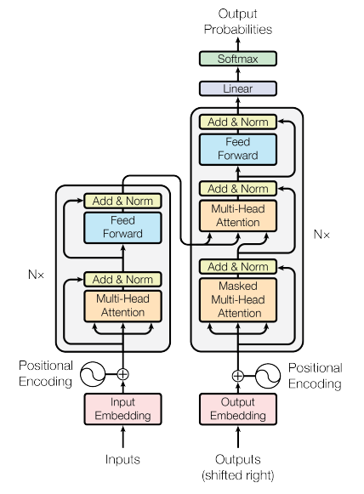
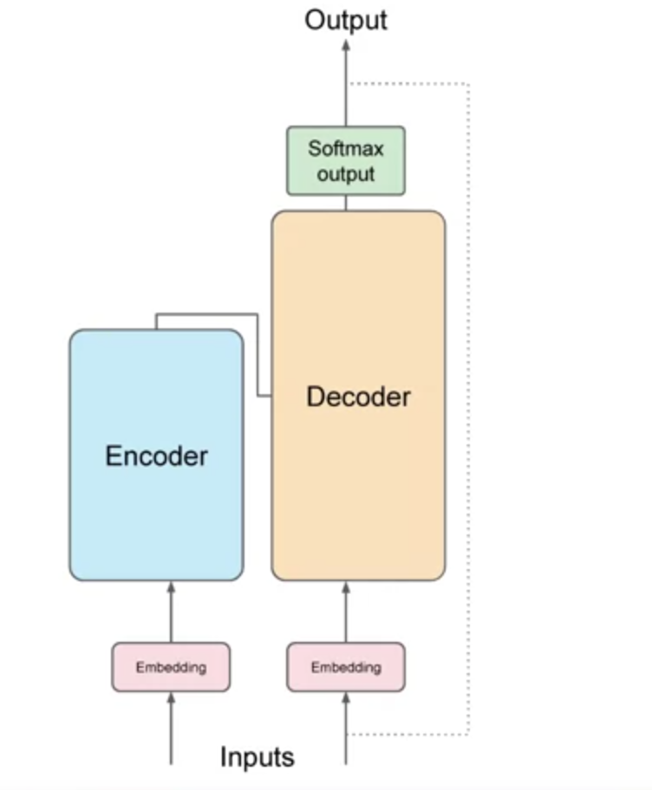
LLM Architecture
Self Attention: https://arxiv.org/abs/1706.03762

Slide 5
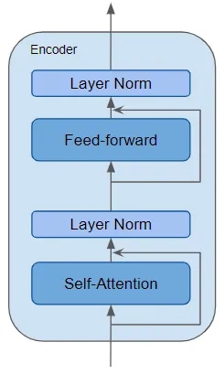
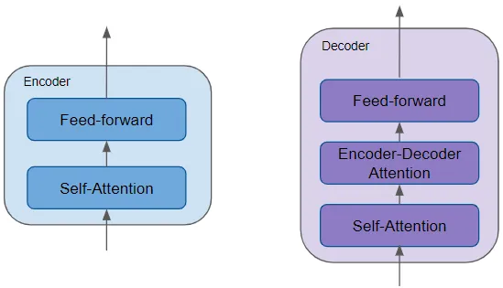


Slide 6
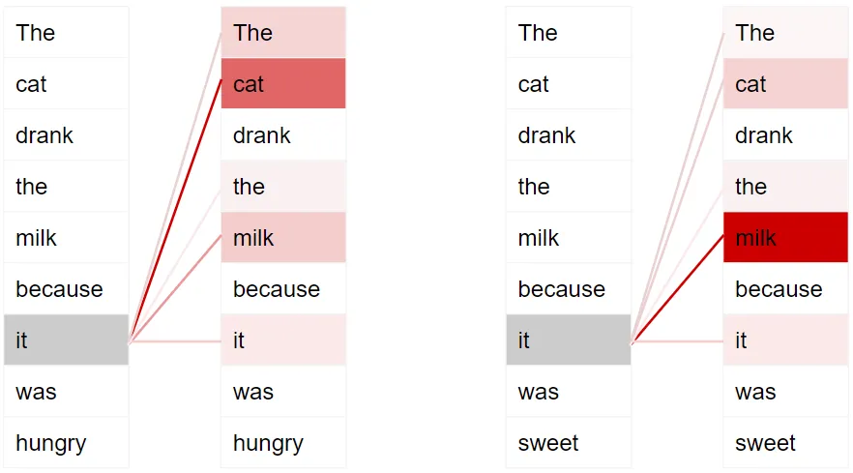
Self Attention
The cat drank the milk because it was hungry.
The cat drank the milk because it was sweet.

Slide 7
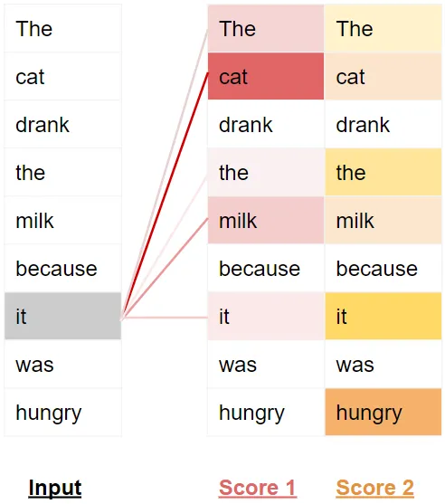

Slide 8
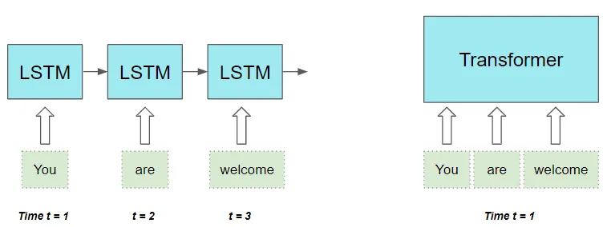
Difference between LSTM and Transformers
The distance between words in the input sequence does not matter. It is equally good at computing dependencies between adjacent words and words that are far apart.

Slide 9
Types of Transformers
Encoder only models(auto encoders) : Consist of an encoder network that compresses the input data into a lower-dimensional representation, often called a latent space, without a corresponding decoder.
Ex: BERT , RoBERTa, ALBERT etc.
Decoder only models(Generative models) : These models generate new data samples based on a learned distribution without an explicit encoder.
Ex: GPT (Generative Pre-trained Transformer)
Encoder – Decoder models : These models consist of two connected neural networks: an encoder and a decoder.
Ex : T5 (Text-To-Text Transfer Transformer), Transformer-XL, Sequence-to-Sequence (Seq2Seq) etc.

Slide 10
Challenges of training LLMs
Data Acquisition and Preprocessing
Computational Resources
Evaluation and Interpretability

Slide 11
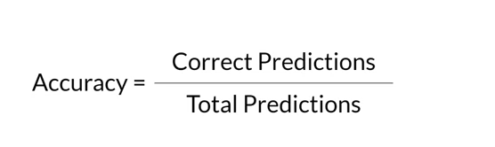
METRICS
ROUGE
BLEU Score
GLUE
Super GLUE
MMLU
HELM
Precision: This metric measures the number of words in the Predicted Sentence that also occur in the Target Sentence.

Slide 12
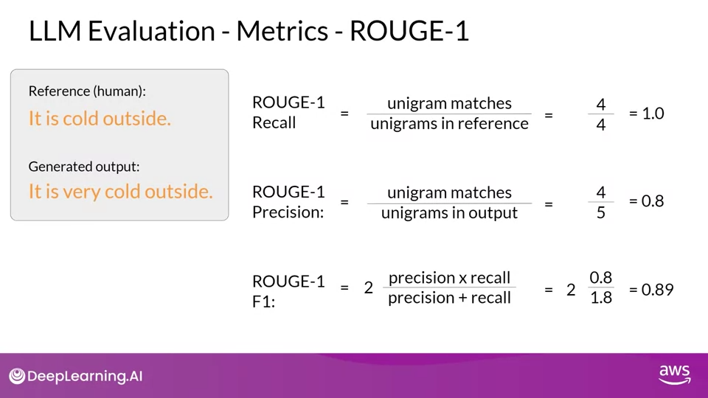

Slide 13
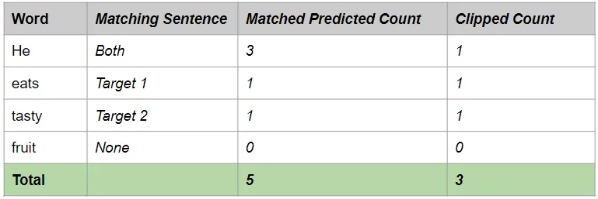
Clipped Precision
Target Sentence 1: He eats a sweet apple
Target Sentence 2: He is eating a tasty apple
Predicted Sentence: He He He eats tasty fruit
Clipped Precision = Clipped number of correct predicted words / Number of total predicted words
Clipped Precision = 3 / 6

Slide 14

Explore
https://towardsdatascience.com/transformers-explained-visually-part-1-overview-of-functionality-95a6dd460452
https://www.linkedin.com/pulse/demystifying-multihead-attention-transformer-neural-network-taneja/?trackingId=o6REbeohSTSI8%2BqOLlJSTQ%3D%3D
https://towardsdatascience.com/foundations-of-nlp-explained-bleu-score-and-wer-metrics-1a5ba06d812b
https://arxiv.org/abs/1706.03762

Slide 15


