Slide 1
Assessment of NYC Public School
Students’ Achievement on Regents Exams
Python Project 1
Vilio Saul
Professor: Imran Khan
September 2026
1

Slide 2
1. Introduction
Goal and research focus
• The goal of this project is to analyze Regents exam performance for a selected NYC public school.
• The analysis examines how student performance differs across Regents exams and across the years 2015–2017.
• The project also reviews student participation, passing performance (65 or above), and high performance (80 or above).
• This analysis helps identify patterns, stronger subject areas, and changes in performance over time.
2

Slide 3
2. Data Source
2014–15 to 2016–17 School-Level NYC Regents Report
• Source: NYC Department of Education school-level Regents exam results.
• The dataset contains school names, Regents exams, years, students tested, mean scores, and scoring percentages.
• For the selected school, the working dataset contains 361 rows and 15 columns.
• The analysis focuses on Mean Score, Total Tested, Percent Scoring 65 or Above, and Percent Scoring 80 or Above.
3

Slide 4
3. Data Cleaning & Preparation
Preparing the data before analysis
• Reviewed the dataset structure, column names, data types, missing values, and duplicate rows.
• Removed duplicate rows when duplicates were identified.
• Converted Mean Score and percentage fields to numeric values so calculations could be performed correctly.
• Created a separate copy of the selected school’s data before making transformations.
• Used pandas grouping and sorting to summarize performance by exam and by year.
4

Slide 5
4. Methodology
Python tools and analytical techniques
• Python and pandas were used for data cleaning, filtering, grouping, and summary statistics.
• Matplotlib was used to create bar charts and a line chart.
• Average Mean Score was calculated for each Regents exam.
• Average Mean Score was also calculated by year.
• Additional analyses examined Total Tested, Percent Scoring 65 or Above, and Percent Scoring 80 or Above.
5

Slide 6
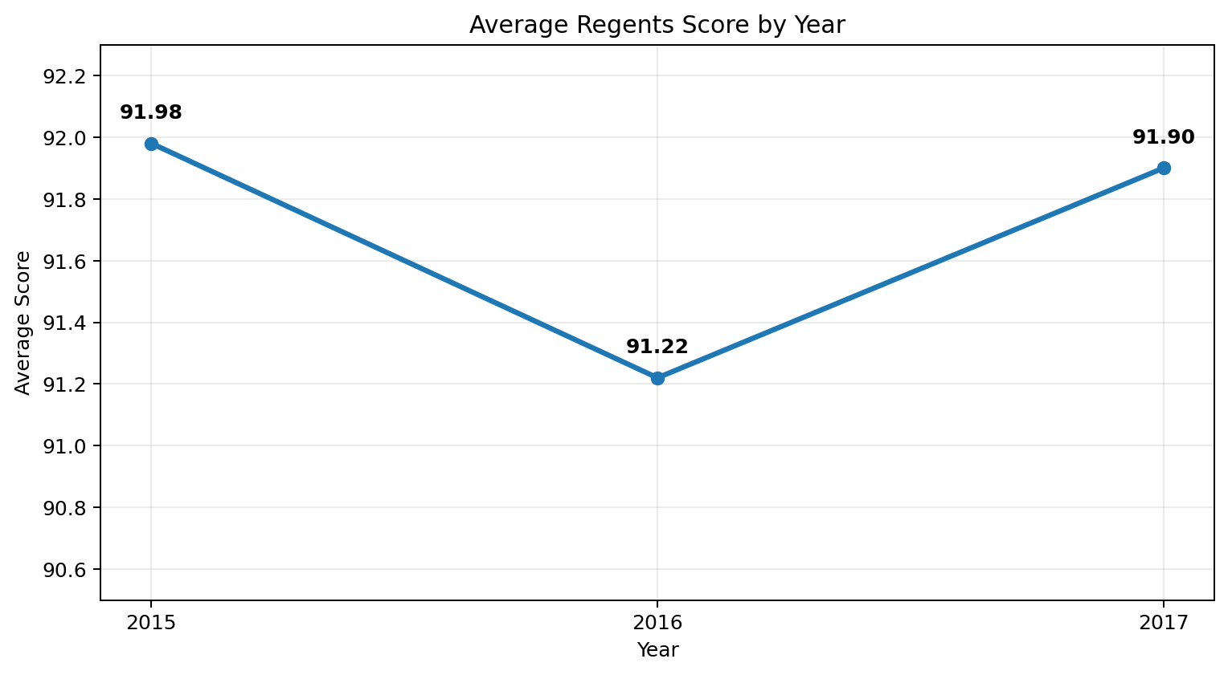
5. Performance by Year
Exact results from the project notebook
2015: 91.98
2016: 91.22
2017: 91.90
Scores decreased in 2016 and increased again in 2017, remaining relatively stable overall.
6

Slide 7
6. Average Score by Regents Exam
Comparing academic performance across subjects
• The average score was calculated separately for each Regents exam.
• The results were sorted from highest to lowest and displayed in a bar chart.
• The visualization shows that performance is not identical across subjects.
• This makes it easier to identify stronger and weaker Regents exam areas for the selected school.
Visualization
Bar Chart
Average Score by Regents Exam
7

Slide 8
7. Participation & Passing Performance
Looking beyond the mean score
• Total Students Tested by Regents Exam was used to compare participation across subjects.
• Percent Scoring 65 or Above was analyzed as a measure of passing performance.
• The passing-rate chart showed high passing percentages across the Regents exams, with variation by subject.
• These measures provide additional context because average scores alone do not describe participation or passing rates.
8

Slide 9
8. Students Scoring 80 or Above
Examining high achievement
• The percentage of students scoring 80 or above was calculated for each Regents exam.
• The results were sorted and visualized with a multicolor bar chart.
• Some subjects had a larger percentage of high-scoring students than others.
• This analysis helps show where the selected school demonstrated especially strong Regents performance.
9

Slide 10
9. Summary Statistics
Final descriptive-statistics review
• The project used descriptive statistics to summarize Mean Score, Total Tested, and scoring percentages.
• The summary table included count, mean, standard deviation, minimum, quartiles, and maximum.
• These statistics provide a broader view of the distribution and variability of the selected school’s Regents results.
• The statistics were interpreted together with the visualizations rather than relying on one number alone.
10

Slide 11
10. Conclusion
Key findings from the analysis
• Regents performance varied across exams, showing differences among subject areas.
• Yearly average performance was 91.98 in 2015, 91.22 in 2016, and 91.90 in 2017.
• The yearly results show a small decline in 2016 followed by an increase in 2017.
• Passing rates and percentages scoring 80 or above also varied across exams.
• Overall, Python, pandas, and Matplotlib provided a clear way to clean, summarize, compare, and visualize the Regents data.
11

Slide 12
References
• NYC Department of Education. 2014–15 to 2016–17 School-Level NYC Regents Report for All Variables.
• CUNY LaGuardia Data Analytics dataset repository.
• Python / Google Colab
• pandas and Matplotlib
Thank you !
12

Slide 13
Documentation & AI Assistance
Tools used to support the project workflow
• Google Colab was used to write and run the Python notebook.
• Python libraries included pandas for data cleaning and analysis and Matplotlib for visualizations.
• GitHub is used to host the completed project notebook as part of the class project portfolio.
• ChatGPT was used to help explain Python concepts, troubleshoot errors, organize project steps, and improve presentation wording.
• Microsoft Copilot was used as an additional AI support resource for documentation and productivity.
• AI suggestions were reviewed against the notebook results; the project calculations and final values come from the student’s analysis.
13

Slide 14
AI Acknowledgment
Responsible use of AI tools
• I used ChatGPT and Microsoft Copilot as support tools during this project.
• They assisted with explanations, troubleshooting, organization, documentation, and presentation wording.
• I reviewed the suggestions, ran the Python code in Google Colab, checked the outputs, and used the results from my own notebook in the final project.
• AI was used to support the learning process and presentation preparation, not as the source of the dataset or the calculated Regents results.
14

Slide 15
References & Project Documentation
• NYC Department of Education — 2014–15 to 2016–17 School-Level NYC Regents Report for All Variables.
• CUNY LaGuardia Data Analytics — dataset repository used for the course project.
• Python — programming language used for the analysis.
• pandas — data cleaning, conversion, grouping, sorting, and descriptive statistics.
• Matplotlib — bar charts and line-chart visualizations.
• Google Colab — notebook environment used to execute and document the Python analysis.
• GitHub — project portfolio and notebook submission platform.
• ChatGPT and Microsoft Copilot — AI support for explanations, troubleshooting, documentation, and presentation preparation.
Python Project 1 • Vilio Saul • Professor Imran Khan • September 2026• La Guardia Community College Continue Education • Data Analytic Courses
15

