Slide 1
Cyber Threat Analytics Platform
with Incident Visualization System

Slide 2
Project Overview
This project studies cybersecurity incidents using connected Power BI dashboards. The data covers incidents, response actions, and locations, and is analyzed by type, place, time, response performance, and future risk.
10.8 hrs
Avg Response Time
13,000
100,000
50,000
25,000
Total Incidents
Critical Incidents
Locations Covered
Cities Covered
What the dashboards cover:
Threat type, severity, and country/city-level breakdown
When incidents happen — by hour, day, week, month, and season
How efficiently incidents are responded to and resolved
Risk scoring, forecasting, and executive-level decision support

Slide 3
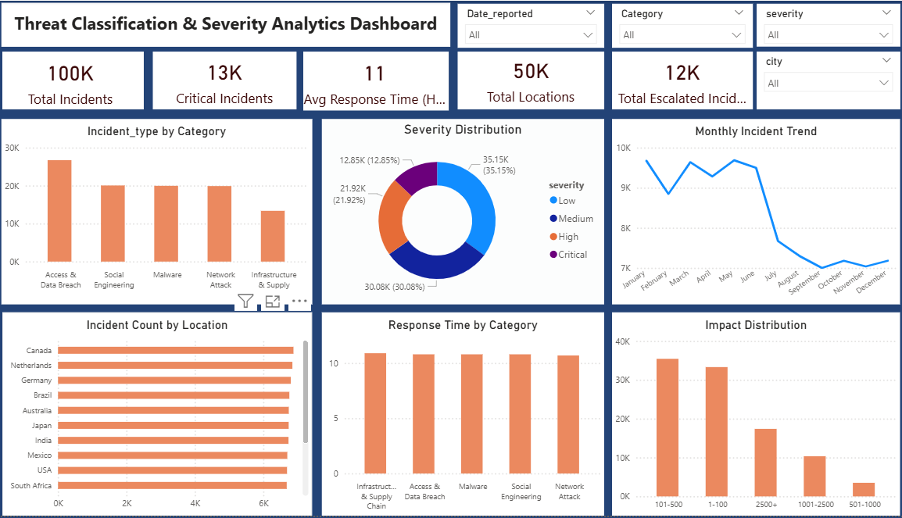
Threat Classification & Severity
Shows Total Incidents, Critical Incidents, and Avg Response Time
Breaks incidents down by category and severity
Tracks the monthly incident trend
Ranks incidents by location and shows response time by category
Shows impact based on number of users affected
1. Threat Classification & Severity Analytics Dashboard

Slide 4
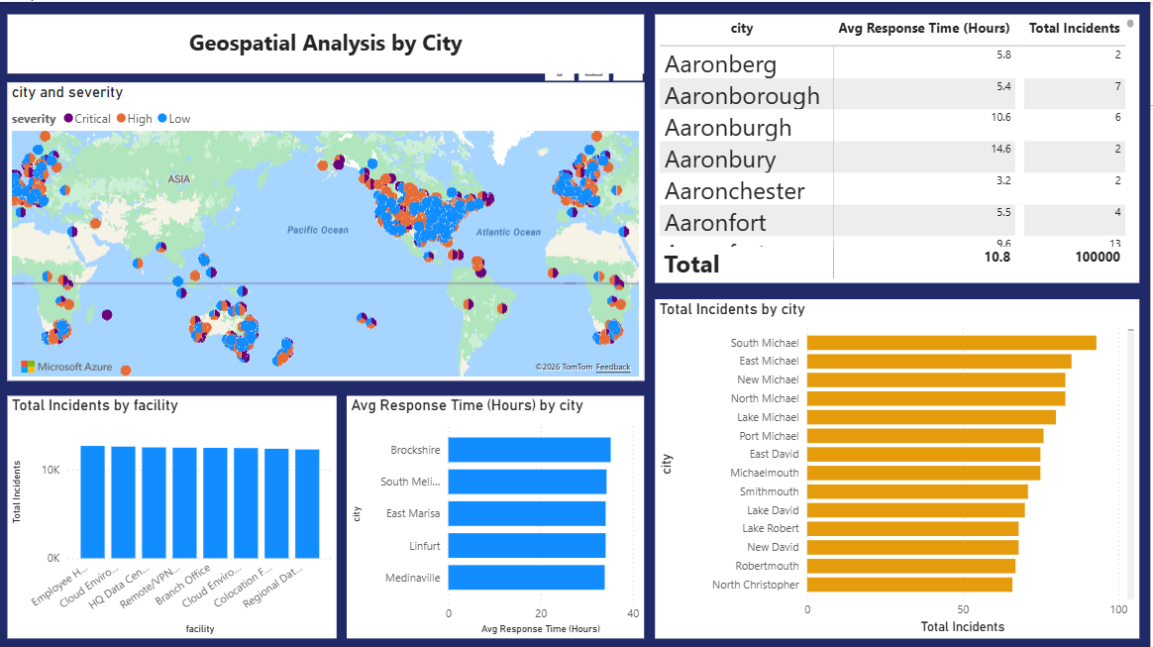
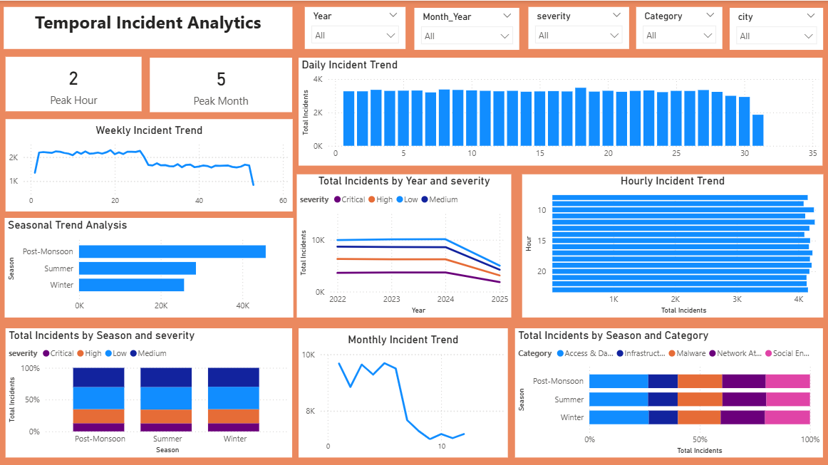
Location & Time-Based Analysis
2. Geospatial Analysis by City
3. Temporal Incident Analytics
Geospatial view: maps incidents by city and facility, with severity color-coded
Temporal view: shows peak hour, peak month, and trends by day, week, season, and year

Slide 5
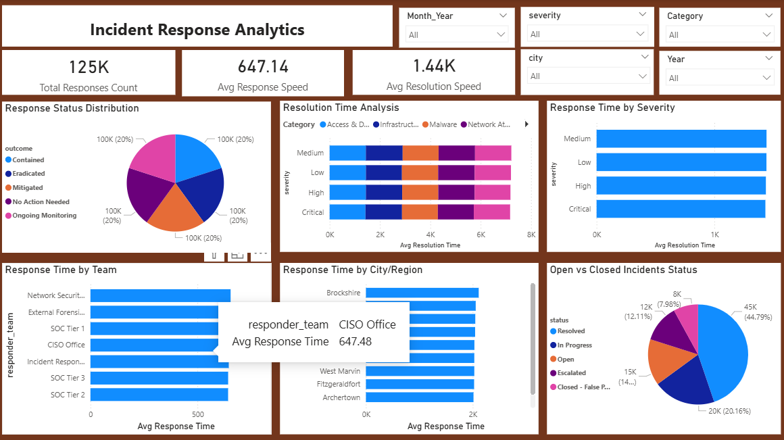
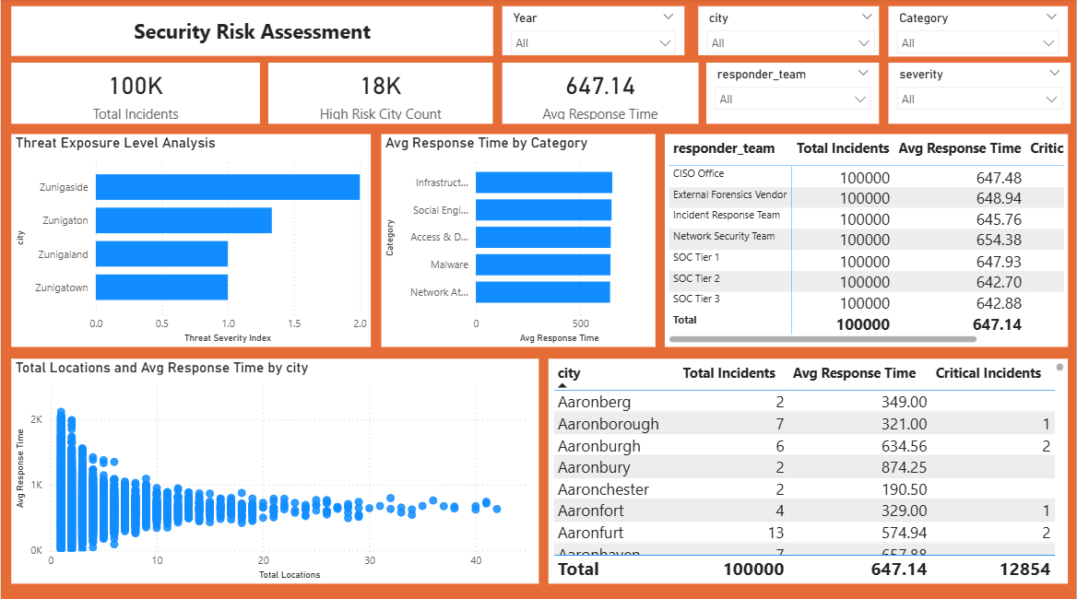
Response Performance & Risk Assessment
4. Incident Response Analytics
5. Security Risk Assessment
Response view: measures response speed, resolution speed, and team performance
Risk Assessment: scores each city's threat exposure and compares risk indicators

Slide 6
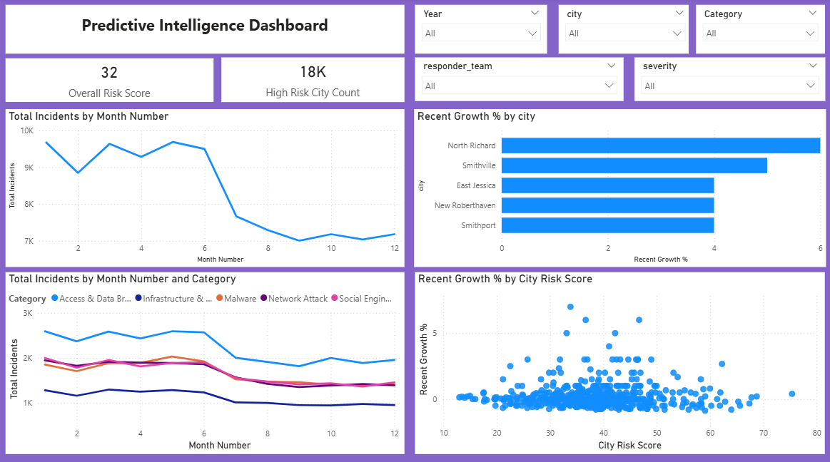
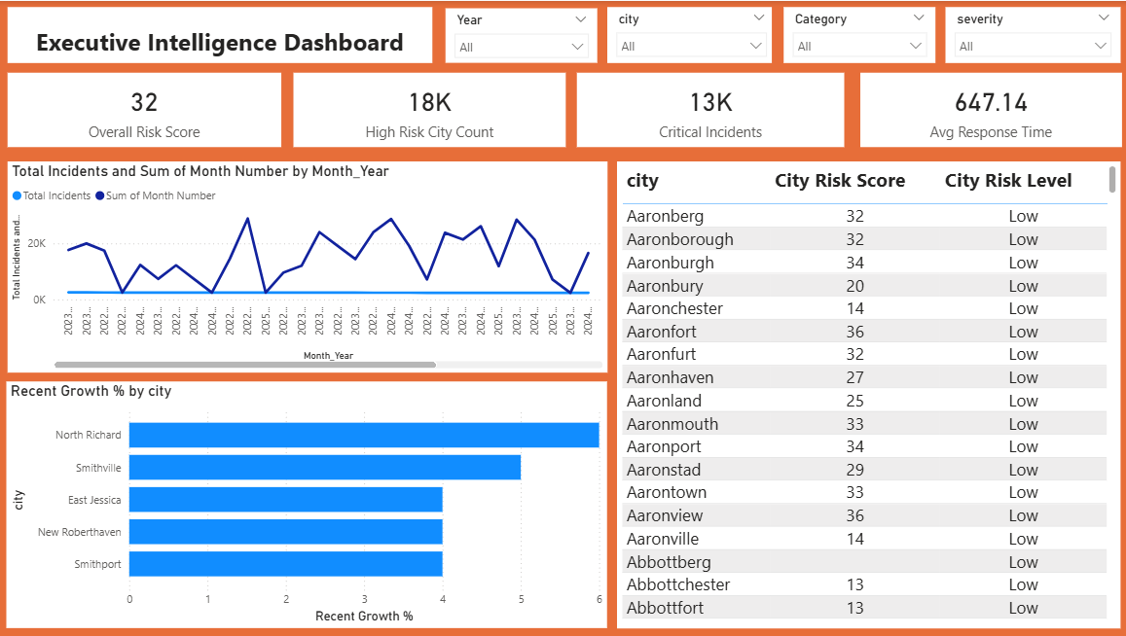
Predictive & Executive Intelligence
6. Predictive Intelligence Dashboard
7. Executive Intelligence Dashboard
Predictive view: estimates future incident trends and flags cities with fast-growing risk
Executive view: a final summary with overall risk score, high-risk cities, and key metrics for decision-makers

Slide 7
THANK YOU

