Slide 1

IACS X
Predicting effects of genetic perturbation in maize
Eagon, Han, Sergio, Victor

Slide 2
About Inari
Problem Statement
Data & Challenges
Scope of Work & Intended Outcome
Roadmap

Slide 3
3 Stages of Inari’s Work
Computation to build genetic knowledge
Out of tens of thousands of genes, which ones to perturb? What are the effects? How are other genes affected?
Genetic editing
Using CRISPR technology for genetic editing
Targeted delivery to parts of the plant

Slide 4
Problem Statement
Data given
Expression levels of the 40,000 genes in 10 tissues across 26 individual maize plants
Main method
Graphical neural network of pairwise correlations
Potential additional information
Biological knowledge, gene function, pathways
Intended outcome
Based on targeted gene modulation,
provide information about the effects on gene expression levels of other maize genes

Slide 5
The Method
Expression Data
n x p
n = # of genes
p = # of samples
= gene
edges = relationships between genes

Slide 6
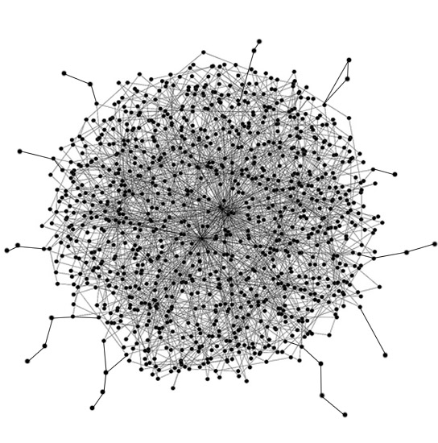
The Method
Extracted key features that serve as the basis of our predictive model
Challenges:
1
Network construction
2
Many genes, few samples
3
How can we incorporate biological knowledge (e.g., functional annotations)?

Slide 7
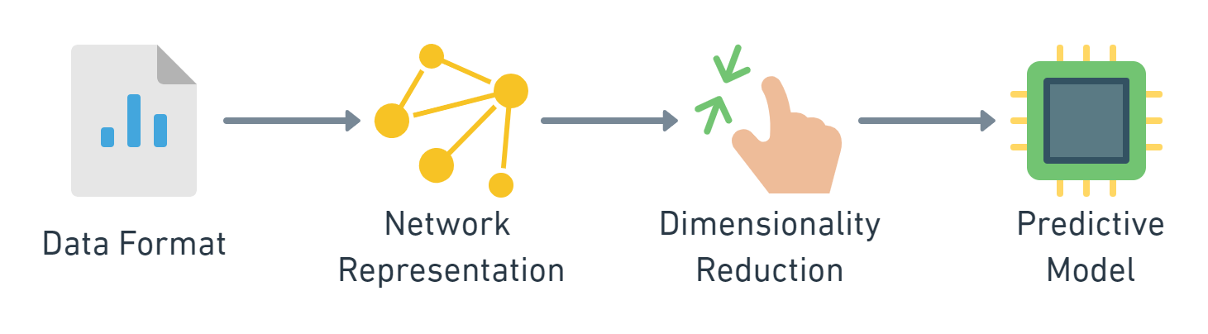
Reproducible Pipeline

Slide 8
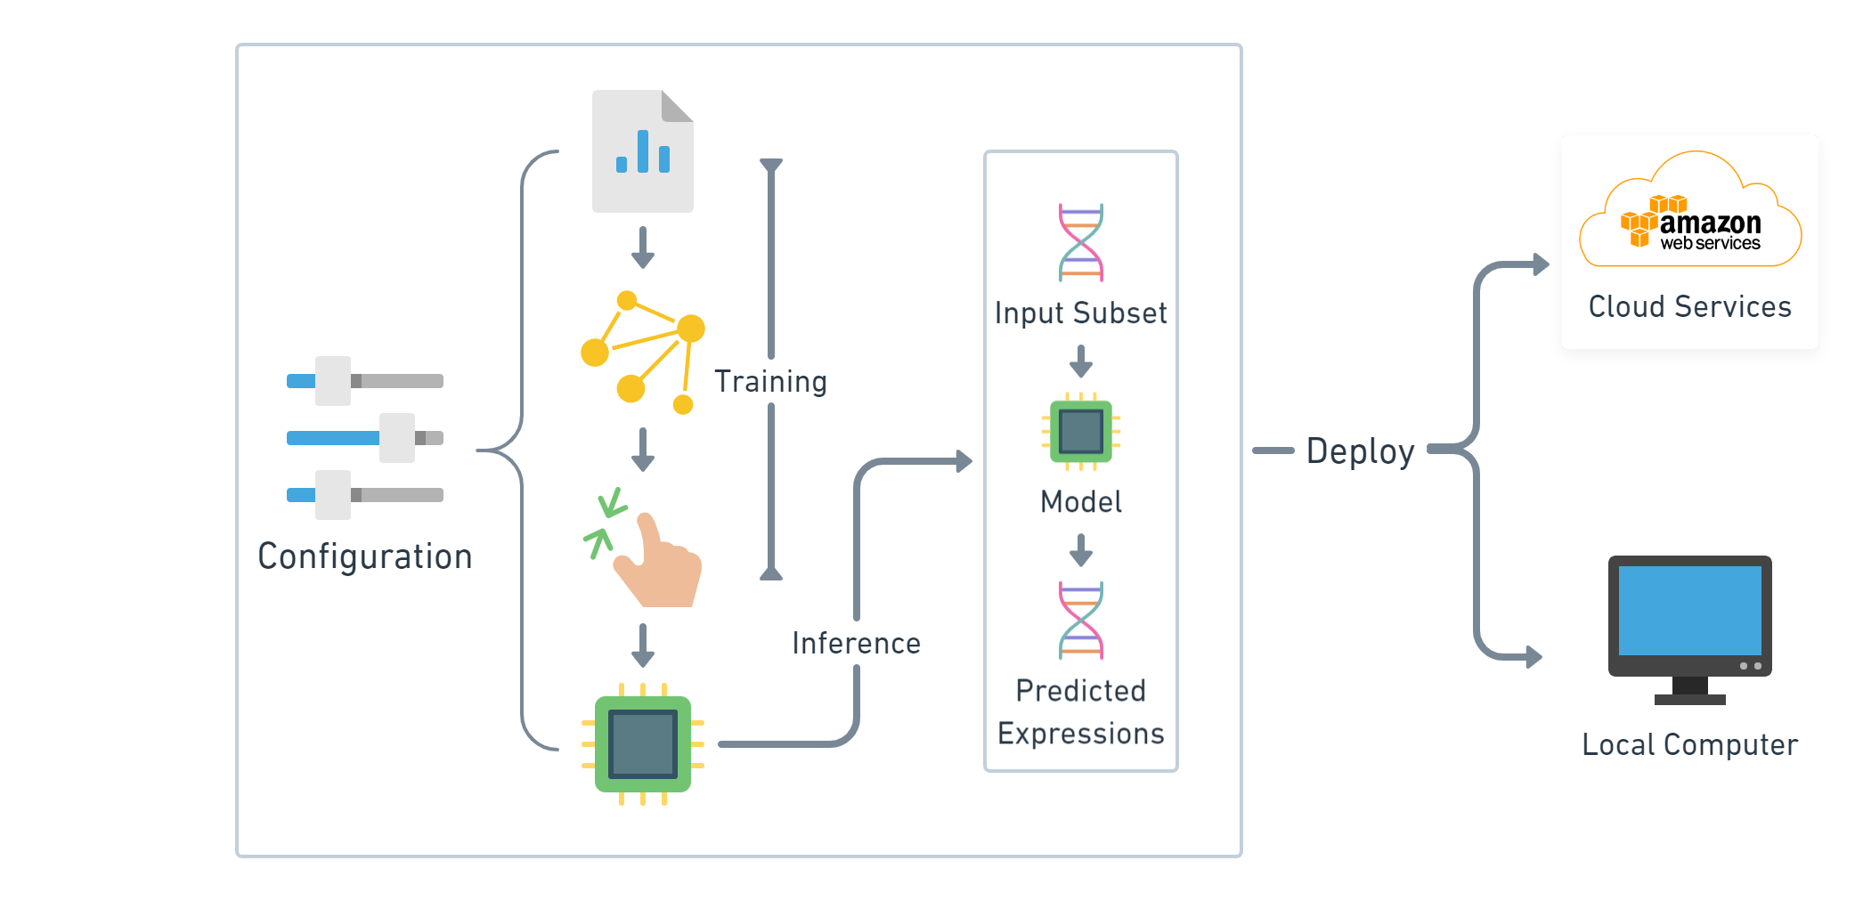
Reproducible Pipeline

Slide 9

Thank You!

