Slide 1

Decentralized File Sharing System
Team Details
Team Number: E14
Sl.Num. | Student Name | USN | Roll Num. | Division
1 | Vinod Badni | 01fe21bcs305 | 517 | E
2 | Shreyas M | 01fe21bcs278 | 544 | E
3 | Nischay N S | 01fe21bcs322 | 560 | E
4 | Rohan Jadhav | 01fe21bcs272 | 557 | E

Slide 2

Contents
Problem Statement
Introduction
Objectives
Connection with SDG
Results
Conclusion

Slide 3
Problem Statement :
Develop a decentralized file-sharing system leveraging blockchain smart contracts to address challenges related to centralized control, limited access, and lack of transparency in traditional book-sharing platforms.

Slide 4
Introduction:
Centralized file-sharing systems encounter challenges like limited access, high costs, and opacity, causing barriers for users to obtain desired books and leading to uneven distribution of knowledge. Furthermore, centralized authorities may impose restrictions or fees, impeding smooth book exchange.​
​
Decentralization shifts control away from a single authority, allowing users to interact directly in decentralized book sharing. This facilitates peer-to-peer transactions, fostering transparency, inclusivity, and fair access to literature, transforming how knowledge is exchanged and accessed.

Slide 5
Objectives:
Develop a decentralized file-sharing platform to overcome centralized system limitations. ​
​
Enable direct peer-to-peer transactions, enhancing access to literature without intermediaries.​
Ensure transparency and inclusivity, fostering equitable distribution of knowledge.

Slide 6
Connection with SDG 16: Peace, Justice, and Strong Institutions:
Target 16.6 of SDG 16 is particularly suitable for the problem statement:​
​
"Develop effective, accountable and transparent institutions at all levels."​
This target directly aligns with the aim of implementing a decentralized book-sharing system to promote transparency, accountability, and accessibility in the sharing of knowledge and resources.

Slide 7
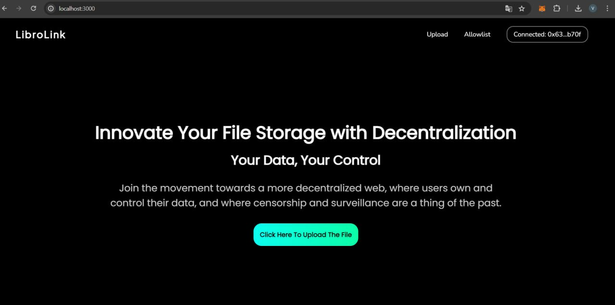
Results
The above figure shows the final user interface of the decentralized book sharing system, which is connected to Meta-mask wallet (top right).

Slide 8
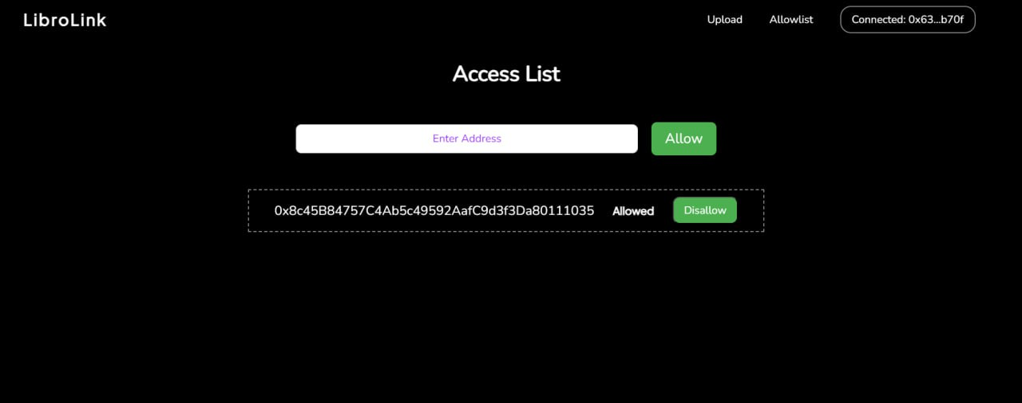
Results
Fig. 2: User granting access.
The figure 2 shows the page that is used by the user to grant access of his books to other accounts i.e. access control page. User enters other accounts address and grants access. User can also disallow the access of his/her books via the access list below.

Slide 9
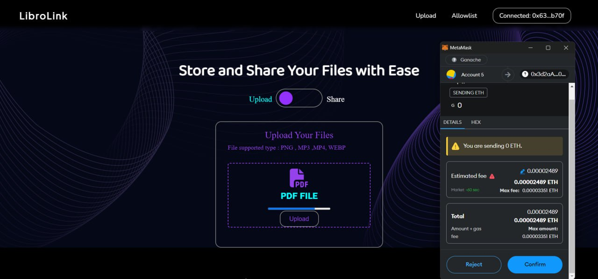
Results
Fig. 3: Uploading the images.
The images are uploaded by the user into the system which are stored in the Pinata IPFS. The Meta-mask wallet shows the completed transactions of the Ethers during the uploading of the images to IPFS as shown in figure 3.

Slide 10
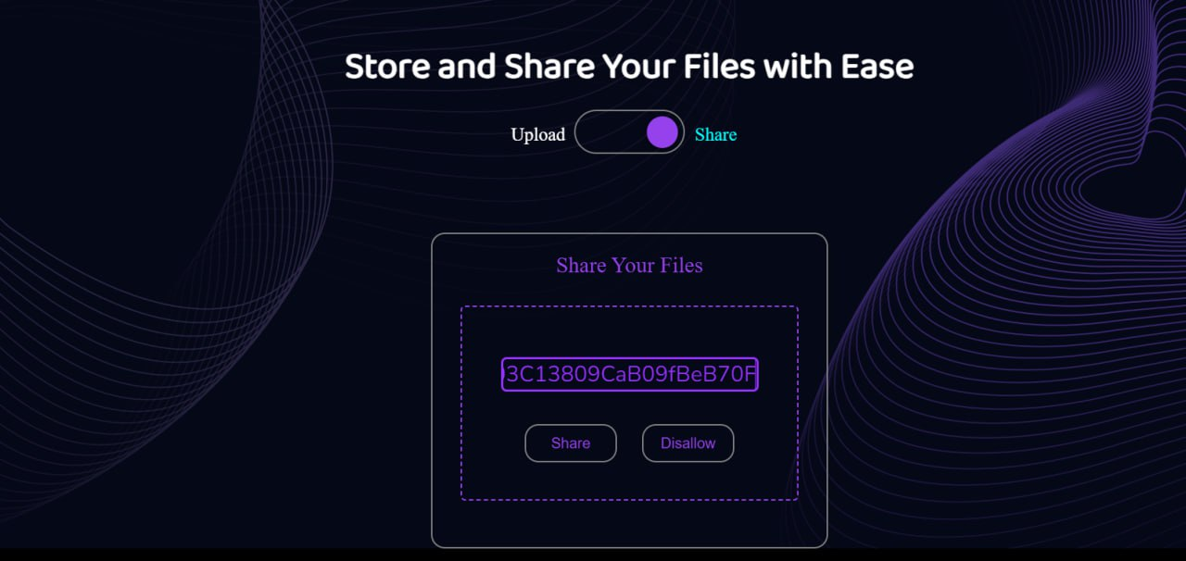
Results
Fig. 4: Sharing of books
The figure 4 shows the book sharing page. The allowed account address is entered by the user and the uploaded books are shared in a peer-to-peer manner.

Slide 11
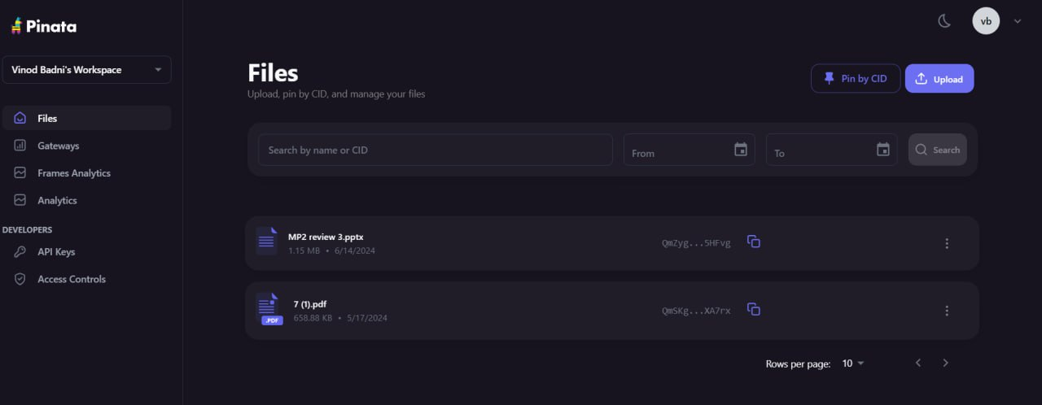
Results
Fig. 5: Books stored in Pinata.
The uploaded books are stored in the Pinata IPFS as shown in figure 5.

Slide 12
Conclusion
The decentralized crowdfunding platform leverages Ethereum blockchain technology and smart contracts to revolutionize fundraising by enhancing transparency, security, and operational efficiency. The integration of MetaMask ensures transactions are conducted securely, while Geth facilitates robust network management, providing a reliable foundation for all interactions. Non-Fungible Tokens (NFTs) add an extra layer of security, guaranteeing transaction integrity and accountability, thereby reducing the potential for fraudulent activities. By leveraging Ethereum blockchain technology, integrating secure transactions via MetaMask, and implementing Non-Fungible Tokens (NFTs) for enhanced transaction security, our platform ensures transparency, accountability, and reduced fraud risk, thereby contributing to the principles outlined in SDG 16.

Slide 13
THANK YOU

