Slide 1
IOT FUNDAMNETALS ECE3501
Guided by :-
Dr SREEDEVI V T
Presented by :-
Vedant Singh Bhanote(19BEE1197)

Slide 2
Smart Road Safety and Vehicle Accident Prevention System for Mountain roads.

Slide 3
Abstract
Growth in population led to growth in technology. People use cars in large number and number of accidents is increasing day by day.
Road accidents are undoubtedly the most frequent happening cases and overall the cause of most damage.
There are many dangerous roads like curvy mountain roads T-roads.
Some mountain roads are very narrow and they have many curved roads.
The problem with these curved roads is that the drivers are not able to see the cars on the other side of the road.
If the vehicle is in great speed then it is difficult to control.
Hence there is the need of many road safety systems.
To avoid these problems we have proposed a vehicle accident system.

Slide 4
OBJECTIVE
Main objective is to reduce the accident by intimating the driver about the obstacle and alerting him to stop the vehicle by using our IOT based smart sensor model which uses sensors like ultrasonic and infrared sensors.
Saving million lives.
Saving fuels. As the driver slows down .

Slide 5
Hardware Specifications.
Ultrasonic proximity sensor
Adruino Microcontroller
IR sensor
LED
Cables and connectors.
Buzzers.
PCB and Breadboard.
Jumpers connector

Slide 6
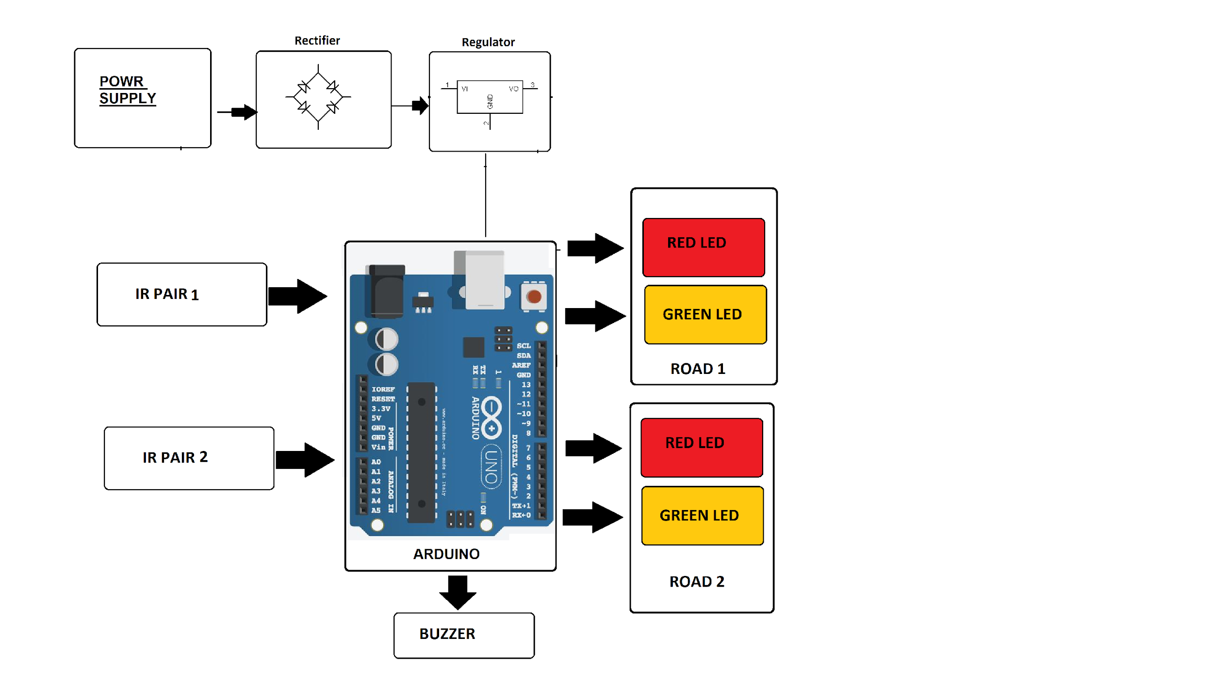
Block Diagram.
Coding will be initiated on Arduino Uno to target the objective

Slide 7
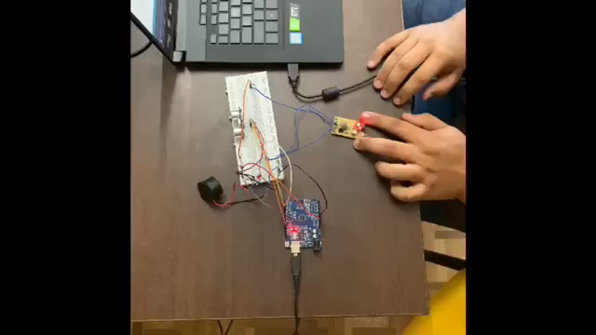
WORKING VIDEO AND ELABORATION

Slide 8
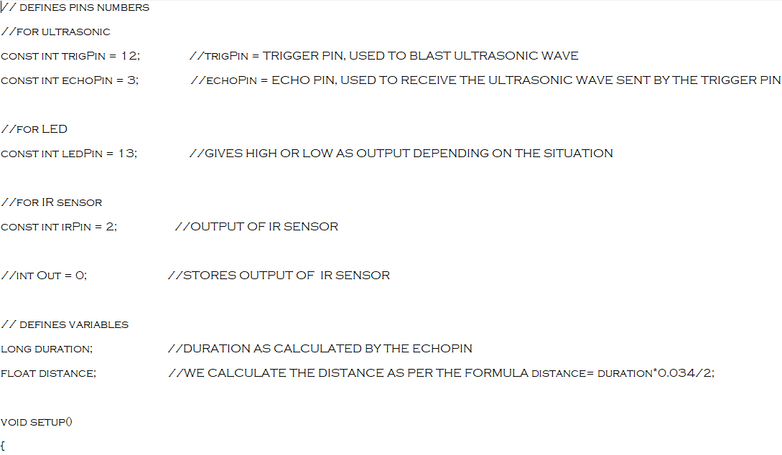
Coding behind

Slide 9
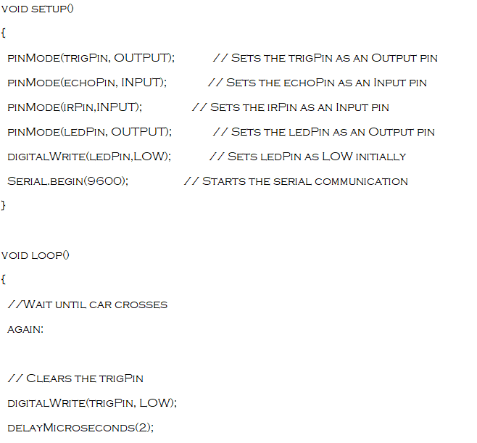

Slide 10
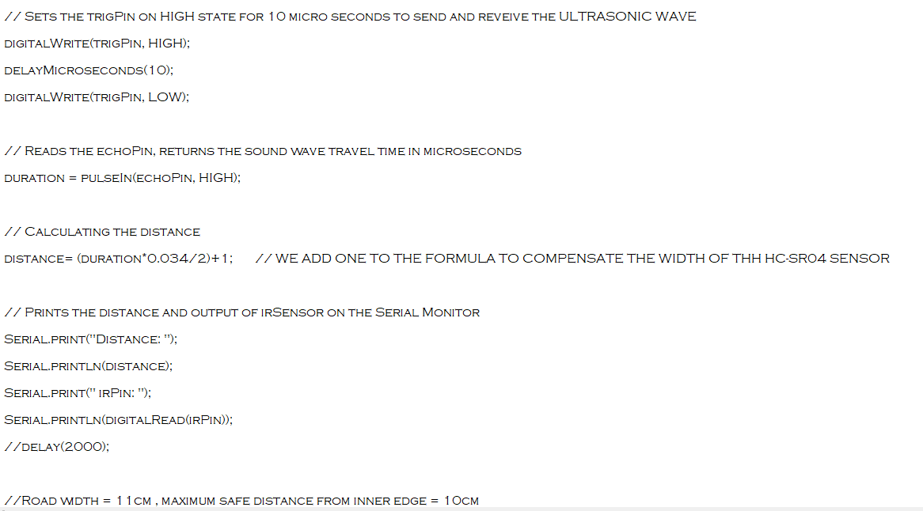

Slide 11
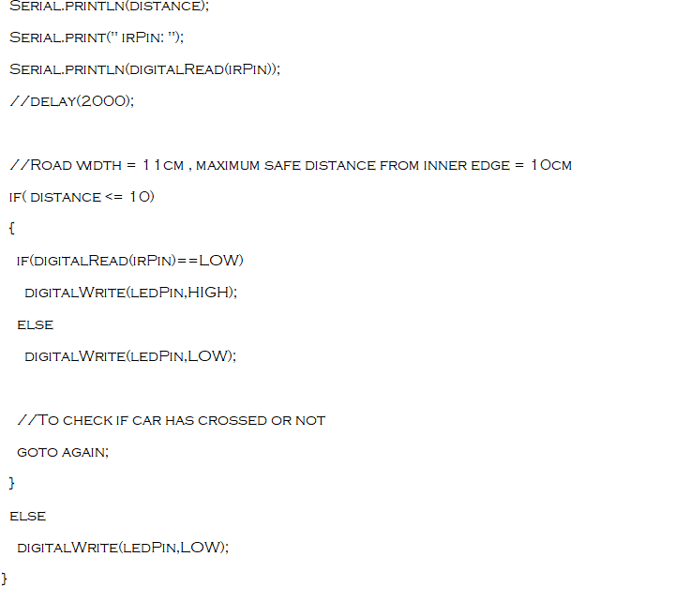

Slide 12
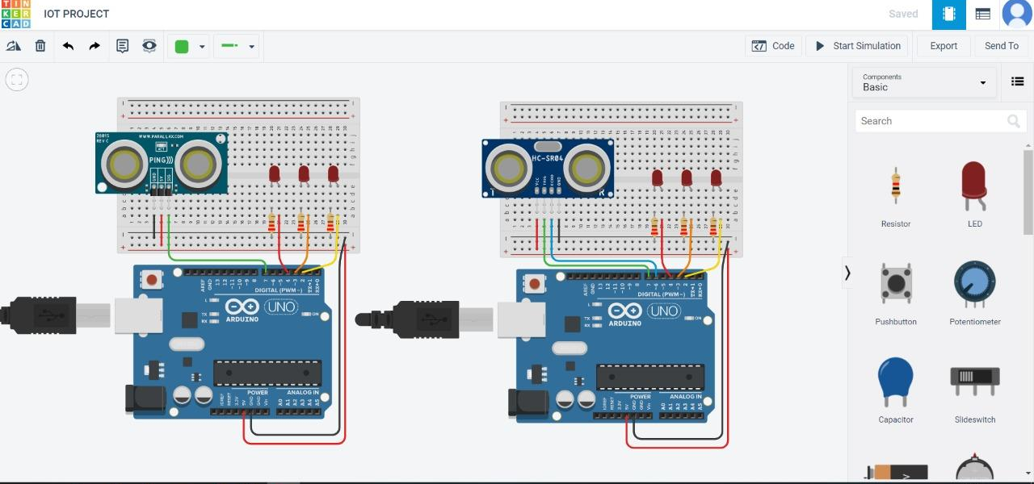
Simulation of Detection System

Slide 13
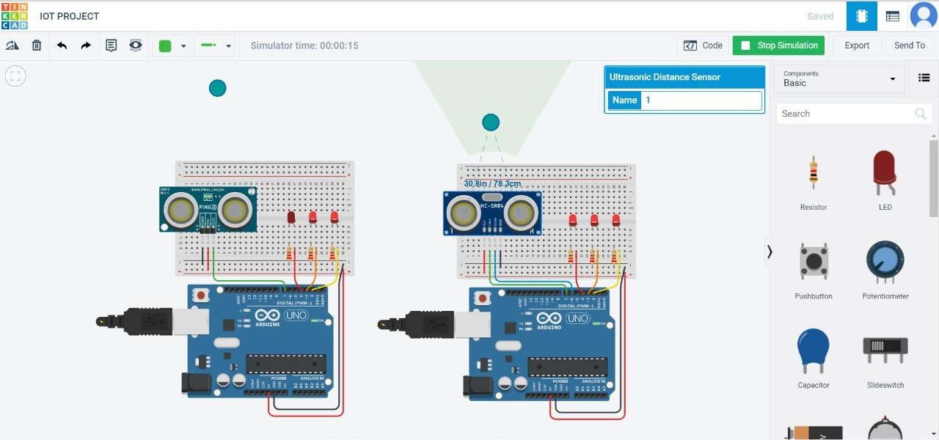

Slide 14
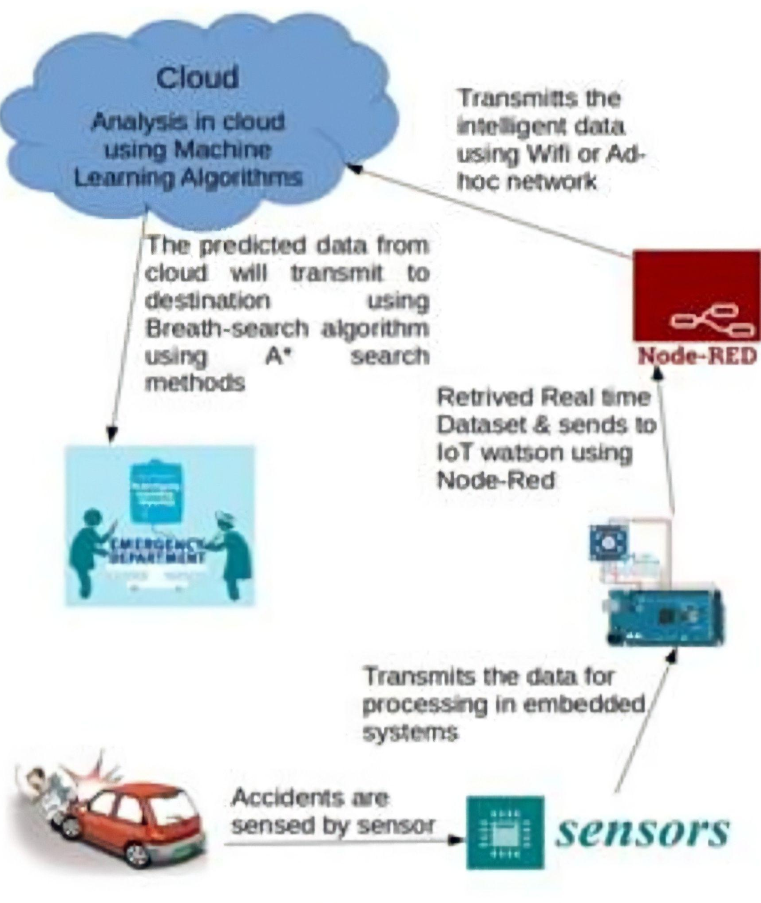
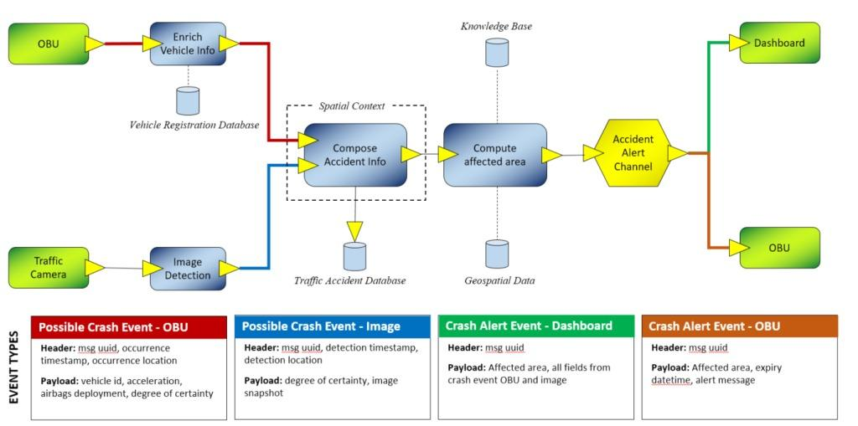
Accident Alert System

Slide 15
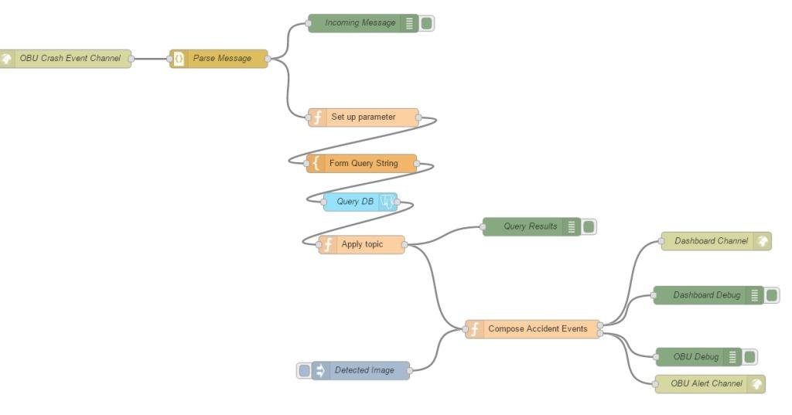
Accident alert system

Slide 16
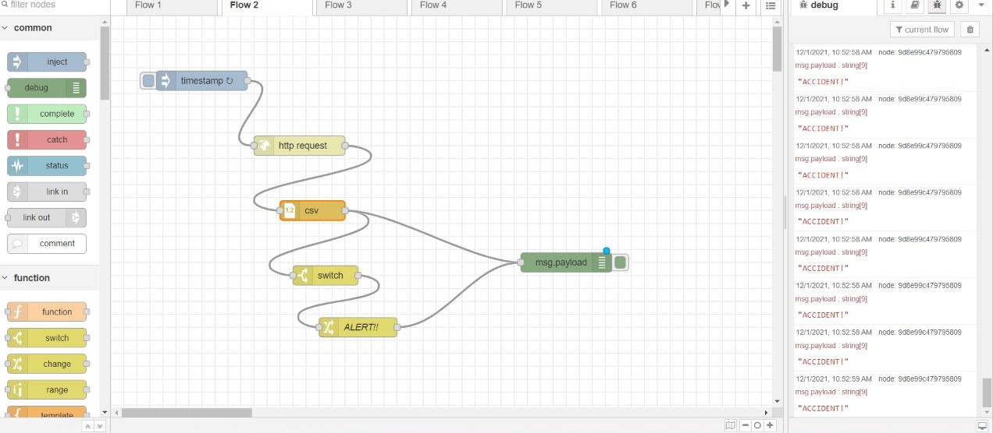
Simulation of speed sensor to monitor speeds of coming cars

Slide 17
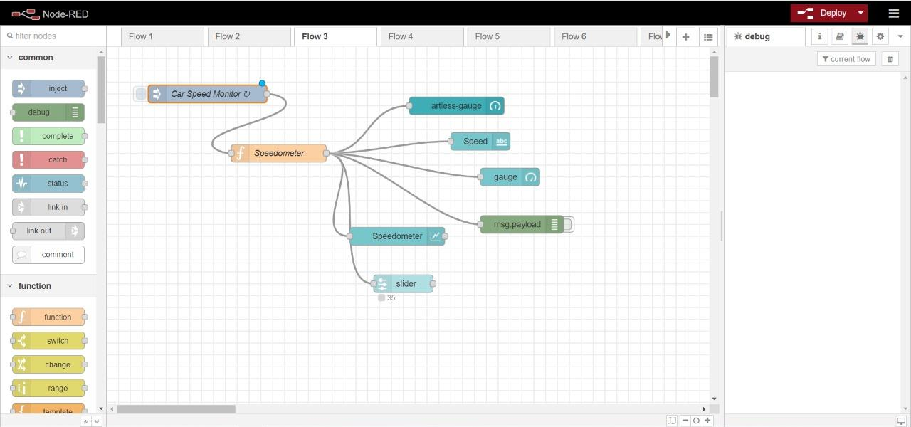

Slide 18
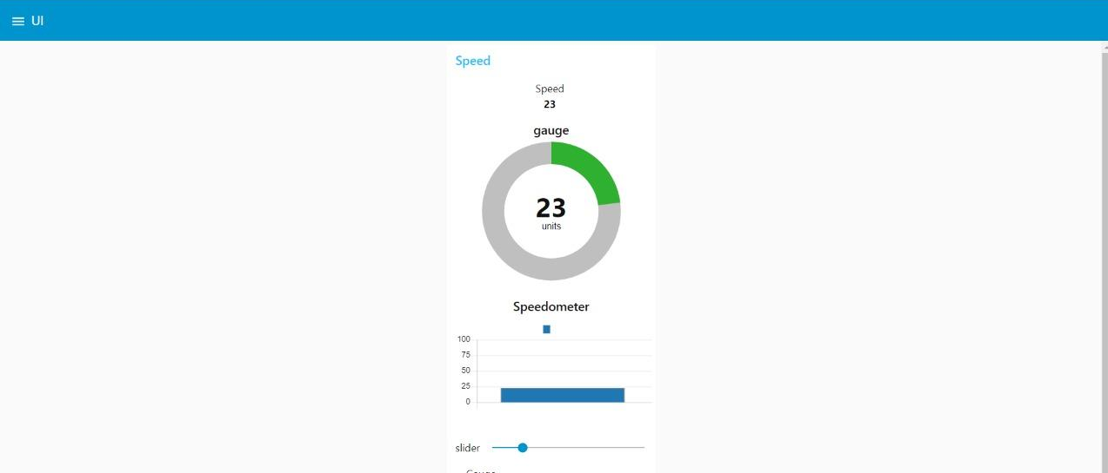

Slide 19
CONCLUSION
People are well aware about their surroundings and senses but are unaware of any unseen approaching dangers on road.
So the smart road safety and accident prevention system is all about saving a life in road accidents through technology.
It requires an IR sensor and an ultrasonic proximity sensor which are used to detect the obstacle .
Alerting is done through buzzer and LED.
Where the driver or a person is notified about the approaching vehicle.

Slide 20
REFERENCES
Academia edu papers
https://www.academia.edu
https://pdfs.semanticscholar.org/ed8b/a76bfa50a97cea99f05e0dc99aa5a47067c0.pdf
Semantics scholars

Slide 21
THANK YOU

