Slide 1
PANGEAWORLD SIMULATION PLATFORM
Project Overview: Geopolitical & Macroeconomic Simulation
01 / 05
ACADEMIC STRATEGY: BUILT FIRST FOR BUS 380 INTERNATIONAL BUSINESS
PangeaWorld was engineered from the ground up specifically for the BUS 380 International Business course. By transforming static business case studies into a living, high-stakes global arena, students actively navigate tariffs, trade embargoes, supply chain shocks, and currency valuations. Its modular architecture scales across Economics, Supply Chain, and Business Fundamentals courses.
35,000+ Lines
Handcrafted Code
240+ Source Files
Modern full-stack web architecture built with React 19, TypeScript & Python FastAPI
3 Games in 1
Gameplay Innovation
Risk + Catan + Capsim
Territorial diplomacy, resource-scarcity barter, and corporate finance governance
25 Test Suites
Enterprise Reliability
Zero Desync Architecture
Rigorous automated integration tests ensuring rock-solid real-time multiplayer states
SYNTHESIZING THE BEST OF THREE LEGENDARY GAMES
• The Geopolitical Strategy of Risk: Global territorial control, diplomatic alliances, contested border defenses, and treaty negotiations that make international politics tangible.
• The Resource Trade of Catan: Scarcity-driven barter mechanics, procedural supply regions, raw material harvesting, and multi-lateral trading desks.
• The Deep Business Mechanics of Capsim: Rigorous financial balance sheets, debt management, factory capacity investments, R&D allocation, and quarterly ROI scoring.
• Seamless Academic Integration: Eliminates expensive commercial simulation licenses ($40–$80 per student) through in-house proprietary software.

Slide 2
PANGEAWORLD SIMULATION PLATFORM
Gameplay Dynamics: 14-Round Macro & Micro Cycle
02 / 05
14-ROUND TEMPORAL ARCHITECTURE: 7 FISCAL YEARS SPLIT INTO 14 SEMI-ANNUAL PHASES
Each simulation represents 7 annual business years, executed as a 48-hour staggered decision loop: Day 1 (First 6 Months) gives National Presidents authoritative macro control, followed by Day 2 (Second 6 Months) where Corporate Executives execute firm-level market operations under the new sovereign reality.
SOVEREIGN PRESIDENTIAL PHASE (MACRO GOVERNANCE)
7 Student Presidents (1 per sovereign nation) + 1 Autonomous Rogue State (Drakmoor)
• Macroeconomic Levers: Sets national tariffs, corporate tax rates, central bank interest rates, and foreign exchange reserves.
• Infrastructure Megaprojects: Allocates treasury into rail networks, deep-water ports, energy grids, and broadband infrastructure.
• Corporate Lobbying Ingestion: Reviews and approves/denies formal lobbying petitions from domestic companies (subsidies, port access).
• Diplomacy & Pangea Assembly: Negotiates bilateral trade corridors, sponsors multilateral sanctions in the UN-style Assembly, and forms defense pacts.
• Intelligence & Military Campaigns: Deploys intelligence/espionage and launches multi-quarter military campaigns with conditional orders.
• President Scorecard & KPIs: Evaluated on National GDP Growth (real & delta), Inflation Stability (CPI index), and Citizen Approval Rating.
CORPORATE EXECUTIVE PHASE (MICRO ENTERPRISE)
70–105 Student Executives across 10–15 competing corporate enterprises per nation (2–4 per team)
• Macro Reaction & Planning: Analyzes new presidential decrees, tariffs, and commodity costs to lock in quarterly business strategy.
• Opportunity-Cost Allocation: Strict CAPSIM-style trade-offs: capital spent on Marketing or R&D directly foregoes tooling, inventory, or debt payoff.
• Supply Chain & Logistics: Procures raw commodities (oil, timber, rare earths), contracts rail/maritime freight, and manages inventory holding.
• Pricing & Market Competition: Sets wholesale/retail pricing, enters foreign consumer markets, and competes against rival firms across 8 nations.
• Sovereign Lobbying Petitions: Drafts formal resource subsidies and infrastructure requests to the national president to remove bottlenecks.
• Executive Scorecard & KPIs: Evaluated on Market Share %, Net Revenue & Margin, Inventory Carrying Cost, Return on Capital, and Valuation.
CROSS-SYSTEM MECHANICS: 6-Month Policy Lag: Simulates macroeconomic delay as corporate balance sheets absorb state fiscal decisions. | Zero-Elimination & AI Swarm: All seats play all 14 rounds; inactive seats are autonomously backfilled. | Context-Grounded AI Advisor: Gemini advisor analyzes Assembly debates & Pangea Times news feeds.

Slide 3
PANGEAWORLD SIMULATION PLATFORM
System Architecture: Real-Time APIs & Full-Stack Tech Engine
03 / 05
Frontend: React 19 & TypeScript
Zero-Lag Student Client
• React 19 Concurrent Features: Instant UI updates, optimistic state rendering, and zero-stutter animations during fast-paced student trading sessions.
• Strict TypeScript Typing: 100% typed domain models across player treaties, territory states, financial ledgers, and market transactions.
• Pure CSS Layout Engine: Responsive design tailored for student laptops, Chromebooks, and tablets without bulky external UI frameworks.
• Interactive Canvas Map: Hardware-accelerated procedural game board rendering territories, trade routes, naval blockades, and resource icons.
Backend: Python FastAPI & WebSockets
High-Throughput State Machine
• Sub-Second Synchronization: Utilizes WebSockets with custom binary compression for instantaneous state sync (<50ms) across 30+ students per room.
• Transactional State Engine: Guarantees atomic trade execution, preventing resource duplication, race conditions, or inventory desyncs.
• In-Memory Active Sessions: Lightning-fast room management handling dozens of concurrent classroom sections with zero database bottleneck.
• Automated Heartbeat Reconnection: Seamlessly restores student state and active negotiations if a student experiences campus Wi-Fi drops.
LMS Integration & Security
Academic Enterprise Ready
• Canvas LTI 1.3 Compatible: Single-Sign-On (SSO) launch directly from Canvas course modules without separate student accounts.
• Automated Gradebook Return: Directly posts simulation participation points, business ROI scores, and decision metrics into the Canvas gradebook.
• Role-Based Access Control: Distinct permission models for student teams, course instructors, teaching assistants, and simulation admins.
• Zero Client Installation: Runs 100% in modern web browsers; requires zero IT approval or desktop software installation for students.

Slide 4
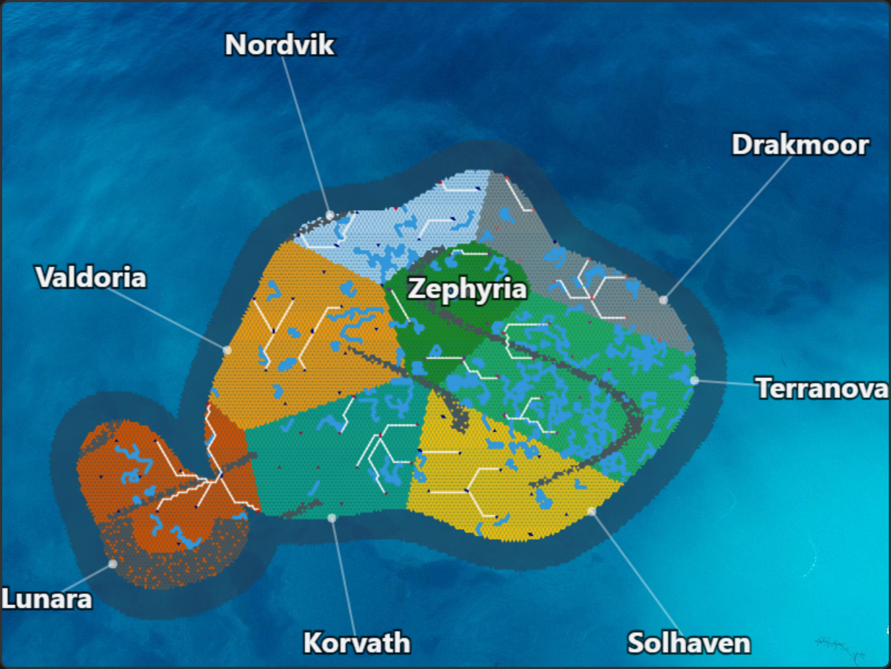
PANGEAWORLD SIMULATION PLATFORM
Procedural World Map & Deterministic Simulation Engine
04 / 05
PROCEDURAL GAME BOARD (HTML5 CANVAS)
Pure-math sine/cosine wave generator & Voronoi tessellation with server-issued seeds
DETERMINISTIC ENGINE & AUTONOMOUS AI SWARM
Synchronized batch processing, microeconomic physics, and AI seat backfill:
Macroeconomic Brain (round_manager.py)
• Simultaneous Turn Resolution: Single-batch execution eliminates first-player advantage; all decisions resolve simultaneously.
• Microeconomic Pricing & FX: Resource prices (oil, minerals, wheat) and floating exchange rates adapt dynamically to trade flows and supply shocks.
• Opportunity-Cost Mandate: Strict trade-off physics: defense expenditures directly reduce domestic infrastructure and industrial capacity.
Autonomous AI Swarm (ai_backfill.py)
• Zero Disruption Seat Backfill: Autonomous bots immediately take over vacant nation seats to prevent classroom stalls from student absences.
• 4 Economic Personalities: Mercantile (trade-focused), Protectionist (tariffs/defense), Diplomatic Arbitrator (neutral), and Aggressor (expansionist).
• 25 Regression Test Suites: Rigorous automated test suites ensure economic math integrity, preventing infinite-wealth loops or exploits.
• 8 Sovereign Nations: 7 student powers + 1 rogue AI state (Drakmoor)
• Living Geography: Mountain chokepoints, navigable rivers, ocean ports & rail lines

Slide 5
PANGEAWORLD SIMULATION PLATFORM
Faculty Command Telemetry, Shock Injector & Institutional ROI
05 / 05
FACULTY COMMAND & SHOCK INJECTOR
• Live Simulation Telemetry: Real-time dashboard tracking student trade volumes, debt-to-GDP ratios, military build-ups, and negotiation chat logs.
• Exogenous Shock Injector: Allows professors to introduce real-world events mid-game: global supply crunches, canal blockades, oil embargoes, or pandemics.
• Pedagogical Pause & Rewind: Pause the simulation clock at any critical teaching moment to debrief strategies, examine game theory, or analyze macro mistakes.
• Automated Grading Analytics: Generates objective performance rubrics based on decision consistency, negotiation skill, and risk management rather than raw wealth.
INSTITUTIONAL VALUE & STUDENT ROI
• Direct Student Cost Savings: Replaces commercial simulation licenses costing $40–$80 per student with a university-owned, zero-cost asset.
• Tailored to Academic Curriculum: Custom-built for university learning objectives rather than generic off-the-shelf business games.
• Multi-Course Scalability: Designed for BUS 380 International Business, but easily deployed in Macroeconomics, Global Supply Chain, and MBA capstones.
• Full Intellectual Property Ownership: 100% university-owned proprietary asset with no recurring vendor licensing fees or per-seat costs.

