Slide 1
Machine Learning Exercise 2 09.06.2023
Panin, Vladimir 12238682
Dass, Reema 12144026
Schweitzer,Valentin 51829840

Slide 2
Fully connected layer 1
Activation layer 1
Input Layer
Output Layer
i1
o1
i2
o2
i3
o3

Slide 3
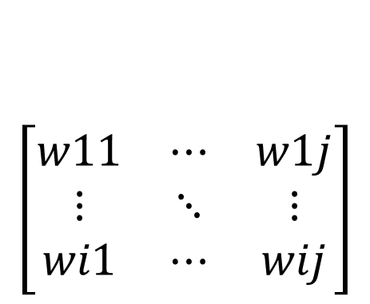
FC Layer Forward propagation
X=[ x1 x2 …. xi ]
B=[ b1 b2 …. bj]
$$\left[\begin{matrix}w11 & ⋯ & w1j \\ ⋮ & ⋱ & ⋮ \\ wi1 & ⋯ & wij\end{matrix}\right]$$
Y=WX+B
Bias b1 =0.1
0.1
output 0.2
0.5
0.5
0.5
def forward_propagation(self, input):
self.output = self.bias
+ np.dot(input, self.weights)
self.input = input
return self.output
output 0.2
0.1
0.5
Bias b1 =0.1

Slide 4
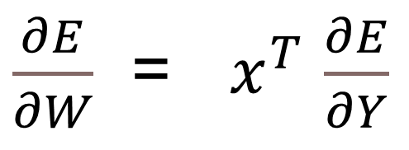
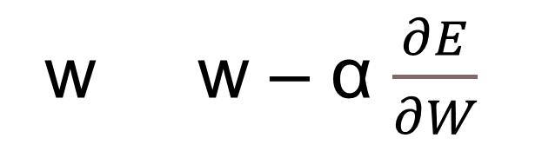


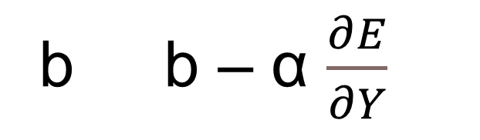
FC Layer Backward Propagation
b b – α $\frac{∂E}{∂Y}$
w w – α $\frac{∂E}{∂W}$
$\frac{∂E}{∂Y}$
$\frac{∂E}{∂Y}$
$\frac{∂E}{∂W}$ = $x^{T}$ $\frac{∂E}{∂Y}$
def backward_propagation(self, output_error, learning_rate):
in_error = np.dot(output_error, self.weights.T)
w_error = np.dot(self.input.T, output_error)
#Adjust bias and weights
self.weights = self.weights - learning_rate * w_error
self.bias = self.bias - learning_rate * output_error
return in_error

Slide 5

Activation Layer & Error Function
Apply Activation function to input
Possible functions are:
Relu
Tanh
Sigmoid
f(xi)
xi
def forward_propagation(self, input_data):
self.input = input_data
self.output = self.activation(self.input)
return self.output
$$Error= \sum_{i=1}^{n}{\left(y_{i}−{\hat{y}}_{i}\right)}$$
def backward_propagation(self, output_error, learning_rate):
return self.activation_derivative(self.input) * output_error

Slide 6

Evaluation
01
Creating the model
models$=\left\{\begin{aligned}Self Coded NN \\ &Sklearn \\ RandomForest\end{aligned}\right.$
Hyperparameter tuning
02
Grid search for the created model
03
Evaluation
F1-Score using same hyperparameters for all models

Slide 7
Congressional voting dataset
Model (Grid search for self-code hyperparams. ) | F1-score Holdout | Hyperparameters
Self-Code | 0.98 | {'activation': ‘sigmoid', ‘node_count': [3, 3], 'learning_rate’: 0.1, epochs=1000}
Sklearn | 0.95 | {'activation': 'tanh', 'hidden_layer_sizes': [3, 3, 3], 'learning_rate': 'constant', 'learning_rate_init': 0.1}
RandomForest | 0.95 | {'max_features': 'sqrt', 'min_samples_split': 2, 'n_estimators': 300}

Slide 8
Spam dataset
Model (Grid search for self-code hyperparams. ) | F1-score Holdout | Hyperparameters
Self-Code |  | {'activation': , ‘node_count': , 'learning_rate’: , epochs=}
Sklearn |  | {'activation': , 'hidden_layer_sizes': , 'learning_rate': , 'learning_rate_init': }
RandomForest | 0.95 | {'max_features': 'log2', 'min_samples_split': 2, 'n_estimators': 400}

Slide 9
Flag dataset
Model (Grid search for self-code hyperparams. ) | F1-score Holdout | Hyperparameters
Self-Code | 0.56 | {'learning_rate': ‘0.5’, 'epochs': ‘2000’, 'node_counts': ‘[10, 10]’, 'activation_function’: ‘sigmoid’}
Sklearn | 0.38 | {'activation': 'relu',learning_rate_init': 0.1, 'learning_rate': 'constant', 'max_iter': 100, 'hidden_layer_sizes': [20, 20, 20]}
RandomForest | 0.74 | {'max_features': 'sqrt', 'min_samples_split': 2, 'n_estimators': 300}

Slide 10
Conclusion
Congressional Voting Dataset
F1 score of self coded NN 3 percentage points bettere
However, runtime was significantly higher
Flag Dataset
Self coded NN outperformed sklearn MultipleClassifier
Random Forest performed best
Runtime of self coded NN was significantly worse compared to sklearn and RandomForest

Slide 11
Congressional voting dataset
Model (Grid search for self-code hyperparams. ) | F1-score | Hyperparameters
Self-Code |  | Hidden_layer_size= , lr= , activation= , epochs= , node_count=
TensorFlow
Model (Grid search for Tensorflow ) | F1-score | Hyperparameters
Self-Code |  | Hidden_layer_size= , lr= , activation= ,
TensorFlow
Model | F1-score | Hyperparameters
Random Forest | 0.96 | Hidden_layer_size= , lr= , activation= ,

Slide 12
Spam dataset
Model (Grid search for self-code hyperparams. ) | F1-score | Hyperparameters
Self-Code |  | Hidden_layer_size= , lr= , activation= , epochs= , node_count=
TensorFlow
Model (Grid search for Tensorflow ) | F1-score | Hyperparameters
Self-Code |  | Hidden_layer_size= , lr= , activation= ,
TensorFlow
Model | F1-score | Hyperparameters
Random Forest | 0.94 | Hidden_layer_size= , lr= , activation= ,

Slide 13
Flag dataset
Model (Grid search for self-code hyperparams. ) | F1-score | Hyperparameters
Self-Code |  | Hidden_layer_size= , lr= , activation= , epochs= , node_count=
TensorFlow
Model (Grid search for Tensorflow ) | F1-score | Hyperparameters
Self-Code |  | Hidden_layer_size= , lr= , activation= ,
TensorFlow
Model | F1-score | Hyperparameters
Random Forest | 0.54 | Hidden_layer_size= , lr= , activation= ,

Slide 14
Evaluation
01
Self coded NN
04
TensorFlow
Hyperparameter tuning
Hyperparameter tuning
02
07
05
Grid search including cross validation for self coded NN
Grid search including cross validation for Tensorflow
Random Forest
Generating F1 score with grid search parameters
03
Evaluation
06
Evaluation
F1-Score using same hyperparameters for Tensorflow model
F1-Score using same hyperparameters for Tensorflow model

Slide 15
Fully connected layer 1
Activation layer 1
Input Layer
Output Layer
i1
o1
i2
o2
i3
o3

