Slide 1
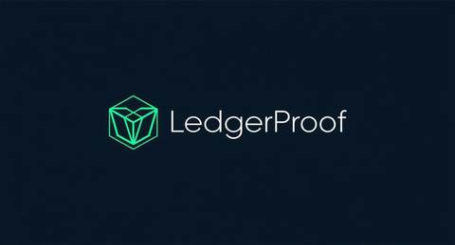
APPENDIX · INVESTOR RETURN ANALYSIS · CONFIDENTIAL
Return Scenarios — Ten31 $5M Seed
Ownership at entry & exit
Comparable exits and valuations
$5M ÷ $30M post-money cap
= 16.67% at entry
VeriSign
Domain trust registry
$20B market cap · $1.7B ARR · 12× ARR
Series A dilution (~20%)
→ ~13.3% post-Series A
SWIFT
Financial messaging standard
~$4B est. · mandatory · 11K+ institutions
Growth rounds (~15% further)
→ ~11–13% at exit
DTCC
Settlement infrastructure
Member-owned utility · $2.4Q cleared/yr
Pro-rata (if exercised)
→ maintains or increases
Verint
Security intelligence SaaS
$3.9B acquisition by Apax 2021 · 5× ARR
Analysis uses 13% at exit (conservative).
Diligent
Governance SaaS
$4.6B acquisition by Clearlake 2022 · 8× ARR
Scenario
Year
ARR
Exit Multiple
Implied Valuation
Ten31 Stake (~13%)
Return on $5M
Early strategic acquisition
Yr 3
$68M
20×
$1.36B
$177M
35×
Base — IPO / coop. transition
Yr 5
$450M
12×
$5.4B
$702M
140×
Upside — global infrastructure
Yr 7
$1.2B
15×
$18.0B
$2.34B
468×
Bitcoin treasury note: LedgerProof, Inc. holds BTC on its balance sheet from Day 1. Ten31's stake carries additional exposure to Bitcoin appreciation — consistent with Ten31's portfolio thesis. Not modeled above.

