Slide 1

Blockchain based ecommerce application
Welcome

Slide 2
Introduction
De-centra is an e-commerce solution demonstrating supply-chain use-case
Completely decentralized
Free-flow trading capabilities to its users without any external involvement
No 3rd party commissions or conditions for business

Slide 3
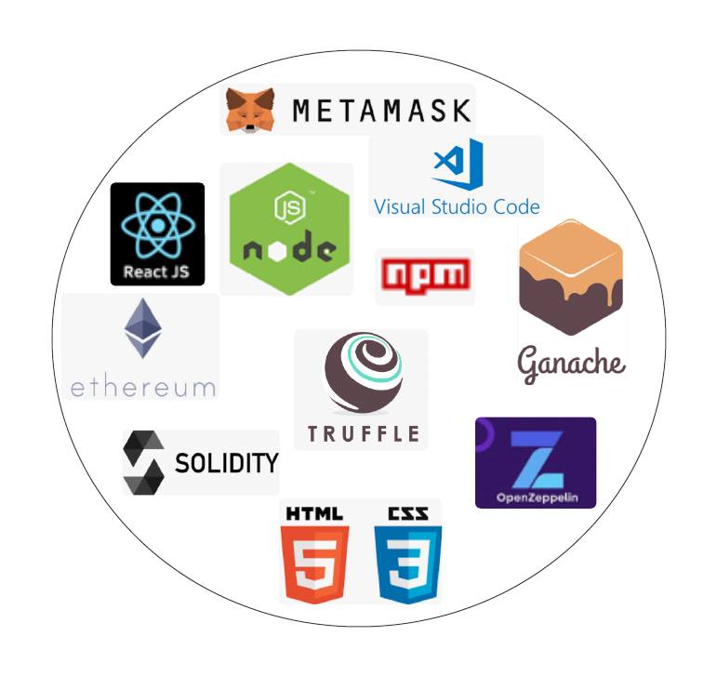
Technology Stack

Slide 4
Implementation notes
Ethereum, Solidity,
Supported functions
Creation of new item
Buying
Dispatching
Tracking
Smart contracts
ItemManager.sol
Item.sol
MyOwnableContract.sol

Slide 5
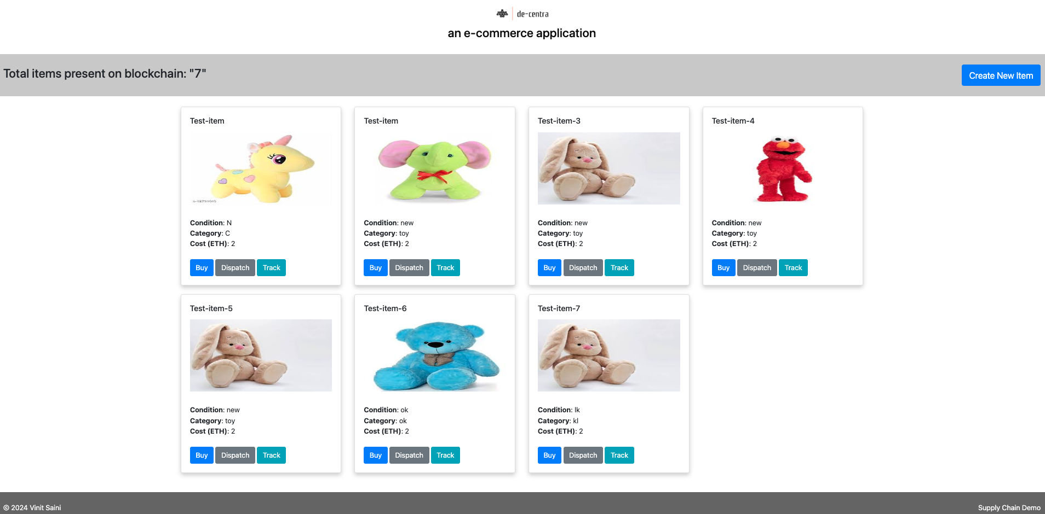
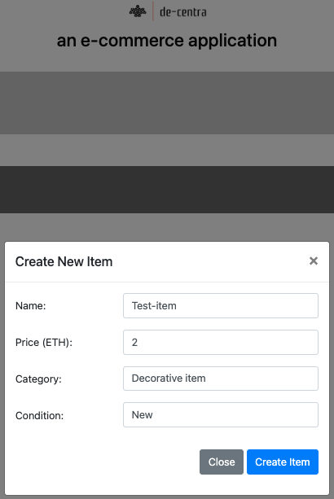
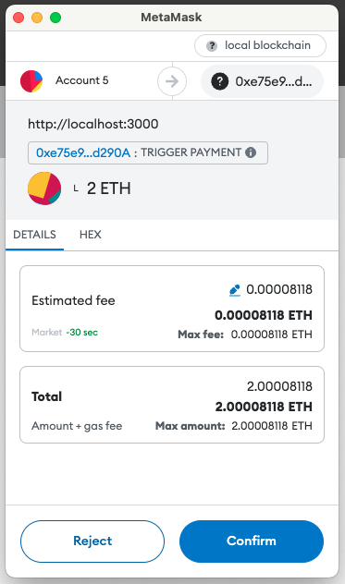
Application Demo

Slide 6
Thank you

