Slide 1

Welcome

Slide 2

Introduction
Visa-chain – A trustworthy, secure solution to process Visas based on Hyperledger Fabric Tech.
Decentralized under a Permissioned Network
Dedicated channels for secure communication
Transparent decision-making among independent entities.
Strict privacy and confidentiality measures
Access limited to authorized users

Slide 3
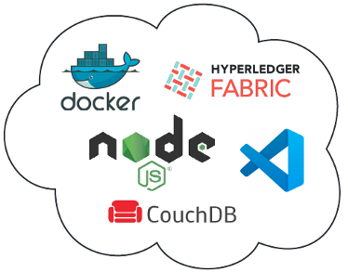
Technology Stack

Slide 4
Implementation notes
Hyperledger Fabric, Node.js
Supported functions
New Visa application
Background checks
Documentation checks
Visa decision
Smart contracts
visaappcontract.js
visaapp.js
queries.js
Client apps
VisaApplication.js
VisaClearence.js
VisaApprove.js
Wallet apps (Identity)
AddToWallet.js
Scripts

Slide 5
Application Demo
No UI Support
Full Backend Implementation
Chaincode
Dedicated channel
Customized Visa-net network
3 Orgs setup
3 Peers
3 CAs
3 CouchDB instances
1 Orderer
Customized Endorsement Policy
Custom Scripts
Launch one-click visa-net network
Add orgs to existing network
One-click deployment of chaincode

Slide 6
Thank you

