Slide 1

Programming Club
Hugh Leather, Pavlos Petoumenos, Volker Seeker

Slide 2
What is it all about?
Programming
More!

Slide 3
Structural Details
News Update
(student involvement encouraged)

Slide 4
Structural Details
Presentation of this Week's Tasks
Basic Skills
Interesting Problem
Weekly Challenge

Slide 5
Structural Details
PROGRAMMING ACTION

Slide 6
News Update
Programming Club
Material Repository
https://github.com/vsee/uoe_programmingclub

Slide 7





News Update
Programming Challenges
Kattis

Slide 8
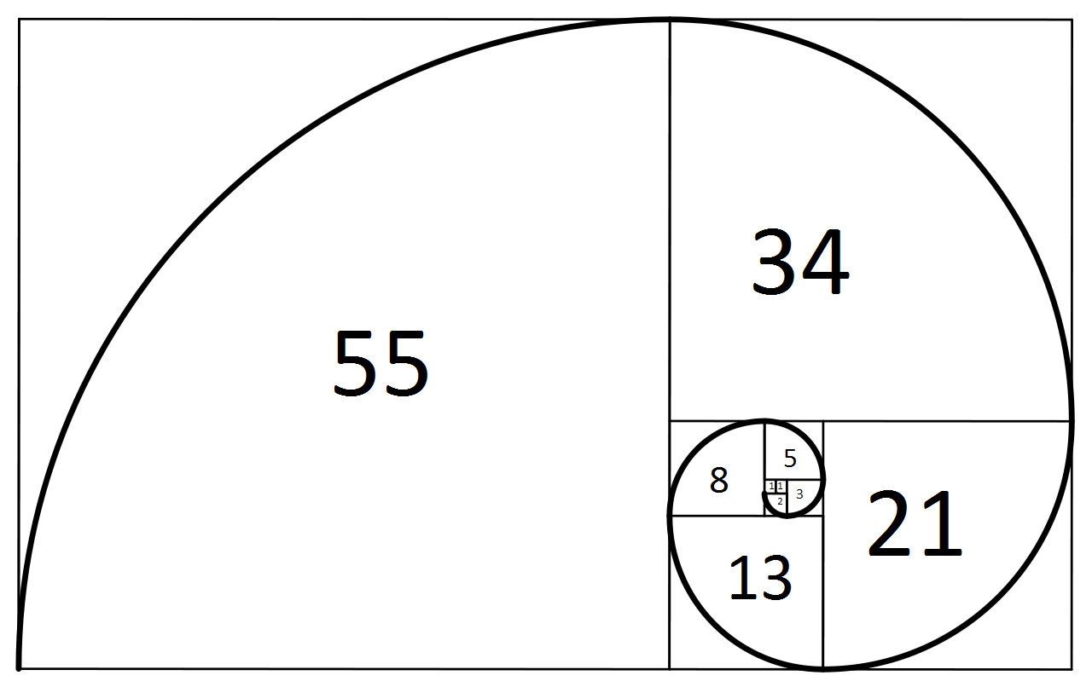
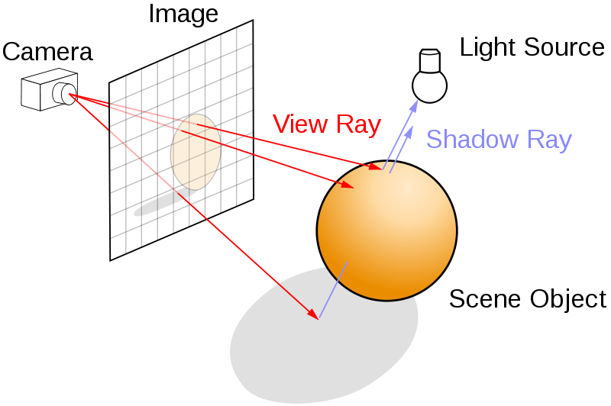
Today's Tasks
Basic Skills
Fibonacci
Interesting Problem
Raytracing
Weekly Challenges
Parameter Substitution
(TopCoder - Single Round Match 225 Round 1 - Division 2, Level Two)
Absurdmark Roads

