Slide 1
REGTAG
Consultation Papers vs MiFID II

Slide 2


Intuition
Matching consultation papers to major regulations
Allows users to understand their impact against larger regulatory framework
In this model, I have used:
Consultation Papers from ASIC (Australian Securities & Investment Commission)
Regulatory technical and implementing standards – MiFID II

Slide 3


What I thought I would do
Extract consultation papers and clean up
Tf-idf on consultation papers
Word2Vec on MiFID II document
Softmax Regression Classifier http://mccormickml.com/2016/04/19/word2vec-tutorial-the-skip-gram-model/
What I actually did
DOC2VEC

Slide 4
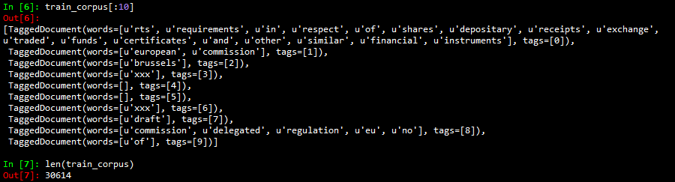

Problem – Weird train corpus

Slide 5
Outcome
Aim to find the similarity between: 1) A doc in test corpus against trained model 2) A list of keywords against test corupus Start with
train = MiFid document
test = Consultation papers

Slide 6
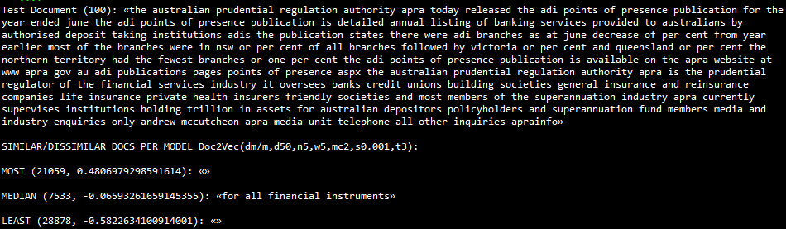
vs Test document

Slide 7
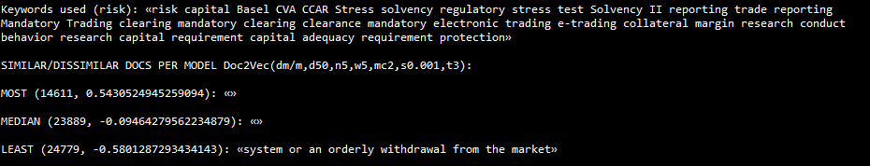
vs Keywords

Slide 8
Revised Outcome
Aim to find the similarity between: 1) A doc in test corpus against trained model 2) A list of keywords against test corupus Switched to:
train = Consultation papers
test = MiFid document

Slide 9
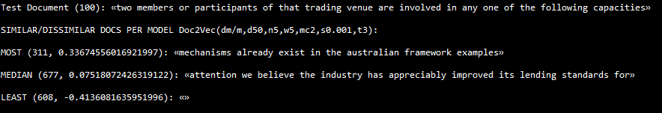
vs Test document

Slide 10
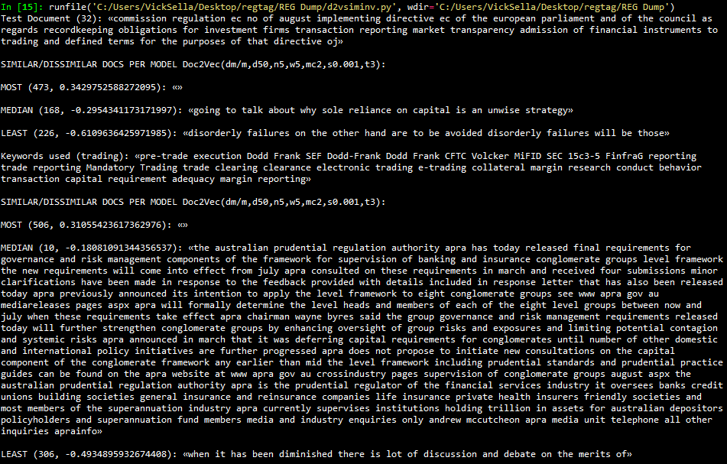
vs Keywords

