Slide 1
Data Structures & Algorithms:
Trees

Slide 2
Trees
A high-level data structure that represents hierarchical data.
Usually implemented as a linked structure, but can also be an array (in some cases) or a hybrid structure (linked + array, linked + hash-table).

Slide 3
Trees Use Cases (some)
- ordered kvs
- representing any kind of hierarchy:
* a file system
* an org structure with people and rights (LDAP)
- AST
- optimized access data structures:
* search
* priority queues
* storage optimization
- persistent data structures
- efficient mapping
- computational linguistics

Slide 4
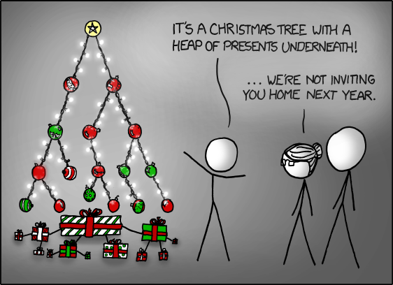
Trees

Slide 5
Specific Tree Variants
- BSTs
- heaps
- BTrees
- Tries, Radix/Patricia Trees
- R-Trees, KD-Trees, Segment Trees
- Finger trees, Merkle Trees
- HAMTs

Slide 6
Tree Traversal
- DFS
- BFS
- pre-order
- in-order
- post-order

Slide 7
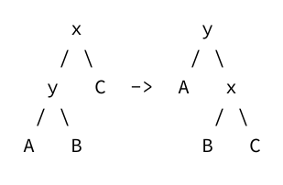
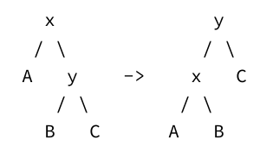
Binary Search Trees (BSTs)
O(log n) for:
- search
- insertion
- modification
- deletion
TreeSort
Require balancing (by tree rotations)
Left Rotation Right Rotation

Slide 8
BST Types
- Red-Black
- AVL
- Splay

Slide 9
Splay Trees
Arguably, the simplest BSTs.
On each access/insertion, the recently accessed element is moved to the top of the tree by a sequence of tree rotations.
Splay trees have a (partial) LRU property.

Slide 10
Splay Tree Balancing
- zig step: make the node new root
- zig-zig step: 2 consecutive zig steps
- zig-zag step: performed when the target and parent are in different directions

Slide 11
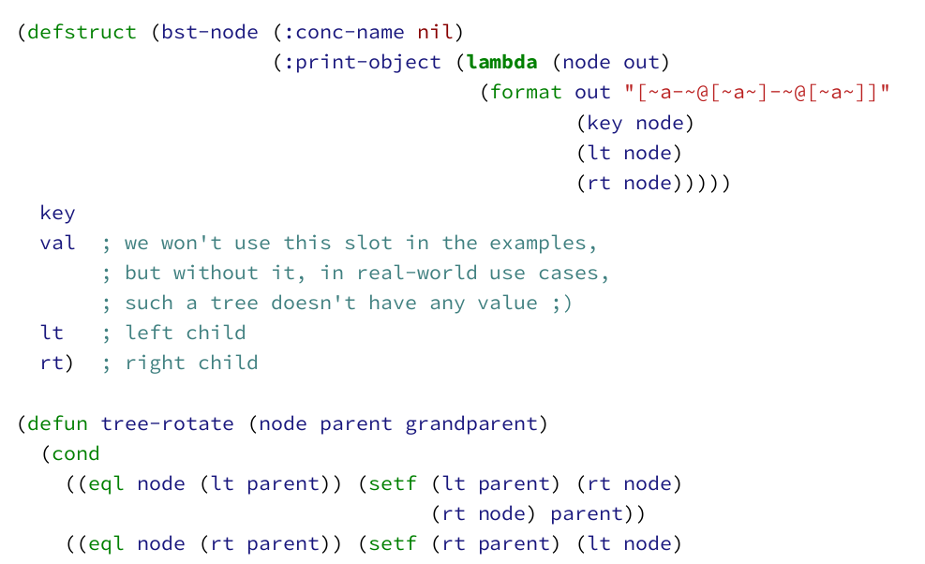
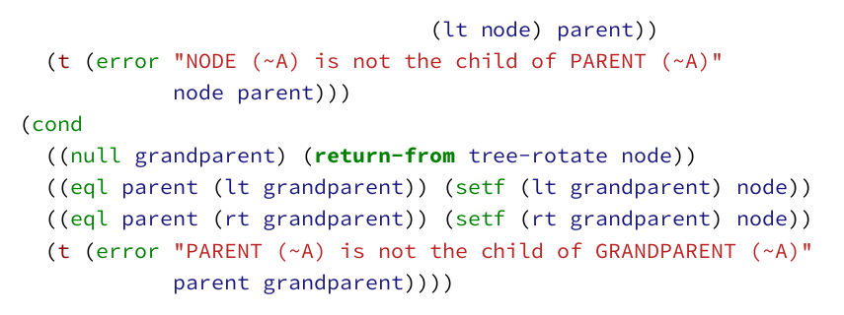
Splay Tree Balancing

Slide 12
B-Trees
Tree + array
Types:
- 2-3 Trees
- B-Trees
- B+-Trees

Slide 13
Heaps
Tree in an array
Heapsort

Slide 14
Tries
Aka prefix trees.
Used for efficient representation of dictionaries and search in them.
Radix tree optimization.

Slide 15
R-Trees
Aka rectangle-trees.
Used for efficient representation of n-dimensional points.
Allows for efficient range queries.

Slide 16
Reading List
https://blog.mapbox.com/a-dive-into-spatial-search-algorithms-ebd0c5e39d2a

