Slide 1
Data Structures & Algorithms:
Graphs

Slide 2
Graphs
A high-level data structure that represents linked data.
Usually implemented in a “distributed” manner.
But can also be represented as a matrix.

Slide 3
Graphs Use Cases (some)
- pathfinding
- network analysis
- dependency analysis in planning, compilers, etc.
- various optimization problems
- distributing and optimizing computations
- knowledge representation and reasoning with it
- meaning representation in NLP

Slide 4
Main Graph Representations
- Collection of nodes
- Collection of relations
- Adjacency matrix
- Adjacency list

Slide 5
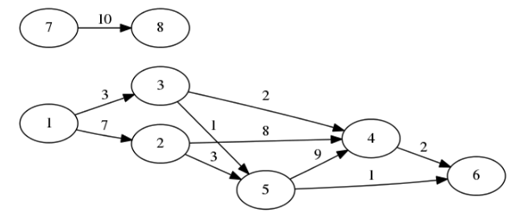

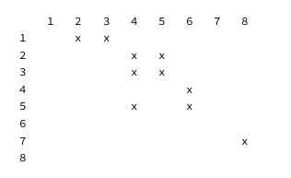
Topological Sort

Slide 6
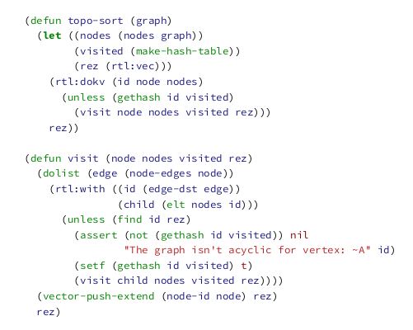
Topological Sort

Slide 7
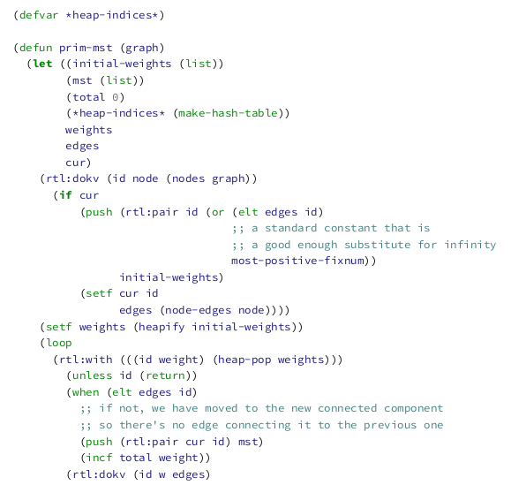
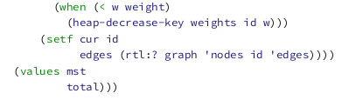
Prim’s MST

Slide 8
Kruskal’s MST
- Build the MST from edges
- Union-Find

Slide 9
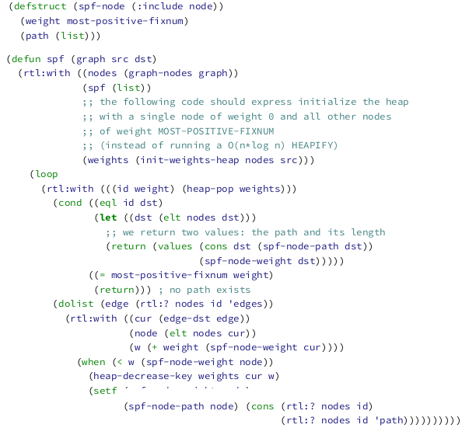
Dijkstra’s Shortest Path

Slide 10
A* (BFS)
- Triangular inequality
- Heuristic algorithm

Slide 11
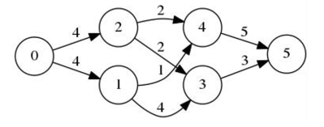
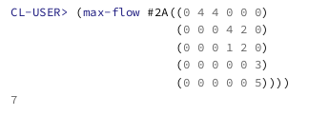
MaxFlow

Slide 12
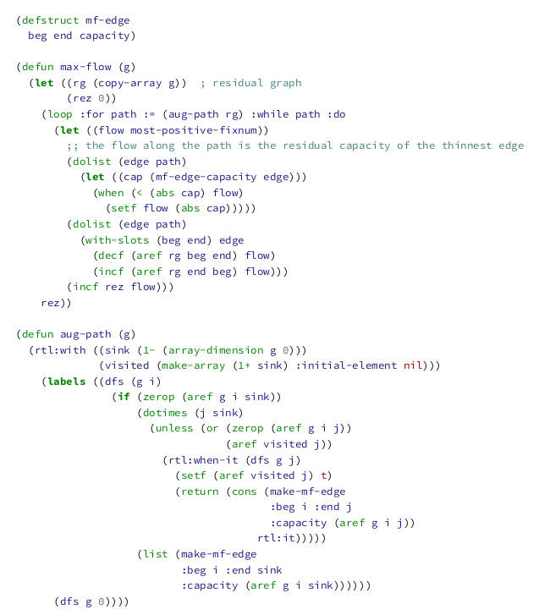
MaxFlow

Slide 13

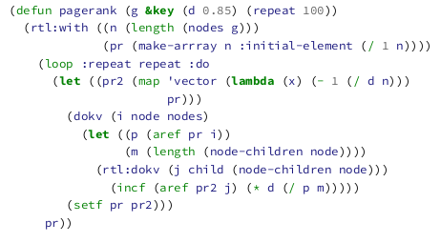
PageRank
- EM algorithm
https://archive.google.com/pigeonrank/

Slide 14
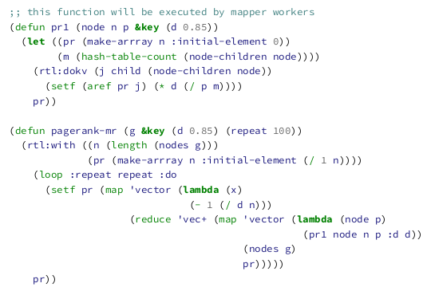
PageRank
https://archive.google.com/pigeonrank/

