Slide 1
Data Structures & Algorithms:
Linked Lists

Slide 2
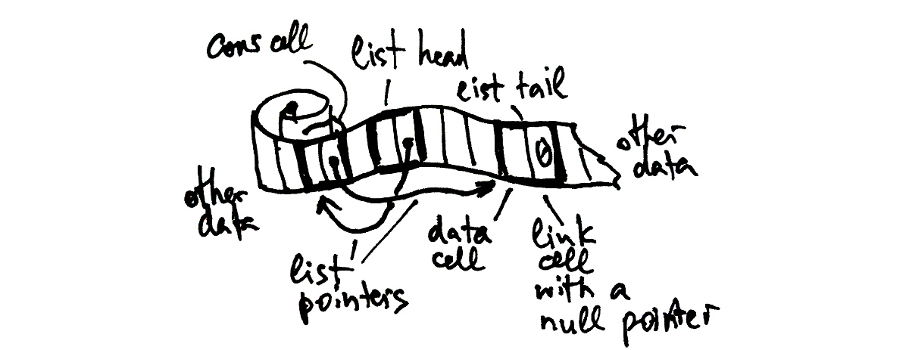
Linked List
- linked
- indexed

Slide 3
List Operations
- allocation
- access by index
- length
- subsequence
- iteration

Slide 4
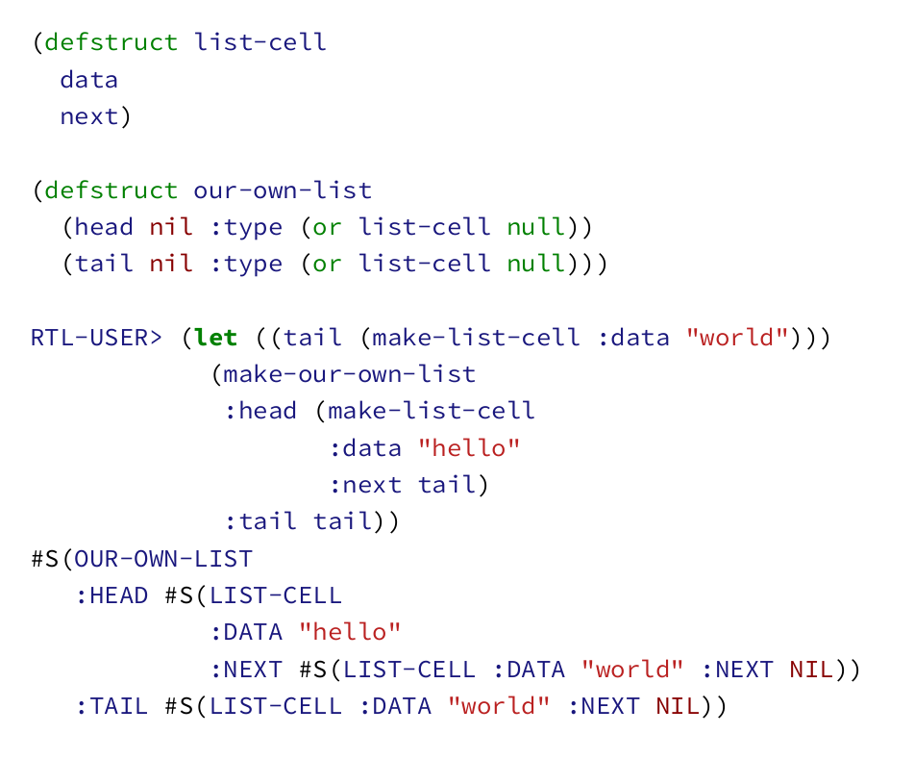
List Structure

Slide 5
Sequence Operations on Lists
- map
- flat-map
- filter, remove(-if(-not))
- find(-if(-not)), position(-if(-not))
- …

Slide 6
Lists as Functional/Persistent DS

Slide 7
Different Kinds of Lists
- doubly-linked list
- plist
- alist
- dlist

Slide 8
Lists for FIFO/LIFO
- stack
- queue
- deque

Slide 9
Lists as Sets
- member
- adjoin
- subsetp
- union, intersection, set-difference

Slide 10
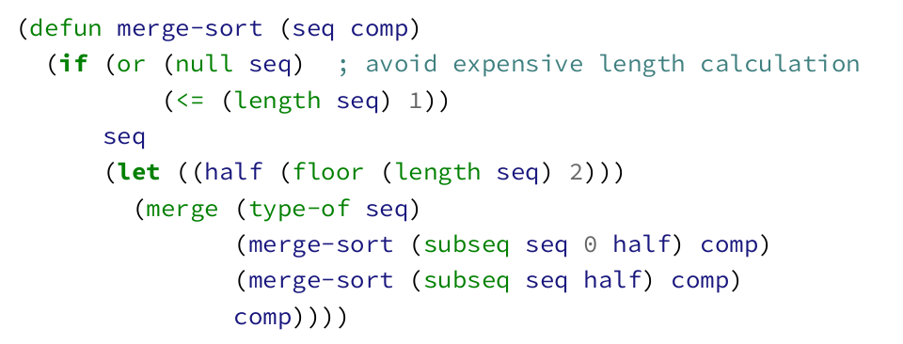
Merge Sort

Slide 11
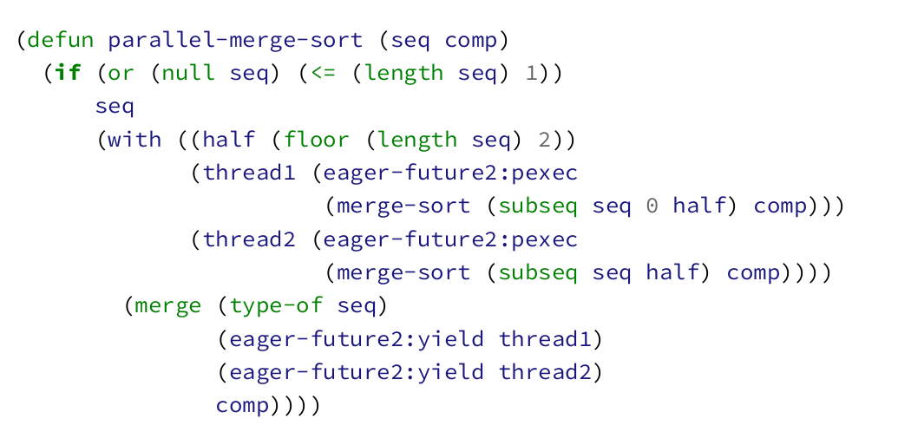
Parallel Merge Sort

