Slide 1
Data Structures & Algorithms:
Arrays

Slide 2
Data Structures
“Bad programmers worry about the code. Good programmers worry about data structures and their relationships.”
– Linus Torvalds

Slide 3
Data Structure Kinds
DS vs Type vs Object
- Abstract (API)
- Concrete (performance characteristics)
- Contiguous
- Linked

Slide 4
Passing DS in Function Calls
- Call-by-value
- Call-by-reference

Slide 5
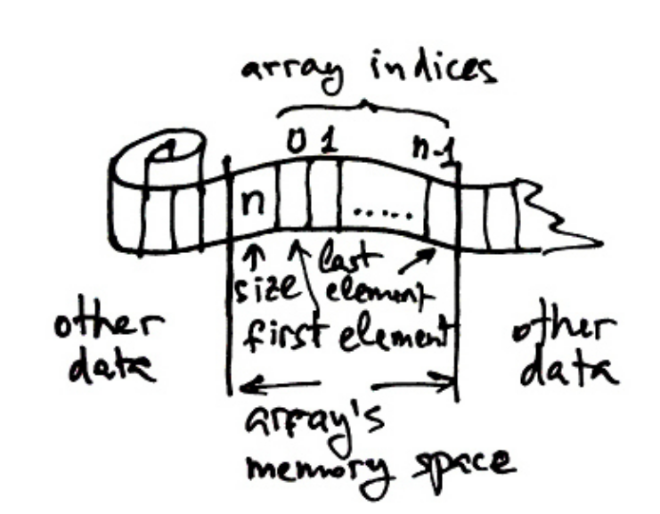
Array
- contiguous
- indexed
- bounded

Slide 6
Array Operations
- allocation
- access by index
- length
- subsequence
- iteration

Slide 7
Tuples

Slide 8
Dynamic Arrays

Slide 9
Multidimensional Arrays
- row-major or column-major order
- iliffe vectors

Slide 10
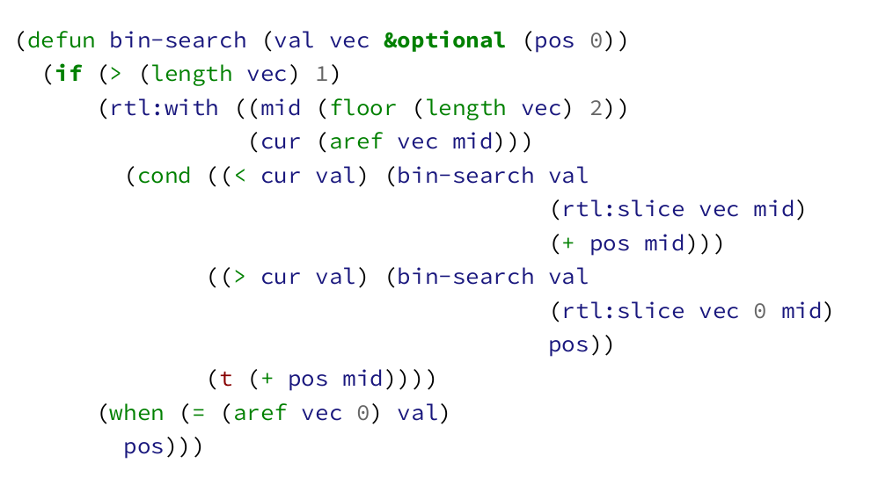
Binary Search

Slide 11
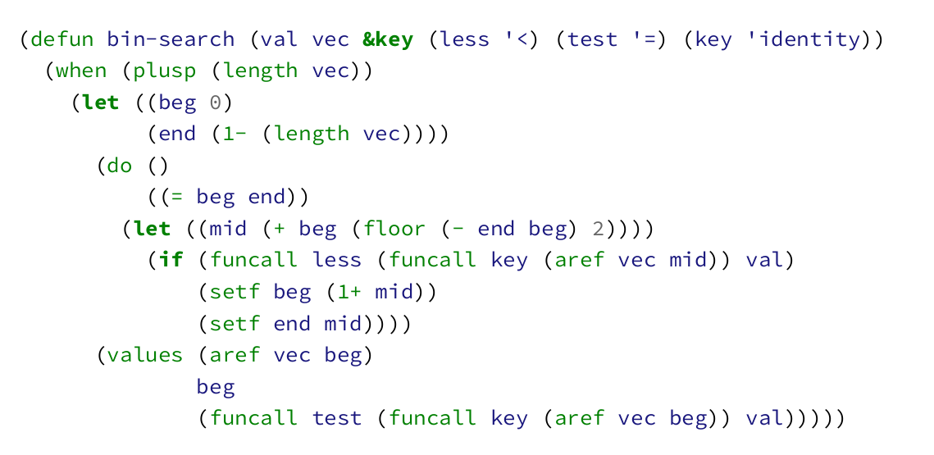
Binary Search

Slide 12
Sorting
Possible qualities:
- in-place
- stable
- online

Slide 13
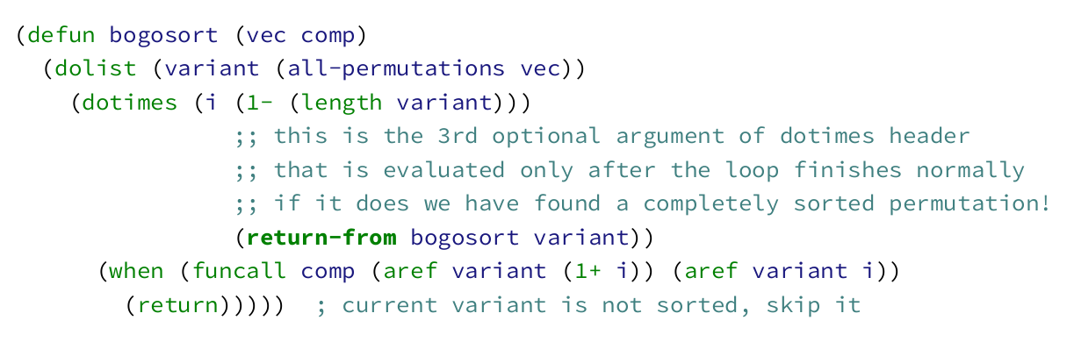
Bogosort

Slide 14
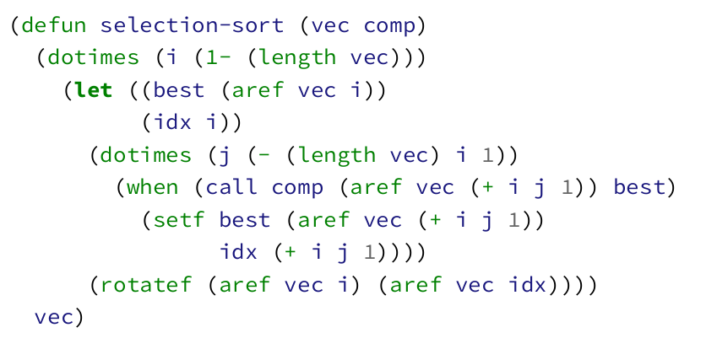
Selection Sort

Slide 15
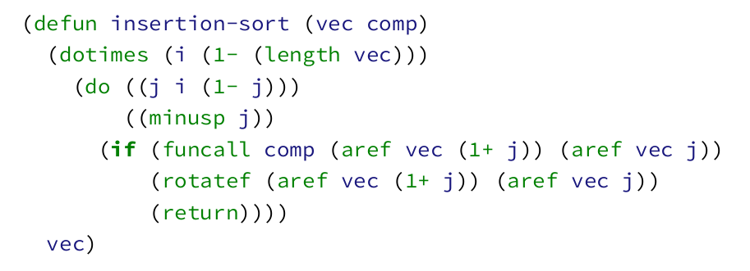
Insertion Sort

Slide 16
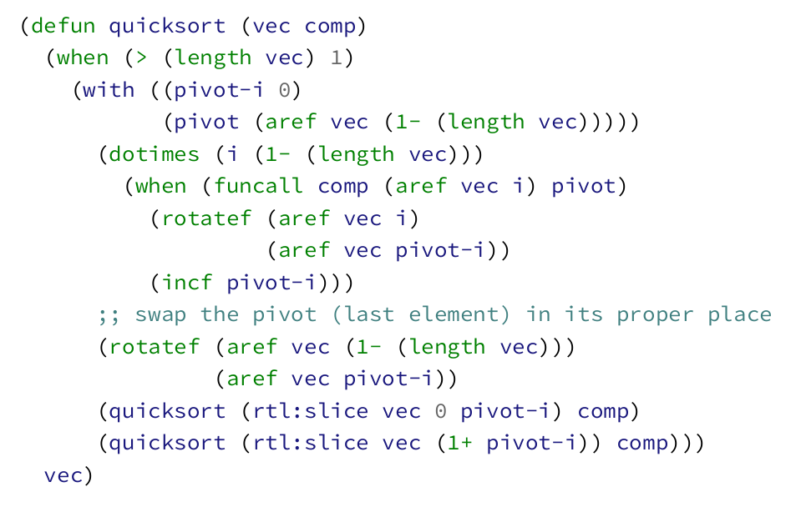
Quicksort

Slide 17
Links
https://www.toptal.com/developers/sorting-algorithms
https://www.bamsoftware.com/hacks/sorts/
https://www.youtube.com/user/AlgoRythmics/videos

