Slide 1
Data Structures & Algorithms:
Kvs & Hash-Tables

Slide 2
Key-Values (KVs)
- abstract DS
- efficient* access by key

Slide 3
KVs Use Cases (some)
- implementation of the object system in programming languages
- most of the key-value stores are, for the most part, glorified key-value structures
- internal tables in the operating system (running process table or file descriptor tables in the Linux kernel), programming language environment or application software
- all kinds of memoization and caching
- efficient implementation of sets
- ad hoc or predefined records for returning aggregated data from function calls
- representing various dictionaries (in language processing and beyond)

Slide 4
KV Variants
- vectors
- associative lists
- hash-tables
- structs
- trees

Slide 5
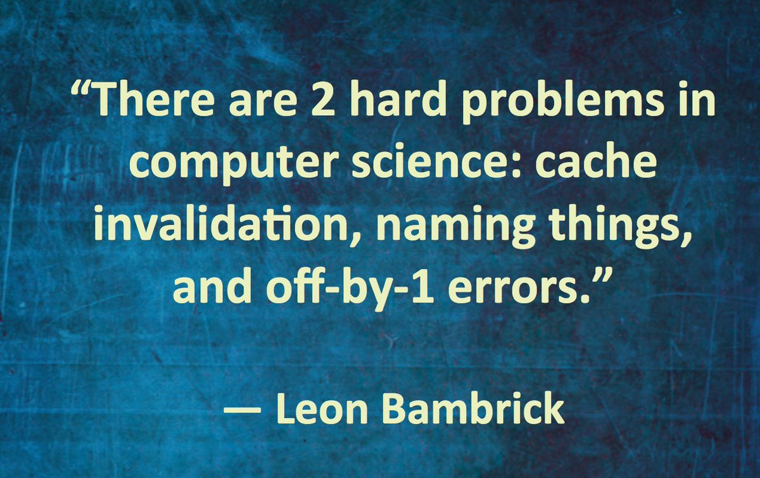
Cashing & Memoization

Slide 6
Cash Invalidation Algorithms
- second chance
- clock
- LFU
- LRU
- LRFU

Slide 7
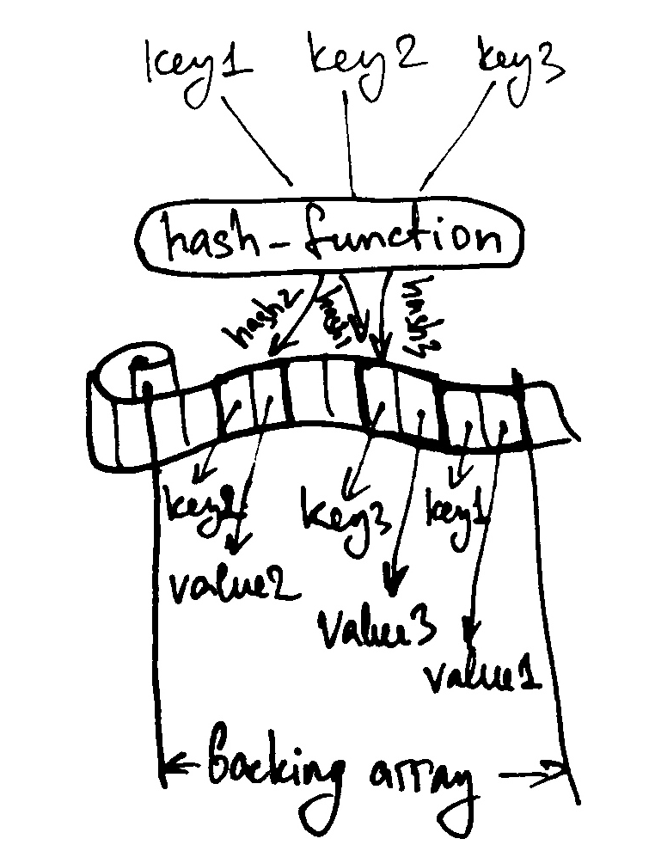
Hash-Tables
- kvs
- contiguous (array-based)
- sparse

Slide 8
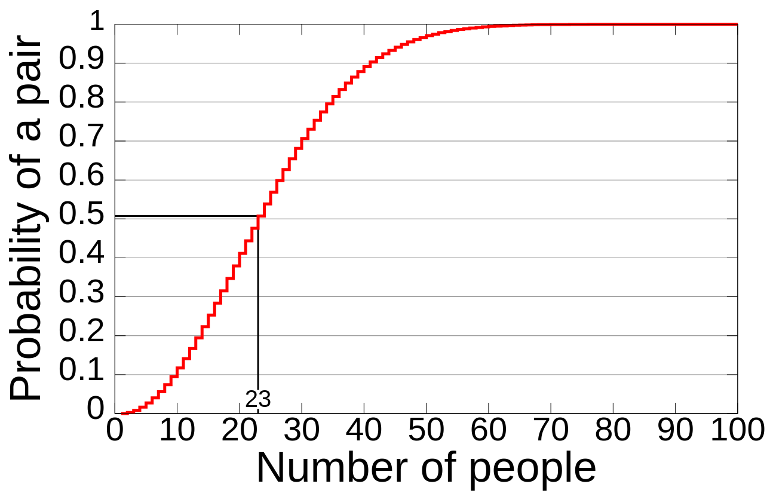
The Birthday Paradox

Slide 9
Collision Avoidance Algorithms
- chaining
- open-addressing
- double hashing
- cuckoo hashing
- quadratic probing

Slide 10
Hash-Functions
- fast general
- specific (e.g. string)
- cryptographic
- special-purpose (rolling hash, pHash, …)

Slide 11
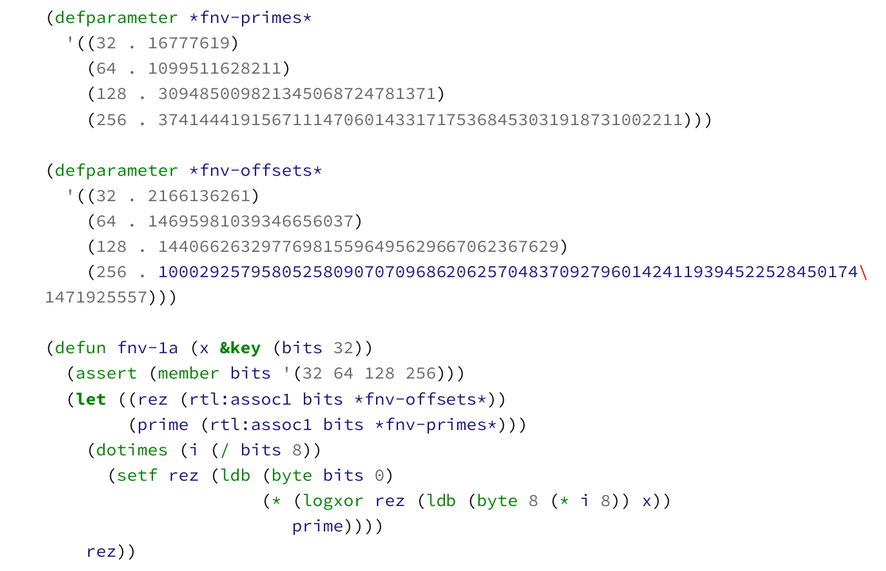
FNV-1a

Slide 12
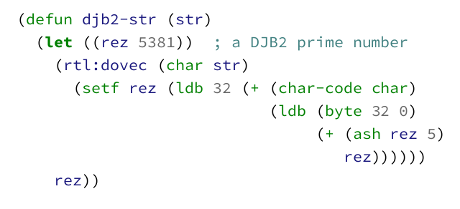
DJB2

Slide 13
Linked Hash-Tables
A hash-table + linked list: each key-value pair also has a next pointer.
Other options for establishing order: add a separate “next pointers” vector.

Slide 14
Perfect Hash-Tables
A set of algorithms to create collision-free hash-table from a predefined set of keys.
Usually, works in a 2 stage process:
- bucketing the keys using one hash
- finding the coefficients of a polynomial-based hash-function for each bucket
Minimal PHT ensure that the size of the backing array is the same as the number of elements.

Slide 15
Reading List
https://softwareengineering.stackexchange.com/questions/49550/which-hashing-algorithm-is-best-for-uniqueness-and-speed

