Slide 1
Distributed Image Processing using PySpark in HDFS
Vishwaksen Jalagam
Pooja Ravindra
Rishil Shah

Slide 2
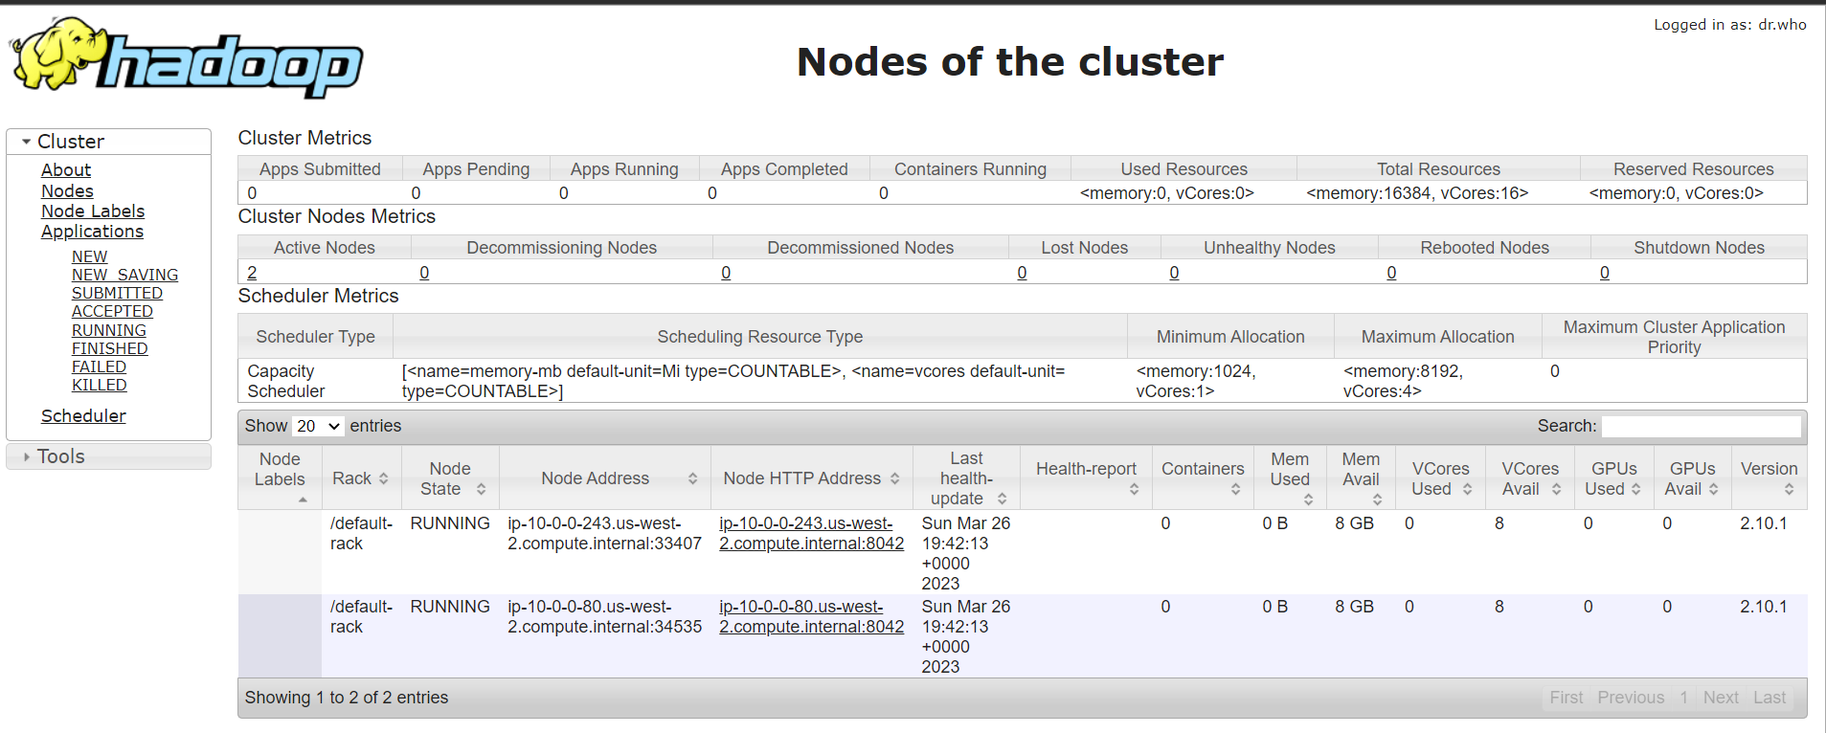
Hadoop Cluster

Slide 3
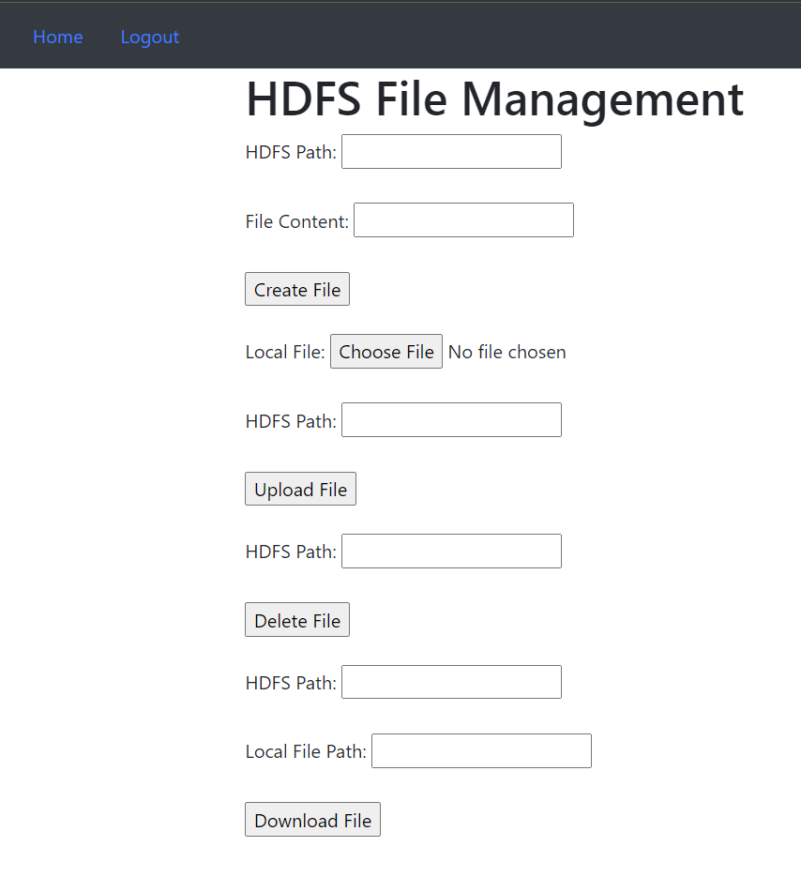
Web Integration
We have created a web application that allows users to sign up, login and upload image or text files into the Hadoop Distributed File System (HDFS). After a user successfully logs in, upon authentication, they can upload, download or delete a file into the HDFS Cluster.

Slide 4
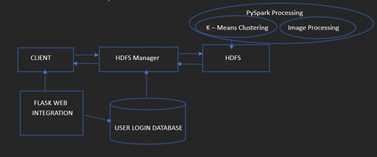
Workflow

Slide 5
Main.py and INIT.PY
We have created a web application that allows users to sign up, login and upload image or text files into the Hadoop Distributed File System (HDFS).
In main.py, create_app() is used to create the Flask application instance and initialize the required extensions such as SQLAlchemy and Flask-Login.
SQL Alchemy is used to set up the database connection and creates all the required tables if they do not exist.
Flask-Login makes it easier to handle user authentication and session management in Flask applications.

Slide 6
Models.py and Views.py
It has been structured using the Model-View-Controller (MVC) pattern, with separate files for each component
models.py: This file defines the data models for the database, including the User and Note models. It sets up the relationships between these models and defines the fields for each one.
views.py: This file defines the routes for the web pages, such as the home page and the login page. It uses the Flask-Login extension to manage access to these pages, so only authenticated users can view them.

Slide 7
Auth.py
auth.py is a module that contains the authentication functionality for the Flask application.
It defines routes for the login and logout pages, as well as a custom user loader function to load users from the database.
The module uses the Flask-Login extension to handle user authentication.
When a user logs in, Flask-Login sets a cookie in the user's browser with a secure token, which is used to verify subsequent requests from the same user.

Slide 8
Image processing using C++
Image processing using C++ involves the use of C++ programming language to manipulate digital images. It is a widely used language in computer vision and image processing due to its high performance and low-level control of hardware resources.
Image data compression using quantization is a technique that reduces the amount of storage required to represent an image while maintaining an acceptable level of visual quality. The basic idea behind this technique is to reduce the number of colors in the image by grouping similar colors together and representing them with fewer bits.

Slide 9
Image processing using pyspark
According to its documentation, the pipe operator enables Spark to process RDD data using external applications. The use of pipe is not C/C++ specific, and it can be used to call external code written in an arbitrary language (shell scripts included). Internally, Spark uses a special type of RDD, the PipedRDD, to pipe the contents of each data partition through the specified external program.
RDD stands for Resilient Distributed Datasets, and it is a fundamental data structure in Apache Spark, a popular open-source distributed computing framework. RDD is an immutable, fault-tolerant collection of data elements that can be processed in parallel across a cluster of machines.

Slide 10
JPEG Compression
JPEG is an ISO standardized image compression algorithm. It’s official standard specifies a well defined set of steps to compress and decompress raw images using JPEG.
JFIF is the file format used for sharing JPEG compressed images.
JPEG operates on blocks of 8x8 pixels, called minimum coded units (MCUs), rather than on the indiviual pixels.
The values of the pixels in the MCUs are centered according to the range of permissible intensities for that component.
DCT is then applied on the MCUs to convert them to their spatial frequencies (which basically means for each MCU, DCT determines what percentage of what frequency can be used to compose the MCU).

Slide 11
Entropy Coding Using Run-Length Encoding and Huffman Coding
The MCU, after it has been transformed using DCT, is quantized so that negligible info about colours and high frequency variations can be thrown away.
After quantization, similar frequencies are grouped together by performing zig-zag traversal of the MCUs.
Run length encoding is performed on the vector of values.
The run-length encoded vector is encoded using Huffman coding to further compress it (DC and AC coefficients are encoded separately).

Slide 12
JPEG Decoder
A JPEG decoder is a program that understands:
The JFIF file format: As observed previously, JPEG is just the image compression algorithm. The encoded data is stored and distributed using the JFIF file standard as prescribed in ITU-T.871.
The JPEG compression algorithm: After reading the encoded data from the JFIF file, it has to replay the steps of encoding in the reverse order to get the original image data back

Slide 13
JPEG TO PPM
PPM (Portable Pixel Map) is a file format for storing images in the uncompressed raster graphics format. PPM files are widely used for image processing applications and are easy to read and write using standard file I/O functions.
JPEG compression involves several lossy compression steps that result in some loss of image data. To allow for accurate comparison of the original and compressed images, it is common to use a lossless file format, such as PPM, to store the original image. The uncompressed PPM file is then used as input to the JPEG compression algorithm. This approach ensures that any differences between the original and compressed images are solely due to the lossy compression process.

Slide 14
Huffman coding in jpeg
Huffman coding is a lossless data compression technique that is widely used in the JPEG image compression standard. In JPEG compression, Huffman coding is used to compress the quantized Discrete Cosine Transform (DCT) coefficients that represent the image.
The Huffman coding algorithm works by assigning shorter codes to symbols that occur more frequently in the data and longer codes to symbols that occur less frequently. The algorithm builds a binary tree of nodes, where each leaf node represents a symbol and its weight corresponds to its frequency of occurrence. The tree is constructed in a way that minimizes the total number of bits required to encode the data.
The time complexity for encoding each unique character based on its frequency is O(nlog n). Extracting minimum frequency from the priority queue takes place 2*(n-1) times and its complexity is O(log n). Thus the overall complexity is O(nlog n).

Slide 15
Color_quantizer.py
This code performs color quantization on an image using K-means clustering in PySpark.
The goal of color quantization is to reduce the number of colors in an image while preserving its visual appearance.
This can be useful for applications like image compression, where reducing the number of colors can significantly reduce the size of the image file.
To start, the code reads an image and converts it to a 2D array of pixels using the imread() function from the matplotlib library. Then, it creates a PySpark DataFrame with a single column named "features" containing the flattened image pixels.
This DataFrame is then transformed using a VectorAssembler to convert the "features" column to a vector column named "feature_vector".

Slide 16
Color_quantizer.py
Next, the code uses the elbow method and silhouette score to determine the optimal number of clusters for the K-means algorithm. It iteratively fits K-means models with different values of K and computes the silhouette score for each model.
After determining the optimal number of clusters, the code fits a K-means model with that number of clusters to the DataFrame.
It uses the model to assign each pixel in the original image to one of the clusters based on its RGB values.
The RGB values of the cluster centers are then used to produce a quantized version of the original image, where each pixel is replaced with the RGB values of its assigned cluster center.
The quantized image is displayed using the imshow() function from matplotlib.

Slide 17
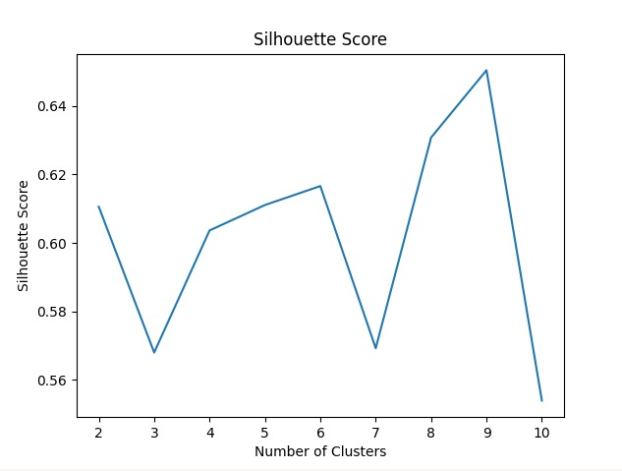
Color_quantizer.py

Slide 18
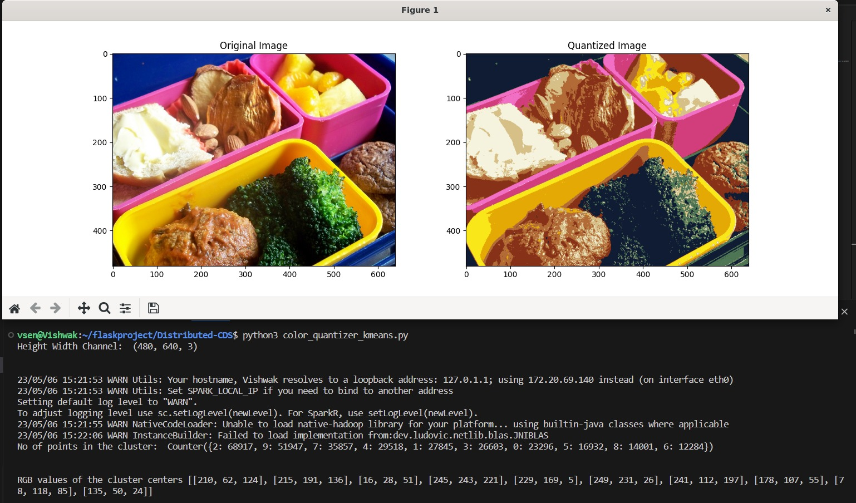
Color_quantizer.py

Slide 19
GITHUB LINK
https://github.com/rishilss99/Distributed-CDS

